Slide 1
CNN Tutorial
2025 Spring

Slide 2
Contents
Basic operations in PyTorch to build a CNN
Introduction to ResNet
PyTorch implementation of ResNet
ResNet with identity blocks
ResNet with convolutional blocks for resizing
Image Processing and Dataloader
Introduction to cifar10_tutorial and HA3

Slide 3
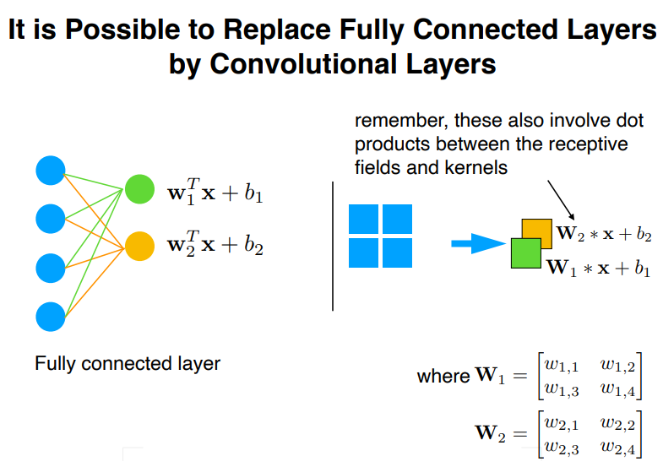
Intuition

Slide 4
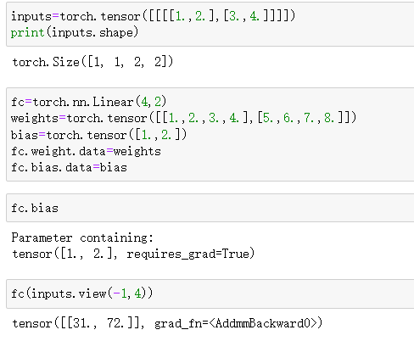
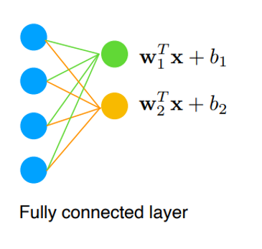
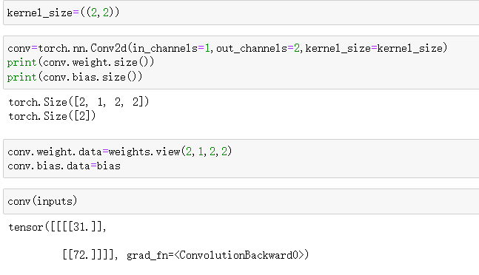
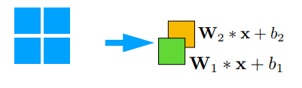
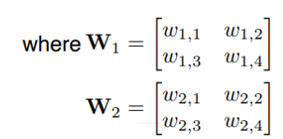

Slide 5
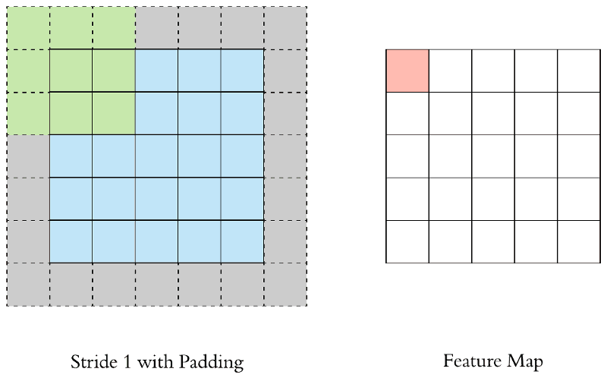
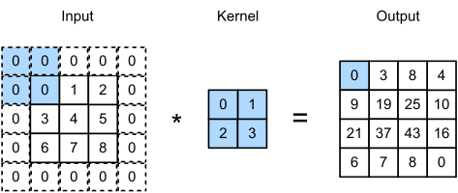
Basic Operation to Build a CNN in PyTorch
# output channels =
# kernels/filters to be used
self.conv1 = nn.Conv2d(3, 6, 5)
Q: what is the number of kernels used ?
Conv2d
torch.nn.Conv2d(in_channels, out_channels, kernel_size, stride=1, padding=0, bias=True, padding_mode='zeros')

Slide 6
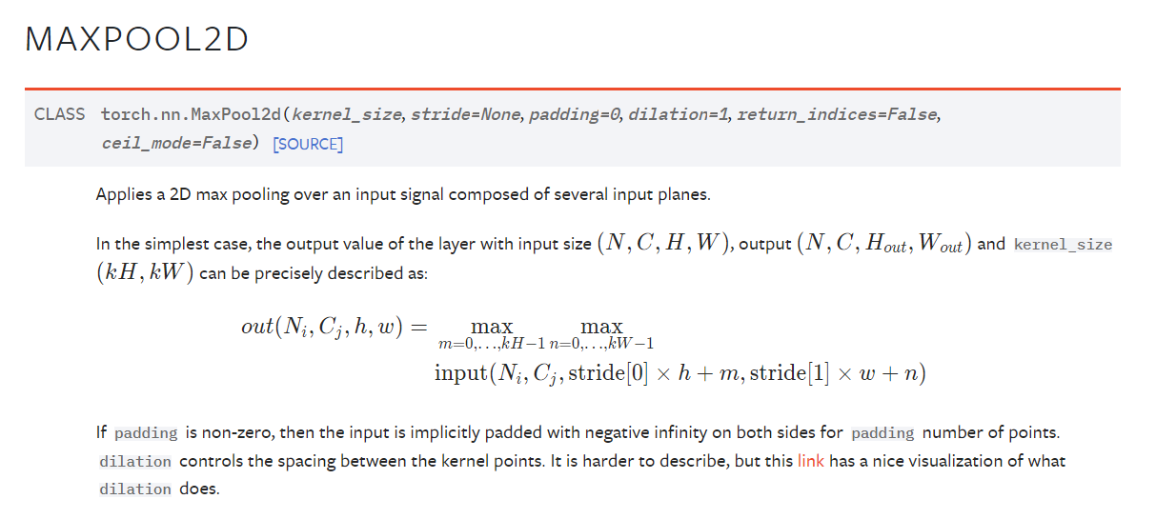
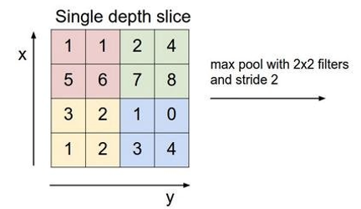
Basic Operation to Build a CNN in PyTorch
MaxPool2d
Question: what is the output ?

Slide 7
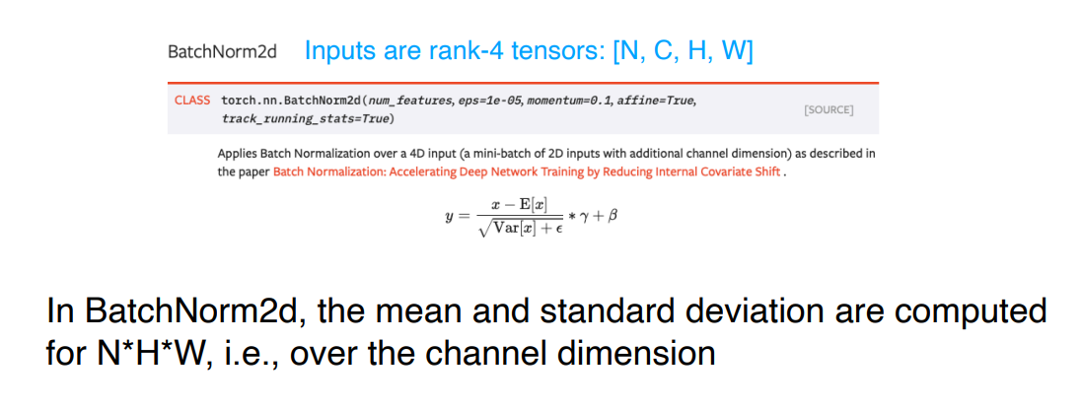
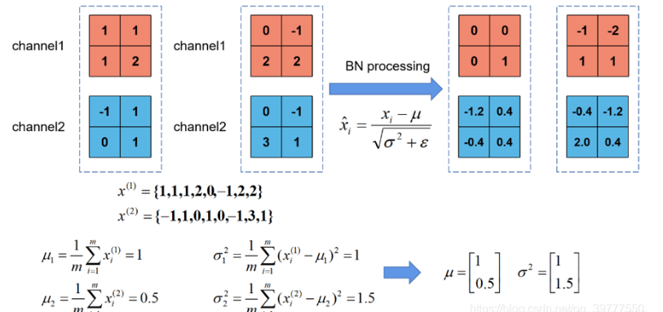
Basic Operation to Build a CNN in PyTorch
BatchNorm2d

Slide 8
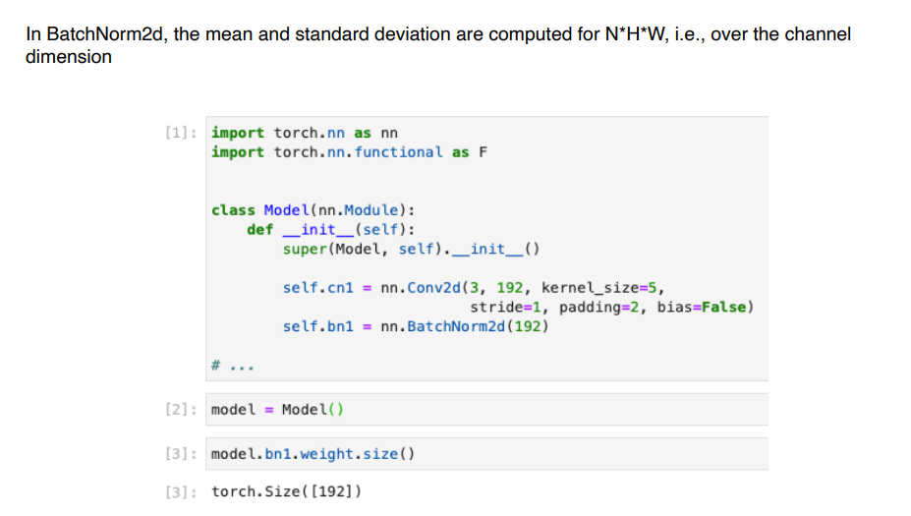
Basic Operations to Build a CNN in PyTorch
BatchNorm2d

Slide 9
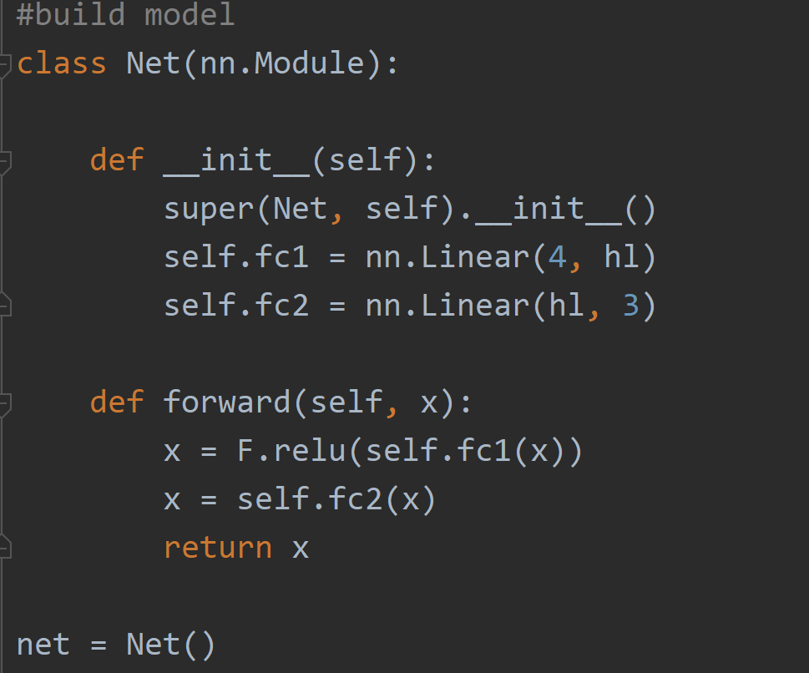
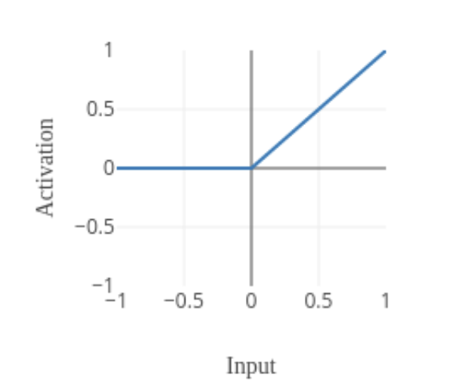
Basic Operations to Build a CNN in PyTorch
Activation Function
an affine operation: y = Wx + b
ReLu activation
Copy from Tutorial 2

Slide 10
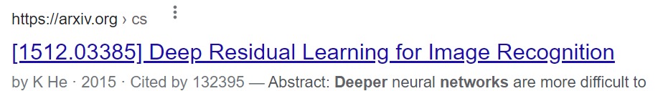
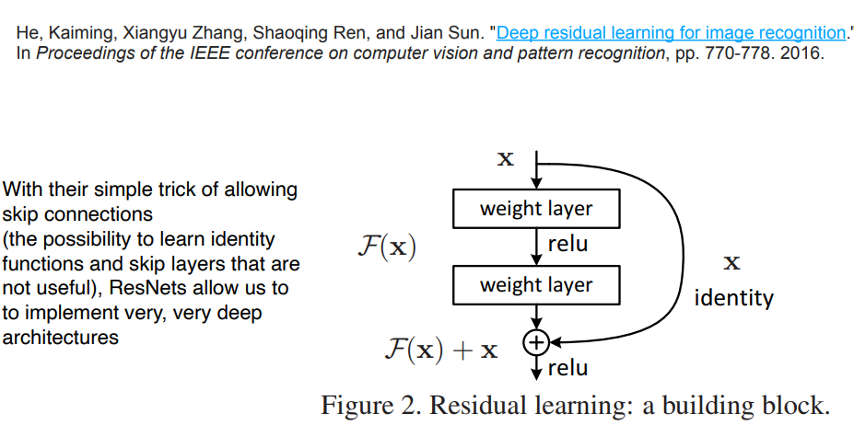
ResNet
Residual connections improve learning stability
Prior to ResNet training very deep neural networks was difficult due to the problem of vanishing gradients.

Slide 11
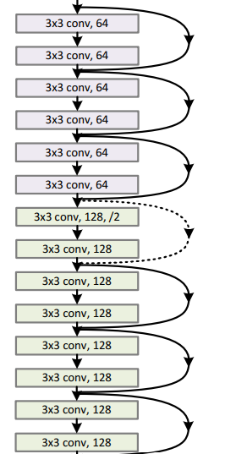
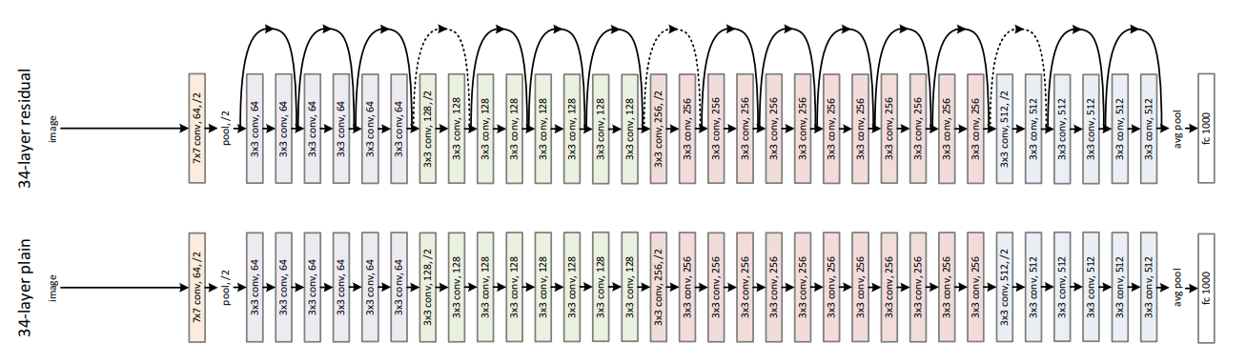
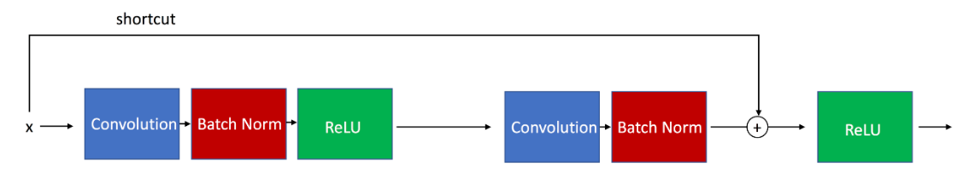
ResNet
ResNet with identity size of output at each block
ResNet with different size of outputs at different blocks

Slide 12
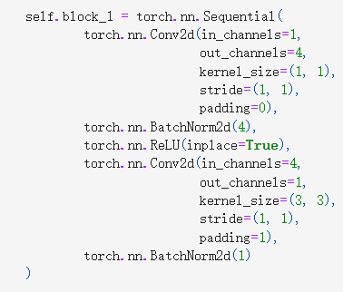
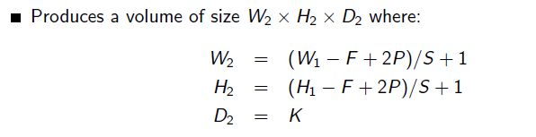
ResNet with identity size of output at each block
Image batch dimensions: torch.Size([128, 1, 28, 28])
Question: what is the output size for this block ?

Slide 13
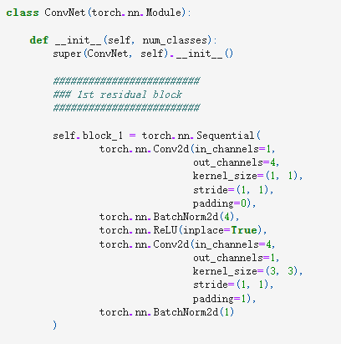
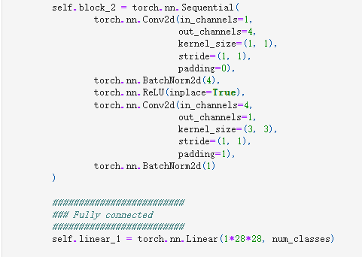
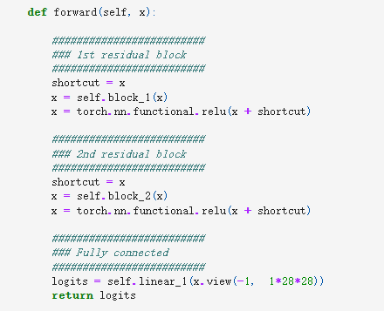
ResNet with identity size of output at each block

Slide 14
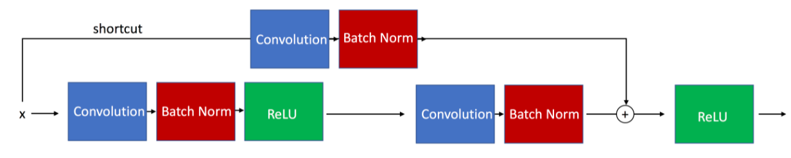
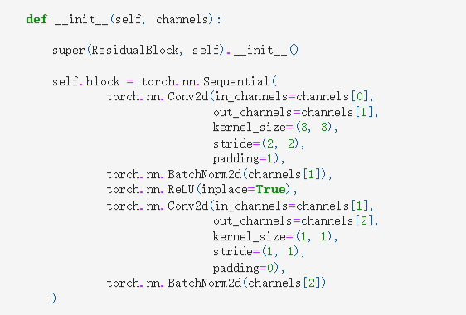
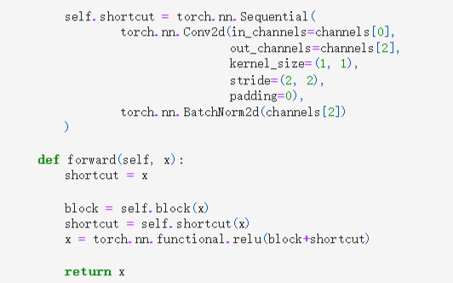
ResNet with different size of outputs at different blocks
Image batch dimensions: torch.Size([128, 1, 28, 28])
Question: what is the output size for this block ?

Slide 15
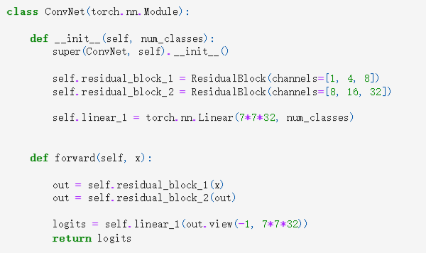
ResNet with different size of outputs at different blocks

Slide 16
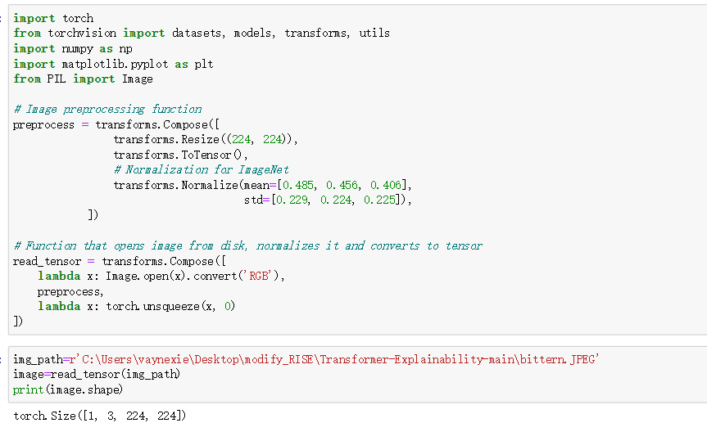
Image Processing and Dataloader
Read a single Image
  Naïve way

Slide 17
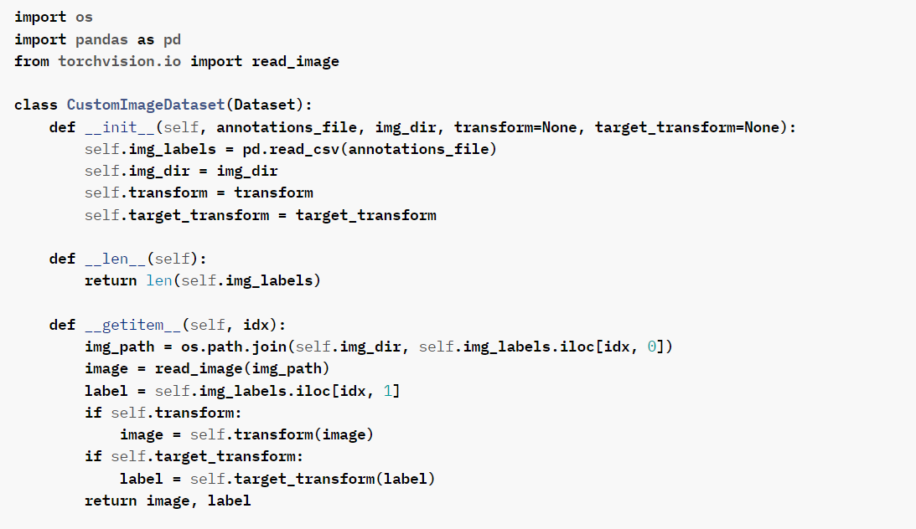
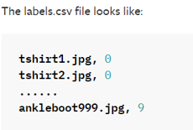
from torchvision import datasets
from torch.utils.data import DataLoader
datasets read the directories and labels of data points in the dataset, and define the image transformation function.
Since we often read datapoints in batches, we use DataLoader to shuffle and batch data.

Slide 18
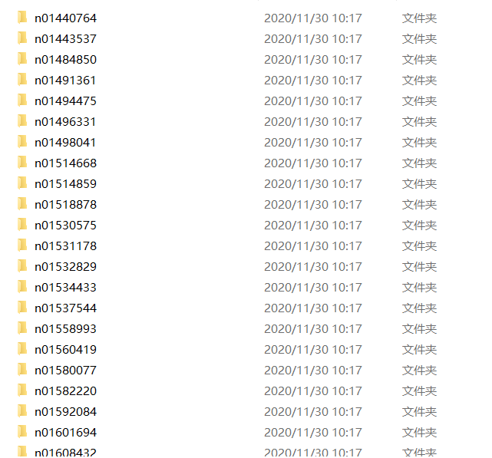
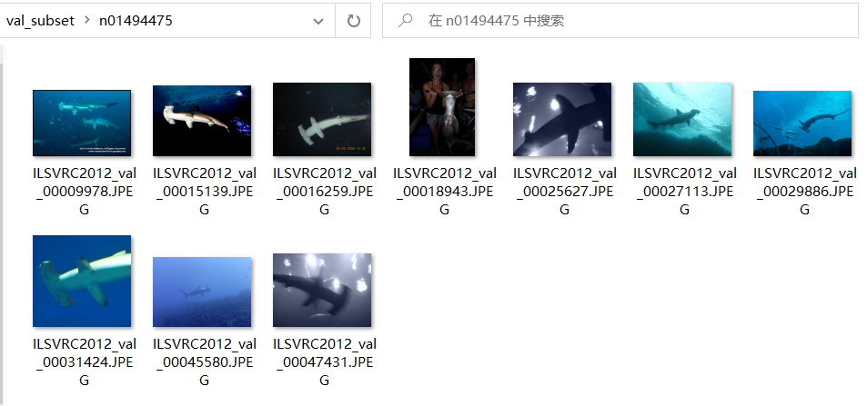
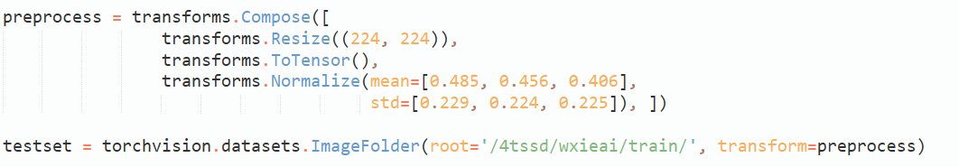
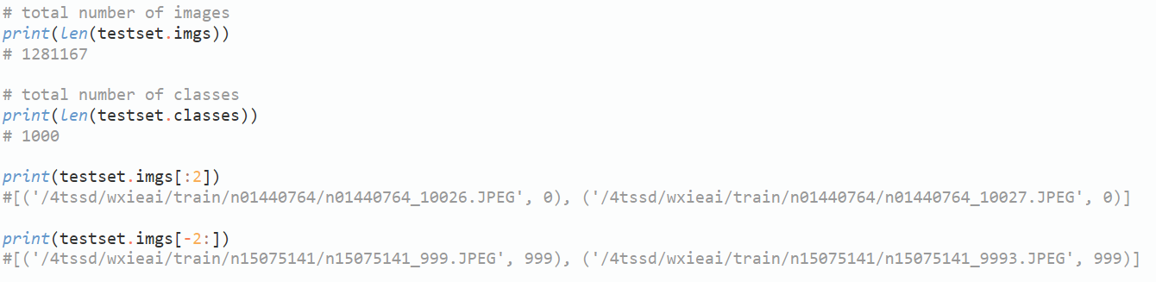
Image Processing and Dataloader
torchvision.datasets.ImageFolder
So far, the computer only stores file paths and labels of images, also the preprocessing functions.
The images are still not loaded.

Slide 19
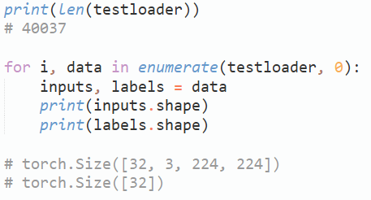
Image Processing and Dataloader
from torch.utils.data import DataLoader
Now, the images in a batch are loaded and pre-processed.
Ready for the model to train on a batch.

Slide 20
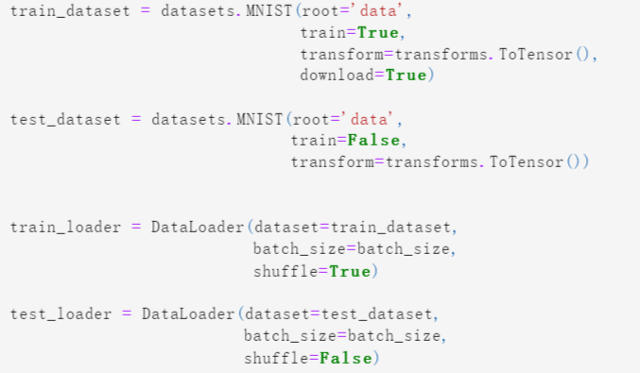
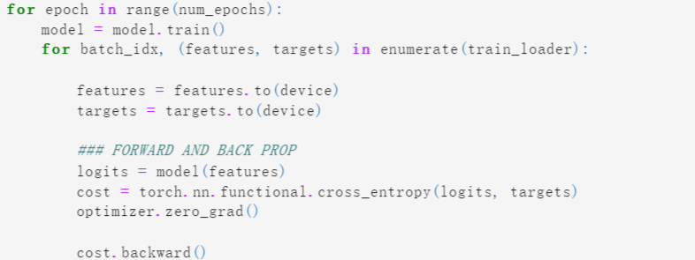
Image Processing and Dataloader
torchvision also provides many built-in datasets in the torchvision.datasets module
https://pytorch.org/vision/stable/datasets.html

Slide 21
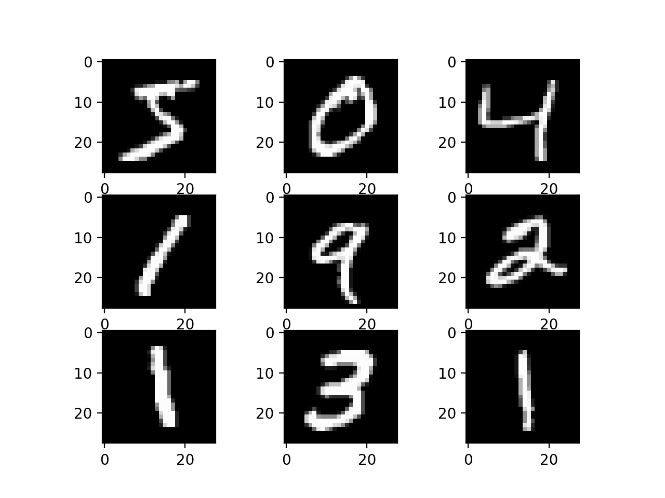
Implementation of ResNet on MNIST Dataset
Link:
https://colab.research.google.com/drive/1ai0f50MH23tbI_buSST6Aa0bWveKFCy9?usp=sharing

Slide 22
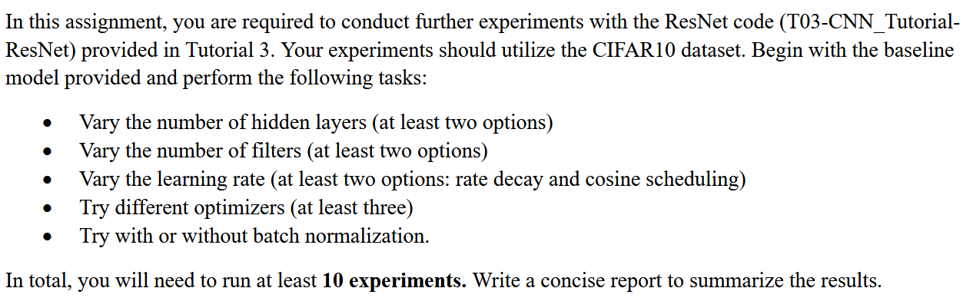
Introduction to cifar10_tutorial and HA3
https://colab.research.google.com/github/pytorch/tutorials/blob/gh-pages/_downloads/4e865243430a47a00d551ca0579a6f6c/cifar10_tutorial.ipynb

