Slide 1
Data structure…

Slide 2
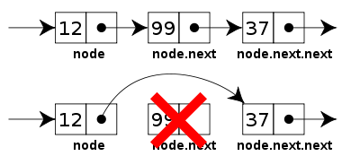
Linked-List

Slide 3
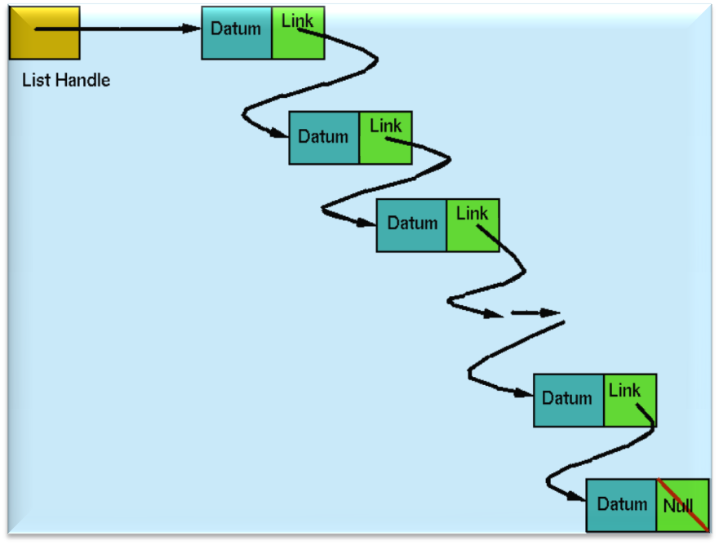
Linked-List Contd…

Slide 4
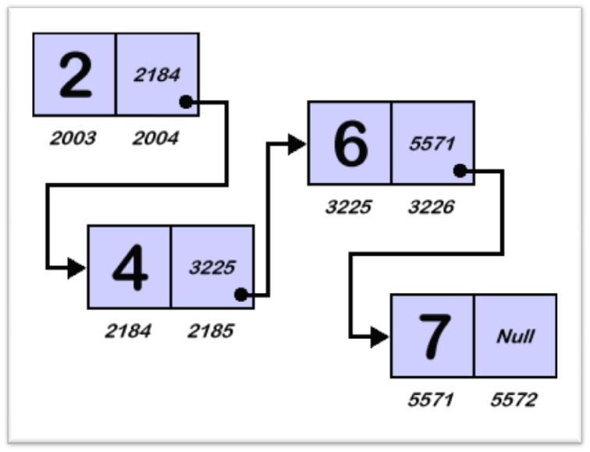
Linked-List Contd…

Slide 5
Linked-List Contd…
Creation of linked list’s first node
struct node{
int item;
struct node *next;
};
Create derived data type for liked-list’s node structure…
void main(){
struct node *head;
head = (struct node *) malloc(sizeof(struct node);
head->next = (struct node *) malloc(sizeof(struct node);
head->next->next = NULL;
}
111
item
next
item
next
head
111
112
117
118

Slide 6
Doubly Linked-List Contd…
Creation of doubly linked list’s first node
struct dbly_node{
struct dbly_node *prev;
int item;
struct dbly_node *next;
};
void main(){
struct dbly_node *head;
head = (struct node *) malloc(sizeof(struct dbly_node);
head->item= 25;
head->next = NULL;
head->prev = NULL;
}
25
110
prev
item
next
head
110
111
112

Slide 7
Doubly Linked-List Contd…
Creation of doubly linked list’s second node
struct dbly_node{
struct dbly_node *prev;
int item;
struct dbly_node *next;
};
25
27
116
110
110
prev
item
next
prev
item
next
head
110
111
112
116
117
118
void main(){
struct node *head;
head = (struct dbly_node *) malloc(sizeof(struct dbly_node);
head->item = 25;
head->next = NULL;
head->prev = NULL;
head->next->next = (struct dbly_node *) malloc(sizeof(struct dbly_node);
head->next->item = 27;
head->next->next = NULL;
head->next->prev = head;
}

Slide 8
traverse_dbly(head);
void traverse_dbly(struct dbly_node *temp){
while(temp!=NULL){
printf(“%d - ”,temp->item);
temp = temp->next;
}
}

Slide 9
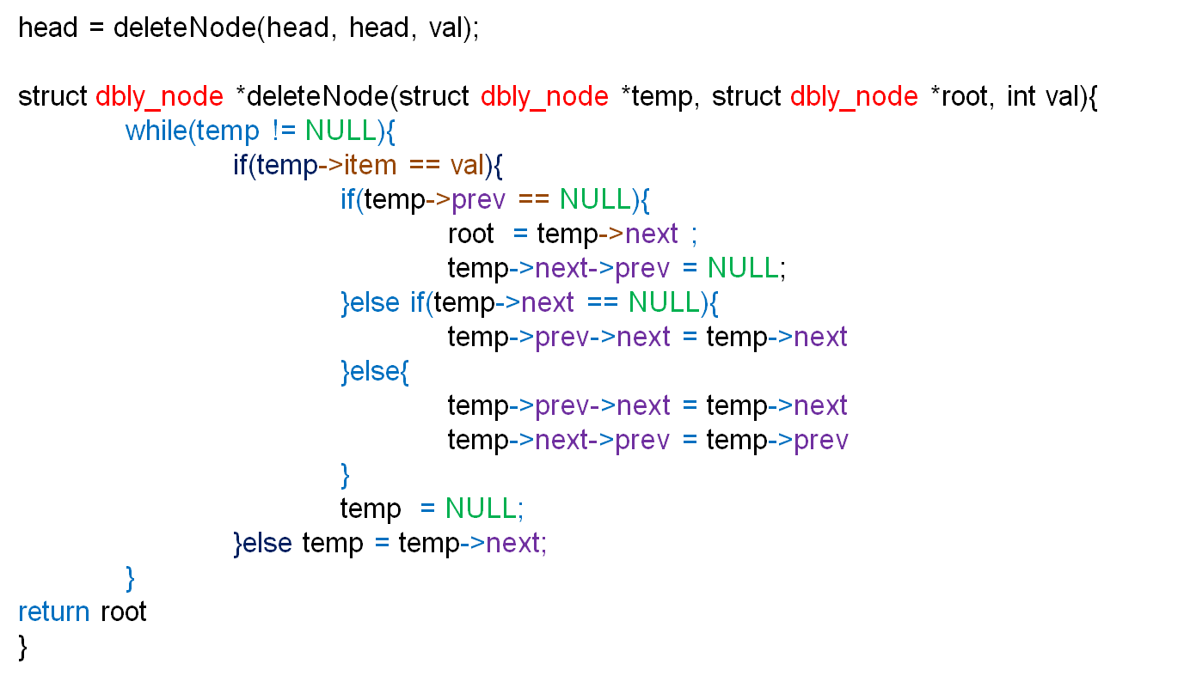

Slide 10
Binary Search Tree
27
25
37

