Slide 1
Fibonacci Heap

Slide 2
Introduction
In this topic, let's examine Fibonacci heap, which supports the same operations like binomial heap but have the advantage that operations that do not involve deleting element run in O(1) amortize time.
From theoretical standpoint, Fibonacci heap is especially desirable when the number of EXTRACT-MIN and DELETE operations is small relative to the number of operations performed.

Slide 3
Comparing Running times of operations
Procedure | Binary Heap Worst Case | Binomial Heap Worst Case | Fibonacci Heap Worst Case
MAKE-HEAP | ϴ (1) | ϴ (1) | ϴ (1)
INSERT | ϴ (lg n) | ϴ (lg n) | ϴ (1)
MINIMUM | ϴ (1) | ϴ (lg n) | ϴ (1)
EXTRACT-MIN | ϴ (lg n) | ϴ (lg n) | ϴ (lg n)
UNION | ϴ (n) | ϴ (lg n) | ϴ (1)
DECREASE-KEY | ϴ (lg n) | ϴ (lg n) | ϴ (1)
DELETE | ϴ (lg n) | ϴ (lg n) | ϴ (lg n)

Slide 4
Structure
Like a binomial heap, Fibonacci heap is a collection of min-heap-ordered trees. Unlike trees in binomial heaps, which are ordered, trees within Fibonacci heaps are rooted but not ordered.
H.min
(a)
23
7
3
17
24
18
52
38
30
26
46
39
41
35

Slide 5
Structure
H.min
(a)
23
7
3
17
24
18
52
38
30
26
46
Marked nodes
39
41
35
H.min
(b)
23
7
3
17
24
18
52
38
30
26
46
39
41
35

Slide 6
Physical Node of Fibonacci heap
P
Key
Degree
left
Child
18
0
right
/ /
mark

Slide 7
Inserting a node in Fibonacci heap
insert 21
21
H.min
17
24
23
7
3
30
26
46
18
52
41
Heap H
35
44
39

Slide 8
Inserting a node in Fibonacci heap
insert 21
21
H.min
17
24
23
7
3
30
26
46
18
52
41
Heap H
35
44
39

Slide 9
Inserting a node in Fibonacci heap
H.min
17
24
23
7
21
3
30
26
46
18
52
41
Heap H
35
44
39

Slide 10
Linking operation
larger root
smaller root
still heap-ordered
15
3
3
56
24
18
52
41
15
18
52
41
77
39
44
56
24
39
44
tree T₁
tree T₂
77
Tree T'

Slide 11
Delete minimum
Delete min->combine its children into root list->update min.
Consolidate trees so that no two roots have same rank.
Rank = 3 (Maximum degree)
H.min
7
24
23
17
3
30
26
46
18
52
41
35
39
44

Slide 12
Delete minimum
Delete min->combine its children into root list->update min.
Consolidate trees so that no two roots have same rank.
Rank = 3 (Maximum degree)
H.min
7
24
23
17
18
52
41
30
26
46
39
44
35

Slide 13
Consolidation
rank
0
1
2
3
H.min
current
7
24
23
17
18
52
41
30
26
46
39
44
35

Slide 14
Consolidation
rank
0
1
2
3
H.min
current
7
24
23
17
18
52
41
30
26
46
39
44
35

Slide 15
Consolidation
rank
0
1
2
3
H.min
7
24
23
17
18
52
41
30
26
46
current
39
44
35

Slide 16
Consolidation
rank
0
1
2
3
H.min
7
24
23
17
18
52
41
30
26
46
current
39
44
35
Link 23 & 17 because having same degree

Slide 17
Consolidation
rank
0
1
2
3
H.min
7
24
17
18
52
41
30
26
46
current
23
39
44
35
Link 7 & 17 because having same degree

Slide 18
Consolidation
rank
0
1
2
3
H.min
24
7
18
52
41
current
26
46
17
30
39
44
35
23
Link 24 & 7 because having same degree

Slide 19
Consolidation
rank
0
1
2
3
current
H.min
7
18
52
41
24
17
30
39
44
23
26
46
35

Slide 20
Consolidation
rank
current
0
1
2
3
H.min
7
18
52
41
24
17
30
39
44
23
26
46
35

Slide 21
Consolidation
rank
0
1
2
3
current
H.min
7
18
52
41
24
17
30
39
44
23
26
46
35

Slide 22
Consolidation
rank
0
1
2
3
current
H.min
7
18
52
41
24
17
30
39
44
23
26
46
35
Link 18 & 41 because having same degree

Slide 23
Consolidation
rank
0
1
2
3
current
H.min
7
52
18
24
17
30
41
39
23
44
26
46
35

Slide 24
Consolidation
rank
0
1
2
3
current
H.min
7
52
18
24
17
30
41
39
23
44
26
46
35

Slide 25
Consolidation
rank
0
1
2
3
current
H.min
7
52
18
24
17
30
41
39
23
44
26
46
35

Slide 26
Consolidation
rank
0
1
2
3
current
H.min
7
52
18
Find minimum by
rank array
24
17
30
41
39
23
44
26
46
35

Slide 27
Find the minimum
H.min
7
52
18
24
17
30
41
39
23
44
26
46
35

Slide 28
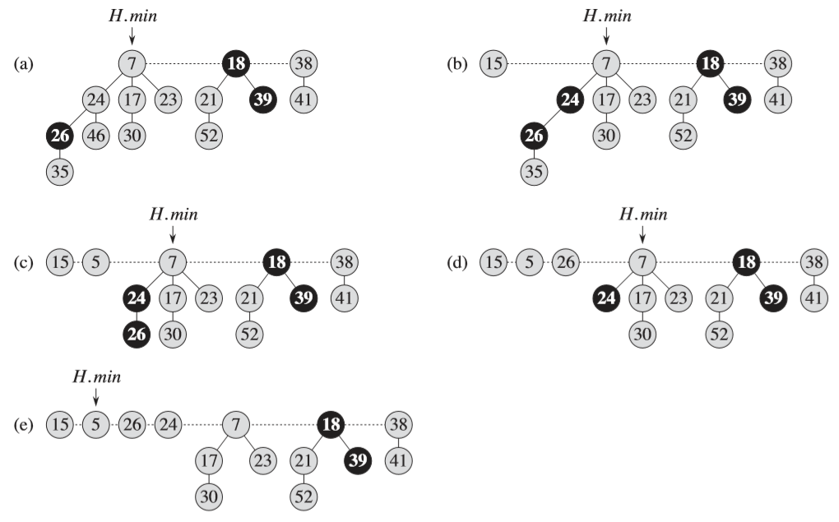

Slide 29
min
7
18
38
marked node:
one child already cut
24
17
23
21
39
41
26
46
30
52
35
88
72
Notes:
If decreasing the key of node i makes it violate heap order property, we can cutout subtree rooted at i and meld it into heap.
To keep trees bushy, we limit the number of cuts among the children of any vertex to 2.
Use the mark of a node to designate whether or not it has had one child cut off

Slide 30
min
7
18
38
24
17
23
21
39
41
26
46
29
30
52
x
35
88
72
decrease-key of x from 46 to 29

Slide 31
min
7
18
38
24
17
23
21
39
41
26
29
30
52
x
35
88
72
decrease-key of x from 46 to 29

Slide 32
min
7
18
38
24
17
23
21
39
41
p
26
29
30
52
15
x
35
88
72
decrease-key of x from 29 to 15

Slide 33
min
7
18
38
24
17
23
21
39
41
p
26
15
30
52
x
35
88
72
decrease-key of x from 29 to 15

Slide 34
x
min
15
7
18
38
72
24
17
23
21
39
41
p
26
30
52
35
88
decrease-key of x from 29 to 15

Slide 35
x
min
15
7
18
38
72
24
24
17
23
21
39
41
mark parent
p
26
30
52
35
88
decrease-key of x from 29 to 15

Slide 36
min
15
7
18
38
72
24
24
17
23
21
39
41
p
26
30
52
35
88
decrease-key of x from 35 to 5
x
5

Slide 37
min
15
7
18
38
72
24
24
17
23
21
39
41
p
26
30
52
x
5
88
decrease-key of x from 35 to 5

Slide 38
min
x
15
5
7
18
38
72
24
24
17
23
21
39
41
p
26
30
52
88
decrease-key of x from 35 to 5

Slide 39
min
x
15
5
7
18
38
72
24
24
17
23
21
39
41
second child cut
p
26
30
52
88
decrease-key of x from 35 to 5

Slide 40
min
x
p
15
5
26
7
18
38
88
24
72
24
17
23
21
39
41
30
52
decrease-key of x from 35 to 5

Slide 41
min
x
p
15
5
26
7
18
38
88
24
72
p'
24
17
23
21
39
41
30
52
second child cut
decrease-key of x from 35 to 5

Slide 42
min
x
p
p'
p''
15
5
26
24
7
18
38
72
88
don't mark
parent if
it's a root
17
23
21
39
41
30
52
decrease-key of x from 35 to 5
Notes:
Note: when a root is linked into another root (in delete-min consolidation phase), we unmark it
Q. How can a root node ever be marked?
A. In delete-min we delete a root node, but promote all of its (potentially) marked children to be roots.

Slide 43
Fibonacci Numbers
The Fibonacci numbers are defined by the following recurrences:
F₀ = 0
F₁ = 1
F_{i} = F_{i-1} + F_{i-2} = 2 for i >= 2
Thus, each Fibonacci number is the sum of the two previous ones, yielding the sequence
0, 1, 1, 2, 3, 5, 8, 13, 21, 34, 55, …..

Slide 44
Let's analyze why named “Fibonacci”
Very interesting
At least
At least
At least
At least
1
2
3
5
8
13
0
1
2
3
4
5
At least
21
6

Slide 45
Let's analyze
At least
At least
At least
At least
1
2
3
5
8
13
0
1
2
3
4
5
At least
21
6

Slide 46
Let's analyse
Degree/ Order | At least no. of nodes
0 | 1
1 | 2
2 | Min(0) + Min(0) + 1 = 3
3 | Min(1) + Min(0) + Min(0) + 1 = 5
4 | Min(2) + Min(1) + Min(0) + Min(0) + 1 = 8
5 | Min(3) + Min(2) + Min(1) + Min(0) + Min(0) + 1 = 13
6 | Min(4) + Min(3) + Min(2) + Min(1) + Min(0) + Min(0) + 1 = 21
7 | And So on...

Slide 47
Potential function
ɸ (H) = t(H) + 2 m (H) *
Maximum Degree
Upper bound D(n) on the maximum degree of any node in an n-node Fibonacci heap.
*According Amortized analysis

Slide 48
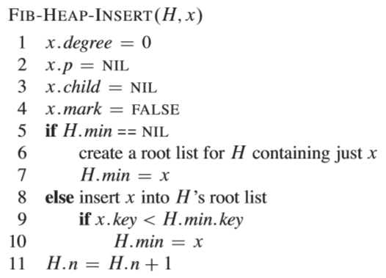

Slide 49
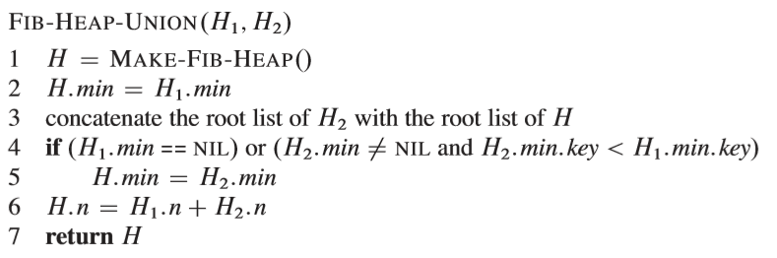

Slide 50
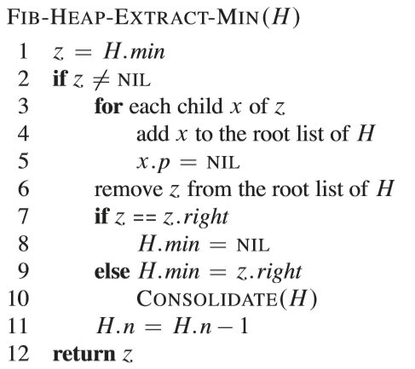

Slide 51
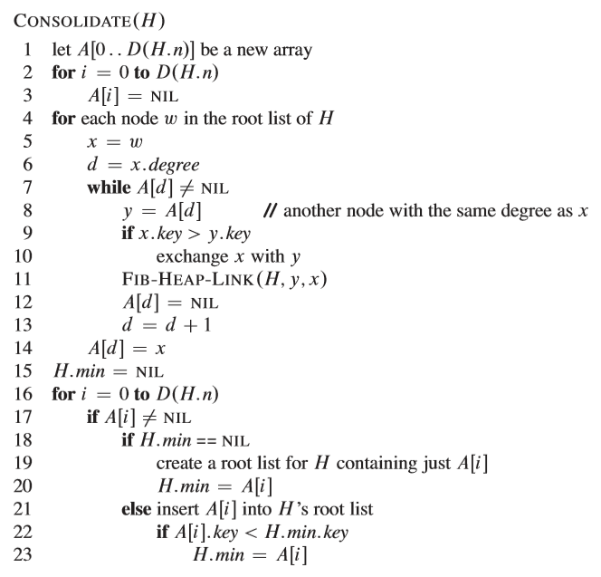

Slide 52
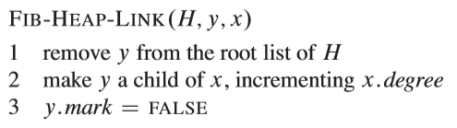
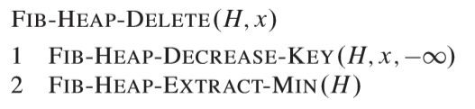

Slide 53
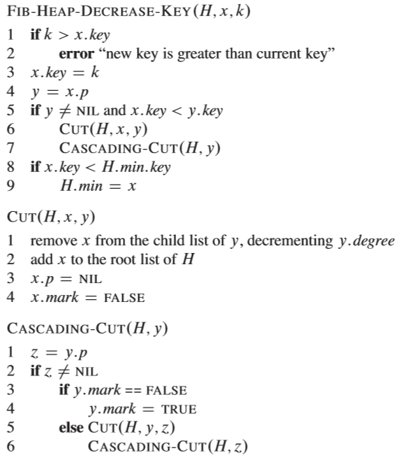
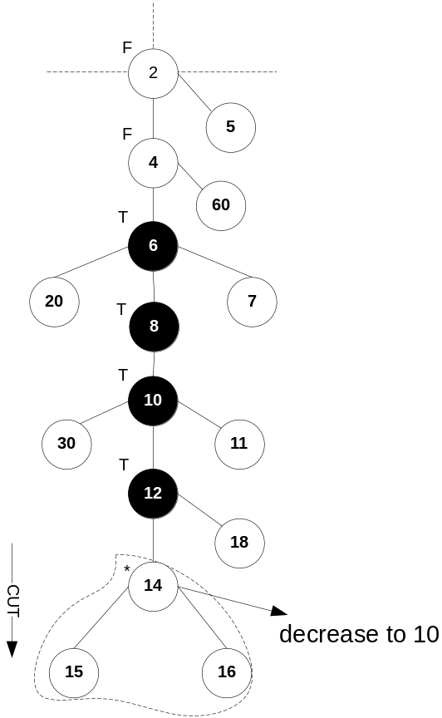

Slide 54
