Slide 1
GRAPH ALGORITHMS

Slide 2
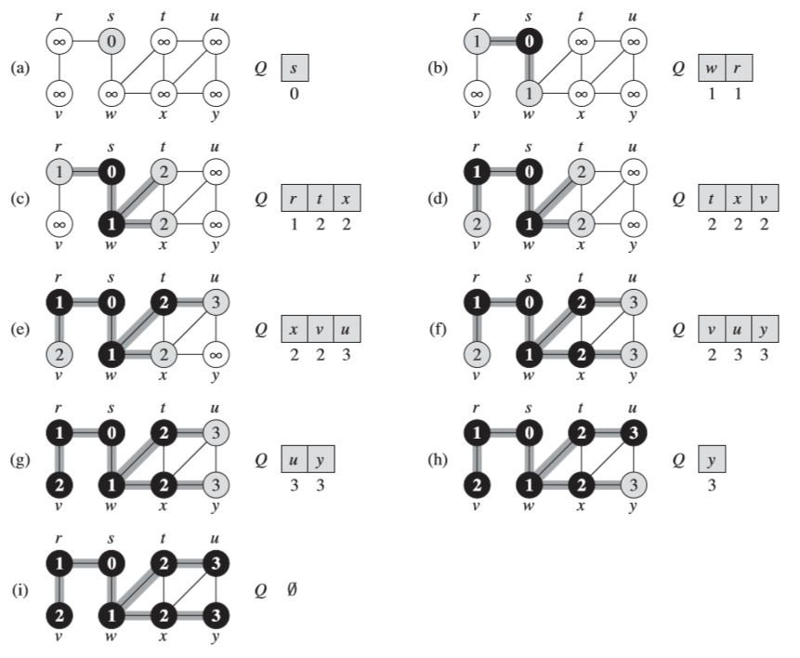
Breadth First Search (BFS)

Slide 3
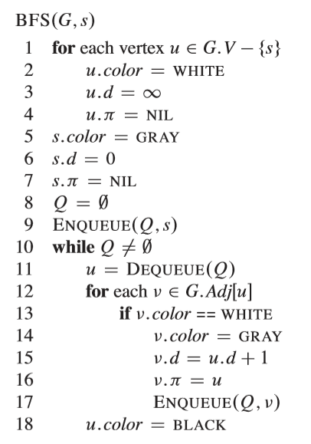

Slide 4
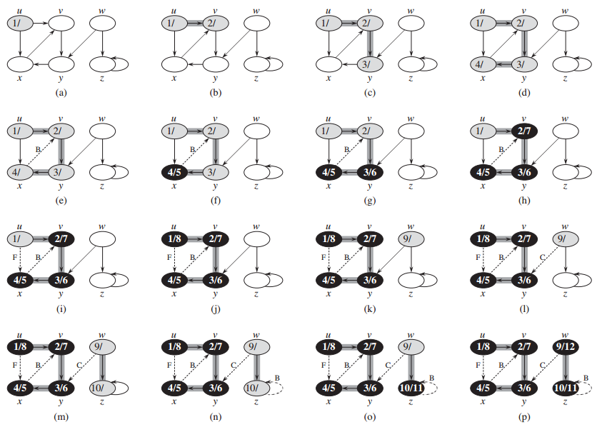
Depth First Search (DFS)

Slide 5
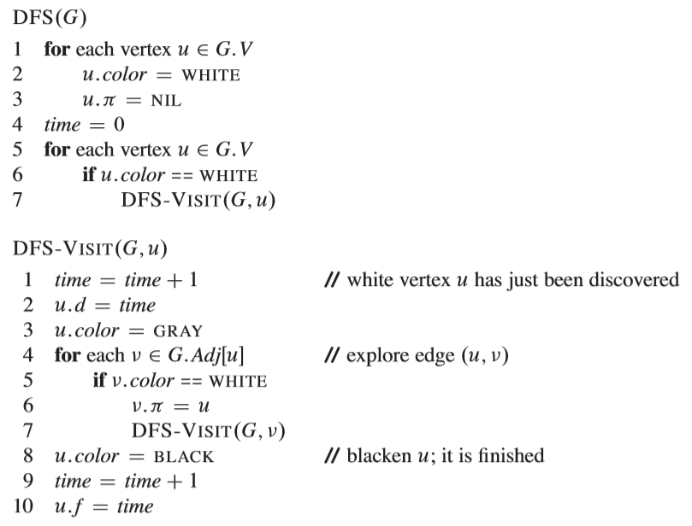
Depth First Search (DFS)

Slide 6
Minimum Spanning Trees

Slide 7
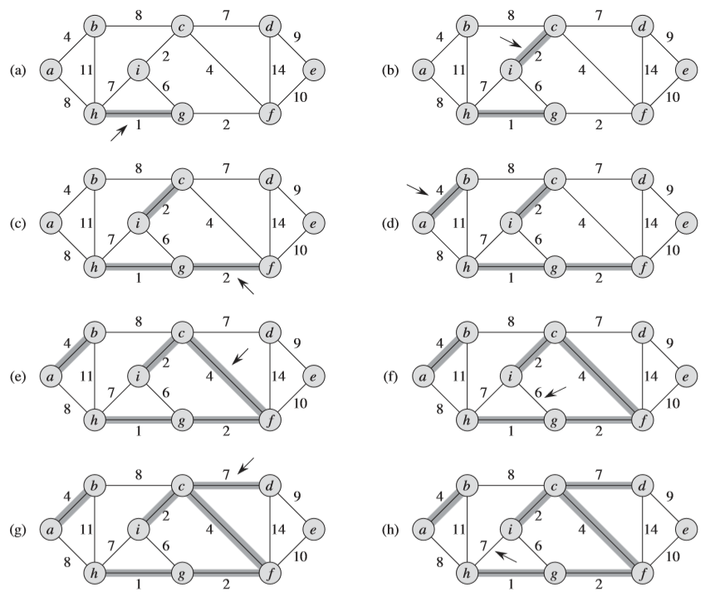
Kruskal's Agorithms

Slide 8
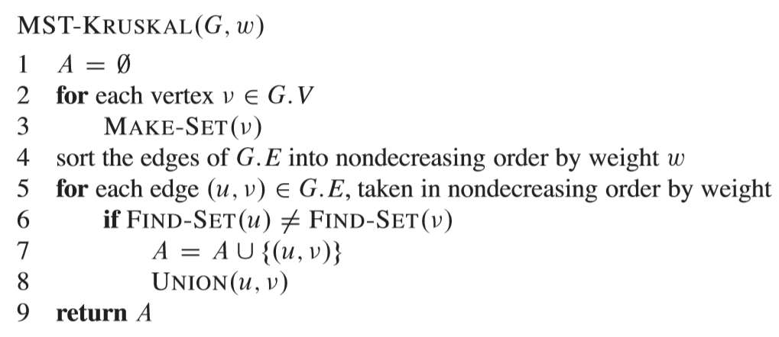
Kruskal's Agorithms

Slide 9
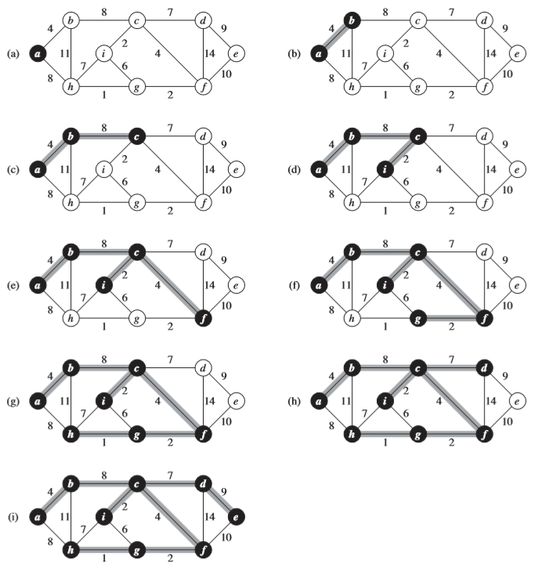
Prim's Agorithms
Prim's Agorithms

Slide 10
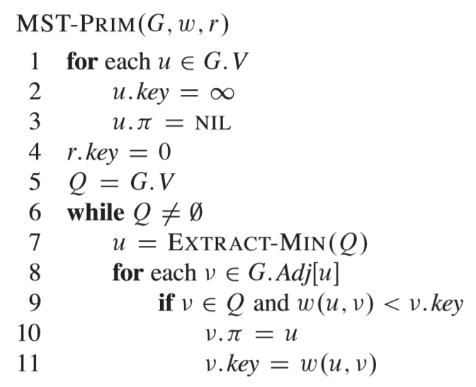
Prim's Agorithms

Slide 11
Single-Source Shortest path

Slide 12
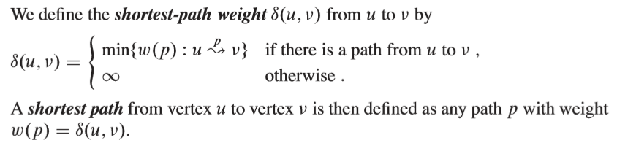
Single-Source Shortest Path

Slide 13
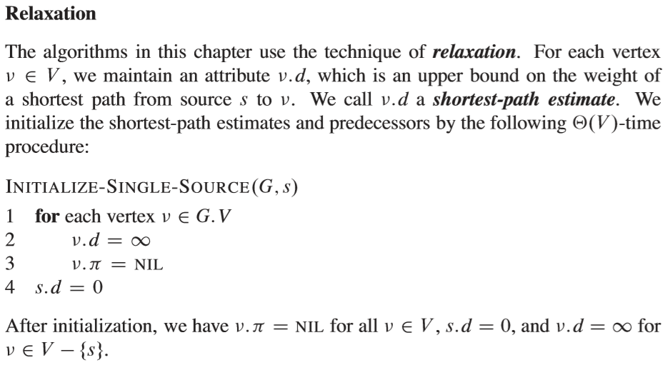
Single-Source Shortest Path

Slide 14
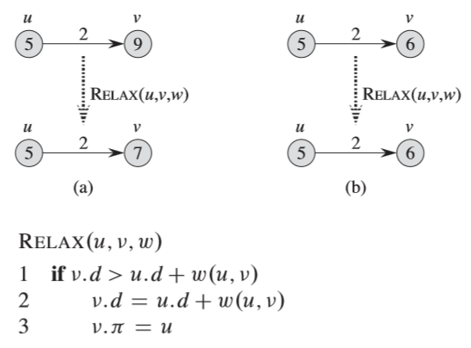
Single-Source Shortest Path

Slide 15
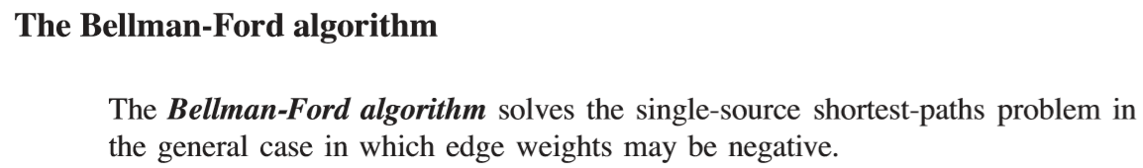
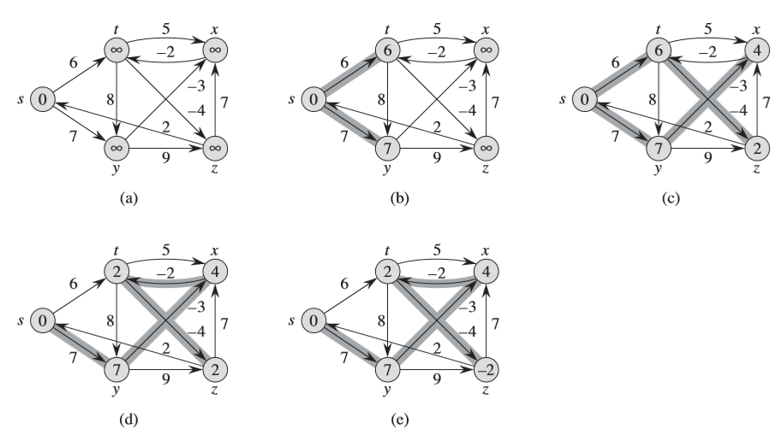

Slide 16
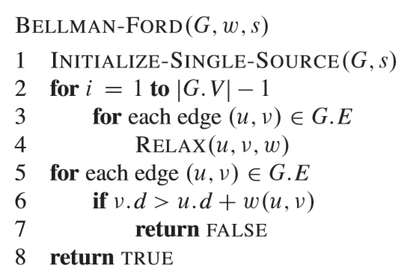

Slide 17
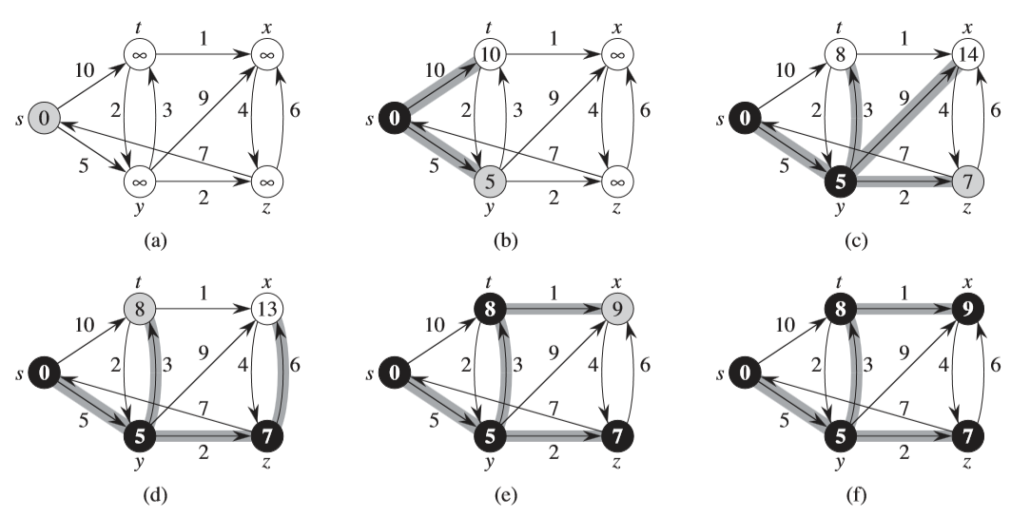
Single-Source Shortest Path (Dijkstra's Algorithm)

Slide 18
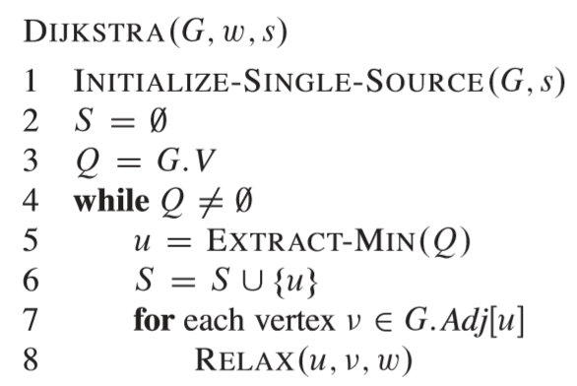
Single-Source Shortest Path (Dijkstra's Algorithm)

Slide 19
All-Pairs Shortest path

Slide 20
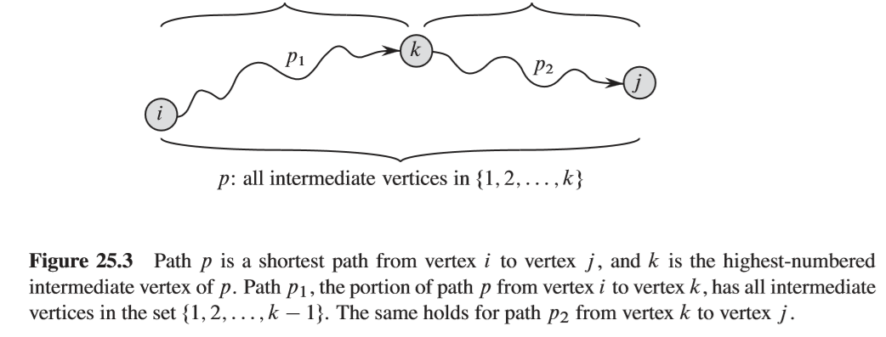

Slide 21
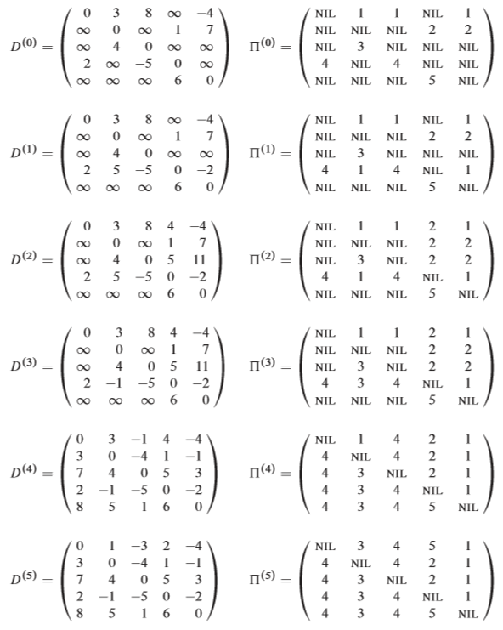
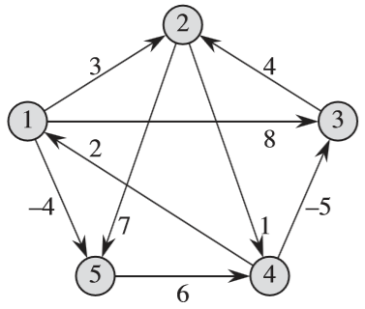
All-pairs Shortest Path
(Floyd-Warshall approach)

Slide 22
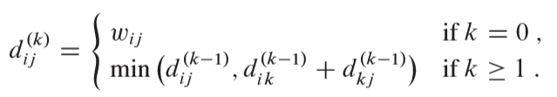
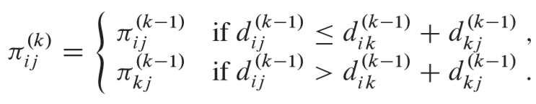

Slide 23
