Slide 1
Dynamic Programming

Slide 2
Introduction
Like 'divide n conquer' method, solves problems by combining the solutions to sub-problems.
A dynamic-programming algorithm solves every sub-problem just once and then saves its answer in a tabular format (table).
Dynamic programming is typically applied to optimization problems.

Slide 3
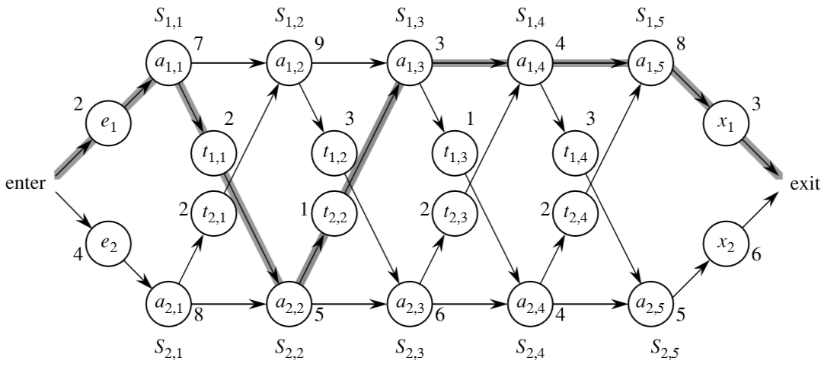
Assembly-line scheduling

Slide 4
Assembly-line scheduling
Assembly
line 1
Station S_{1,1}
Station S_{1,2}
Station S_{1,3}
Station S_{1,4}
Station S_{1,5}
Station S_{1,6}
7
9
3
4
8
4
2
3
2
3
1
3
4
Chassis
enters
completed
auto exits
4
2
1
2
2
1
2
Assembly
line 2
8
5
6
4
5
7
Station S_{2,1}
Station S_{2,2}
Station S_{2,3}
Station S_{2,4}
Station S_{2,5}
Station S_{2,6}
1 | 2 | 3 | 4 | 5 | 6
9 | 18 | 20
12 | 16 | 22
2 | 3 | 4 | 5 | 6
1 | 2
1 | 2
f₁[ j ]
l₁[ j ]
l* = ?
f* = ?
f₂[ j ]
l₂[ j ]

Slide 5
Assembly-line scheduling
Assembly
line 1
Station S_{1,1}
Station S_{1,2}
Station S_{1,3}
Station S_{1,4}
Station S_{1,5}
Station S_{1,6}
7
9
3
4
8
4
2
3
2
3
1
3
4
Chassis
enters
completed
auto exits
4
2
1
2
2
1
2
Assembly
line 2
8
5
6
4
5
7
Station S_{2,1}
Station S_{2,2}
Station S_{2,3}
Station S_{2,4}
Station S_{2,5}
Station S_{2,6}
1 | 2 | 3 | 4 | 5 | 6
9 | 18 | 20 | 24 | 32 | 35
12 | 16 | 22 | 25 | 30 | 37
2 | 3 | 4 | 5 | 6
1 | 2 | 1 | 1 | 2
1 | 2 | 1 | 2 | 2
f₁[ j ]
f* = 38
l₁[ j ]
l* = 1
f₂[ j ]
l₂[ j ]

Slide 6
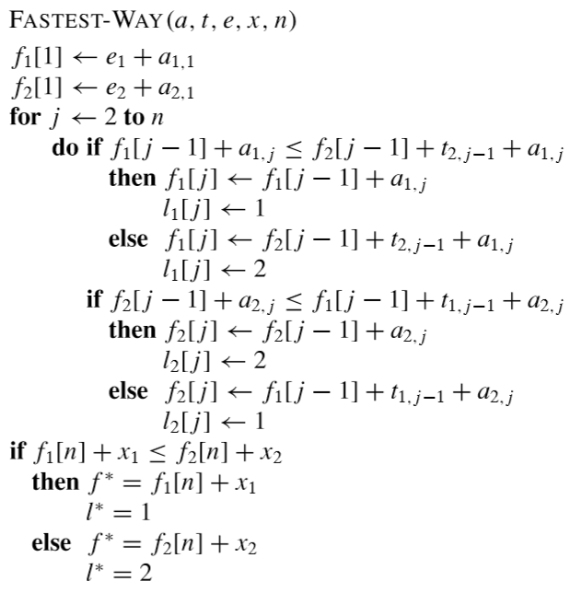
Assembly-line scheduling
Algorithm

Slide 7
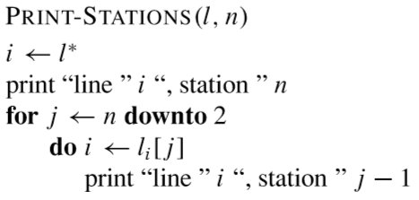
Assembly-line scheduling
Algorithm
2 | 3 | 4 | 5 | 6
1 | 2 | 1 | 1 | 2
1 | 2 | 1 | 2 | 2
l₁[ j ]
l* = 1
l₂[ j ]

Slide 8
Assembly-line scheduling
Assembly
line 1
Station S_{1,1}
Station S_{1,2}
Station S_{1,3}
Station S_{1,4}
Station S_{1,5}
Station S_{1,6}
7
9
3
4
8
4
2
3
2
3
1
3
4
Chassis
enters
completed
auto exits
4
2
1
2
2
1
2
Assembly
line 2
8
5
6
4
5
7
Station S_{2,1}
Station S_{2,2}
Station S_{2,3}
Station S_{2,4}
Station S_{2,5}
Station S_{2,6}
1 | 2 | 3 | 4 | 5 | 6
9 | 18 | 20 | 24 | 32 | 35
12 | 16 | 22 | 25 | 30 | 37
2 | 3 | 4 | 5 | 6
1 | 2 | 1 | 1 | 2
1 | 2 | 1 | 2 | 2
f₁[ j ]
f* = 38
l₁[ j ]
l* = 1
f₂[ j ]
l₂[ j ]

Slide 9
Longest common sub sequence
Biological applications often need to compare the DNA of two (or more) different organisms. A strand of DNA consists of a string of molecules called bases, where the possible bases are adenine, guanine, cytosine, and thymine.
For example, the DNA of one organism may be
S₁ = ACCGGTCGAGTGCGCGGAAGCCGGCCGAA,
and the DNA of another organism may be
S₂ = GTCGTTCGGAATGCCGTTGCTCTGTAAA. One reason to com- pare two strands of DNA is to determine how “similar” the two strands are, as some measure of how closely related the two organisms are.
In our example, the longest strand
S₃ = GTCGTCGGAAGCCGGCCGAA

Slide 10
Longest common sub sequence
In the longest-common-subsequence problem, we are given two sequences X = (x₁,x₂,.... x_{m}) and Y = (y₁,y₂,.... y_{n}) and wish to ﬁnd a maximum- length common sub-sequence of X and Y . This section shows how to efﬁciently solve the LCS problem using dynamic programming.

Slide 11
Longest common sub sequence
Lets take an example: Two strands to be matched
X = {A, B, C, B, D, A, B}
Y = {B, D, C, A, B, A}
Lets take 2 tables c and b to compute longest common sub-sequence having dimensions
c [0......7] [0......6]
b [1......7] [1......6]

Slide 12
Longest common sub sequence
 |  | y_{i} | 1 | 2 | 3 | 4 | 5 | 6
 | x_{i} |  | B | D | C | A | B | A
 | 1 | A
 | 2 | B
 | 3 | C
 | 4 | B
 | 5 | D
 | 6 | A
 | 7 | B
 | j | 0 | 1 | 2 | 3 | 4 | 5 | 6
i |  | y_{i} | B | D | C | A | B | A
0 | x_{i} | 0 | 0 | 0 | 0 | 0 | 0 | 0
1 | A | 0
2 | B | 0
3 | C | 0
4 | B | 0
5 | D | 0
6 | A | 0
7 | B | 0
b
c

Slide 13
Longest common sub sequence
 | j | 0 | 1 | 2 | 3 | 4 | 5 | 6
i |  | y_{i} | B | D | C | A | B | A
0 | x_{i} | 0 | 0 | 0 | 0 | 0 | 0 | 0
1 | A | 0
2 | B | 0
3 | C | 0
4 | B | 0
5 | D | 0
6 | A | 0
7 | B | 0
b & c matrix are overlapped
to find out the result better in a picture.

Slide 14
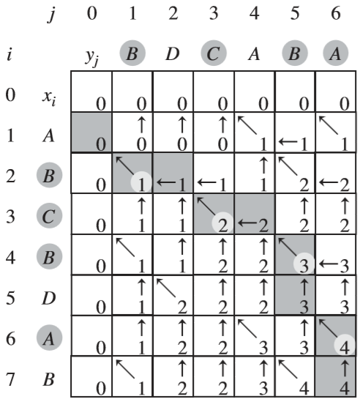
Longest common sub sequence
Resultant Matrix

Slide 15
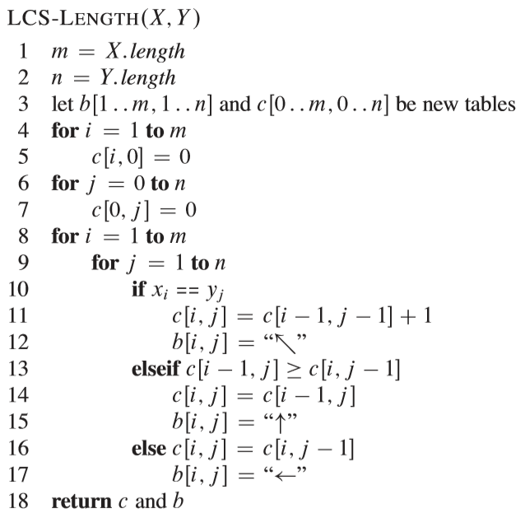
Finding
Longest common sub sequence
Algorithm

Slide 16
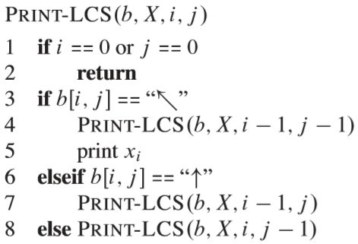
Print
Longest common sub sequence
Algorithm

Slide 17
THANKS
Rest in Next Class

