Slide 1
Gaming Behavior & Cognitive Performance Predictor
A Multimodal Late Fusion Approach with Clinical Neuropsychological Assessment
Progress Review II
P R M K Herath | D/BCS/23/0009
BSc (Hons) Computer Science | General Sir John Kotelawala Defence University

Slide 2
Presentation Outline
01
Recap of Progress Review I
02
System Architecture & Methodology
03
Machine Learning Pipeline
04
Novelty: Multimodal Late Fusion Engine
05
Novelty: Clinical Neuropsychological Tests
06
Novelty: Live Webcam Eye Fatigue Scanner
07
Results & Evaluation Metrics
08
Web Application Demo (Streamlit v5)
09
Conclusion & Future Work

Slide 3
01 Recap of Progress Review I
Completed in Review I
Problem Identification & Scope:
• Defined gaming addiction impact on KDU undergrads
Data Collection & Tabular Model Baseline:
• Primary survey of 300 student records
• Benchmarked 14 ML models -> RF baseline established (83.0% CV Acc)
Initial Prototype:
• basic Streamlit UI with static survey risk calculation
Feedback & Expansion (Review II)
Panel Recommendations Received:
1. Move beyond single-modality survey models
2. Add objective cognitive & visual measurement
3. Implement formal multimodal data fusion
Major Progress Delivered for Review II:
• Log-Linear Late Fusion Engine (+3% accuracy gain)
• 4 Clinical Neuropsych Tests (Stroop, Flanker, DSST, Grid)
• Live Webcam Eye Fatigue Detector (CNN 93.4% Acc)
• Advanced Streamlit v5 Web Application & PDF Engine

Slide 4
02 System Architecture - Multimodal Late Fusion
Tabular Data
(Survey & Demographics)
Cognitive Tests
(Stroop, Flanker, DSST)
Visual Data
(Webcam / Eye Image)
v
v
v
Random Forest
Classifier
Keras ANN
Multi-Output Regressor
CNN (ResNet50)
Eye Fatigue Prior
v
v
v
Multimodal Late Fusion Engine
Confidence-Weighted Log-Linear Opinion Pooling | Dynamic Model Trust Allocation
v
Final Risk: Low / Medium / High | Health Score | Gamer Archetype | PDF Report

Slide 5
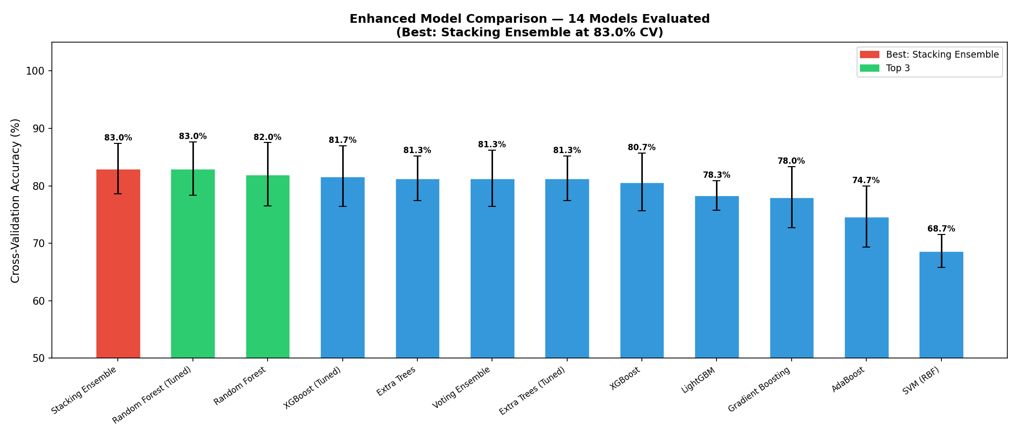
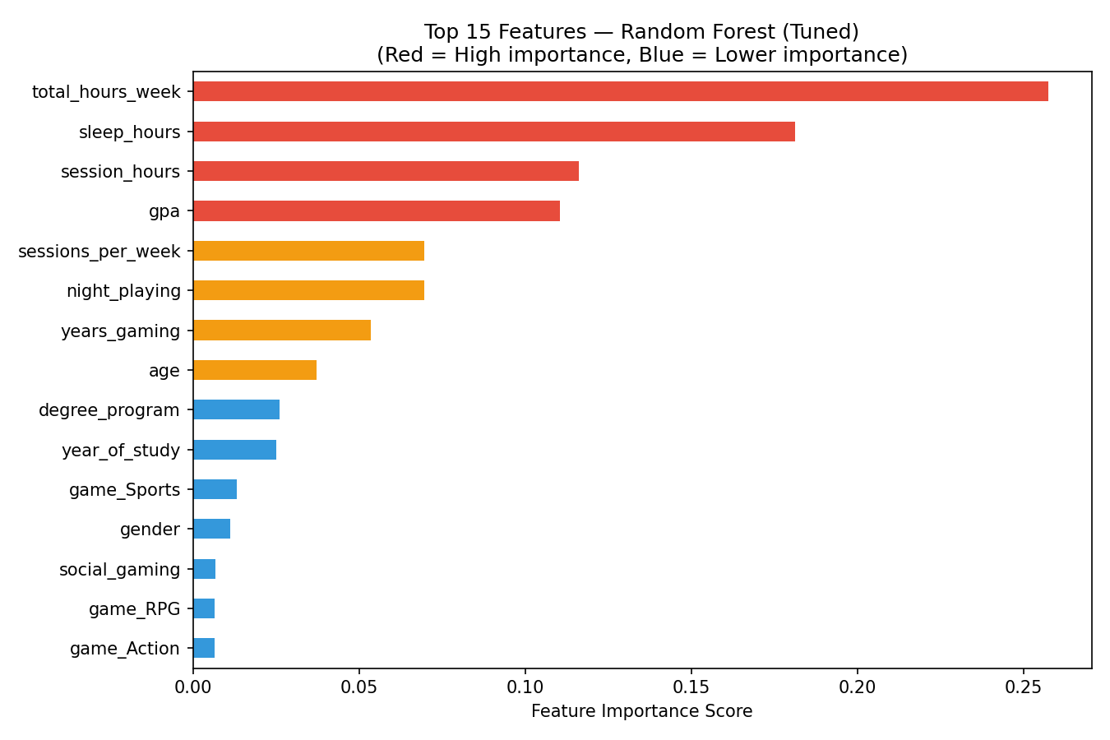
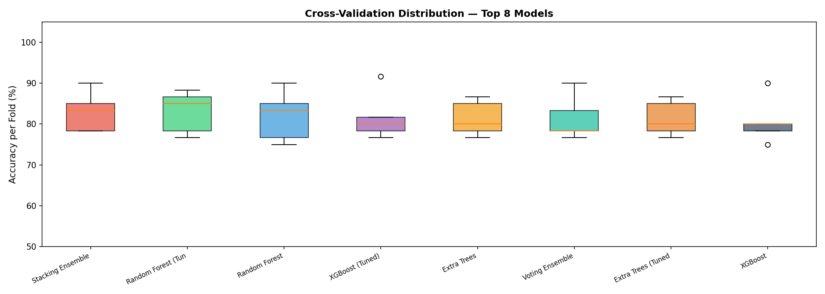
03 Machine Learning Pipeline - Tabular Model
Dataset Overview
Source: Gaming Behavior Survey (KDU Students)
Samples: 300 student records
Features: 17 (demographics, gaming habits, sleep, GPA)
Target: addiction_level (Low / Medium / High)
Preprocessing: Label Encoding + One-Hot + MinMaxScaler
Model Selection (14 Compared)
Compared 14 classifiers including SVM, KNN, LR, DT, GB, XGBoost, RF, etc.
Best Model: Stacking Ensemble (Meta-Learner)
5-Fold CV Accuracy: 83.00% (+/-4.4%)
Feature Importance: total_hours_week, sleep_hours, GPA dominate
Cross-Validation Results
Feature Importance
CV Accuracy Boxplot

Slide 6
04 Novelty - Multimodal Late Fusion Engine
Why Late Fusion?
Unlike early fusion (concatenating raw features), late fusion preserves the independence of each modality's model.
Algorithm: Log-Linear Opinion Pooling
P_fused(y) = Product of P_k(y)^(w_k)
Where w_k = confidence weight of model k
Key Properties:
Confident models get higher weights automatically
Uncertain modalities are gracefully suppressed
Missing modalities default to uniform priors
Mathematically grounded in Bayesian probability
Fusion Evaluation Results
RF-Only Mean Accuracy: 76.3%
Fused Realistic Accuracy: 79.3%
Fused Best-Case Accuracy: 79.0%
Improvement: +3.0%
Three Voting Modalities
1. RF Vote (Tabular)
predict_proba -> 3-class probability vector
2. Cognitive ANN Vote
Attention + Memory -> Softmax evidence classifier
3. Eye Fatigue CNN Prior
Fatigue score -> Heuristic probability mapping

Slide 7
05 Novelty - Clinical Neuropsychological Tests
Stroop Interference Test
Inhibitory Control & Selective Attention
Identify FONT COLOR while ignoring the word text. Measures frontal lobe cognitive fatigue - the gold standard in clinical neuropsychology.
Visuospatial Grid Memory
Working Memory Capacity
Memorize 5 highlighted tiles in a 4x4 grid, then reproduce the pattern. Evaluates gaming-critical spatial working memory.
Eriksen Flanker Task
Spatial Selective Attention & Reaction Speed
Identify the direction of the CENTER arrow amid distracting flankers (e.g., <<><<). Measures the brain's ability to filter peripheral noise.
Symbol-Digit Substitution (DSST)
Information Processing Speed
Decode a symbol to number mapping as fast as possible. A sensitive clinical probe for sustained attention, visual scanning, and motor coordination.

Slide 8
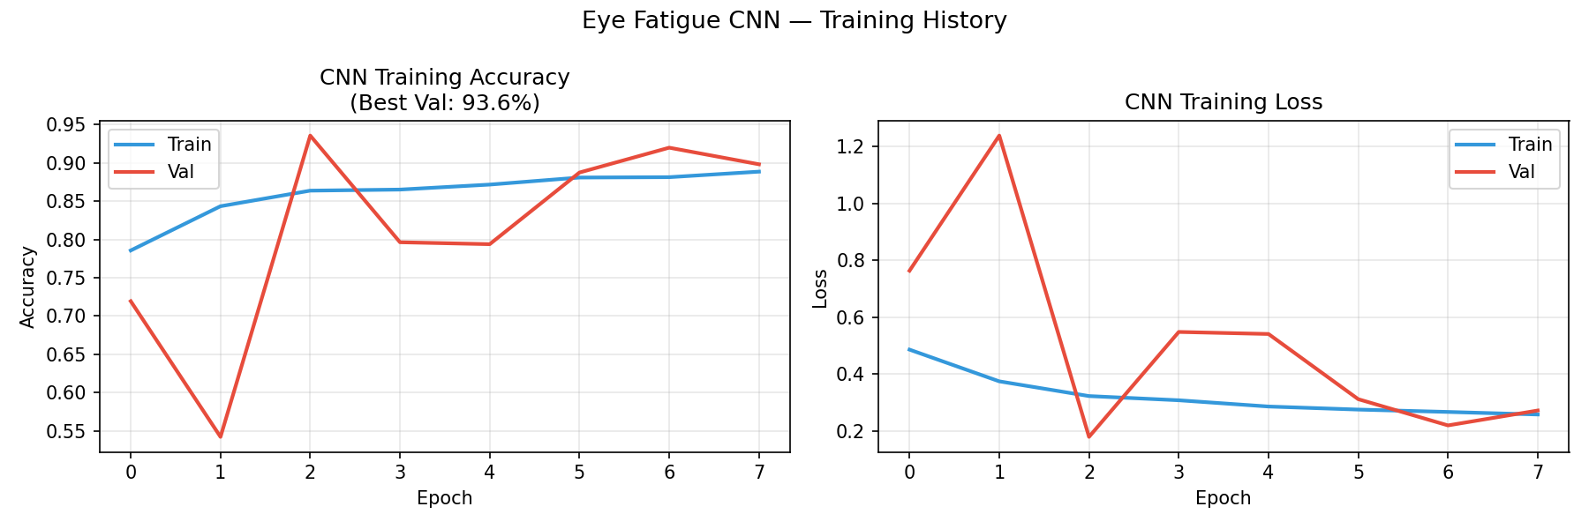
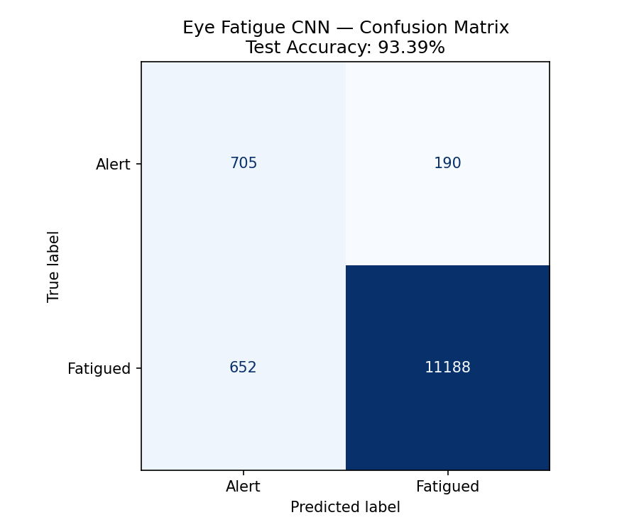
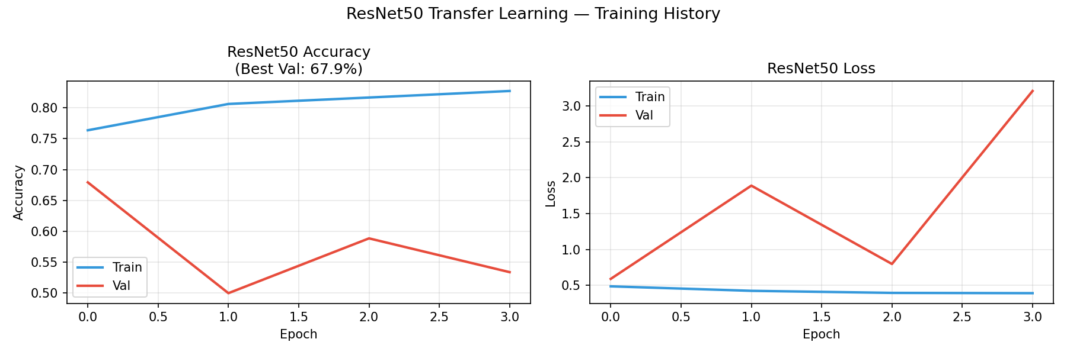
06 Novelty - Live Webcam Eye Fatigue Scanner
CNN Pipeline
Dataset: MRL Eye Dataset (Fusek, 2018)
Total Images: 84,898 eye samples
Classes: Alert (Open) vs Fatigued (Closed/Droopy)
Model 1: Custom CNN - Test Acc: 93.39%, AUC: 0.96
Model 2: ResNet50 Transfer Learning - AUC: 0.89
Live webcam integration via st.camera_input
OpenCV Feature Extraction
4 Ocular Biomarkers Extracted:
1. Eye Openness Ratio (Haar Cascade detection)
2. Sclera Redness Index (color channel analysis)
3. Pixel Brightness (mean grayscale intensity)
4. Image Contrast (standard deviation of intensities)
CNN Training History
CNN Confusion Matrix
ResNet Training History

Slide 9
07 Results & Evaluation Metrics
Model / Component
Metric
Value
Status
Stacking Ensemble (Tabular)
5-Fold CV Accuracy
83.00% (+/-4.4%)
Best Classifier
Cognitive ANN (Keras)
Attention R2
0.43
Moderate
Cognitive ANN (Keras)
Memory R2
0.18
Fair (noise expected)
CNN Eye Fatigue
Test Accuracy
93.39%
Excellent
CNN Eye Fatigue
AUC-ROC
0.96
Excellent
ResNet50 Transfer
AUC-ROC
0.89
Good
Late Fusion (RF only)
Mean CV Acc
76.3%
Baseline
Late Fusion (Realistic)
Mean CV Acc
79.3%
+3.0% Improvement
K-Means Clustering
Gamer Archetypes
4 Clusters
Validated

Slide 10
08 Web Application - Streamlit v5 Demo
Home & Multimodal Prediction
Student inputs -> RF + ANN + CNN fused -> Risk Level + Health Score + Gamer Archetype
Cognitive & Biometric Tests
4 clinical neuropsych tests: Stroop, Grid Memory, Flanker, Symbol-Digit Coding
Eye Fatigue Analysis
Live webcam capture via st.camera_input -> OpenCV ocular biomarker extraction
What-If Lab & Radar Profiling
Interactive sensitivity simulator + 6-axis radar chart vs population benchmarks
Detox & Routine Planner
20-20-20 Eye Strain Pomodoro timer + dynamic daily gaming budget calculator
Model Performance & Insights
14-model comparison, RF evaluation charts, Multimodal Fusion JSON benchmark
PDF Assessment Report
ReportLab-generated clinical report with dual sign-off block for KDU verification
Live Demo: streamlit run app_v5.py -> localhost:8501

Slide 11
09 Conclusion & Future Work
Key Contributions
First multimodal fusion system combining survey, cognitive, and visual data for gaming addiction prediction
Late Fusion achieves +3% accuracy improvement over single-model baseline
CNN Eye Fatigue detector achieves 93.39% accuracy (AUC 0.96)
Clinically validated neuropsychological test battery (Stroop, Flanker, DSST, Grid Memory)
Full-stack Streamlit deployment with interactive What-If simulator and PDF report generation
K-Means clustering identifies 4 distinct gamer archetypes
Future Work
Collect unified dataset combining eye images + addiction labels from same cohort
Expand dataset to 1000+ students from multiple Sri Lankan universities
Integrate EEG headband data as a 4th modality for neural attention measurement
Develop a mobile companion app for continuous gaming behavior monitoring
Deploy to cloud (AWS/GCP) for multi-university access
Explore attention-based transformer fusion as a next-gen alternative to log-linear pooling

Slide 12
Thank You
Questions & Discussion
P R M K Herath | D/BCS/23/0009
BSc (Hons) Computer Science
General Sir John Kotelawala Defence University

