Slide 1
AZURE CLOUD · DATA ENGINEERING PROJECT
Energy Consumption
Forecasting Pipeline
TEAM MEMBERS
Gokavarapu Venkatesh
Bharathi R
Sakthivel A
Kummari Maneendra
Neha Mahajan
Vailada Balaji
ENERGY CONSUMPTION FORECASTING PIPELINE
01

Slide 2

01 — INTRODUCTION
Project Overview
What This Project Does
Primary Goals
The Energy Consumption Forecasting Pipeline is an end-to-end, fully Azure-native data engineering solution. It ingests raw energy usage, device metrics, grid load, weather and tariff & billing data through Azure Data Factory into Azure Data Lake Storage Gen2, then refines it through a Databricks Lakehouse medallion architecture (Bronze → Silver → Gold).
Reliably ingest & store raw CSV data from multiple source systems
Clean, validate & standardize data using a medallion architecture
Transformations are modeled with dbt, workflows are orchestrated with Apache Airflow, and analytics-ready Gold data powers Databricks SQL dashboards — giving stakeholders a governed, forecast-ready view of energy demand. Slack keeps the team informed of pipeline health in real time.
Automate ingestion and orchestration end-to-end on Azure
Deliver analytics-ready Gold data for forecasting dashboards
Proactively monitor pipeline health with Slack alerting
ENERGY CONSUMPTION FORECASTING PIPELINE
02

Slide 3
Problem Statement
The Energy Grid & Business Challenges
Operational vulnerabilities confronting modern power distribution utilities:
• Unpredictable Demand Volatility
Extreme weather fluctuations, sudden heatwaves/cold snaps, and uncoordinated EV charging create steep, erratic spikes in consumer power consumption.
• Grid Instability & Peaking Strain
Substations and feeder lines frequently experience localized overload during peak demand periods, risking transformer failure and rolling brownouts.
• Excessive Standby Reserve Costs
Without precise forward-looking demand estimates, utilities over-procure expensive standby generation on spot markets, driving up operating costs.
• Delayed Reactive Decision-Making
Grid operators traditionally rely on historical averages rather than near-real-time predictive forecasts, hindering dynamic load-shedding and tariff balancing.
Data Engineering Bottlenecks & Objective
Architectural barriers and the pipeline solution required:
• Siloed & Asynchronous Ingestion
Smart meter telemetry, weather stations, substation sensors, and dynamic tariff rates arrive in heterogeneous formats and distinct velocities.
• Data Quality & Schema Inconsistency
Raw incoming streams contain duplicate device signals, missing sensor readings, unit mismatches, and schema drift that corrupt predictive models.
• Lack of Unified Medallion Lakehouse
Absence of a standardized Bronze → Silver → Gold progression prevents auditable lineage, versioning, and fast ad-hoc analytics.
• Pipeline Objective & Mission
Build an automated, resilient Azure Databricks Lakehouse with dbt and Airflow to extract, cleanse, and curate forecast-ready energy datasets powering executive SQL dashboards.
ENERGY CONSUMPTION FORECASTING PIPELINE
03

Slide 4





02 — STACK
Tools & Technologies
Ingestion & Orchestration
Storage Layer
Processing & Transformation
Azure Data Factory — ingestion, copy activity & pipeline scheduling
Apache Airflow — DAG-based workflow orchestration
Azure Data Lake Storage Gen2 — raw & parquet zones (/raw, /target)
Unity Catalog External Locations — credential-less access path via Managed Identity
Databricks Lakehouse — Spark & Auto Loader ingestion via External Locations
dbt — SQL modeling, testing & lineage across Bronze, Silver and Gold
Analytics & BI
Monitoring & Alerts
Databricks SQL — ad-hoc queries & data exploration
Databricks Dashboards — interactive reporting
Slack — pipeline, job & data-quality notifications
ENERGY CONSUMPTION FORECASTING PIPELINE
04

Slide 5
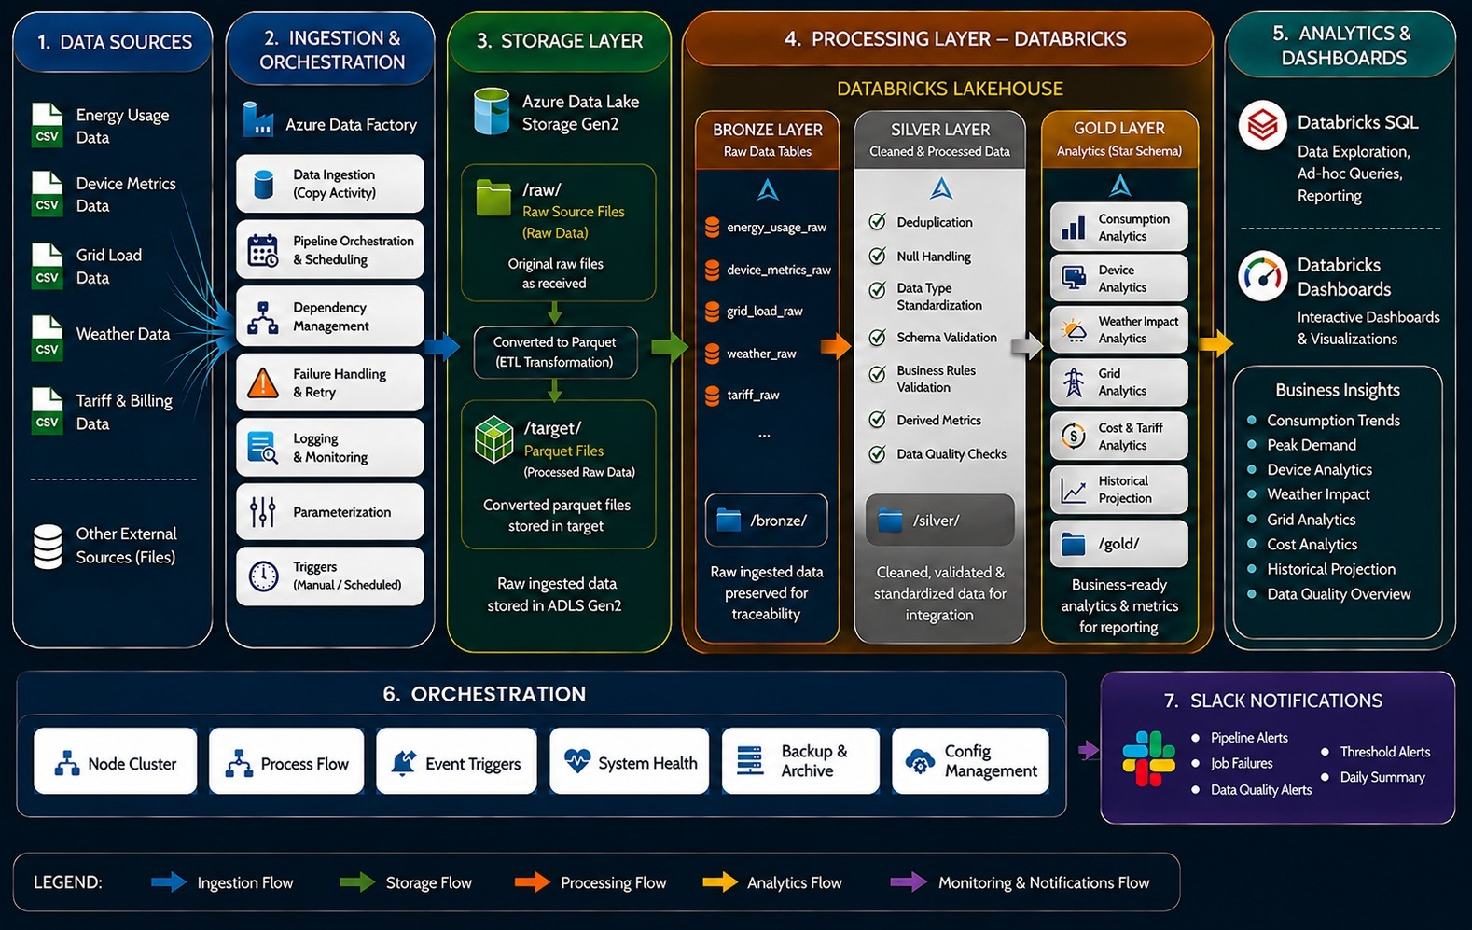
03 — ARCHITECTURE
High-Level Design
ENERGY CONSUMPTION FORECASTING PIPELINE
05

Slide 6







Low-Level Design
1
Source CSV Files
energy_usage, device_metrics, grid_load, weather, tariff_billing
2
ADF Copy Activity → ADLS /raw/
Original raw files landed as-received; pipeline & dependency management with retry
3
ADF ELT → ADLS /target/
Raw files converted to Parquet for efficient downstream processing
4
Bronze Layer (Databricks)
5 raw Delta tables: energy_usage_raw, device_metrics_raw, grid_load_raw, weather_raw, tariff_raw
5
Silver Layer — dbt models
Dedup · null handling · type standardization · schema & business-rule validation · derived metrics · DQ checks
6
Gold Layer — Star Schema
Consumption, Device, Weather, Grid, Cost & Tariff, Historical Projection marts
7
Databricks SQL / Dashboards
Ad-hoc queries, interactive dashboards & business insights
8
Airflow Orchestration + Slack Alerts
DAGs schedule every stage; Slack notified on failures, DQ issues & daily summary
ENERGY CONSUMPTION FORECASTING PIPELINE
06

Slide 7
04 — DATABRICKS LAKEHOUSE
Medallion Architecture — Layer Tables & Schemas
BRONZE LAYER
Raw Ingestion Tables (5)
Extracted via Unity Catalog External Location (ADLS Gen2 /target/)
• device_metrics
• energy_usage_stream
• grid_load_stream
• tariff_metrics
• weather_source
SILVER LAYER
Cleansed Staging Tables (5)
Modeled via dbt Transformations
• stg_device_metrics
• stg_energy_usage_stream
• stg_grid_load_stream
• stg_tariff_metrics
• stg_weather_source
GOLD LAYER
Curated Dimensions & Facts (6)
Star Schema Marts (KPIs Excluded)
• dim_feeder
• dim_household
• dim_operator
• dim_substation
• dim_zone
• fact_grid_load
ENERGY CONSUMPTION FORECASTING PIPELINE
07

Slide 8

Medallion Architecture — Bronze & Silver
BRONZE LAYER
SILVER LAYER
Raw Data Tables
Cleaned & Processed Data
ADLS Ingestion via Unity Catalog External Location
• External Location URL: abfss://target@<storage>.dfs.core.windows.net/
• Storage Credential: Azure Managed Identity (RBAC Blob Contributor, keyless)
• Ingestion Engine: Auto Loader (cloud Files) & PySpark read parquet into Delta
⬡ Data Extracted from ADLS Gen2 (/target/ Parquet Storage) ➔
Deduplication
Null Handling
Data Type Standardization
Schema Validation
device_metrics
energy_usage_stream
Business Rules Validation
Derived Metrics
grid_load_stream
Data Quality Checks
tariff_metrics
weather_source
Data extracted from ADLS Gen2 (/target/) via Unity Catalog External Locations for secure, keyless access. Auto Loader streams raw parquet files directly into append-only Bronze Delta tables.
Cleaned, validated & standardized data for integration, modeled with dbt. Stored at /silver/.
ENERGY CONSUMPTION FORECASTING PIPELINE
08

Slide 9






08 — QUALITY ASSURANCE
Testing & Validation
Pipeline Unit Tests
Data Quality Rules
dbt Tests
Component-level testing of Azure Data Factory activities and Databricks notebooks
Validation of nulls, duplicates, ranges & business rules enforced at the Silver layer
Schema, uniqueness, not-null & referential integrity tests on every Silver and Gold model
Stakeholder UAT
Reconciliation Checks
End-to-End Validation
Dashboard & report validation with business stakeholders before sign-off
Row-count & value reconciliation between Bronze, Silver and Gold outputs
Full pipeline run validated in staging before promotion to production
ENERGY CONSUMPTION FORECASTING PIPELINE
09

Slide 10






Medallion Architecture — Gold Layer
GOLD LAYER — Analytics (Star Schema)
Business-ready analytics & metrics for reporting — stored at /gold/
Consumption Analytics
Device Analytics
Weather Impact Analytics
Grid Analytics
Cost & Tariff Analytics
Historical Projection
Gold tables feed Databricks SQL for ad-hoc queries and Databricks Dashboards for interactive, decision-ready reporting.
ENERGY CONSUMPTION FORECASTING PIPELINE
10

Slide 11
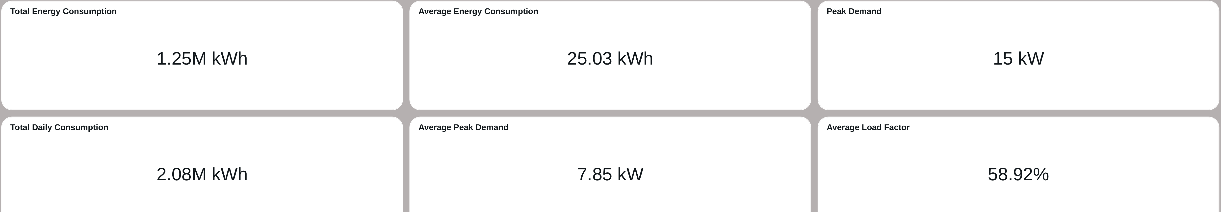
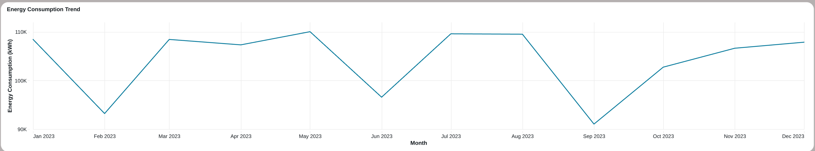
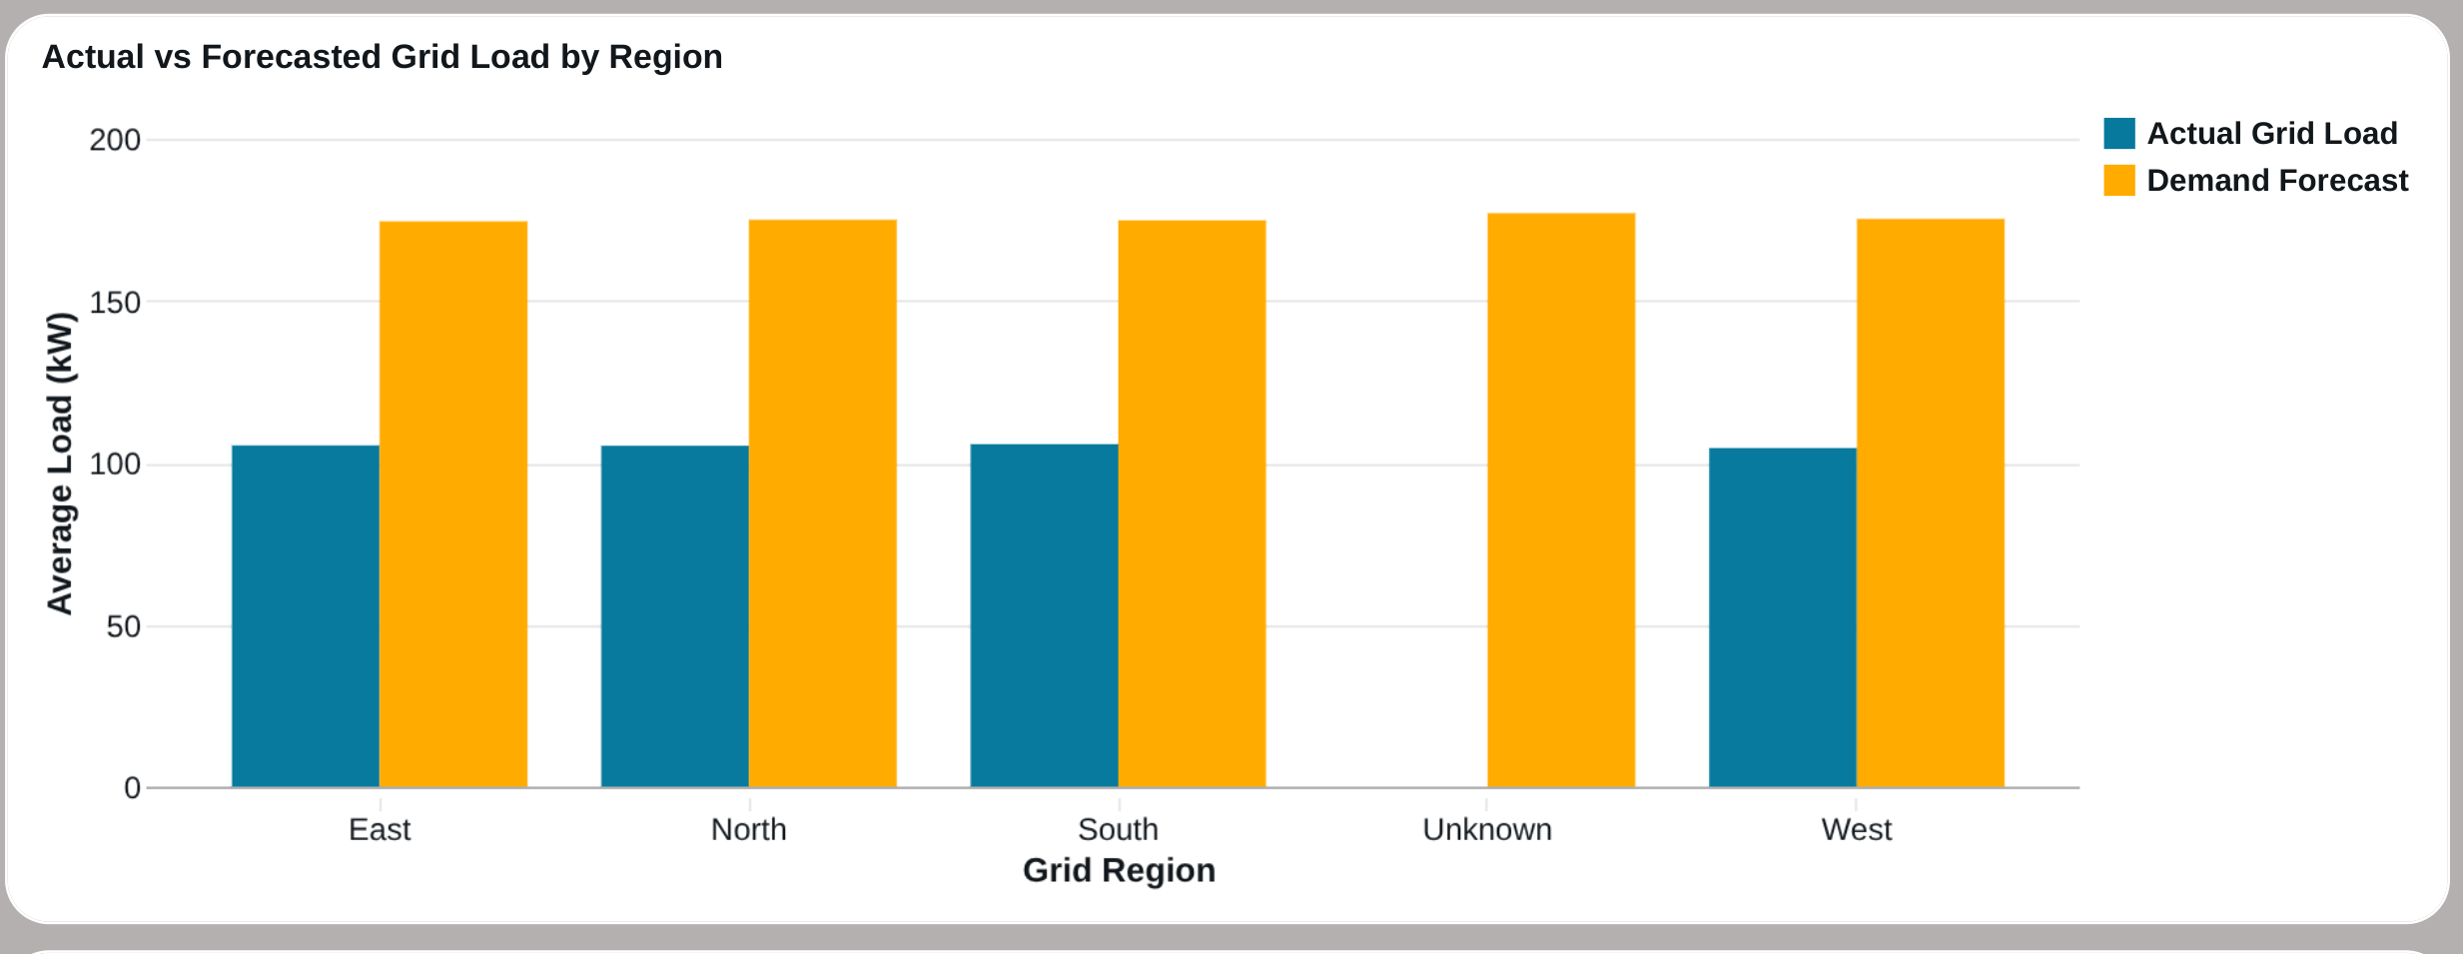
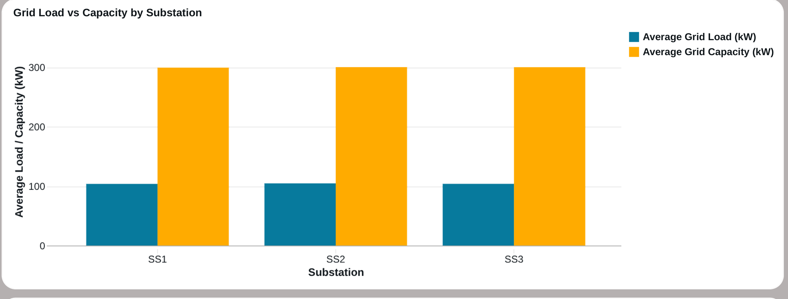
06 — ANALYTICS
Dashboards — Forecast & Grid Intelligence
Key Dashboard Highlights
• Real-time tracking of 1.25M kWh total consumption & 15 kW peak demand
• Continuous 104.11 kW average grid load with 34.70% capacity utilization
• Regional Actual vs. Forecasted load comparisons for proactive power dispatch
• Substation capacity headroom & line loss tracking (5.49% average loss)
• Device category consumption breakdown & weather-condition impact correlations
• Governed Databricks SQL dashboards delivering actionable grid intelligence
ENERGY CONSUMPTION FORECASTING PIPELINE
11

Slide 12





07 — OPERATIONS
Pipeline Orchestration
Apache Airflow DAGs schedule and sequence every stage — Azure Data Factory ingestion, Databricks Bronze → Silver → Gold jobs, and downstream analytics — with dependency-aware execution and automatic retries.
Airflow
DBT Integration
Pipeline Trigger
Airflow DAG manages and monitors the dbt Cloud pipeline execution
Airflow triggers and monitors dbt Cloud transformation jobs
Airflow triggers the dbt Cloud job and monitors its execution
Execution Monitoring
Deployment Control
Config Management
Continuous health checks across every pipeline stage
Airflow controls execution of the configured dbt Cloud deployment job
Centralized, parameterized pipeline configuration
ENERGY CONSUMPTION FORECASTING PIPELINE
12

Slide 13


Alerts, Monitoring & Logging
Slack Notifications
Pipeline Monitoring & Logging
Real-time channel alerts
Databricks job run monitoring & cluster health tracking
Azure Data Factory activity logging across every pipeline run
Airflow DAG run history for scheduling & retry visibility
Centralized logs for auditing, debugging & root-cause analysis
Threshold-based rules trigger Slack alerts automatically
Daily summary digest posted for stakeholder visibility
Pipeline Alerts
Job Failures
Data Quality Alerts
Threshold Alerts
Daily Summary
ENERGY CONSUMPTION FORECASTING PIPELINE
13

Slide 14

09 — VALUE
Business Impact & Outcomes
A governed, forecast-ready view of energy demand enables faster, more confident decisions — from grid load balancing to cost planning.
Consumption Trends
Peak Demand Forecasting
Device Analytics
Weather Impact
Grid Analytics
Cost Analytics
Historical Projection
Data Quality Overview
Outcome: optimized grid load balancing, proactive cost & tariff planning, improved forecasting accuracy, and faster decision-making — all on a scalable, fully Azure-native architecture.
ENERGY CONSUMPTION FORECASTING PIPELINE
14

Slide 15



THANK YOU
Questions & Discussion
Energy Consumption Forecasting Pipeline

