Slide 1
Responsive React Dashboard Using Reusable Components and Mock REST API
By: Maneeswaran S Tech Stack: React JS, CSS, Recharts, REST API (JSONPlaceholder)

Slide 2
Project Overview
Built using React JS (functional components)
Designed with Reusable UI Components
Integrated with a Mock REST API
Supports Light and Dark Mode
Fully Responsive for all devices

Slide 3
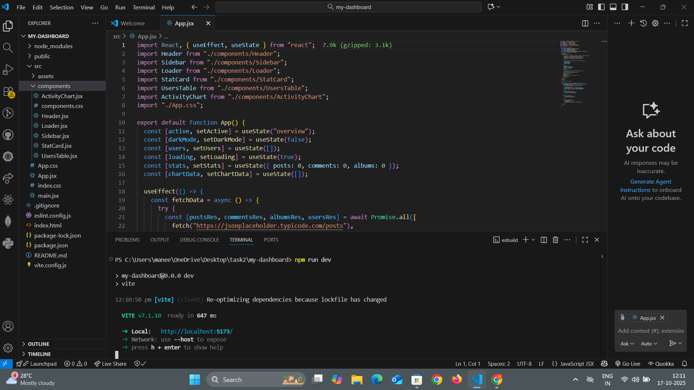
Project Folder Structure

Slide 4
React Concepts Used
Concept | Purpose
useState() | Manage component state
useEffect() | Fetch API data on load
Props | Pass data between components
Conditional Rendering | Switch pages dynamically
Component Reusability | Avoid duplicate code

Slide 5
API Integration
Mock REST API: 👉 https://jsonplaceholder.typicode.com/
Fetched Data:
/posts → Total Posts
/comments → Total Comments
/albums → Total Albums
/users → Users Table

Slide 6
Components Overview
Component | Description
Header | Shows title & Dark Mode toggle
Sidebar | Handles navigation (Overview, Users, Reports)
StatCard | Displays summary stats (posts, comments, albums)
ActivityChart | Visualizes daily data using Recharts
UsersTable | Shows user data in tabular format
Loader | Displays spinner during data fetch

Slide 7
Dark Mode Feature
Controlled using darkMode state
Toggles between light 🌞 and dark 🌙 themes
CSS class .dark dynamically changes styles
Fully responsive for all components

Slide 8
Activity Chart
Built using Recharts Library
Displays random daily data
Responsive and dynamic
Can be easily replaced with real data

Slide 9
Users Table
Displays users fetched from REST API
Columns: Name, Email, City
Uses .map() to dynamically render rows
Easily replaceable with real backend data

Slide 10
Project Flow Diagram
App.jsx
↓
useEffect() → Fetch API Data
↓
setState() → Update Stats, Users, Chart
↓
Child Components Receive Props
↓
React Re-renders Updated UI

Slide 11
Responsive Design
✅ Works on desktop, tablet, and mobile
✅ Sidebar adapts on smaller screens
✅ Chart auto-resizes
✅ Font sizes adjust with media queries

Slide 12
Reusability Benefits
Write once, use everywhere
Less code repetition
Easy debugging and updates
Cleaner and modular structure

Slide 13
Key Learnings
React State & Props
Conditional Rendering
API Integration using fetch()
Component Reusability
Dark Mode & CSS Management
Responsive UI with Flexbox

Slide 14
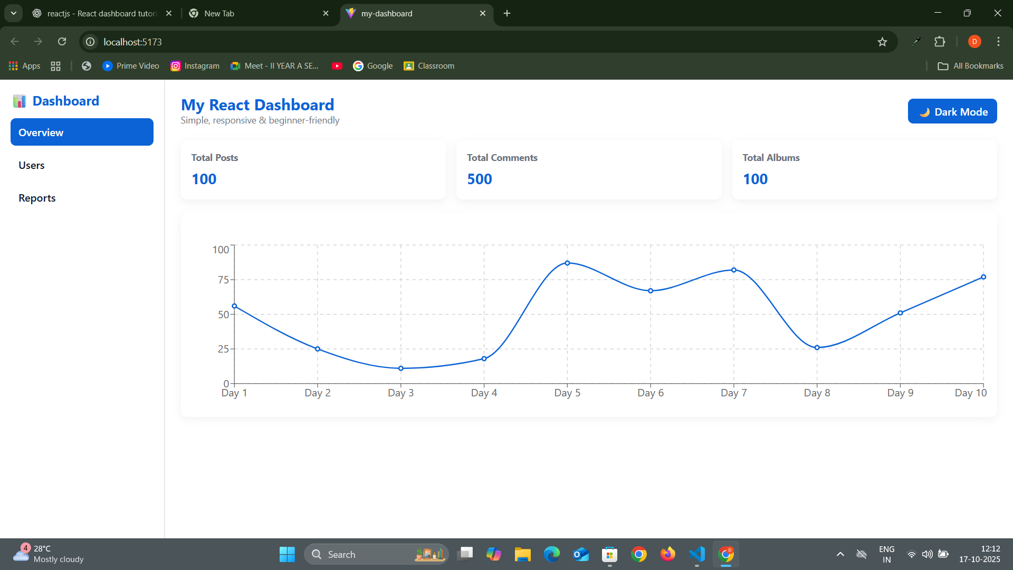
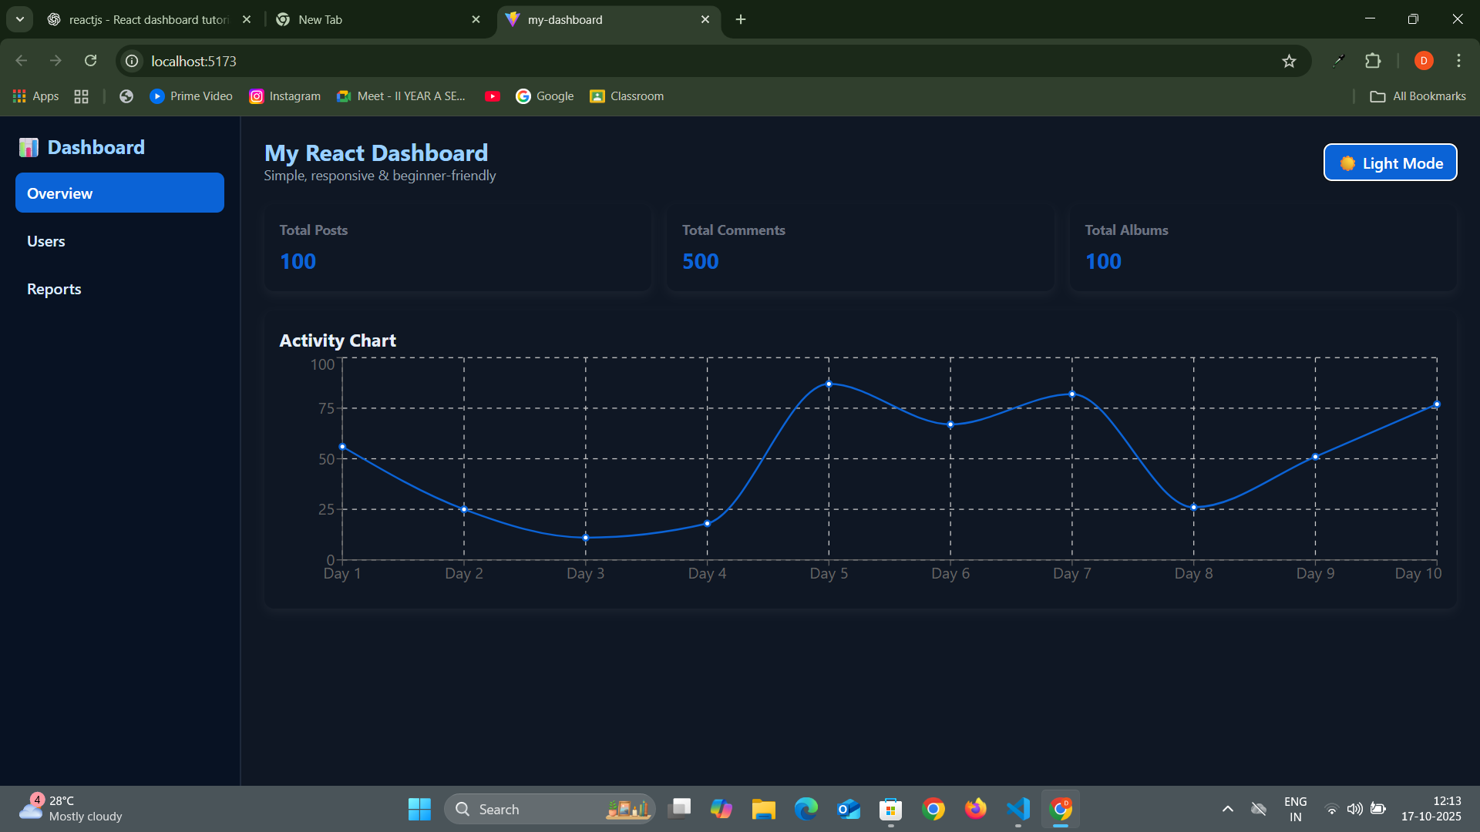
Final Demo

Slide 15
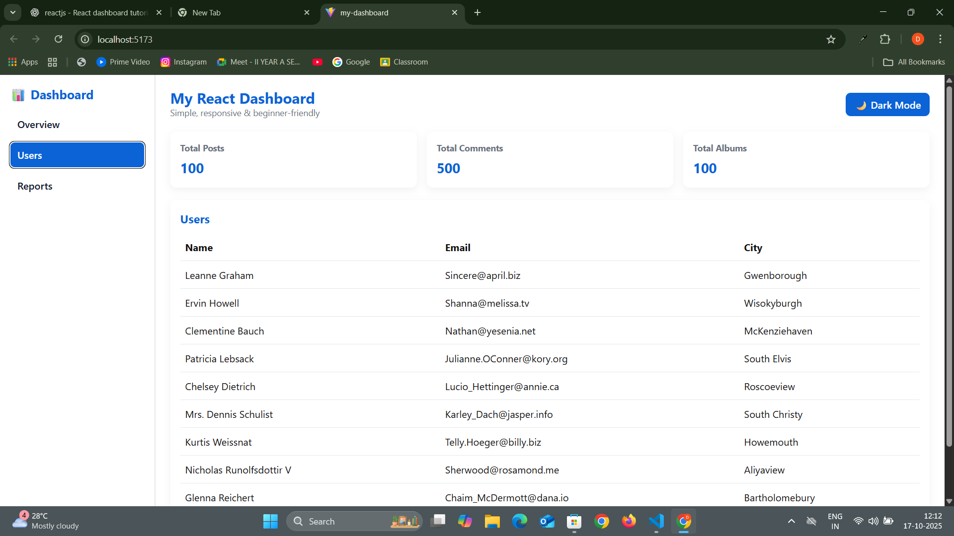
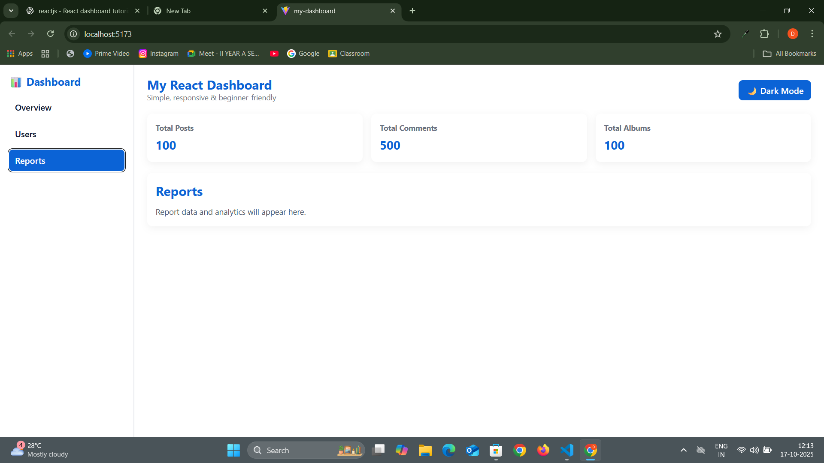

Slide 16
Thank You 🙏
Created by Maneeswaran 📧 manees444waran@gmail.com 💻 React JS | CSS | REST API

