Slide 1
B. Tech ECE FINAL YEAR PROJECT -FINAL REVIEW
Energy Saving using Automated Street Light System
Using an Arduino based IoT controller for Smart lighting which helps save energy compared to regular street lights.
-Maneesh Busi
16BEC0710
Supervisor: Guide:
AV Satish Kumar Elizabeth Rufus
Senior Vice President-Engineering Professor
Quantela Technologies,Hyderabad Department of Sensor and
satish@quantela.com Biomedical technology

Slide 2
CURRENT STATUS AND MOTIVATION
(Literature survey and identifying the gap)
Smart lighting is a lighting technology designed for energy efficiency. This may include high efficiency fixtures and automated controls that make adjustments based on conditions such as occupancy or daylight availability. LED bulbs, including smart lights, are much more energy-efficient than older incandescent bulbs.
Automating them using MQTT and an ambient light sensor will further reduce the costs and can be controlled from farther distances.

Slide 3
HARDWARE /SOFTWARE DETAILS
Arduino MEGA
NodeMCU
LEDs
IR sensors
Ambient light sensors (LDR)
Node-red software
Cardboard model of city

Slide 4
OBJECTIVE
To make a small-scale city model with automated street lights.
To save power and money by automating street lights using an Arduino based IoT Controller using MQTT protocol.
To provide a manual access module incase the ambient light sensor is not accurate or is facing some issues.

Slide 5
METHODOLOGY
The command to turn on/off the light is given to the cloud manually by the web app.
The intensity of light emitted is controlled by the ambient light sensor. The sensor also sends data to the cloud.
The infrared sensors are used to detect vehicle movement.
When a vehicle passes the intensity of the light increases, when it leaves the light intensity decreases according the light sensor reading.
If “ldr” is the reading from the sensor then the intensity given to the street lights is:
y=255-ldr

Slide 6
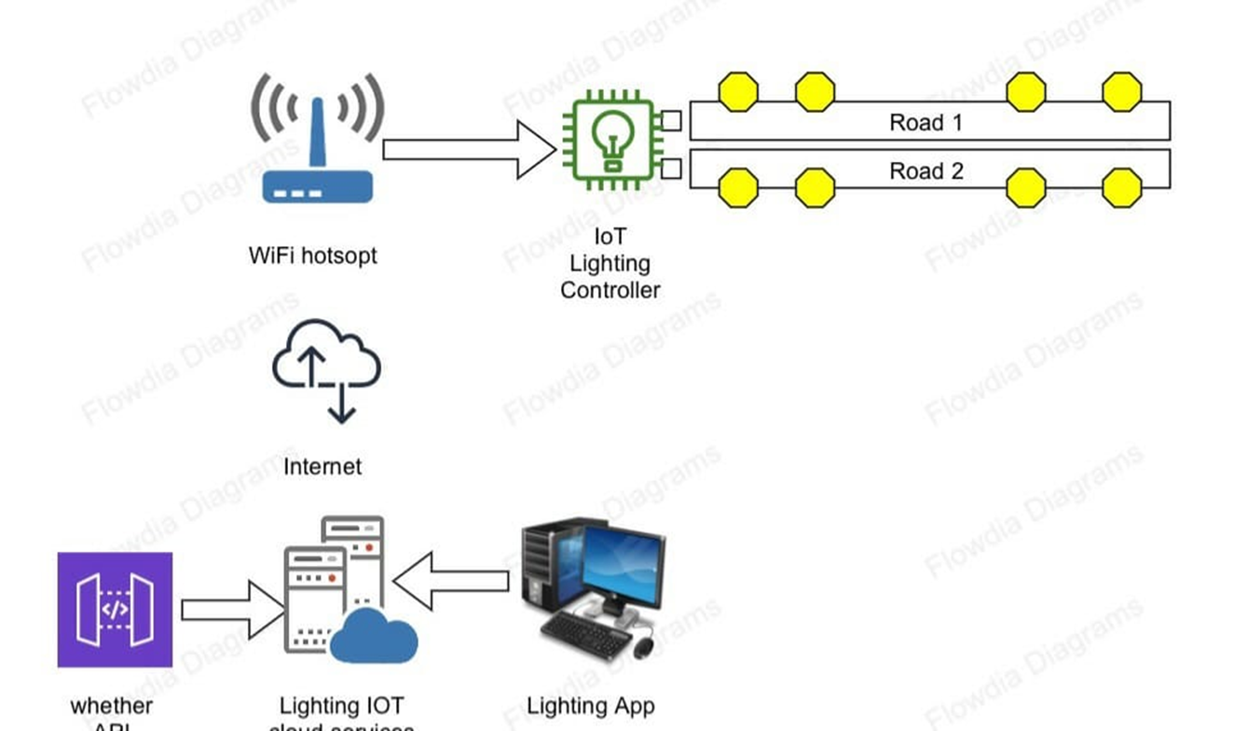
METHODOLOGY
By using a online development tool called node-red, we can make use of the mqtt protocol to send messages from the laptop to the Arduino and vice versa. This can be used to manually switch off the LEDs, and to record the light intensity .

Slide 7
RESULTS
The lights change intensity based on the readings taken from the ambient light sensor.
The infrared sensors installed control the lights too. When a vehicle passes then the lights have a greater intensity. When the vehicle leaves the lights go back to a lower intensity(based on the light sensor)
Manually controlling the lights is also possible but a little slow due to the lag.

Slide 8
CONCLUSIONS
From this we can conclude that it is possible to automate lights to an intermediate degree using only an Arduino microcontroller and ESP module(to connect to the internet)
The new automated lighting system consumes almost 85% less power compared to normal street lighting systems.

Slide 9
SCOPE FOR IMPROVEMENT
We can further improve this project by incorporating a weather API to get timings of sunset and sunrise of that day. This will help the switch the lights on and off based off of these timings.
We can also incorporate a machine learning module using raspberry pi and pi camera to detect the presence of an ambulance so that the next lane can make way for it.

Slide 10
OUTCOME OF IMPROVEMENTS
Successful with incorporating weather API to the project, but weather API was giving out wrong timings so it was not included in the project.
Tried the machine learning algorithm into training a raspberry pi to recognize ambulances, but the processing power was not enough. There was a delay in the functioning of the rest of the project because of the machine learning part.
Created a website for a custom dashboard that plots the light intensity values and also lets the user to control the lights manually.

Slide 11
TIME LINE (Dec. to April 2020)
January- Learning about the MQTT protocol and using it to connect the Arduino to the internet to receive its commands
February- Creating the Web App to manually control the IoT controller and using an ambient light sensor to control the intensity of the lights..
March –Using a weather API to get information about sunset and sunrise to automate the street lights. Using raspberry pi to create a machine learning algorithm to recognize an ambulance.
- Making a draft of the report.
April- Debugging and submission of final thesis.

Slide 12
REFERENCES
https://ieeexplore.ieee.org/document/6518523
https://ieeexplore.ieee.org/document/8389131
https://ieeexplore.ieee.org/document/8630735
https://ieeexplore.ieee.org/document/6072726?arnumber=6072726

