Slide 1

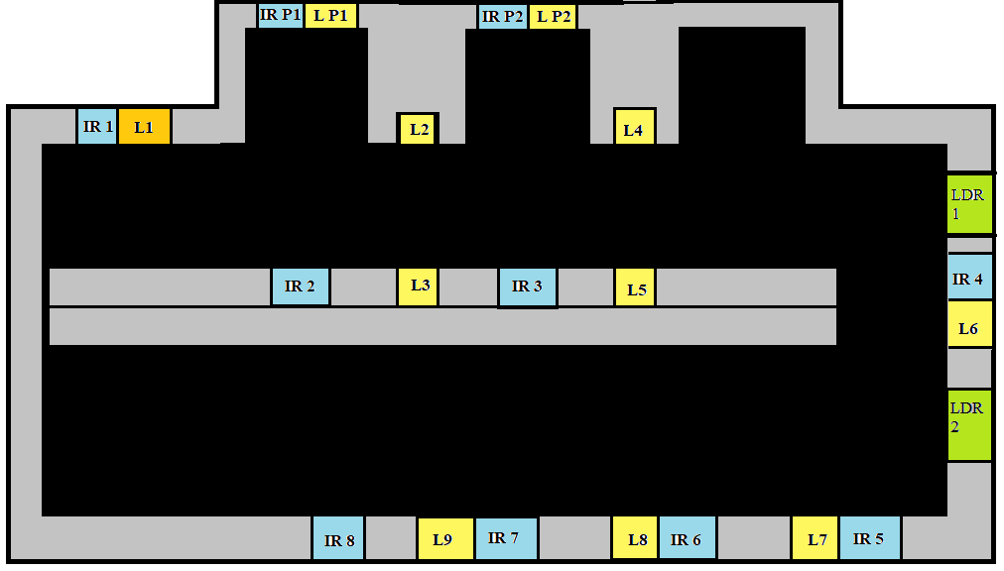
Energy saving using Automated Street Lighting System
Maneesh Busi| Prof. Elizabeth Rufus | SENSE
Motivation/ Introduction
Automation’s main goal is to reduce manual labor or man power with the help of intelligent systems so that humans can be used for more creative and thought-based work instead of physical work. But usage of machines usually requires a lot of electrical power. So one of the main considerations when automating a particular system is cost effectiveness and power consumption.
SCOPE of the Project
The main aim of the project is Automatic street power saving system using Ambient Light resistor and Infra-red sensors. We can save power automatically using this system instead of someone manually doing it. So it’s also cost effective. Nowadays, in the whole world, street lights consume enormous electric energy. The number of street lights is not known accurately, but it is said that one hundred million or one billion street lights exist in the whole world. If one hundred million street lights exist, each street light consumes 20W and a half of all street lights always turn on in the whole world, 8760GWh electric power, which is about 0.8% of annual consumption of electric power in Japan. In the future, many developing countries will install many street lights and consume much electric power. Thus, to save electric power that is consumed by street lights is important to reduce greenhouse gases. Current street lights are controlled only by means of the embedded brightness sensors; they are automatically turn on when it becomes dark and automatically turn off when it becomes bright. This is the huge waste of energy in the whole world and should be changed. There are some attempts in which the energy wastes of the street lights are reduced. A sensor light, which is controlled by a brightness sensor and a motion sensor, is sometimes used to reduce wastes of energy. It only turns on for a while when the motion is detected in front of the light and it is dark. However, usually a sensor light is too late to turn on when pedestrians or vehicles come in front of it. The light should turn on before pedestrians or vehicles come. Ideally, it is desirable that smart street lights look like usual street lights; no one notices that smart street lights are usual street lights.
Fig. 1.1 Drawn Model
In lane 2, IR 5 triggers L7 and L8, IR 6 triggers L8 and L9 and switches off L7. And when the vehicle passes IR 7, L6 is switched off and L9 stays on. Finally, the vehicle reaches IR8 and switches off L9. Throughout this process, the LDR takes in the light intensity. The lights that are supposed to be “switched off” will decrease its intensity out based on the ldr value.
Results
LED street lights have a higher lamp life and lumens per watt consumed, making it ideal for street lights. And by using the system proposed in this project, we can further reduce the power consumption. The lights only turn on with full intensity when a vehicle passes by, so if there is a lot of traffic the lights would be at full intensity throughout but if we take a highway as an example, not many vehicles use a highway during night except for goods carriers. Let us take a single LED street light that consumes 60W of power per hour at full intensity. If it is turned on from 6pm to 6am then it consumes 720W of power. If this system is implemented, then when there are no vehicles the street light will be at 40 to 50% brightness depending on its surroundings, because if it is located near a city then the city lights would illuminate the road and the sensor will record a higher light intensity causing the LED street light to glow at 20% or less intensity. So, if we assume it goes down to 40% i.e., 24W of power. Depending on the number of vehicles passing through the number of times it burns with full intensity changes. The best-case scenario is that no vehicles used the road that night which means only 288W were consumed which is far less than 720W. And the worst case is that the road was really busy that night and the lights were always at full intensity which means it is at 720W. By this we can tell that the amount of power consumed will always be 720 or less, and the average power consumed will be 504W. The street lights we use today use 250W of power per hour. So, in a month the energy consumed by a single street light is 90kW. If we were to use the proposed system with automated LED lights then the average power consumed will be 21.6kW. Which is already 75% less than normal street lights. Using our system, average power consumed per night is 504W, so in a month it is 15.12kW.Therefore, by using the proposed system energy consumption can be reduced by almost 85%.
Methodology
The model consists of two lanes, the first being a parking space and the other a regular one-way highway. The parking space has two spaces available and there are ambient light sensors at the end of each lane. When switched on, the ambient light sensor detects the light falling on it, and calculates how much light intensity is required to light up the lane i.e., how much voltage is supplied to the street lights. The LDR detects the light and converts it into an analog value between 0 and 255. This value is then subtracted from 255 and stored. This Y value is then used to vary the intensity of the street lights. This is done using PWM pins on the Arduino Board. As this is happening, the infrared sensors (IR Sensors) are looking for objects (vehicles) that pass in front of them. When they detect a vehicle, the IR sensor sends a Boolean value to the Arduino and the arduino increases the intensity of 2 street lights, that come right after the sensor, to full intensity regardless of the Y value. One of the major drawbacks of an automatic light system is that it assumes that the vehicles are constantly moving without stopping in the middle of the road. But that is not always the case. It could be a medical emergency or maybe the vehicle broke down. If the car is stopped right next to the sensor i.e., blocking the sensor then the street light will be on. But if the vehicle stops between two sensors, then most street lights would switch off after a while. This drawback is rectified. The Arduino board and the NodeMCU communicate serially with short messages. For example, to switch on light 1 from lane 1 the NodeMCU sends the message L11O, which means lane 1, light 1, ON. To switch it off we send L11F. The messages sent through MQTT are even shorter as we don’t have to specify the lane in the message. The topic to which the message is sent to tells us the lane number. The light levels are communicated by sending the data in a JSON Format from arduino to NodeMCU via serial communication line. Then the NodeMCU sends it to the server using MQTT protocol and the website plots the data in real time. There are 4 different html files that can be rendered. Namely, the home page or the dashboard, the control page for lane 1, lane 2 respectively and the contact page. The Paho-MQTT library for JavaScript is used to receive the data i.e. the LDR readings of both the lanes and are plotted in real time. The control pages have “buttons” that are used to send messages using the MQTT-protocol to the Arduino board to switch on the street lights. Fig 1.1 is the drawn model of the project.
IR denotes the infra-red sensors, L denotes street lights and LDR is a light dependent sensor. When the IR sensor is triggered, it switches on the light that is next to it and switches on the light that is before it. The vehicle passes from IR 1 to IR 4 in the first lane and then turns into the second lane. In the first lane, IR 1 triggers L1, IR 2 triggers L2 and L3 and IR 3 triggers L4 and L5.
Conclusion/ Summary
The performance of the QAM modulation in FSO systems is analyzed with the ASEP parameter. For different values of the atmospheric turbulence, ASEP is analyzed with respect to the average SNR. For the weak atmospheric turbulence conditions, we used the log normal channel model for implementation of the system. The output observed was that ASEP is increasing with the length of link and decreasing with SNR. For the moderate and strong turbulence observed, as the difference a−b grows smaller, a significant improvement in the error performance is obtained. The final work contains the Double gamma model. Here the work is done for the weak turbulence model. This model showed an ASEP in the range of 10⁻¹² which is indeed showing a better performance than the above two models.
Contact Details
moses.maneesh@gmail.com
Acknowledgments/ References
1) https://ieeexplore.ieee.org/document/6518523
2) https://ieeexplore.ieee.org/document/8389131
3) https://ieeexplore.ieee.org/document/8389131
4) https://ieeexplore.ieee.org/document/6072726?arnumber=6072726

