Slide 1
Secret Word Puzzler
Name :G.MANEESHA
MSSID :MSS2019031

Slide 2
Introduction
It is a simple word guessing game. Based on the given hints we will guess the hidden word letter by letter. We have to guess the word within the limited number of attempts. For every wrong guess player will lose the attempt.

Slide 3

Technologies used:
Python3
Module:random module

Slide 4
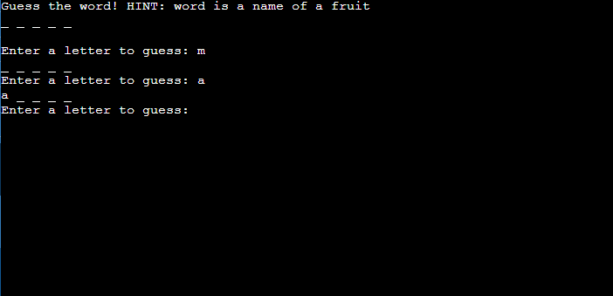
Input format:
We have to enter one letter at a time.

Slide 5
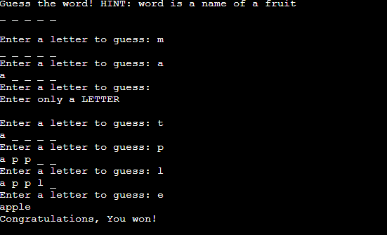
Output format:
On the console the output will be shown.
If we guess the word then on the console it will show “congrats”.
It we fail to guess the word then it will show “Try again”.

Slide 6
Overview:
It is developed by using python language. It is user friendly game. The python random module plays an important role in this game development. This game enhances our vocabulary and test our word recognition skill. This is a good learning and fun game for all age people.

Slide 7
Learnings:
Random module in python
Handling different types of Exceptions in python

Slide 8
Thank You

