Slide 1


Slide 2

TEAM MEMBERS:
R.MADHUMITHA(22BFA33201)
P.MANEESHA(22BFA33196)
K.LEELA(22BFA33153)

Slide 3
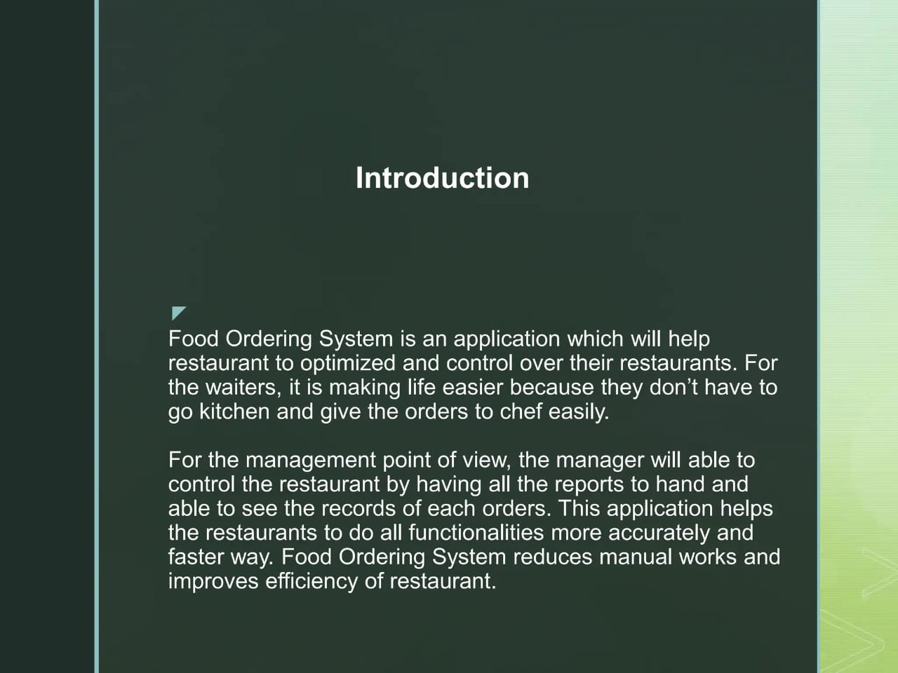

Slide 4
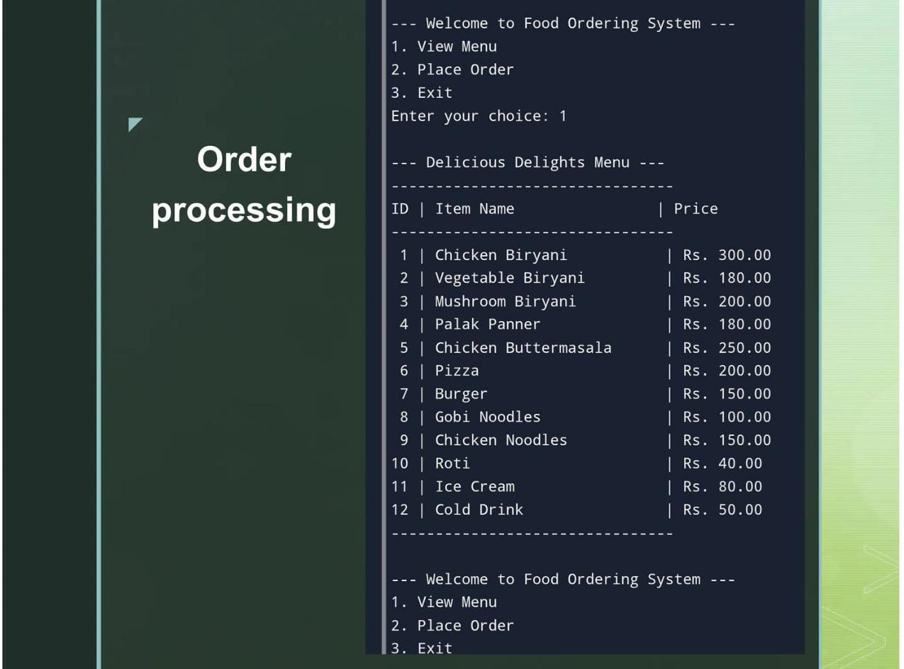

Slide 5
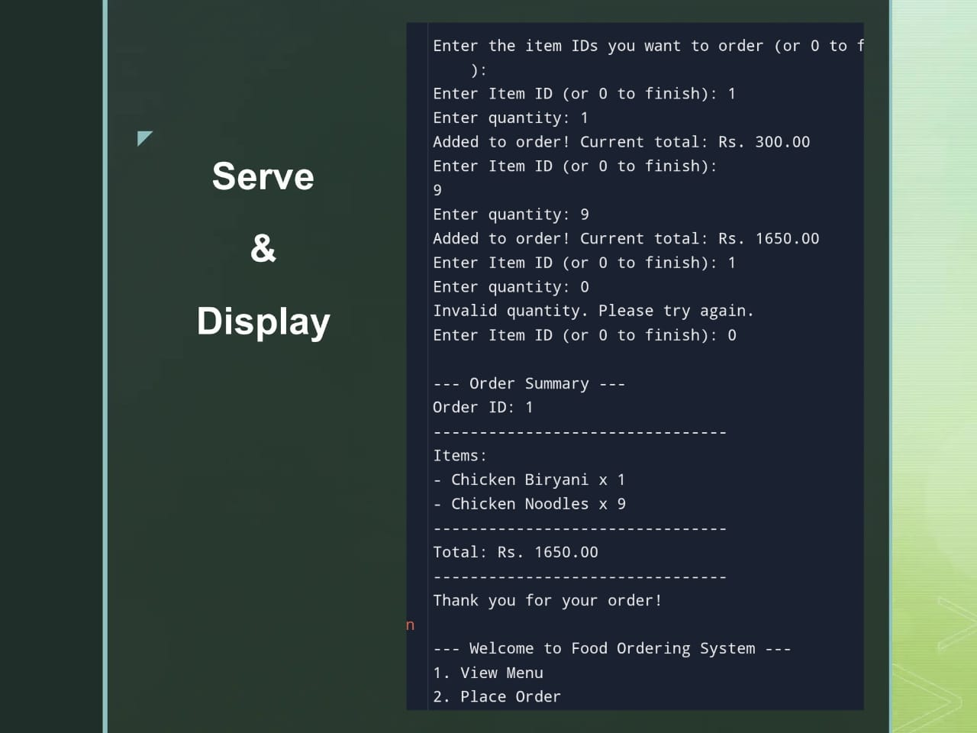

Slide 6
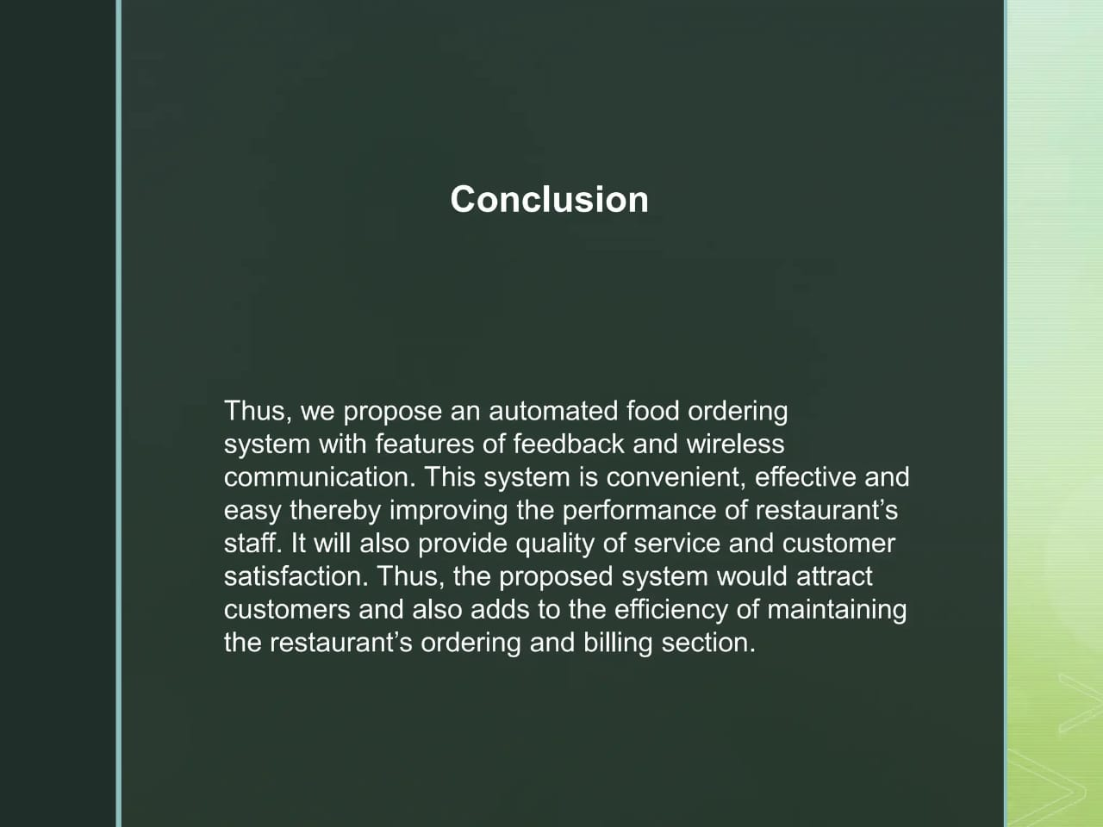

Slide 7


