Slide 1
MFRP
Sales System for Automobile Company.
TOPICS:
Summary
SPFx Part
Invoice Monthly Report
Security
Deployment
BY
MANEESHA CHEBROLU
(845142)

Slide 2
SUMMARY
Created sales system for automobile company.
Customer List:- Created one customers list on the team site. created columns like Customer ID, Customer Name, Customer Email Address. Added Validation in the list forms by using Pre Save Action method.
Products List:-Created one Product list on the team site. created columns like Product ID, Product Name, Product Unit Price, Product Expiry Date & Product Type. Added Validation in the list forms by using Pre Save Action method.
Orders List:-Created one Orders list on the team site. created columns like Order ID, Customer ID, Product ID, Unit Sold, Unit Price, Sale Value & Order Status Added Validation in the list forms by using Pre Save Action method.

Slide 3
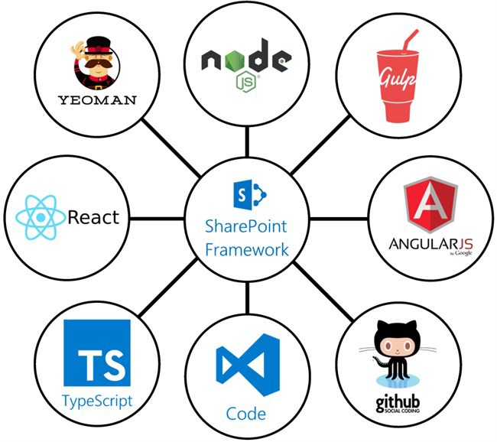
SPFx Part(Order Form)
Created order form for add, update, delete items from the order list.
The SharePoint Framework (SPFx) is a page and web part model.
Here, To build SPFx webpart we have used ReactJS.
Used SPFx for creating the order form. Added Add function , Edit function, Delete Function. Added HTML part in the .tsx file for client side part. Used dropdowns which will auto populate the rest form. Customised the form by using .SCSS file. added CSS code and used classes for customisation.

Slide 4
SPFx Part
Commands that are used for the SPFx Project creation.
1.To create a directory for SPFx solution
md firstspfx-webpart
2. To navigate to above created directory
Cd firstspfx-webpart
3. Run Yeoman SharePoint Generator to create the solution
yo @microsoft/sharepoint
4.To execute
Gulp serve

Slide 5
Invoice Monthly Report
Created flow from power automata by using which when item will be added the mail will be send to the sales manager for approval or rejection. This part will trigger when the sales value will be greater than 1,00,000/-. If the sales value is less then 1,00,000/- then the order status will update as completed and Invoice will be sent to the Consumer who made the request.
Created another flow for generating monthly report. The report will get update after every one hour and the data from the order list will get auto populate in the excel sheet in the form of report.

Slide 6
SECURITY
Created two security groups in the admin of SharePoint.
ADMINISTRATOR:-Created this group and added the user. Gave the full access to the administrator group. Means they can delete, edit the lists. They can do anything. Generally site owners are added in this group.
SALES USER:-Created this group and added a user. Gave only contribution access to this group. The members of this group can only read the lists. They will not be able to delete or edit anything.

Slide 7
Deployment
Clear the temporary folders and files created in the solution.
gulp clean
•Build compiles the code and creates the necessary temporary files and folders.
gulp build
•Bundle task will generate the scripts required to run the web part on the site.
gulp bundle --ship
gulp package-solution –ship
.Sppkg file palys a main role for deployment webpart in sharepoint online.
Webpart deployed succefully completed, then the we can publish our webpart easily.

Slide 8
THANK YOU

