Slide 1


A PROJECT ON
JOB PLACEMENT PREDICTION

Slide 2
Scope of the problem
Can you monitor past data using machine learning to predict whether the candidate gets placed or not ?
This dataset is downloaded from Kaggle:
https://WWW.kaggle.com Kaggle
This dataset contains the information of
13 columns and 215 rows which is very less data.

Slide 3
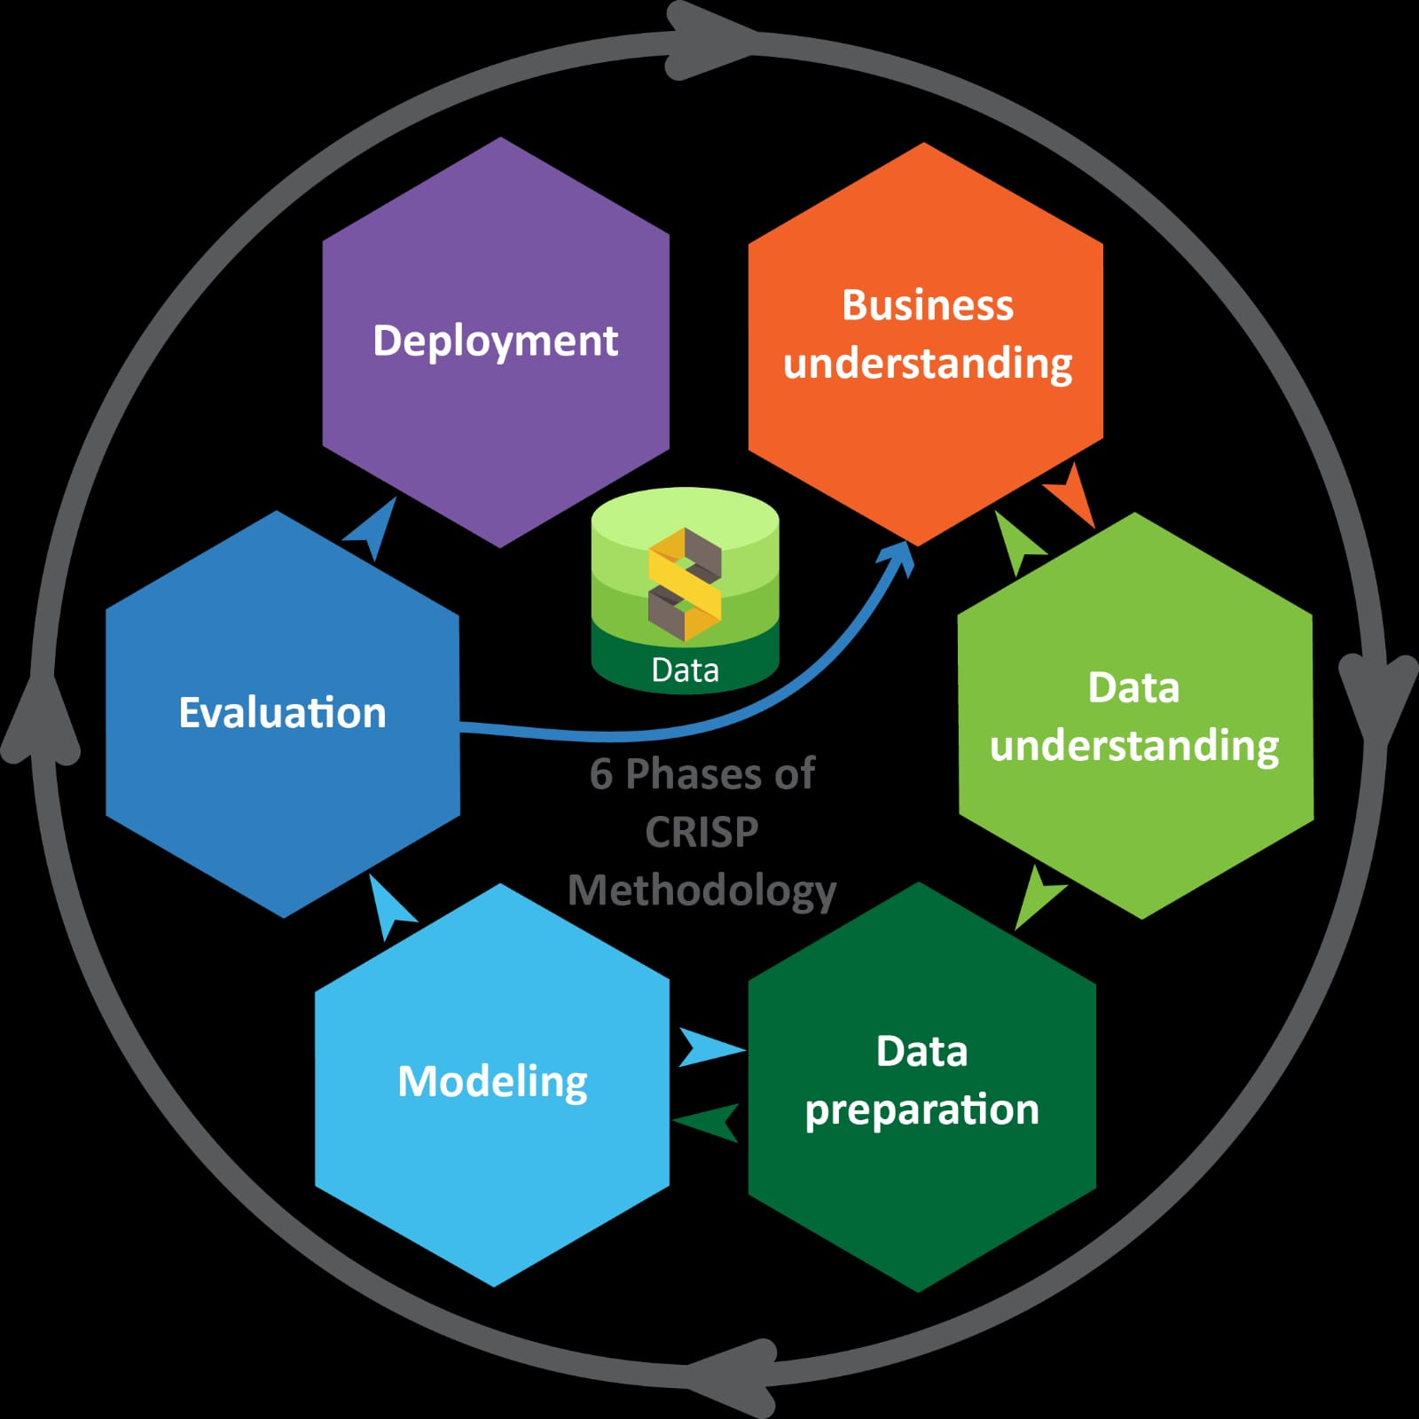
Phases of CRISP -DM Methodology
1.Business Understanding :
Business objective
Project plan
2. Data Understanding:
Collect, describe and explore the data
Quality verification
3.Data Preparation :
Relevant variables
Data formatting
4. Modelling :
Model selection
Assess the model
5.Evalution :
Evaluate and review the process
6. Deployment :
Monitor and maintain the plan

Slide 4
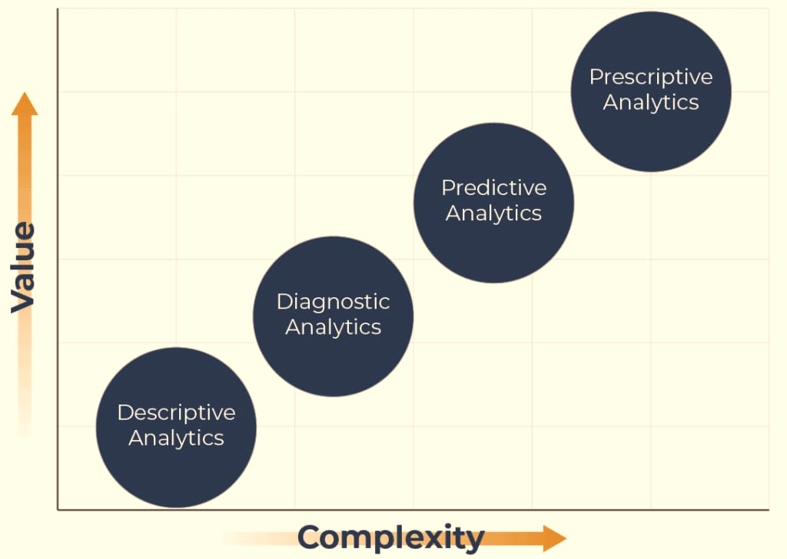
DATA ANALYTICS
How can we make it happen?
What will Happen?
Why did it Happen?
What Happened?

Slide 5
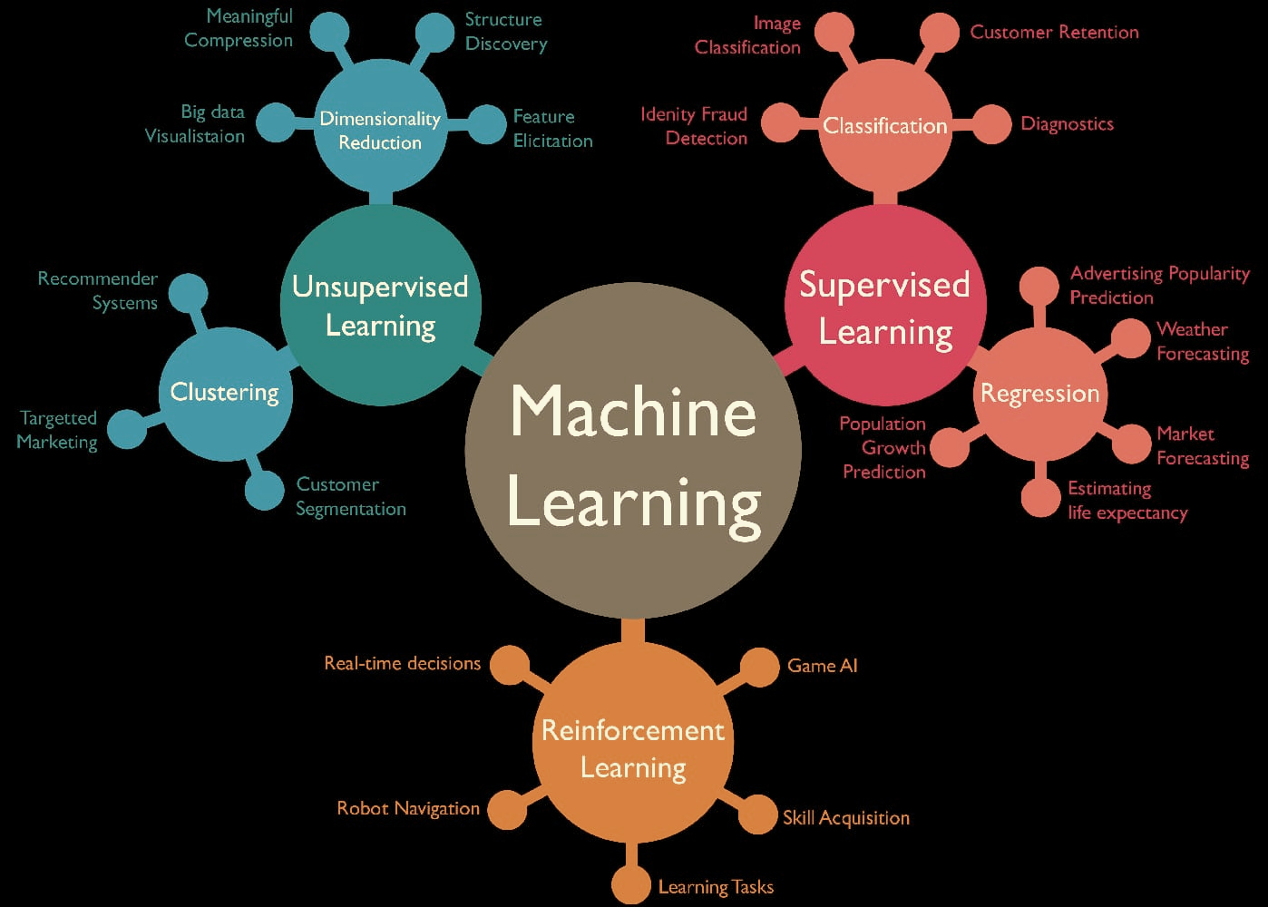
TYPES OF MACHINE LEARNING
V

Slide 6
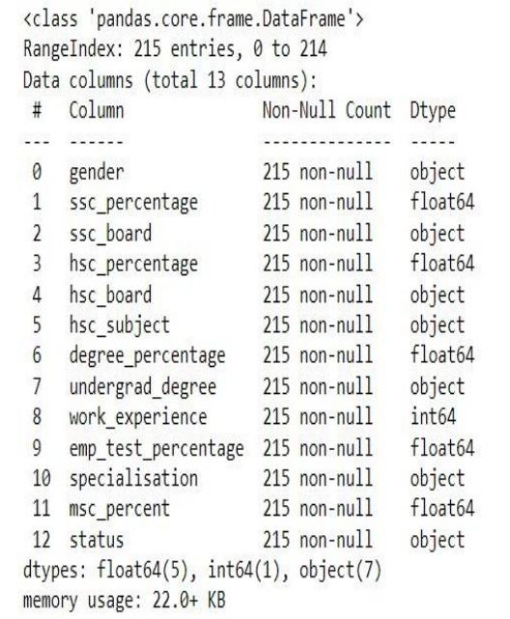
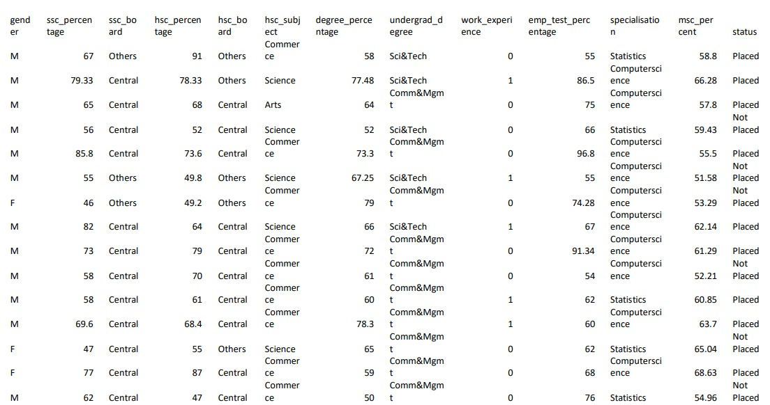
APPROACH OF THE PROBLEM
Structure of Datatypes
Dataset

Slide 7
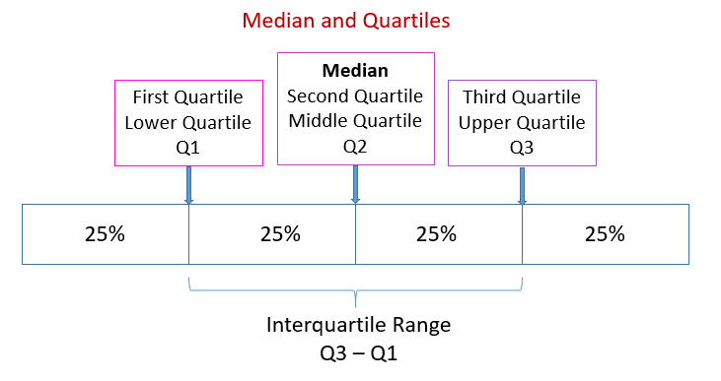
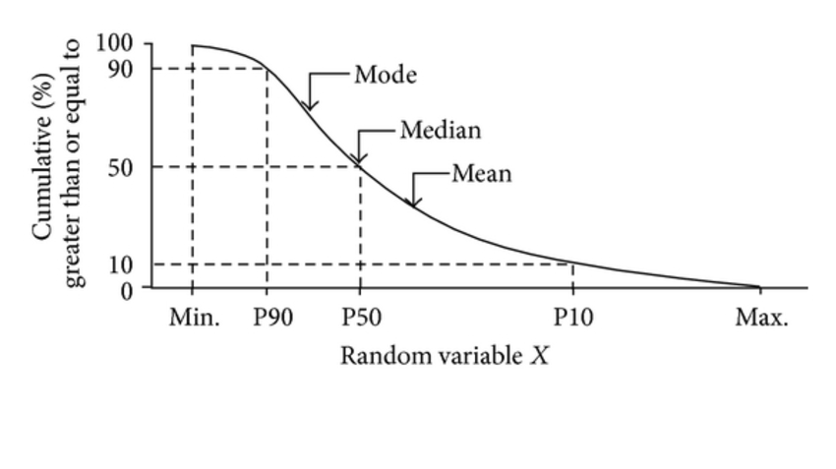
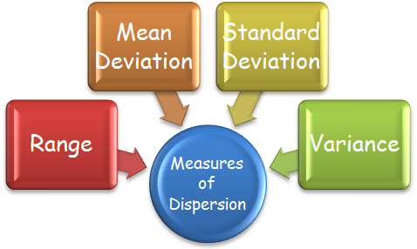
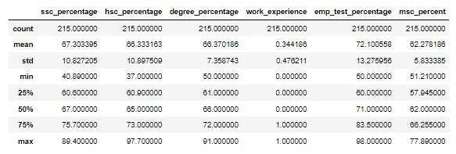
UNDERSTANDING THE DATA USING DESCRIPTIVE STATISTICS
Measures of Central Tendency and Measures of Dispersion

Slide 8
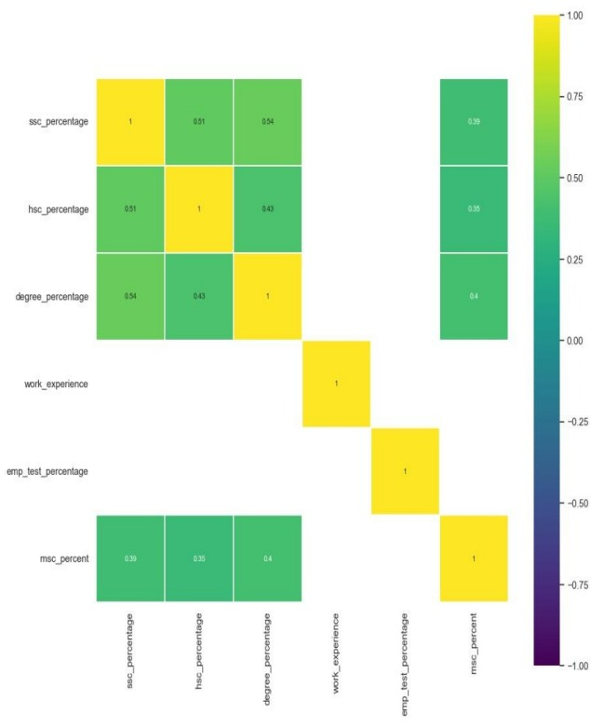
DATA VISUALIZATION
Correlation Plot:
Continuous Vs Continuous
Relationship between variables
Colour = Strength of relationship.
Correlation close to 1 : strong positive correlation
Correlation close to -1 : strong negative correlation
Correlation near to 0 : less or no correlation

Slide 9
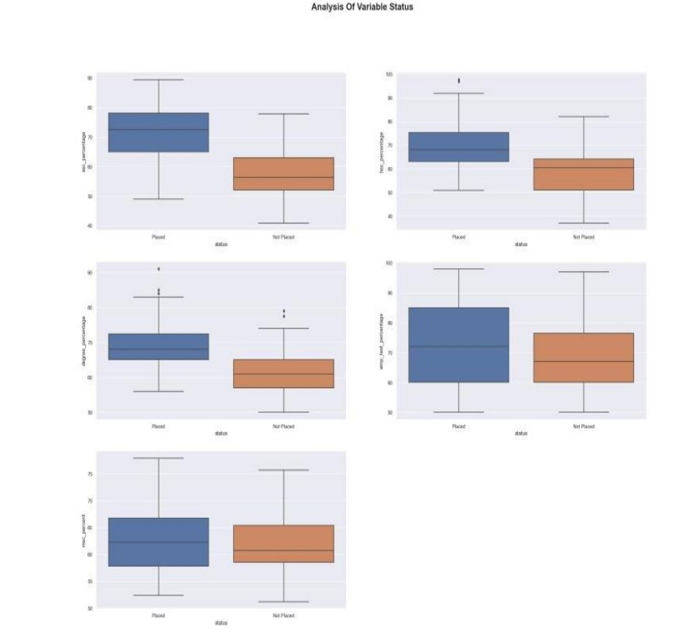
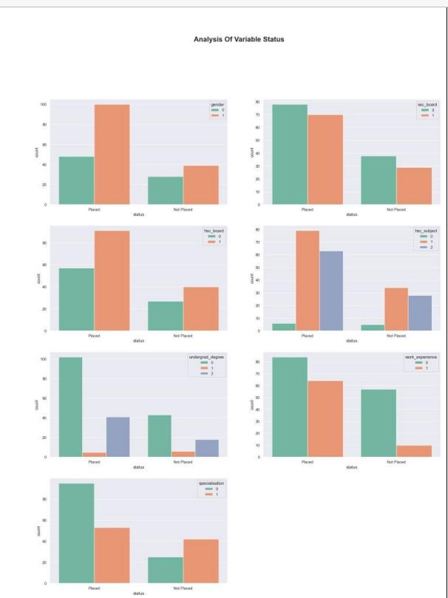
BOX PLOT (UNIVARIATE ANALYSIS)
ANALYSIS OF VARIABLE STATUS
(BIVARIATE ANALYSIS)

Slide 10
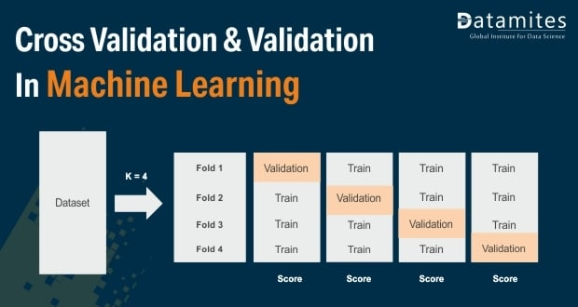
MODEL VALIDATION
Model validation is the process of evaluating a trained model on test data set. This provides the generalization ability of a trained model

Slide 11
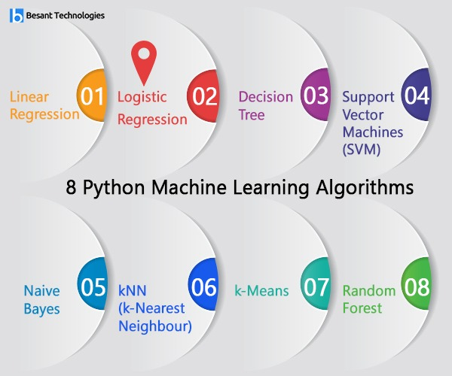
FITTING OF DIFFERENT MODELS

Slide 12
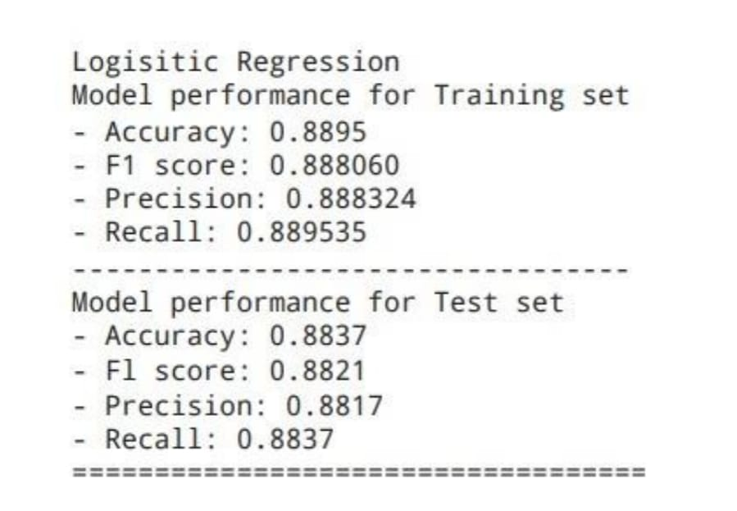
LOGISTIC REGRESSION
MODEL PERFORMANCE
Logistic Regression is one of the most popular machine learning algorithms, which comes under the supervised learning technique.
It is used for predicting the categorical dependent variable using a given set of independent variables.
Accuracy of Logistic Regression Model is 88%

Slide 13
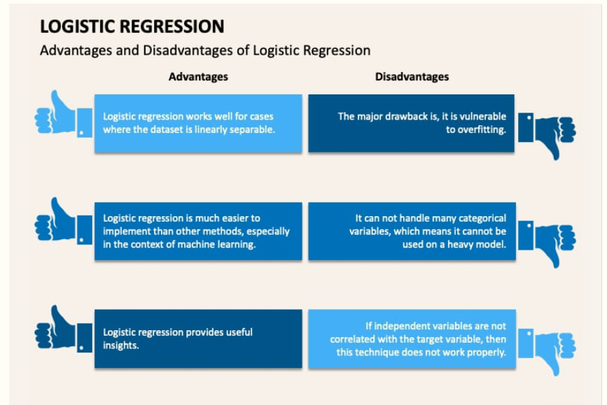

Slide 14
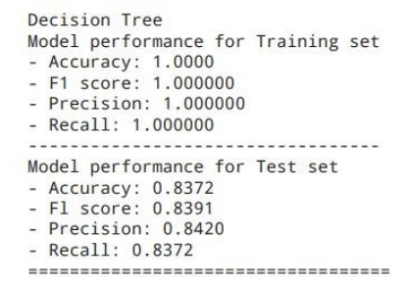
DECISION TREE
MODEL PERFORMANCE
A Decision tree is a type of supervised machine learning used to categorize or make predictions based on how a previous set of questions were answered.
The model is trained and tested on a set of data that contains desired categorization.
Accuracy of decision tree model is 83%

Slide 15
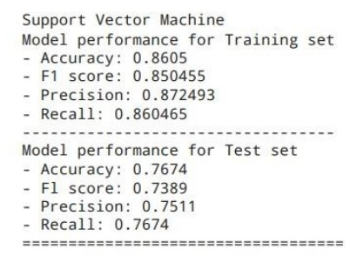
SUPPORT VECTOR MACHINE(SVM)
MODEL PERFORMANCE
Support Vector Machine or SVM is one of the most popular supervised learning algorithms, which is used for classification as well as regression problems.
Accuracy of Support Vector Machine is 76%.

Slide 16
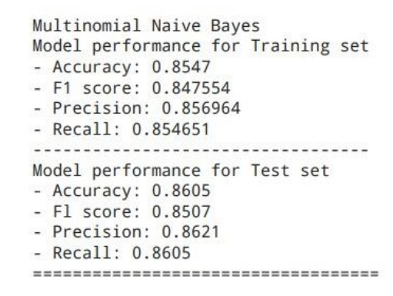
NAIVE BAYES
MODEL PERFORMANCE
Naïve Bayes classifier is one of the simple and most effective classification algorithms which helps in building the fast machine learning models that can make quick predictions.
It is based on Bayes theorem and is mainly used in text classification that includes a high-dimensional training data set.
Accuracy of Naive Bayes model is 86%.

Slide 17
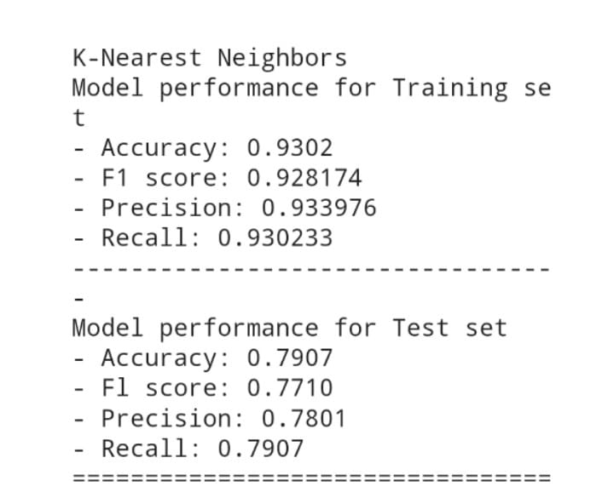
K-NEAREST NEIGHBOUR(KNN)
MODEL PERFORMANCE
K-Nearest Neighbour (KNN) method is simplest method in machine learning.
It is very simple and easy to understand and to implement.
This method has been wide applications in many domains like recommendation systems etc.
Accuracy of KNN Model is 79%.

Slide 18
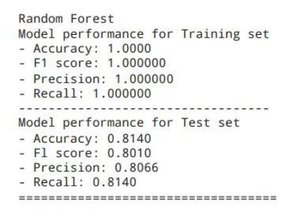
RANDOM FOREST
MODEL PERFORMANCE
Random Forest is a popular machine learning algorithm that belongs to supervised learning technique.
It can be used for both classification & regression problems in machine learning.
It is based on the concept of ensemble learning,which is a process of combining multiple classifiers to solve a complex problem and to improve the performance of the model.
Accuracy of Random Forest model is 81%.

Slide 19
CONCLUSION
• After importing our dataset, the first thing we have observed is there are 13 columns and 215 rows which is very less data.
• In our observation there are no missing values and outliers in our data as it is very small dataset.
• In our observation the people who got more than 60% in ssc, hsc, degree, employee test, msc percentage were only placed in the job.
• Next, Modelling comes into the sight we have used Algorithms like KNN, Navies Bayes, Decision Tree, Logistic Regression. Out of all these Logistic Regression Model performed well.
• The accuracy score of the Logistic Regression model is 88%

Slide 20
ACKNOWLEDGEMENT
I deem it a great pleasure to express my deep sense of gratitude and indebtedness to my research DMMLT Faculty Dr. M. VENUGOPALA RAO, data scientist, GM, for her valuable guidance, and enlightening discussions throughout the progress of my project work.
I also express my sincere and heartfelt thanks to Co-Ordinater KARANAM LAKSHMI, Department of Statistics, BBCIT for providing the necessary support and facilities in the department for completion of this work successfully.
It is indeed with great pleasure I record my thanks to Dr. DVNS MURTHY, Director General, Department of Statistics, BBCIT for having provided with all the facilities to carry out our work.
I thank all Non-Teaching members of the Department of Statistics, who helped me during my thesis work.
I am thankful to the BBCIT for permitting me to carry out this work.

Slide 21


