Slide 1
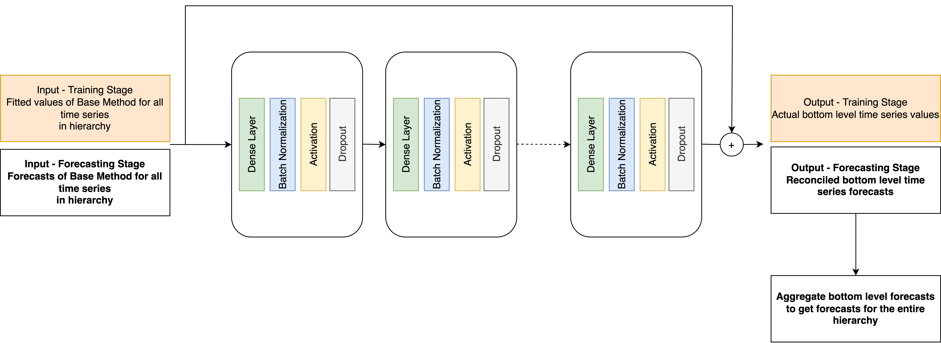
Proposed Reconciliation Network

Slide 2
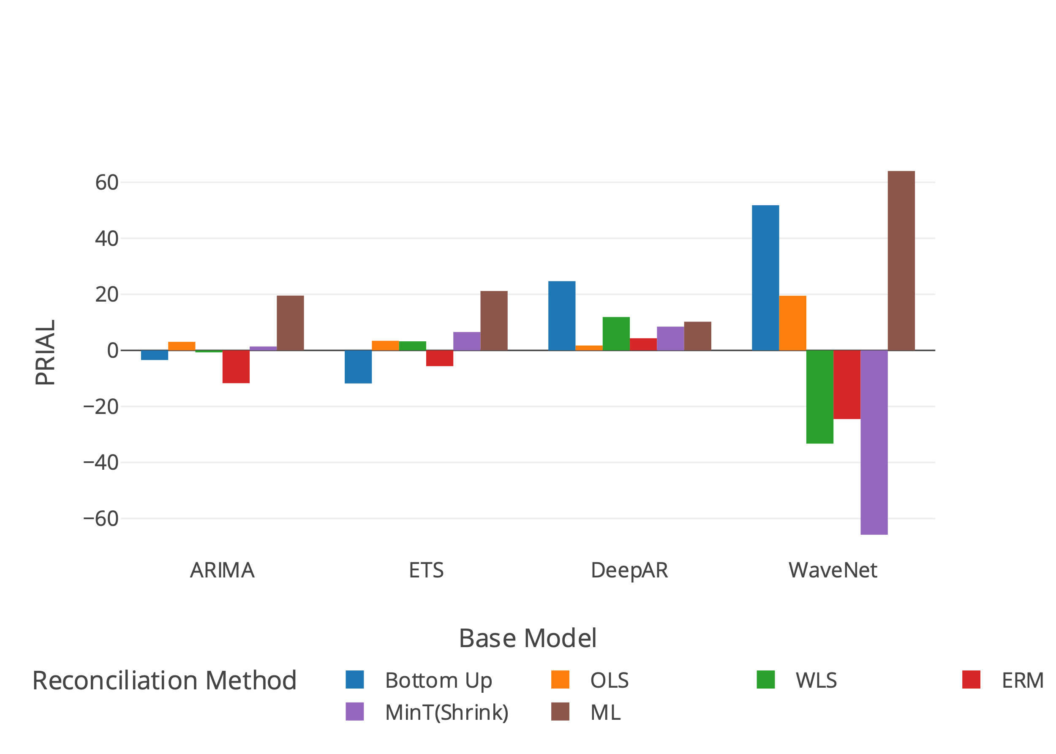
Results – Prison Dataset (Short Horizon)
Rank | ARIMA | ETS | DeepAR | WaveNet
1 | Proposed ML (19.55) | Proposed ML (21.18) | Bottom UP (24.70) | Proposed ML (64.01)
2 | OLS (3.05) | MinT(Shrink) (6.55) | WLS (11.90) | Bottom Up (51.81)
3 | MinT(Shrink) (1.38) | OLS (3.42) | MinT(Shrink) (8.47) | OLS (19.50)

Slide 3
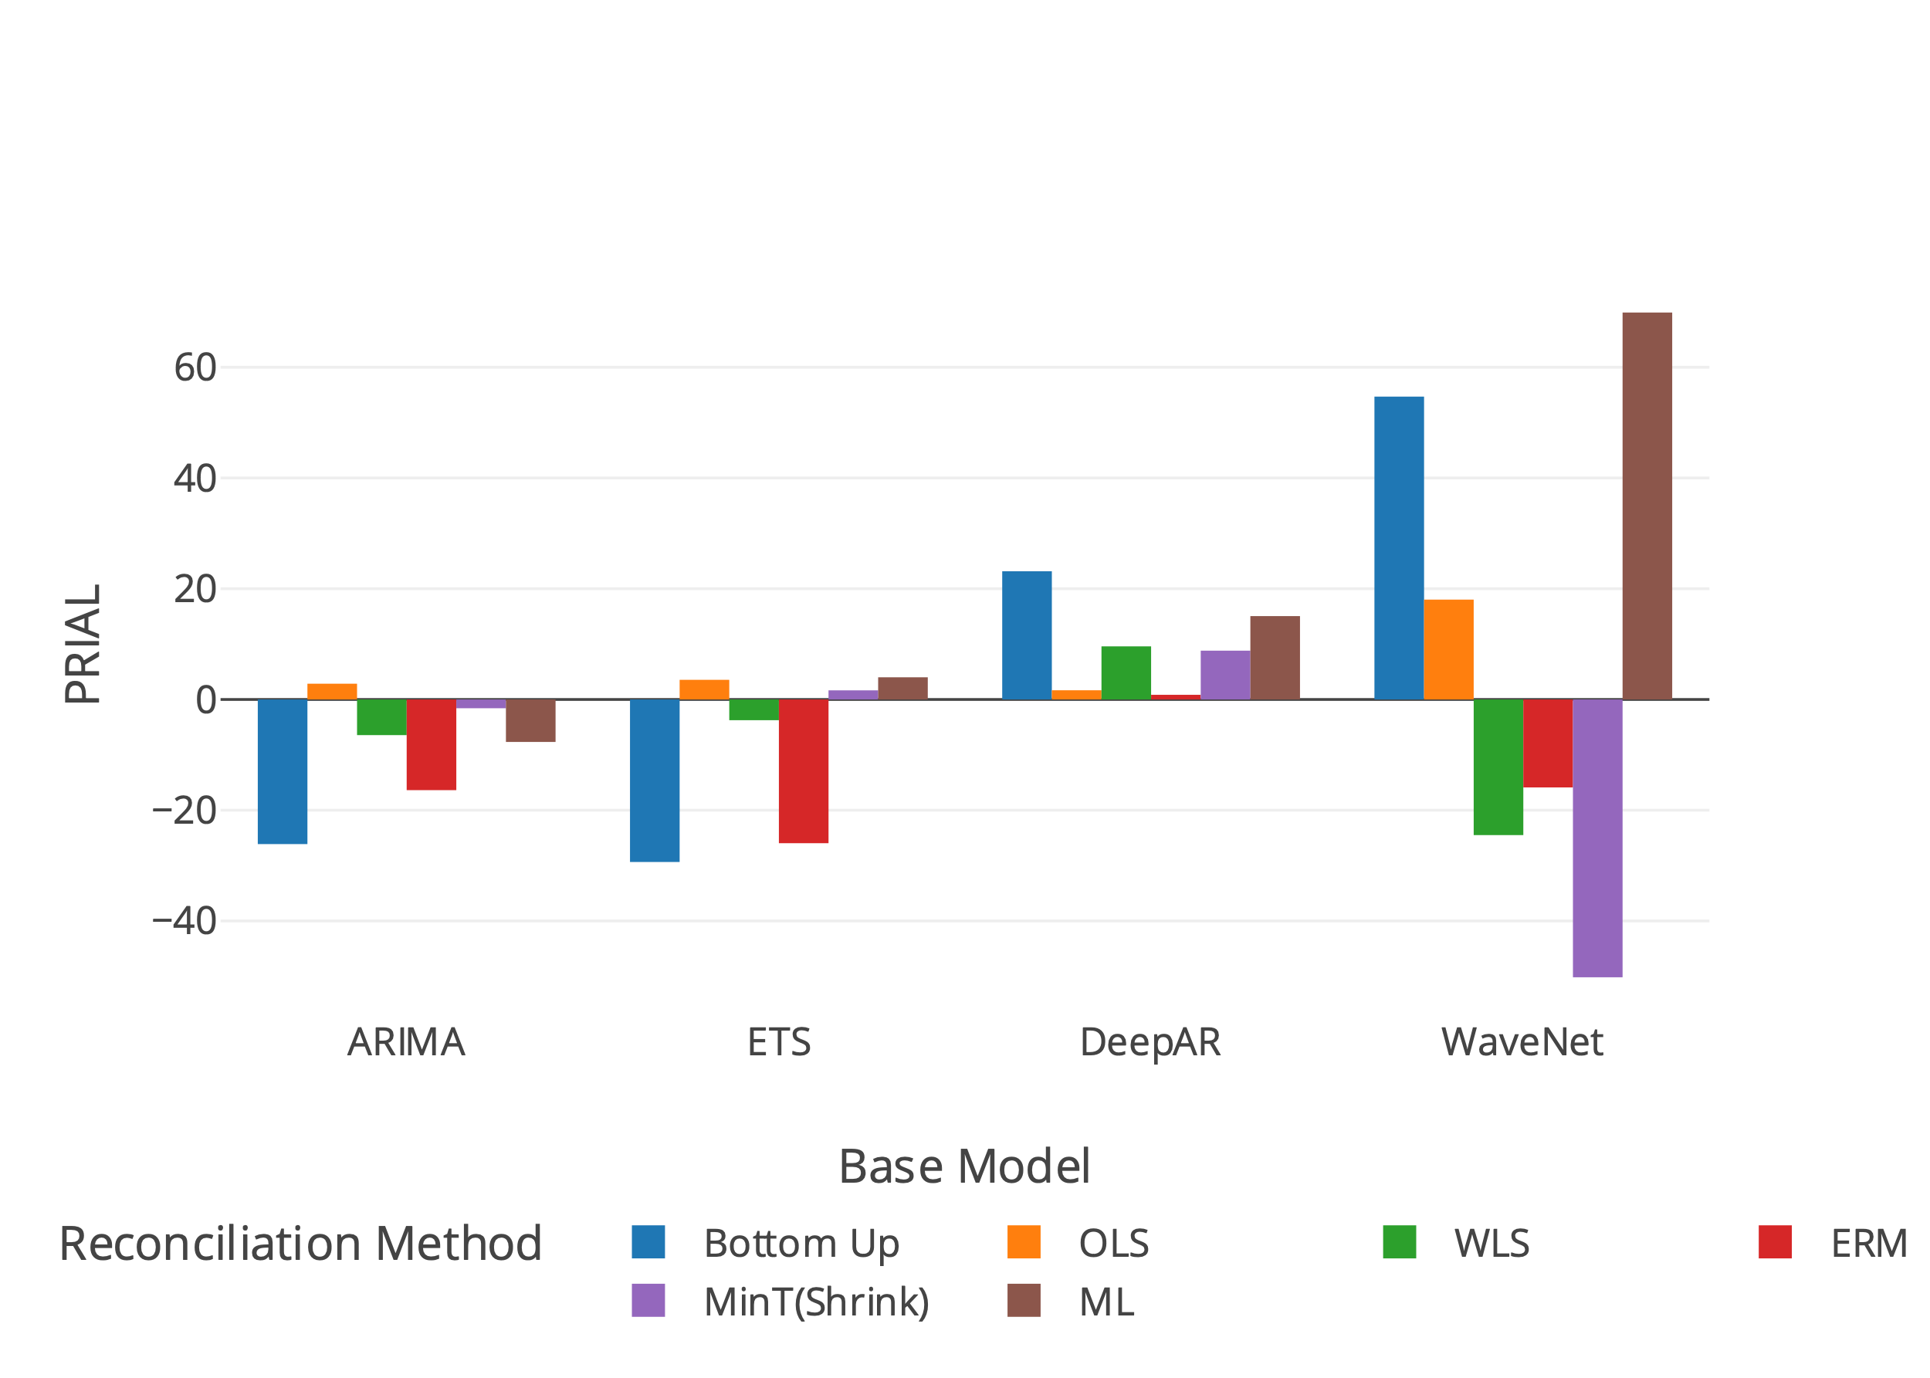
Results – Prison Dataset
Rank | ARIMA | ETS | DeepAR | WaveNet
1 | OLS (2.84) | Proposed ML (17.42) | Bottom UP (23.15) | Proposed ML (69.88)
2 | MinT(Shrink) (-1.59) | OLS (3.54) | Proposed ML (15.05) | Bottom Up (54.69)
3 | WLS (-6.44) | MinT(Shrink) (1.65) | WLS (9.58) | OLS (18.03)

Slide 4
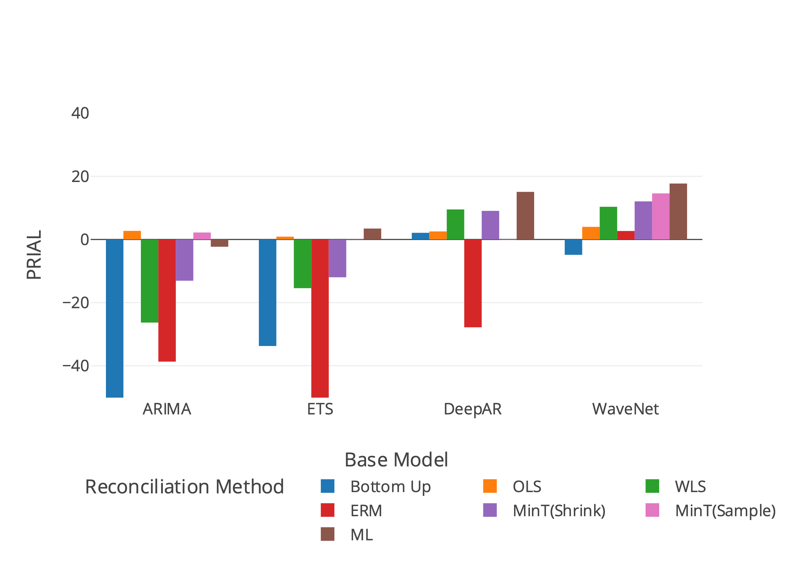
Results – Tourism (Short Horizon)
Rank | ARIMA | ETS | DeepAR | WaveNet
11 | OLS (2.72) | Proposed ML (3.46) | Proposed ML (15.08) | Proposed ML (17.72)
22 | MinT(Sample) (2.21) | OLS (0.89) | WLS (9.51) | MinT(Sample) (14.59)
33 | Proposed ML (-2.29) | MinT(Sample) (0.09) | MinT(Shrink) (9.06) | MinT(Shrink) (12.06)

Slide 5
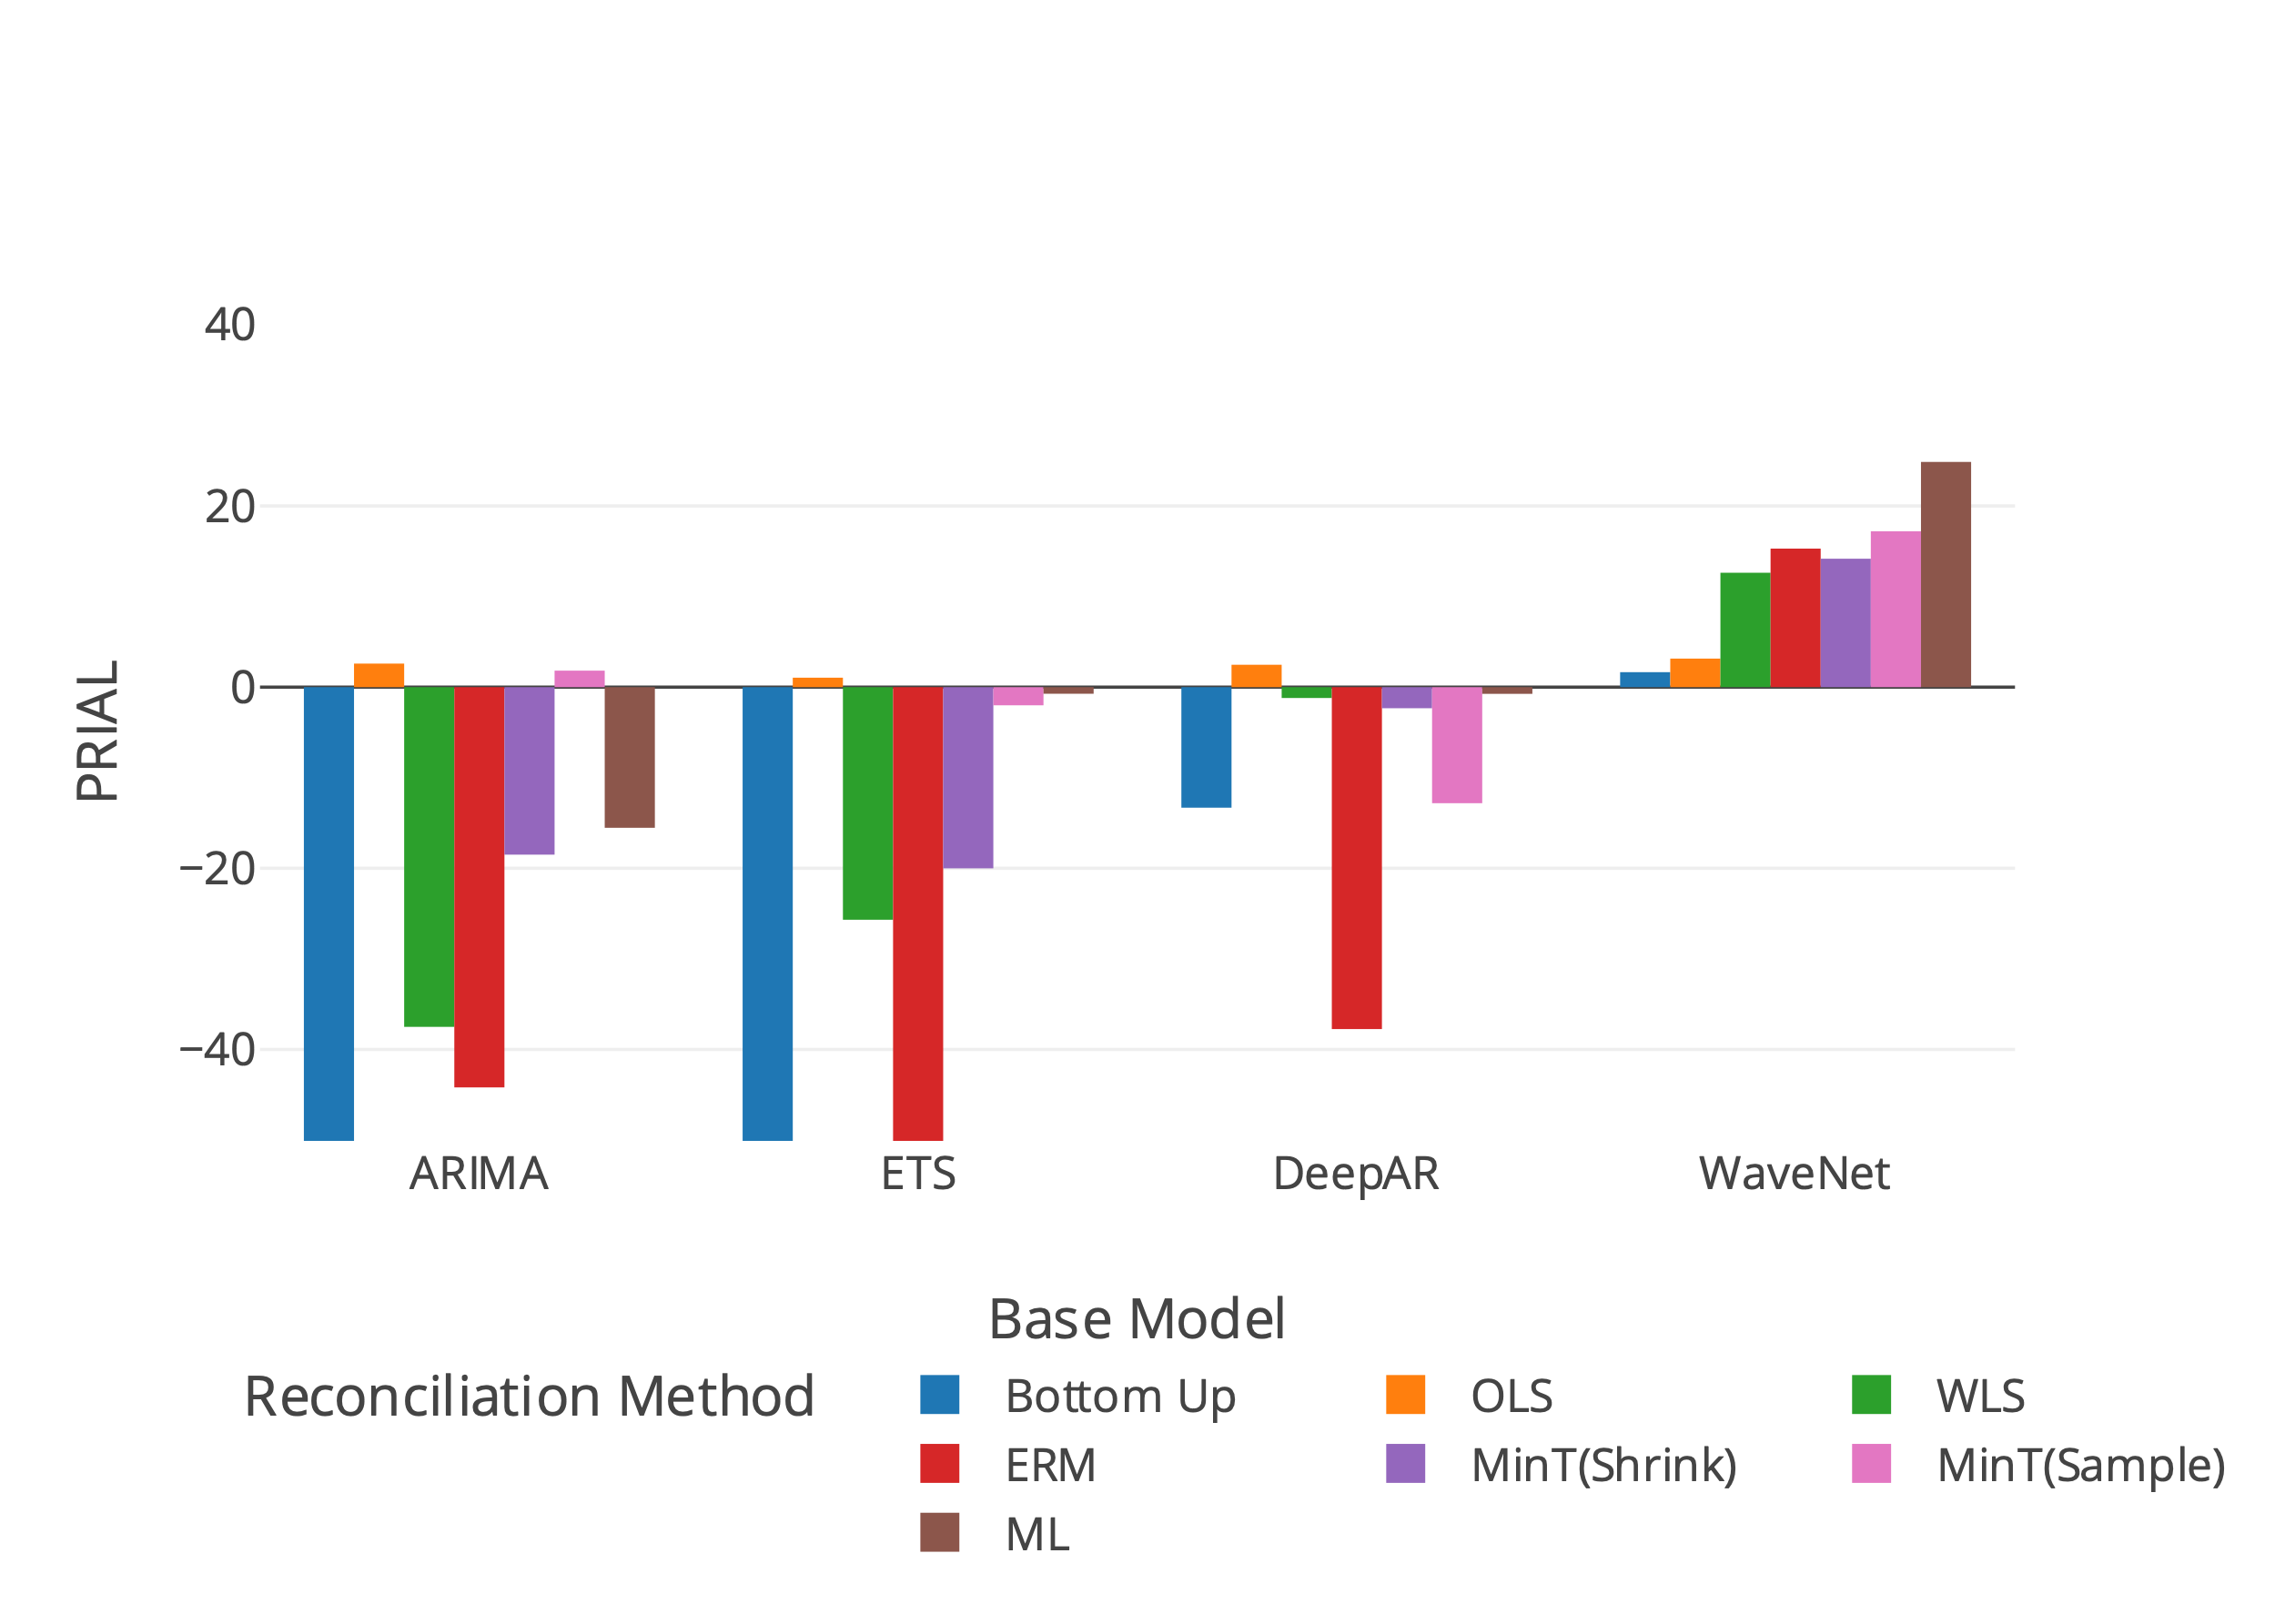
Results - Tourism
Rank | ARIMA | ETS | DeepAR | WaveNet
1 | OLS (2.59) | OLS (1.04) | OLS (2.46) | Proposed ML (24.86)
2 | MinT(Sample) (1.82) | Proposed ML (-0.72) | Proposed ML (-0.73) | MinT(Sample) (17.20)
3 | Proposed ML (-15.52) | MinT(Sample) (-2.01) | MinT(Shrink) (-2.32) | ERM (15.29)

Slide 6
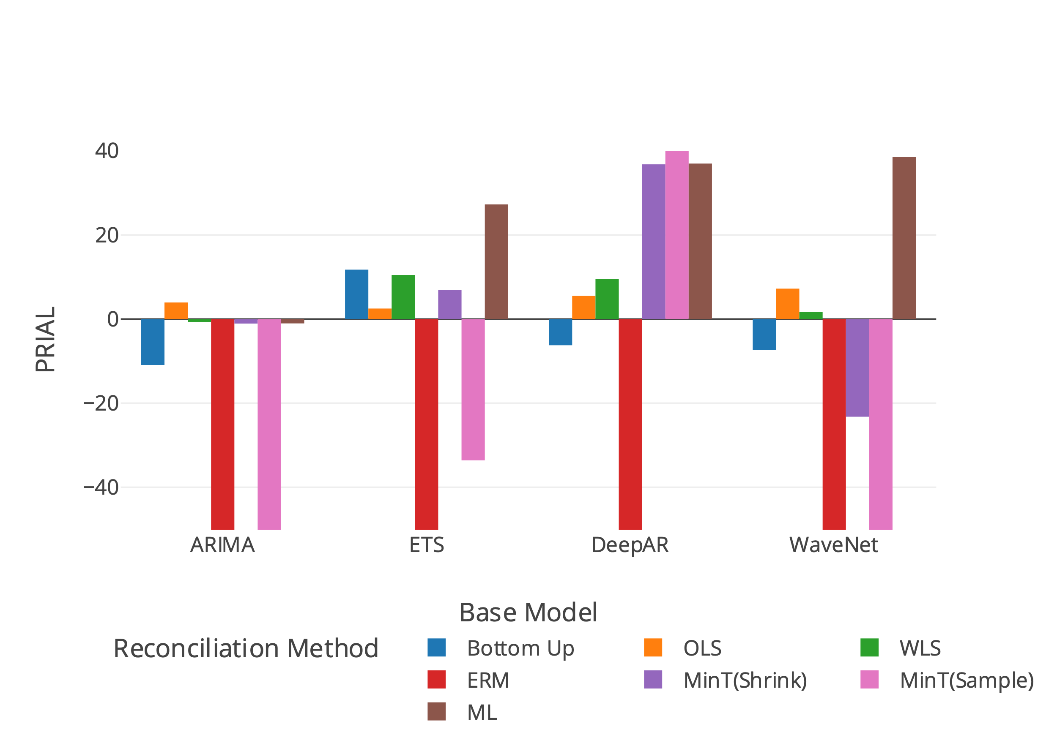
Results –Labour (Short Horizon)
Rank | ARIMA | ETS | DeepAR | WaveNet
1 | OLS (3.93) | Proposed ML (27.25) | MinT(Sample) (40.25) | Proposed ML (38.54)
2 | WLS (-0.67) | Bottom Up (11.73) | Proposed ML (36.96) | OLS (7.23)
3 | Proposed ML (-1.04) | WLS (10.47) | MinT(Shrink) (36.77) | WLS (1.69)

Slide 7
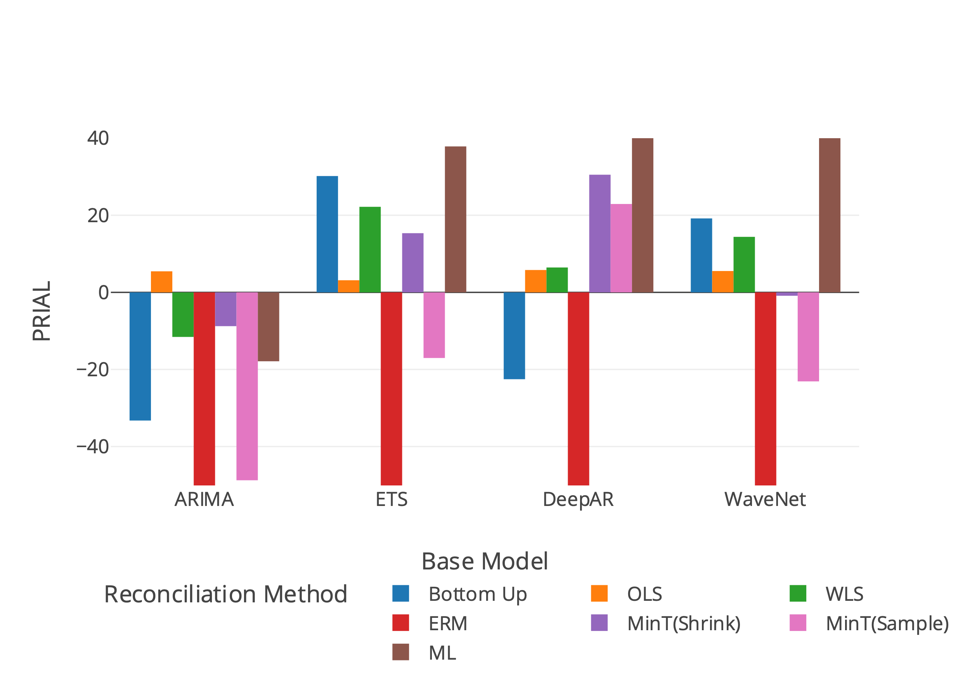
Results - Labour
Rank | ARIMA | ETS | DeepAR | WaveNet
1 | OLS (5.46) | Proposed ML (37.86) | Proposed ML (46.43) | Proposed ML (43.78)
2 | MinT(Shrink) (-8.76) | Bottom Up (30.18) | MinT(Shrink) (30.53) | Bottom Up (19.18)
3 | WLS (-11.56) | WLS (22.19) | MinT(Sample) (22.93) | WLS (14.40)

Slide 8
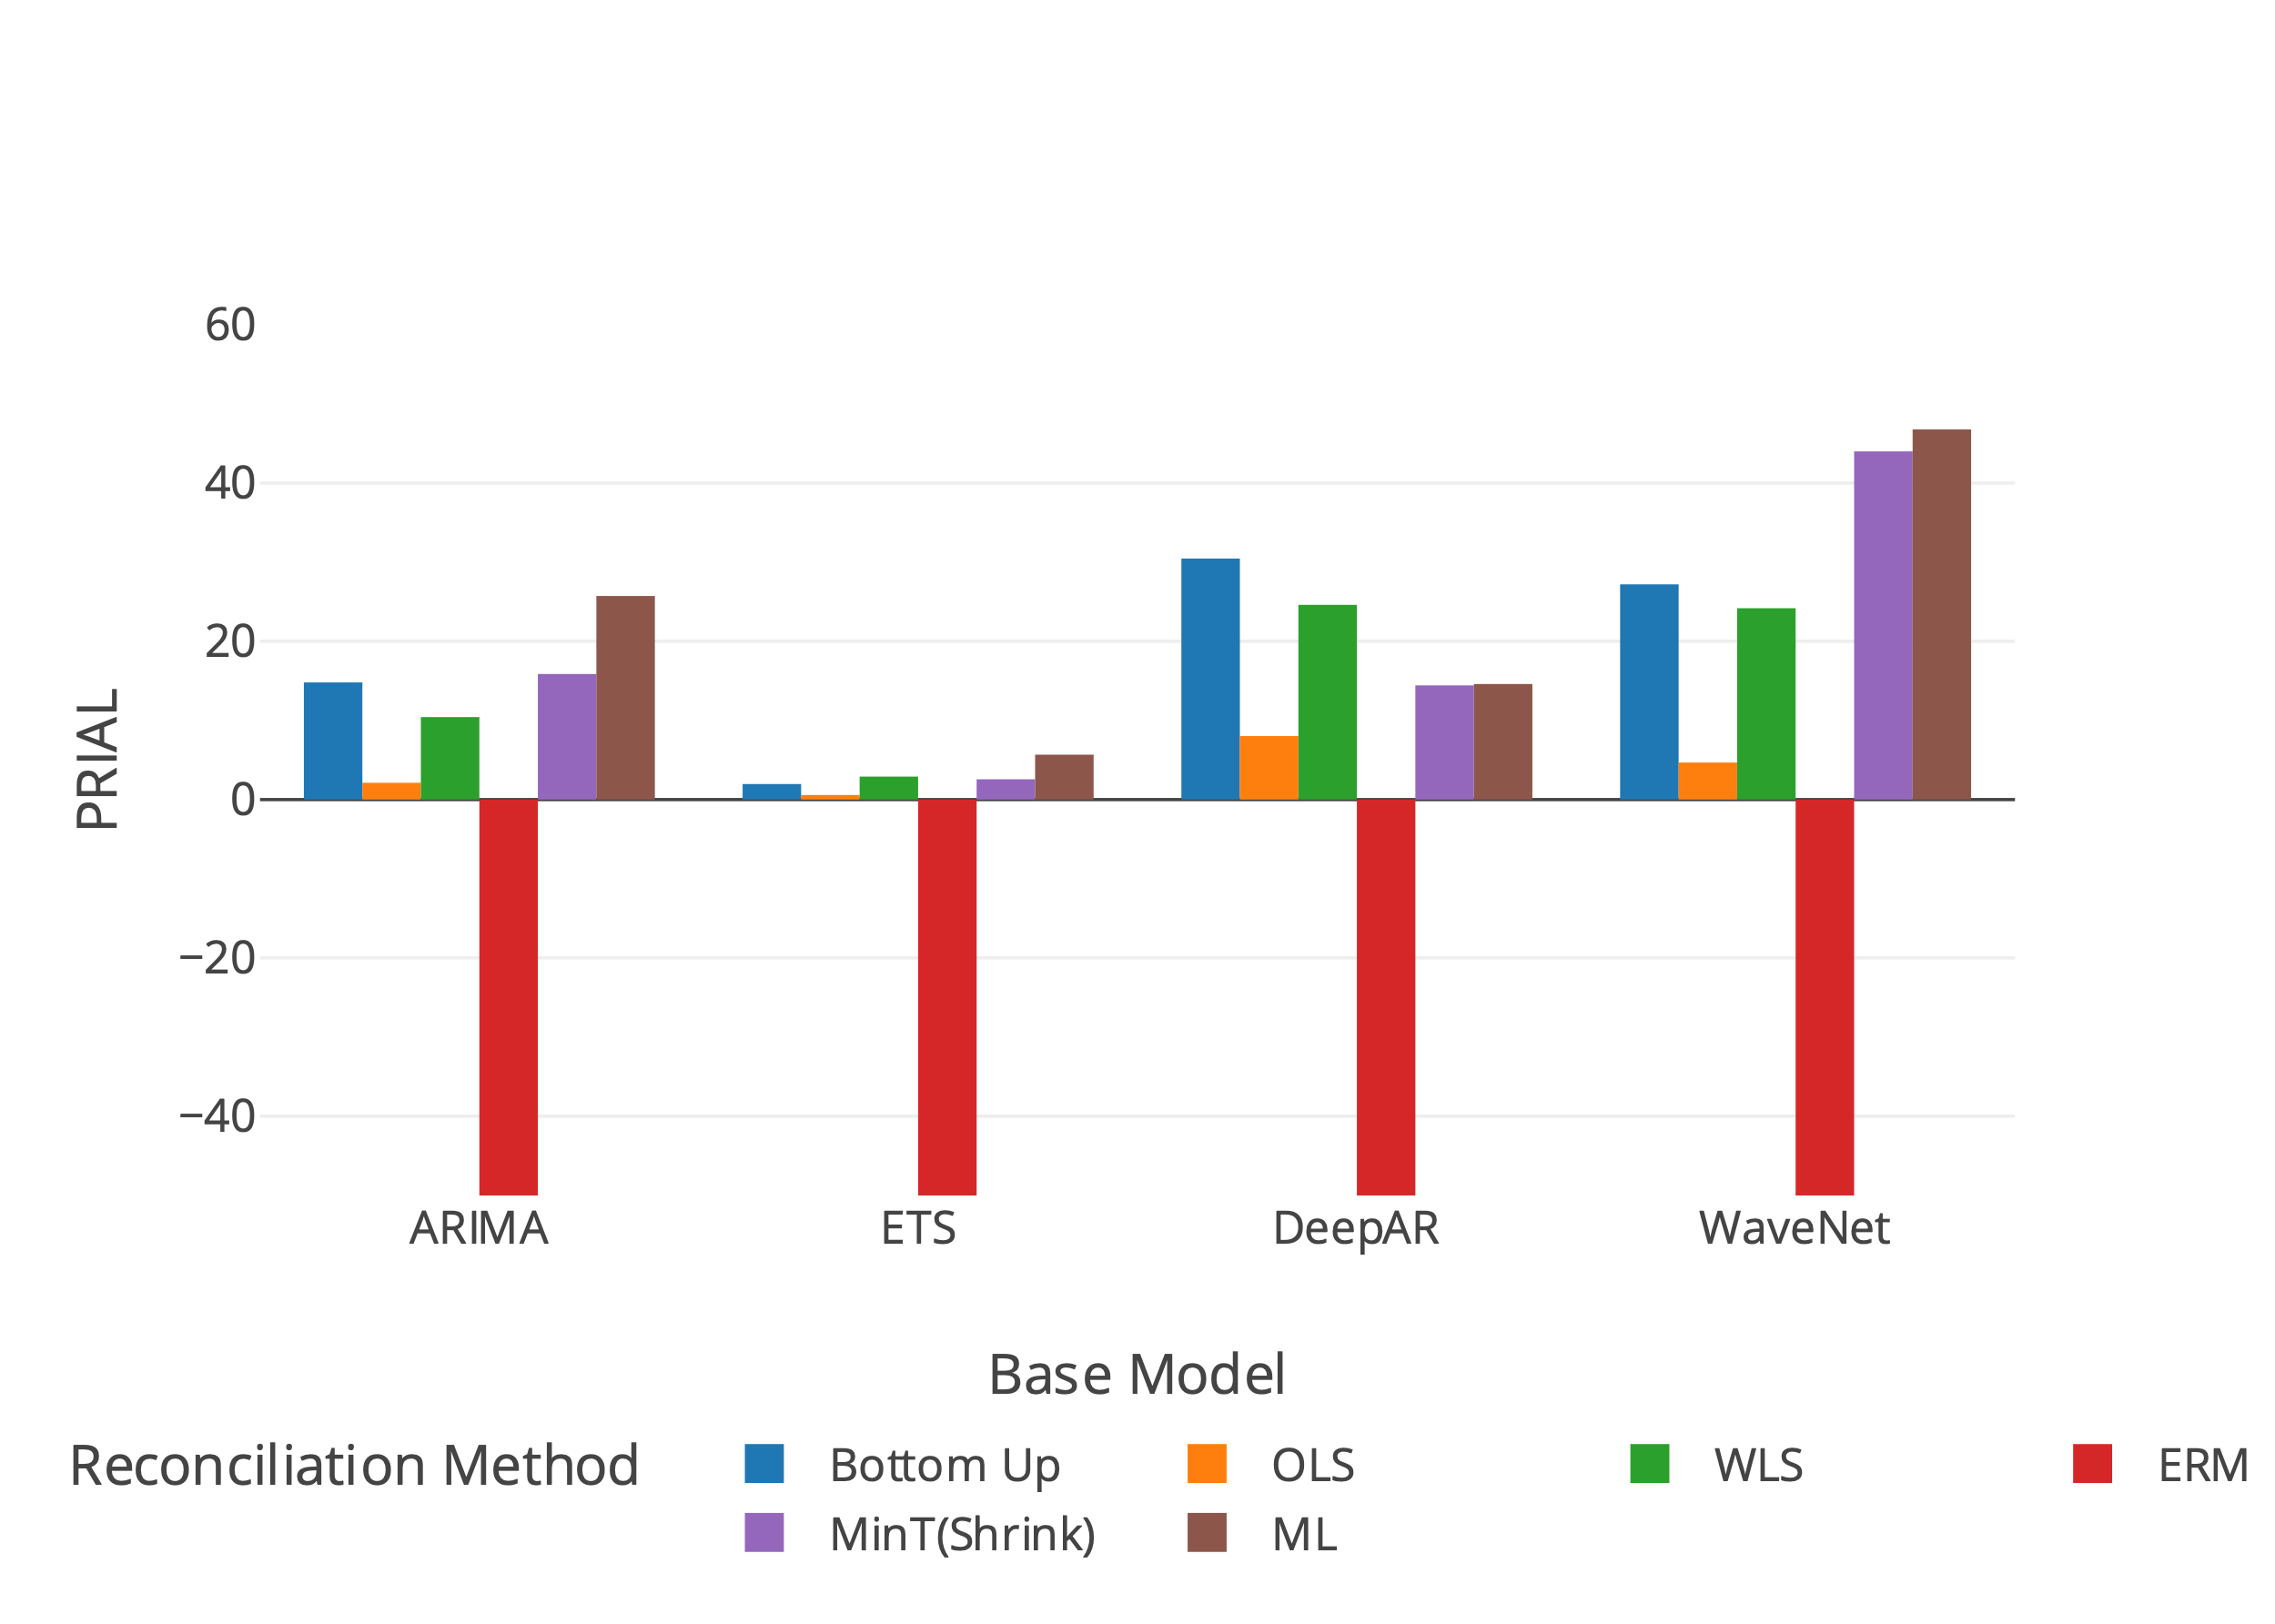
Results - Wikipedia (Short Horizon)
Rank | ARIMA | ETS | DeepAR | WaveNet
1 | Proposed ML (25.72) | Proposed ML (5.67) | Bottom Up (30.46) | Proposed ML (46.77)
2 | MinT(Shrink) (15.87) | WLS (2.91) | WLS (24.61) | MinT(Shrink) (43.99)
3 | Bottom Up (14.80) | MinT(Shrink) (2.56) | Proposed ML (14.60) | Bottom Up (27.20)

Slide 9
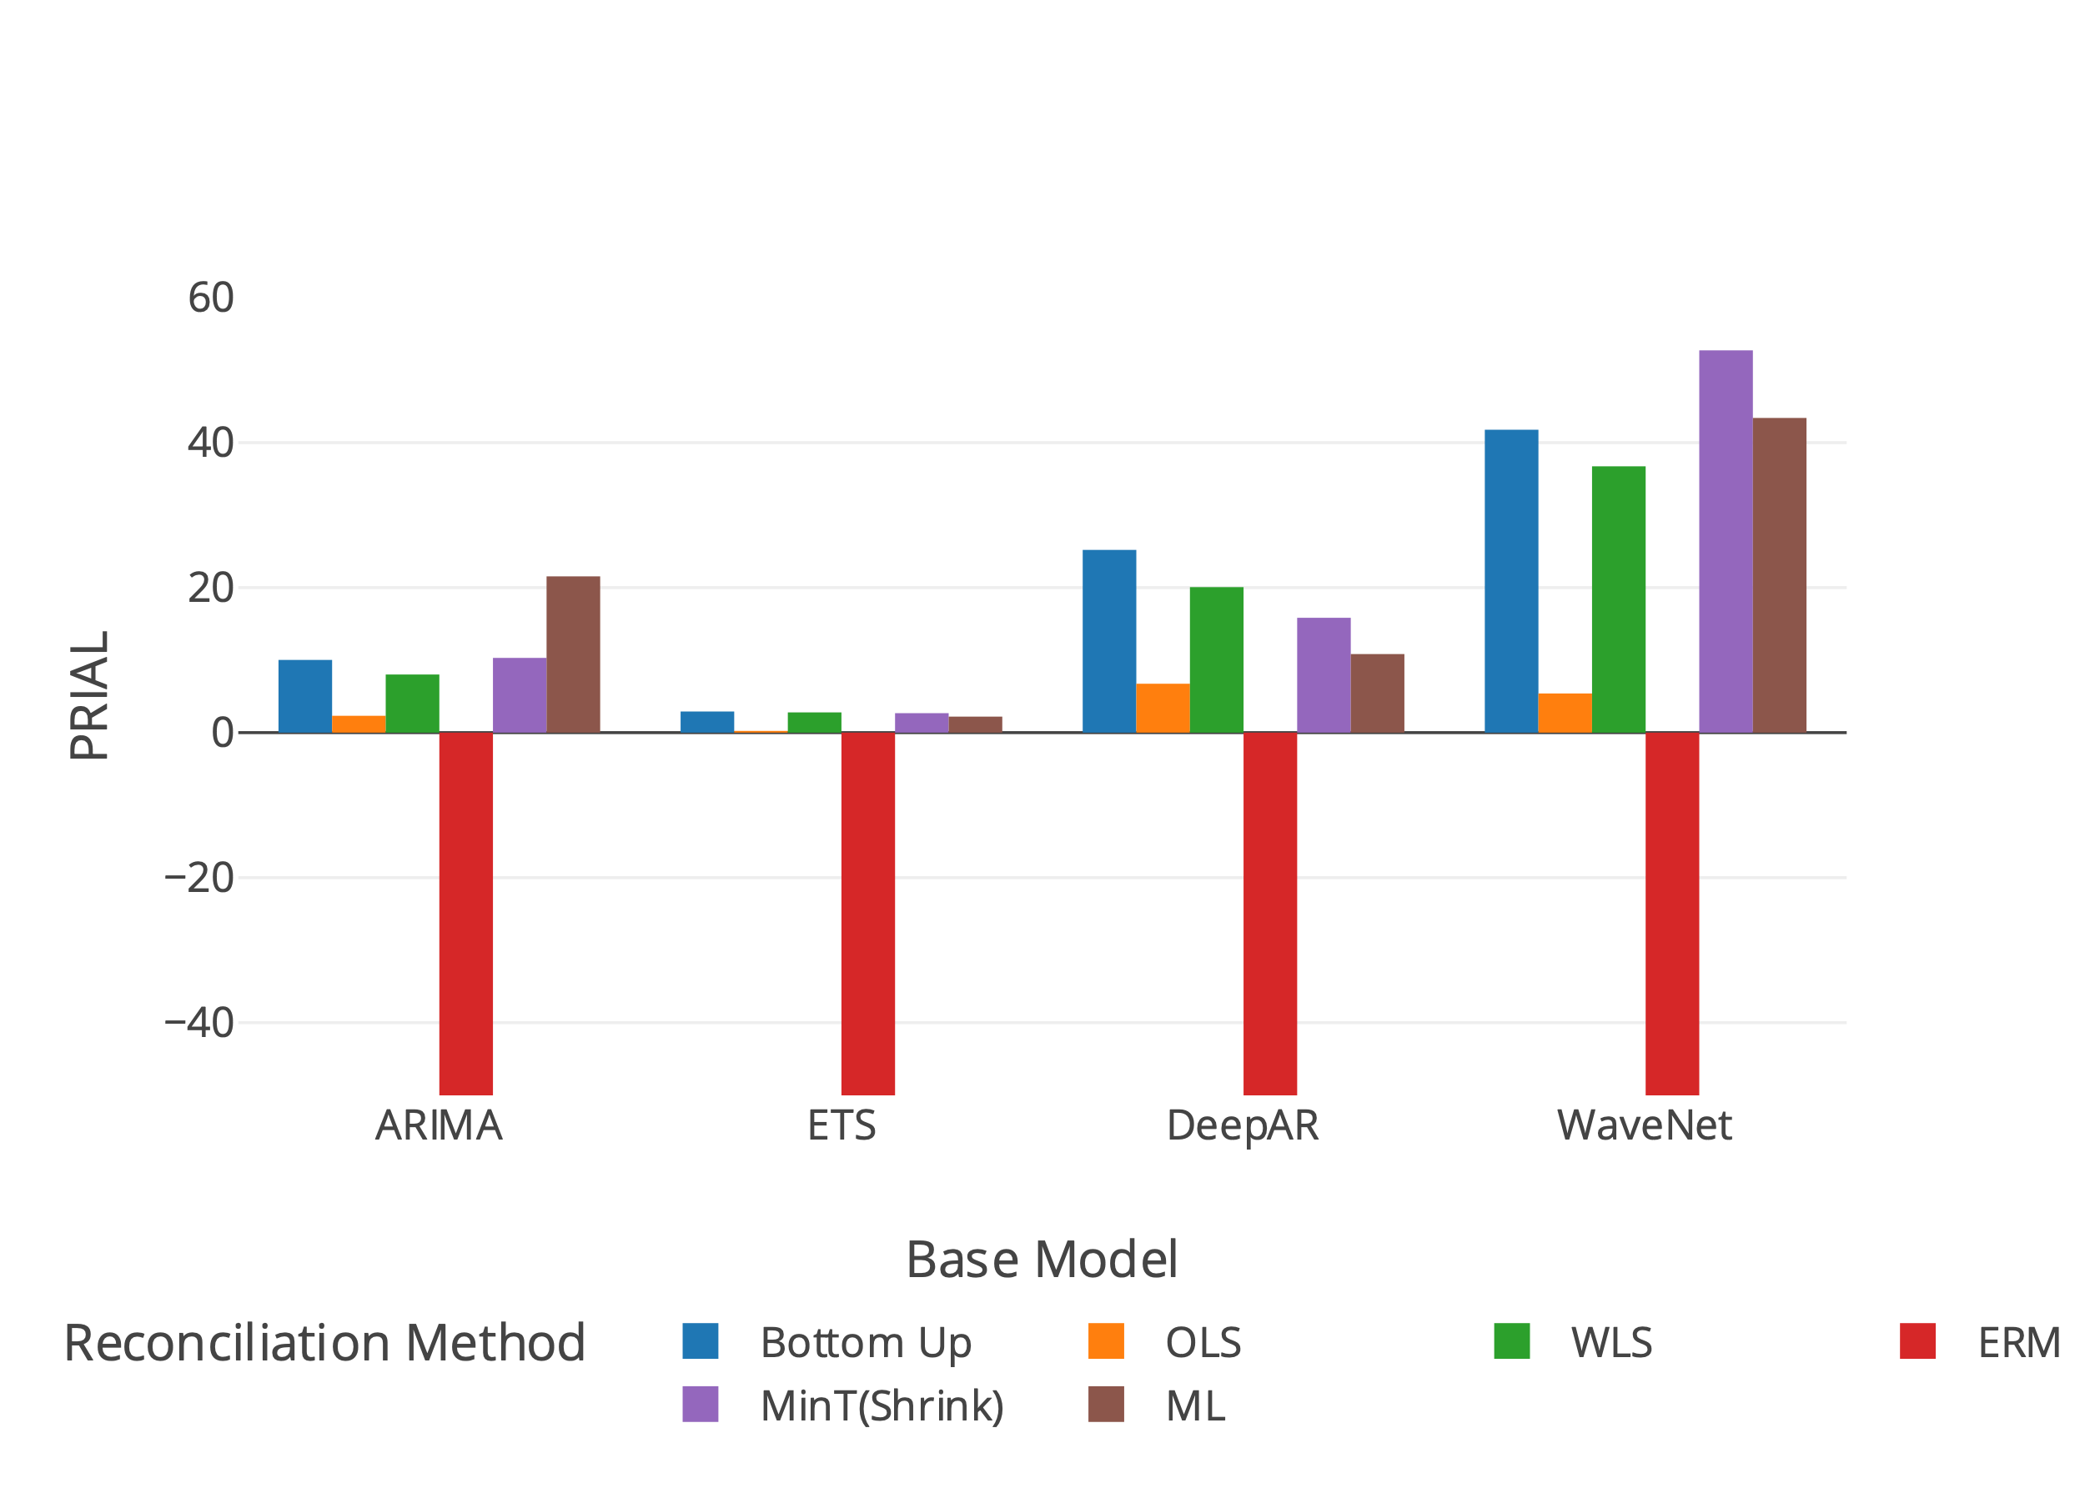
Results - Wikipedia
Rank | ARIMA | ETS | DeepAR | WaveNet
1 | Proposed ML (21.55) | Bottom Up (2.91) | Bottom Up (25.20) | MinT(Shrink) (52.72)
2 | MinT(Shrink) (10.30) | WLS (2.79) | WLS (20.06) | Proposed ML (43.40)
3 | Bottom Up (10.02) | MinT(Shrink) (2.68) | MinT(Shrink) (15.83) | Bottom Up (41.77)

