Slide 1
ANALYSIS OF ALLOTMENT (for the batch 2022-26 & 2023-2027)

Slide 2
ABOUT THE DATASETS:
Batch (2022-2026):
1.size: 1791 x 71
2.Total no. of allotments (students): 1791 Through which 682 are female and 1209 are male.
3.Total number of branches: 13
4.The allotment has occurred in 6 different categories 1. category –A (convenor)
2.category –B(Through JEE)
3.NRI
4.Management
5.PMSSS
6.Spot

Slide 3
Batch (2023-2027):
1.size: 1823 x 71
2.Total no. of allotments (students): 1823 Through which 691 are female and 1132 are male.
3.Total number of branches: 13
4.The allotment has occurred in 6 different categories 1. category –A (convenor)
2.category –B(Through JEE)
3.NRI
4.J&K
5.PMSSS
6.Spot
7.CIWG
8.OCI
9.FN

Slide 4
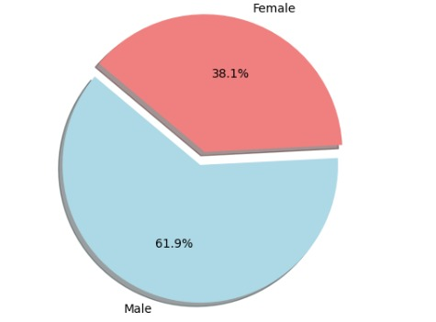
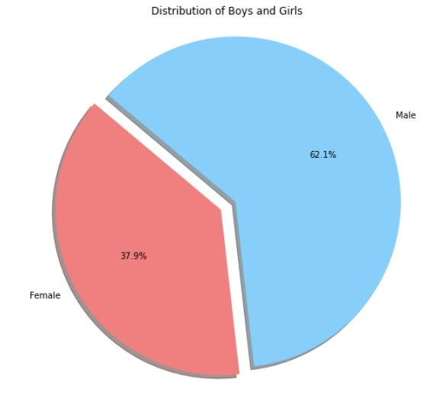
BASIC FINDINGS: MALE VS FEMALE
2022: 2023:

Slide 5
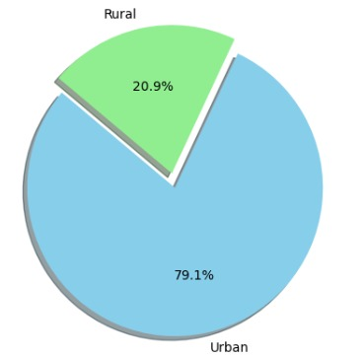
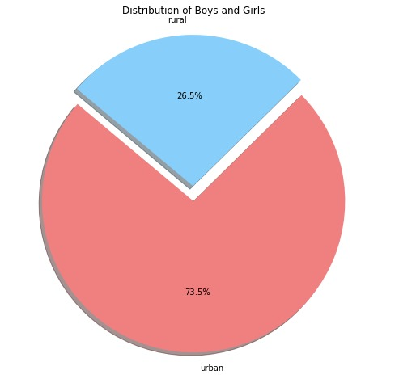
URBAN VS RURAL
2022 2023

Slide 6
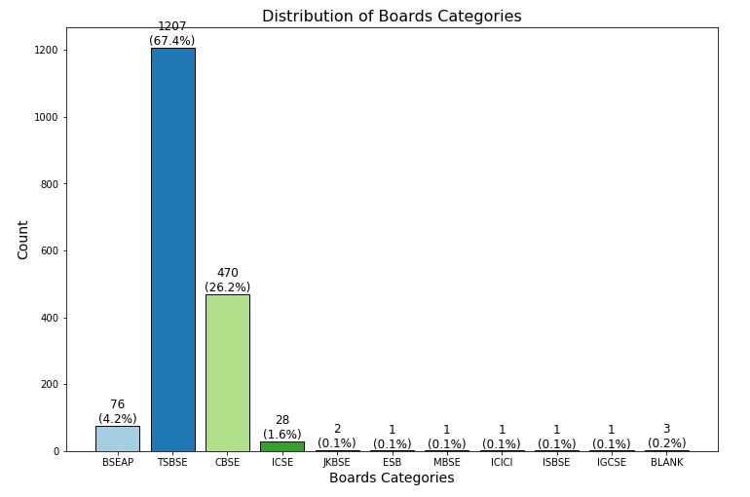
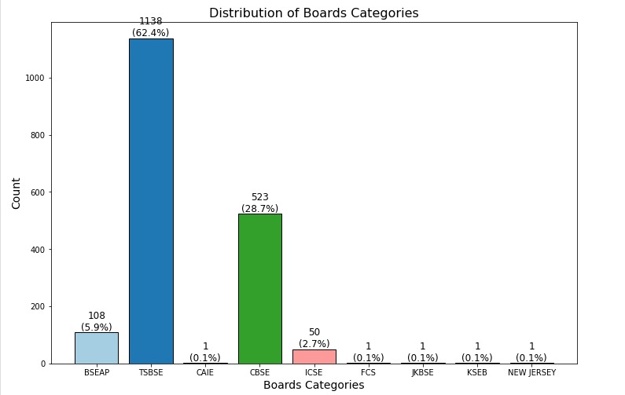
10th board:
2022: 2023:
2023:

Slide 7
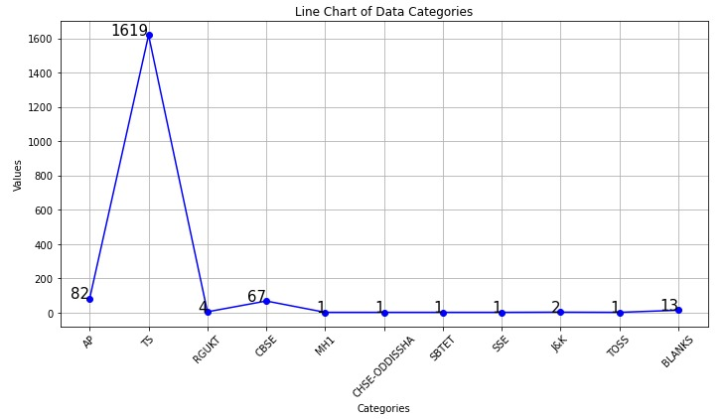
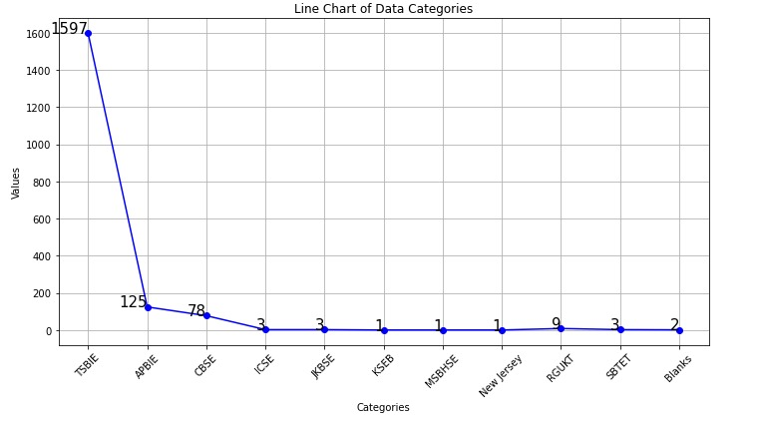
12th board:
2022 2023:

Slide 8
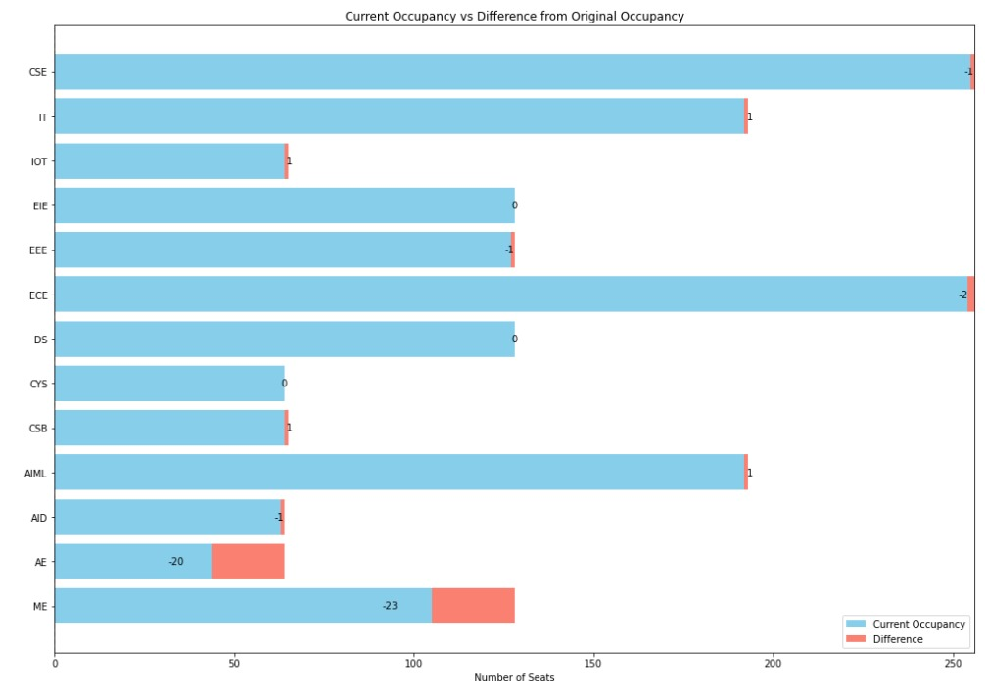
ALLOTTED vs REMAINING SEATS
2022

Slide 9
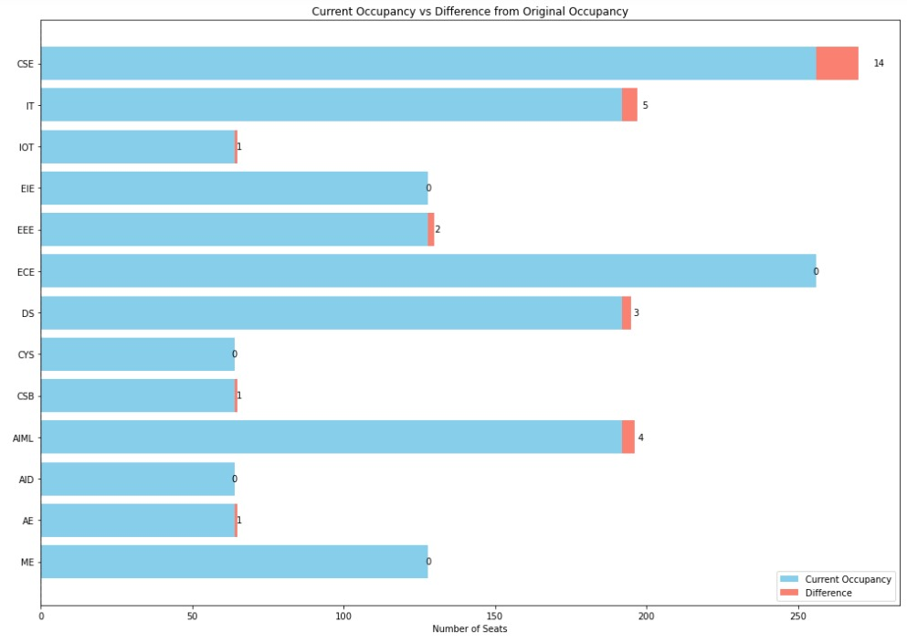
ALLOTTED VS REMAINING SEATS
2023

Slide 10
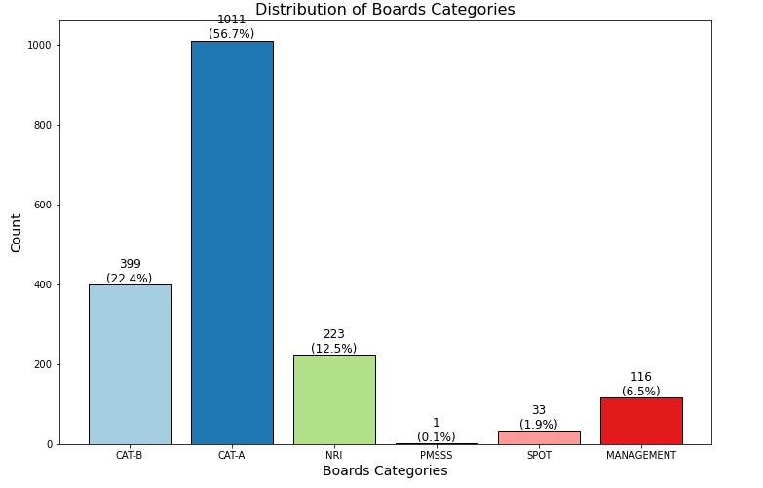
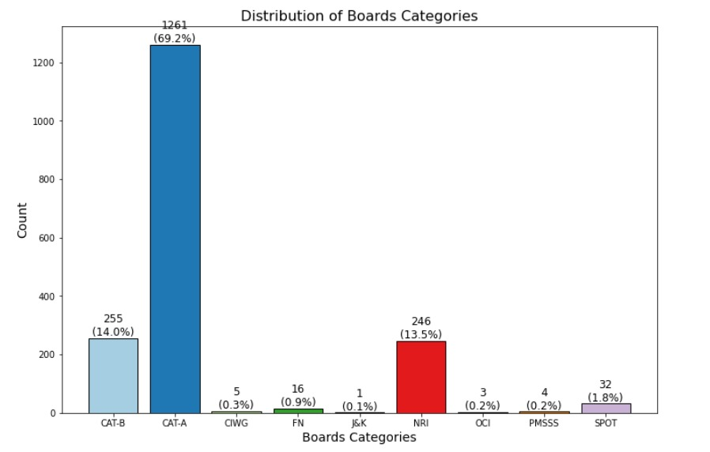
CATEGORY WISE ALLOTMENT
2022 2023

Slide 11
INSIGHTS WHICH CAN BE DRAWN:
1.Student percentage of joining Based on places.
2.Student average Eamcet rank Based on places (Quality of students)
3.Percentage of students in Rural and Urban Areas.
4.No. of management seats based on place.
a. Management seats Based on State
b. Management seats Based on District
c. Management seats Belonging to urban and rural areas
5.Opting the Branch Based on JEE rank for CAT-B students
6.Maximum and Minimum JEE RANK Department wise for Cat-B students. (trend from 2022 to 2023)
7.No. of CAT-A, CAT-B (NRI Sponsored, NRI, Merit) in Each branch.
8.Based On gender which category is chosen and count of students.
9.Based on economical status Academic performance and branch choice.
10. Students benifiting from Government scholorships.

