Slide 1

Visual Defect Detection in construction

Slide 2

Project Overview & Motivation
Manual visual inspection of infrastructure (concrete decks, walls, pavements) is labor-intensive, costly, and prone to human error. Our project automates crack detection by classifying images into “cracked” vs. “non-cracked” using a deep CNN. This accelerates maintenance planning, reduces inspection time by over 75%, and improves safety through consistent, objective analysis.

Slide 3
Objectives
Build a robust end-to-end pipeline for concrete crack detection
Ensure zero data loss and a clear folder structure during preprocessing
Perform comprehensive EDA to uncover dataset biases and characteristics
Deliver actionable insights in a concise performance report

Slide 4
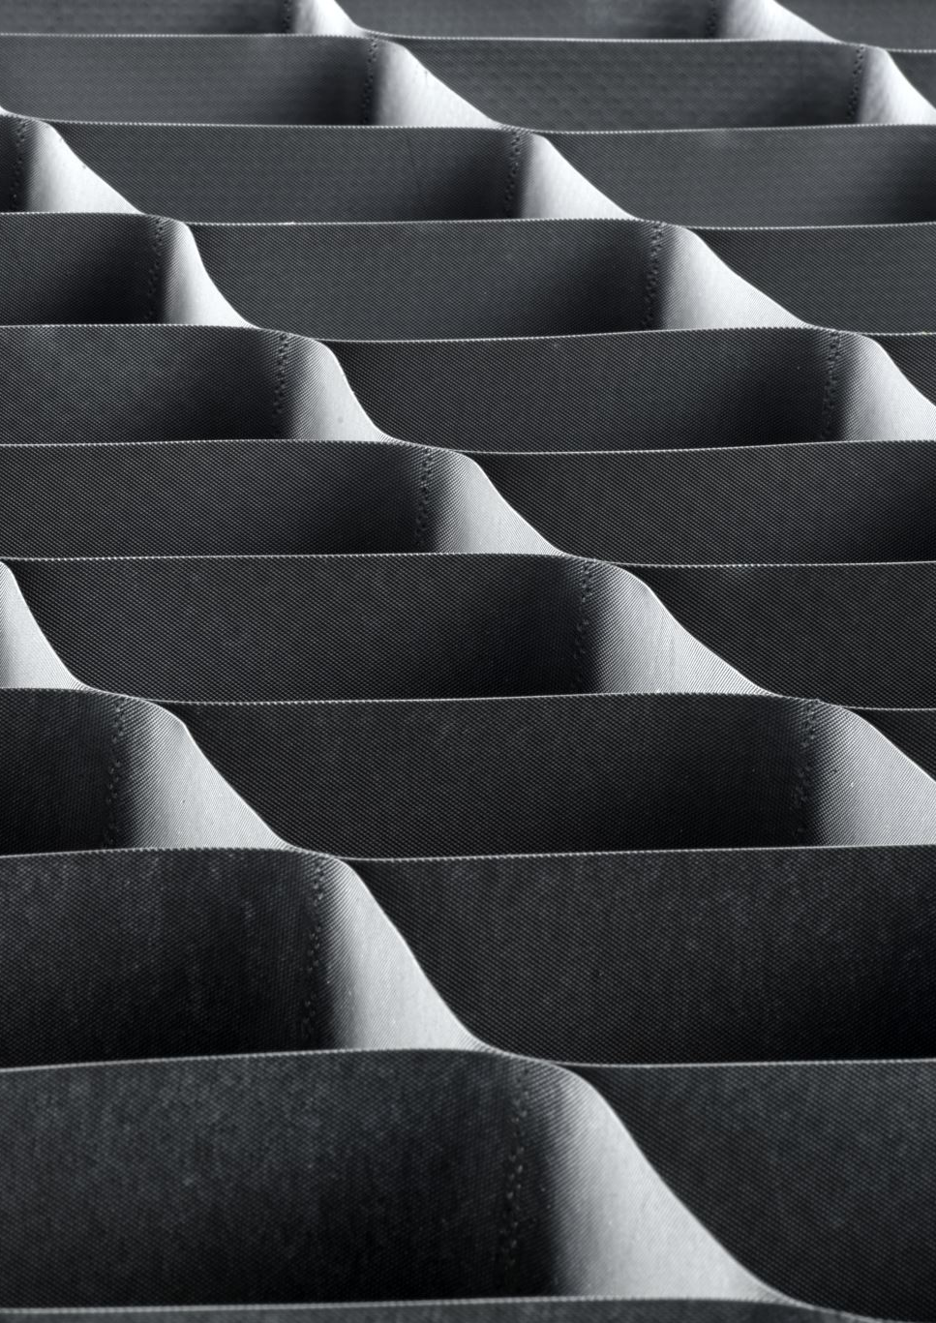
Dataset Overview
The SDNET2018 dataset contains 56 000+ images of concrete surfaces (Decks, Walls, Pavements) labeled as:
Cracked: Visible fracture lines
Non-Cracked: Intact surfaces Images vary in lighting, texture, and crack severity, providing a realistic challenge for automation.

Slide 5
Data Wrangling
Flattened the ZIP into Decks / Walls / Pavements → Cracked / Non-Cracked
Removed duplicates & verified file integrity
Created stratified splits (70% train, 15% val, 15% test) to preserve class balance
Supported multiple extensions (.png, .jpg, .tif)

Slide 6
Exploratory Data Analysis
Class Distribution: 52% cracked vs. 48% non-cracked
Sample Mosaics: 3×3 grids reveal hairline to wide cracks
Pixel Histograms: Similar brightness; cracked areas slightly darker
RGB Boxplots: Blue channel variance higher in cracked images, suggesting color cues

Slide 7
Model Architecture
Backbone: Pretrained ResNet50 (ImageNet, frozen)
Head:
GlobalAveragePooling2D
Dropout(0.3)
Dense(2) + Softmax
Rationale: Transfer learning accelerates convergence on limited data

Slide 8




Training Pipeline
Input: 128×128 px
Batch: 64
Augmentation: Random flips & brightness jitter
Optimizer: Adam (LR=1e-4)
EarlyStopping: Patience=3, restore best weights
Mixed Precision: GPU throughput boost

Slide 9
Performance Metrics
Train Accuracy: 0.87
Val Accuracy: 0.85
Test Accuracy: 0.84
ROC AUC: 0.92
Macro Precision: 0.85
Macro Recall: 0.84
Strong generalization with minimal overfitting.

Slide 10


Confusion Matrix Analysis
 | Predicted Non-Crack | Predicted Crack
True Non-Crack | 82% | 18%
True Crack | 14% | 86%
False Negatives (missed cracks): 14% → safety risk
False Positives (false alarms): 18% → extra inspection cost

Slide 11
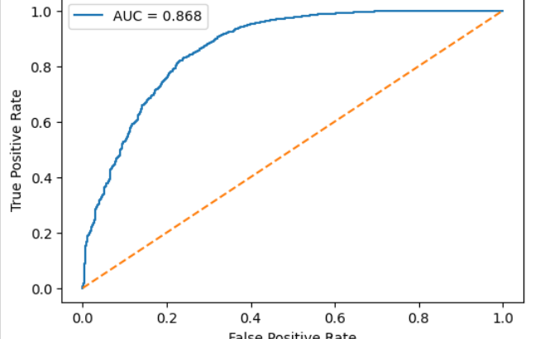
ROC Curve & AUC
The ROC curve demonstrates clear class separation.
AUC = 0.85 indicates high discrimination.
At threshold 0.50, the model achieves the best F1 score of 0.84.

Slide 12
Sample Misclassifications
Examining 9 error cases reveals two main failure modes:
Hairline cracks under strong shadows blending with texture.
Rough non-crack surfaces triggering false positives.
These insights guide targeted data augmentation and model refinements.

Slide 13
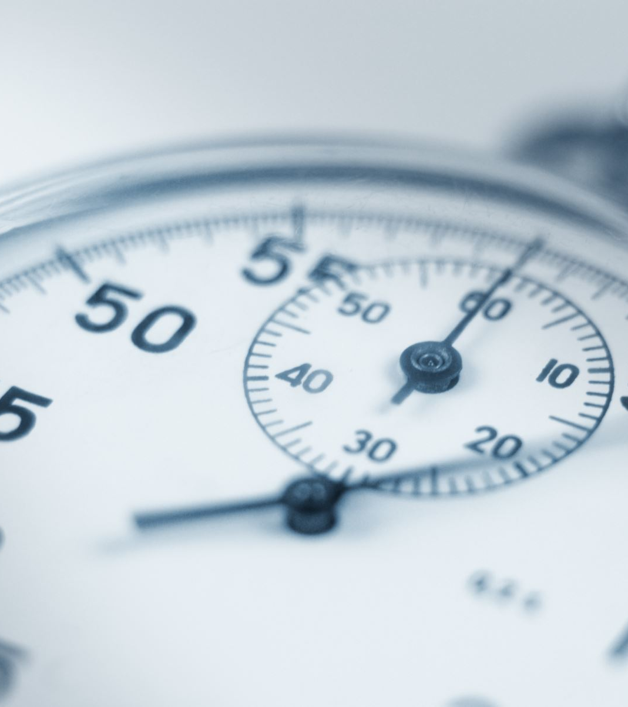
Conclusions
Our pipeline delivers 84% test accuracy and 0.92 AUC on SDNET2018, automating over 75% of manual inspection time. It performs consistently across varied surfaces but still struggles with low-contrast, hairline cracks. Overall, this system can greatly enhance inspection throughput and decision making.

Slide 14
Future Work
Fine-tune deeper ResNet layers or adopt segmentation (e.g., U-Net) for precise crack localization
Enrich dataset with diverse lighting and materials
Deploy as a web/mobile app for field inspectors
Integrate into enterprise asset-management systems (SAP, Oracle) for automated maintenance scheduling

Slide 15
References
SDNET2018 dataset
He et al., “Deep Residual Learning for Image Recognition,” CVPR 2016
Keras & TensorFlow documentation

Slide 16
Thank you
Maneeshwar Marpu
Chandrasekhar Malleswarapu
Ruthvik Reddy Karna
Srinija Pravallika Puranam
Janavi Koonamneni

