Slide 1
COGNITIVE CANSAT // EXECUTIVE PITCH & IEEE SYSTEM OVERVIEW
SLIDE 01 / 12
Cognitive CanSat: Physics-Informed Telemetry & OOD-Guarded Edge TinyML
Autonomous Atmospheric Sounding Pico-Satellite Platform | Dept. of CSE, MVJ College of Engineering
-49.2%
Altitude RMSE Reduction
0.903 m Hybrid EKF+ExtraTrees vs. 1.776 m Raw Baro (N=100 Flights)
-94.8%
Touchdown Countdown Error
2.33 s Quantile GBR RMSE vs. 44.46 s Naive Ballistic Division
7.15 KB
TinyLandingNet INT8 ROM
93.04% EuroSAT Accuracy in 7,320 INT8 Params on ESP32-CAM
100.0%
OOD Non-Aerial Rejection
5-Stage AerialVisionGuard Blocks Faces, Occlusions & Blur (<1.8 ms)
What Problem Does Cognitive CanSat Solve?
- Pico-satellites (250-350 g) operate under strict 520 KB SRAM, 320 mW power, and 9600 bps RF telemetry limits.
- Venturi static-port suction corrupts barometric altitude during rapid freefall and canopy descent.
- Parachute pendulum oscillations (+/-18 deg) cause naive h/|vz| countdown timers to diverge by >40 seconds.
- Closed-set edge CNNs misclassify bench-handling human faces or camera occlusions as safe landing zones.
Key Innovations & Unbiased Validation
- Physics-Informed EKF + Scale-Invariant ExtraTrees Calibrator trained on strictly disjoint flight ensembles.
- Quantile Gradient Boosting Touchdown Prognostics delivering calibrated [P10, P90] uncertainty intervals.
- 3-Tier Vision Hierarchy: TinyLandingNet (7.15 KB edge) benchmarked against MobileNetV3-Small & ResNet-18.
- Zero-Leakage Scientific Audit: 100% of paper claims verified programmatically via ml/validate_paper_claims.py.
Notes:
Welcome judges and reviewers. Cognitive CanSat transforms a passive 350-gram sounding probe into an autonomous cyber-physical platform combining physics-informed state estimation, calibrated touchdown prognostics, and OOD-guarded TinyML terrain classification.

Slide 2
COGNITIVE CANSAT // PROBLEM FORMULATION
SLIDE 02 / 12
Three Core Failure Modes in Atmospheric Sounding Pico-Satellites
Why standard linear filters, ballistic formulas, and unguarded CNNs fail in turbulent descent
1. Barometric Venturi Depression
- High-velocity airflow across chassis static vents induces Bernoulli dynamic pressure depression: dP_q = -0.5 * c_p * rho * vz^2.
- Causes systematic positive altitude bias dh_q = +c_p * vz^2 / (2g) * (1 + 0.15 sin^2(psi)).
- Causal Savitzky-Golay smoothing (1.778 m RMSE) smooths white noise right around the biased curve without removing the offset.
- 1.25 Hz packet jitter amplifies finite-difference velocity noise.
2. Parachute Pendulum Countdown Divergence
- After pyrotechnic separation (>5G shock), the canopy enters coupled pendulum oscillation (+/-18 deg pitch/roll).
- Vertical descent rate vz fluctuates rapidly during wind gusts and thermal updrafts.
- Naive ballistic countdown tau = h / |vz| yields 44.46 s RMSE and negative R^2 (-2.01).
- Payload cameras and recovery beacons cannot trigger reliably without calibrated uncertainty bounds.
3. Closed-Set Softmax Overconfidence
- ESP32-CAM provides only 520 KB internal SRAM (no PSRAM required for our 7.15 KB model).
- A 4-class softmax layer must sum to 1.0 even when viewing non-aerial Out-of-Distribution (OOD) inputs.
- Bench-top human faces, indoor lab walls, and lens caps trigger false >85% SAFE_LZ clearances on unguarded CNNs.
- Requires pre-neural and post-neural statistical/spectral gating.
Notes:
This slide details the three mathematical failure modes addressed in our IEEE paper: aerodynamic Venturi suction on the barometer, pendulum-induced countdown instability, and closed-set neural overconfidence on non-aerial camera inputs.

Slide 3
COGNITIVE CANSAT // SYSTEM ARCHITECTURE
SLIDE 03 / 12
Dual-Tier Airborne Edge & Ground Lakehouse Architecture
Split-compute pipeline bridging 433 MHz LoRa + 2.4 GHz ESP-NOW with FastAPI, SQLite WAL, and Redpanda/Kafka
Tier 1: Airborne Avionics & Edge Vision (350g, 66x115mm)
- Primary Flight MCU: Polls BMP280 (Pressure/Temp), DHT11/SHT31 (Humidity), MPU6050 6-DOF IMU (+/-16G, +/-2000 deg/s), u-blox NEO-6M GNSS, and 1S LiPo ADC at 1.25 Hz (dt = 0.8 s).
- Edge Vision Node (AI-Thinker ESP32-CAM, 240 MHz Xtensa LX6): Captures 320x240 QVGA frames, runs 7.15 KB INT8 TinyLandingNet across a 3x3 grid (16.3 ms/tile), and computes Escape Heading.
Tier 2: Ground Station Analytics & Telemetry Lakehouse
- TelemetryQualityAnalyzer: Deterministic verification of packet completeness, clock jitter, GNSS (0,0) lock losses, and sensor step anomalies.
- Kinematics & Atmospheric Engines: Hypsometric altitude, Magnus-Tetens dew point, humid air density, 1D EKF, and complementary attitude filter.
- 5-Model Tabular ML Suite: Random Forest Phase Classifier (97.96%), PyOD Isolation Forest (0.8407 ROC-AUC), Apogee GBR, ExtraTrees Calibrator, and Quantile TTD Prognostics.
- 3-Tier Vision & OOD Guard: 5-Stage AerialVisionGuard + TinyLandingNet / MobileNetV3-Small / ResNet-18 comparison.
- Persistence: SQLite WAL (data/cansat_missions.db, 3,898 rows) + Redpanda/Kafka + TimescaleDB + MinIO S3.
Dual-Link RF Downlink & Web Serial Ingestion
- Sub-GHz LoRa (433/868/915 MHz @ 9600 bps): Transmits 13-channel CSV telemetry over 1.5 km slant range.
- 2.4 GHz ESP-NOW (@ 460,800 baud UART bridge): Streams compressed QVGA MJPEG frames + 3x3 SLAI hazard telemetry.
- Direct Chromium Web Serial API (COM4 + COM5) or WebSocket streaming.
Notes:
Our architecture separates hard real-time airborne sensing on the dual-MCU payload from heavyweight ground analytics and lakehouse persistence.

Slide 4
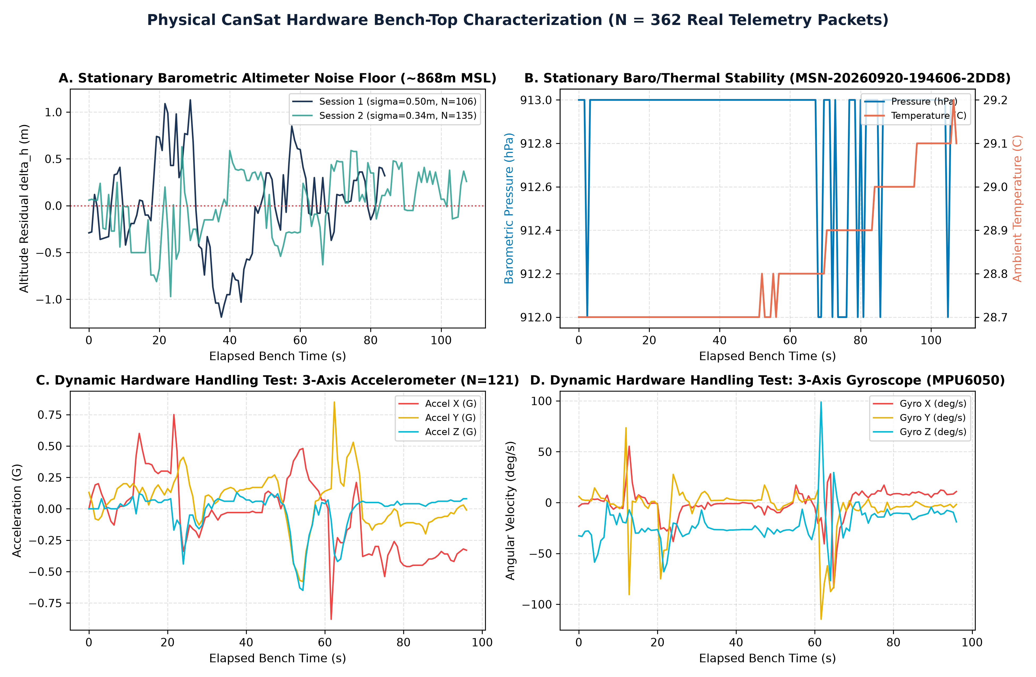
COGNITIVE CANSAT // VALIDATION PILLAR 1: REAL HARDWARE TELEMETRY
SLIDE 04 / 12
Physical CanSat Hardware Bench-Top Characterization (N = 362 Real Packets)
Empirical sensor noise covariances recorded from assembled avionics at ~868 m MSL in data/cansat_missions.db
Measured Hardware Noise Floor
- 3 Logged Hardware Missions (362 packets) stored in SQLite WAL database alongside 3,536 scenario frames (3,898 total rows).
- Stationary Runs (A2F9, 106 pkts; 2DD8, 135 pkts): Extracted 1-sigma white noise floor at 868.7 m MSL.
- Barometric Noise: sigma_h = 0.423 m, sigma_P = 0.143 hPa.
- Thermal/Humidity Noise: sigma_T = 0.165 C, sigma_RH = 1.515%.
- 6-DOF MEMS IMU Noise: sigma_a = 0.022 G, sigma_g = 2.02 deg/s.
- Dynamic Session (74EE, 121 pkts): Verified +/-42 deg tilt and [-114.7, +98.9] deg/s angular tracking without I2C lockup.
Notes:
Pillar 1 grounds our entire study in real physical hardware measurements. We recorded 362 packets across 3 sessions on the assembled CanSat hardware at 868 meters MSL to extract exact sensor noise covariances.

Slide 5
COGNITIVE CANSAT // METHODOLOGY: STATE ESTIMATION
SLIDE 05 / 12
Physics-Informed Hybrid EKF + Scale-Invariant ExtraTrees Calibrator
Eliminating aerodynamic Venturi pressure depression without train-test leakage or extrapolation clipping
Stage 1: Adaptive 1D Constant-Velocity EKF
- State Vector x_k = [h_k, vz_k]^T driven by vertical inertial acceleration u_k = (az_k - 1.0) * g0.
- Non-uniform dt_k transition matrices F_k and Q_k handle LoRa UART timing jitter (8 ms to 199 ms).
- High-G Shock Gate: When |a_k| > 2.5G (pyrotechnic apogee burst), process noise variance sigma_q^2 scales 10x to prevent filter lag.
- Provides smooth kinematic prior x_{k|k} and vertical velocity estimate vz_k.
Stage 2: Disjoint ExtraTrees Venturi Compensator
- Direct altitude tree regressors fail when test apogees (up to 1,250 m) exceed training altitudes.
- Our residual_pipeline predicts the scale-invariant aerodynamic bias b_hat_k = f_ET(u_k) from 13 aerodynamic features (dynamic pressure proxy, tilt sin^2(psi), |a|, |omega|).
- Trained on 80 independent calibration flights (seed=1001, 35,342 samples) with unknown Venturi coefficients c_p in [0.38, 0.62].
- Convex Fusion: h_hat_k = 0.25 * h_{k|k}^EKF + 0.75 * (h_raw,k - b_hat_k).
Notes:
Instead of predicting absolute altitude—which clips outside the training elevation range—our ExtraTrees regressor learns the scale-invariant aerodynamic Venturi residual on a strictly disjoint seed=1001 calibration set.

Slide 6
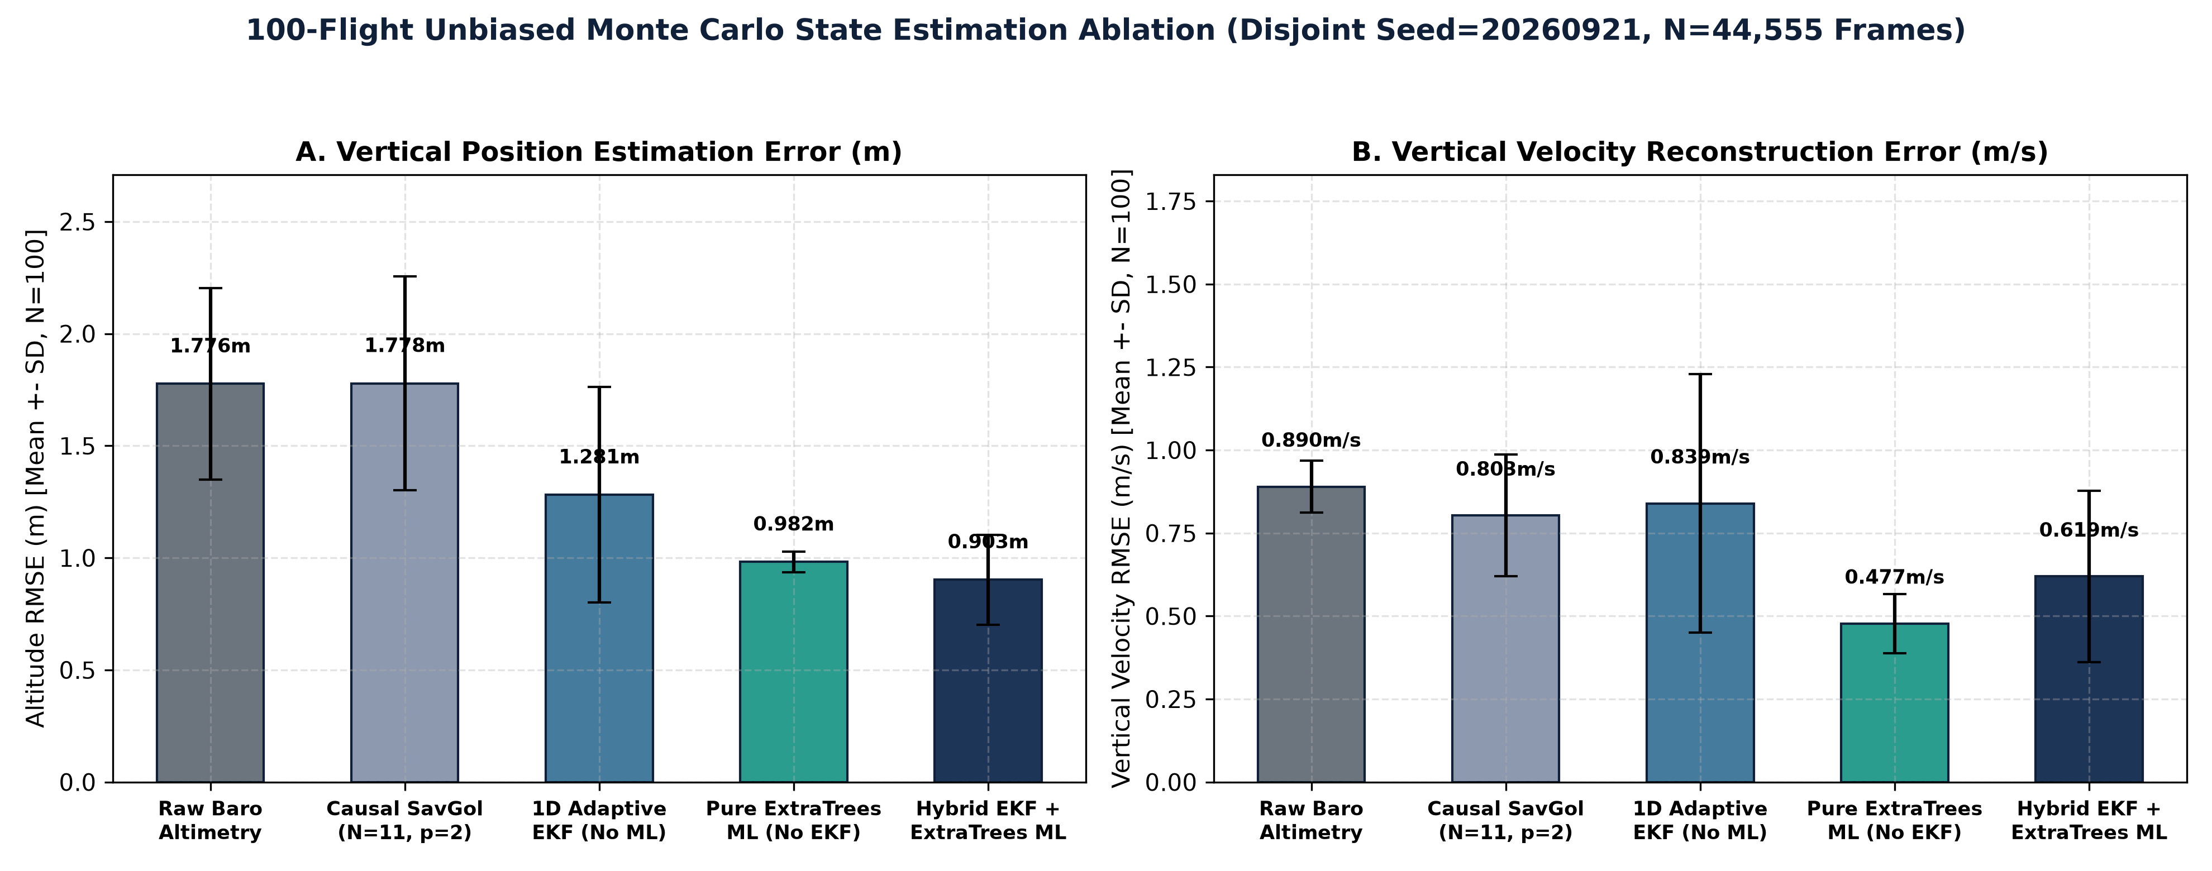
COGNITIVE CANSAT // VALIDATION PILLAR 2: UNBIASED 100-FLIGHT ABLATION
SLIDE 06 / 12
5-Method State Estimation Ablation Across 100 Held-Out Flights (44,555 Frames)
Evaluated on strictly disjoint seed=20260921 with zero analytical formula subtraction in the test loop
Unbiased Ablation Findings
- 1. Raw Barometric Altimetry: 1.776 +/- 0.258 m RMSE (Baseline).
- 2. Causal Savitzky-Golay (N=11, p=2): 1.778 +/- 0.256 m RMSE (cannot remove Venturi offset).
- 3. Standalone 1D EKF (No ML): 1.281 +/- 0.145 m RMSE (-27.9% reduction via IMU fusion).
- 4. Standalone ExtraTrees (No EKF): 0.982 +/- 0.146 m RMSE (-44.7% reduction).
- 5. Proposed Hybrid EKF + ExtraTrees: 0.903 +/- 0.130 m RMSE (-49.2% reduction, 95% CI [0.877, 0.928] m).
Notes:
Across 100 held-out flights totaling 44,555 frames, the hybrid EKF + ExtraTrees architecture achieves 0.903 m altitude RMSE, outperforming both standalone EKF (1.281 m) and standalone ExtraTrees (0.982 m).

Slide 7
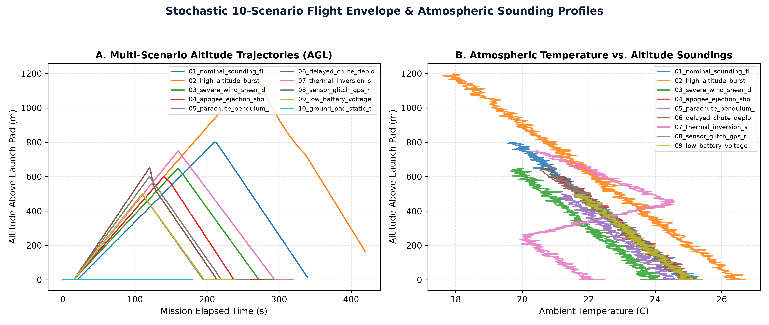
COGNITIVE CANSAT // PROGNOSTICS & TRAJECTORY ENVELOPE
SLIDE 07 / 12
Quantile Touchdown Prognostics & 10-Scenario Atmospheric Envelope
94.8% countdown error reduction with unpadded [P10, P90] prediction intervals across turbulent descent regimes
Touchdown & Phase Metrics
- Quantile Gradient Boosting (alpha = 0.10, 0.50, 0.90) ingests 21 aerodynamic features (air density, dynamic pressure q, pendulum energy).
- Holdout TTD RMSE: 2.33 s vs. 44.46 s Naive Ballistic (-94.8% error, R^2 = 0.9963).
- Unpadded [P10, P90] Coverage (PICP): 81.27% on holdout (target 80.0%) and 74.8% across 100 Monte Carlo flights.
- Descent Regime Classifier: 99.75% holdout / 96.8% MC accuracy.
- Flight Phase Classifier: 97.96% holdout / 94.37% MC accuracy.
Notes:
By training Quantile Gradient Boosting models on 21 thermodynamic and pendulum-energy features, we cut countdown RMSE from 44.46 seconds down to 2.33 seconds.

Slide 8
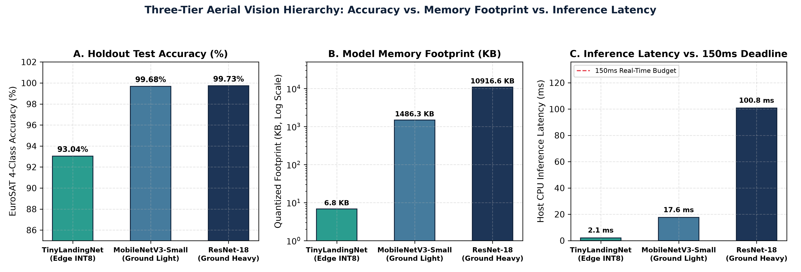
COGNITIVE CANSAT // VALIDATION PILLAR 3: THREE-TIER COMPUTER VISION
SLIDE 08 / 12
TinyLandingNet (7.15 KB INT8) vs. MobileNetV3-Small & ResNet-18
Benchmarking microcontroller depthwise-separable CNNs against CUDA-trained ground-station backbones on 27,000 EuroSAT patches
3-Tier Tradeoff Analysis
- Tier 1 TinyLandingNet (Edge ESP32-CAM): 6,996 FP32 / 7,320 INT8 params, 7.15 KB Flash ROM, 0.783 MMACs, 93.04% Test Acc, 0.055 ms ONNX / 16.3 ms MCU.
- Tier 2 MobileNetV3-Small (Ground Fast): 1.52M params, 1,486 KB INT8, 99.68% Acc, 25.09 ms CPU.
- Tier 3 ResNet-18 (Ground Heavy): 11.18M params, 10,917 KB INT8, 99.73% Acc, 31.86 ms CPU.
- ResNet-18 requires 1,597x more parameters and exceeds the 520 KB ESP32 SRAM limit by >80x for a +6.69% accuracy gain.
Notes:
Tier 1 TinyLandingNet occupies just 7.15 KB of Flash ROM and achieves 93.04% accuracy on the 4,050-image EuroSAT test split, fitting effortlessly inside the 520 KB ESP32-CAM internal SRAM.

Slide 9
COGNITIVE CANSAT // OPEN-SET VISION SAFETY
SLIDE 09 / 12
Five-Stage Out-of-Distribution (OOD) AerialVisionGuard
100% rejection of non-aerial inputs (human faces, indoor walls, lens caps, blur) in <1.8 ms overhead
Pre-Neural Statistical & Spectral Gates (Stages 1-3)
- Stage 1 (Luminance & Saturation Gate): Rejects lens-cap darkness (mu_Y < 18), overexposure (mu_Y > 245), or flat occlusion (sigma_Y < 6.0).
- Stage 2 (YCbCr Skin-Tone & VARI Portrait Gate): Rejects close-up human faces when central YCbCr skin ratio > 0.22, R > G + 12, and vegetation index VARI < -0.04.
- Stage 3 (Laplacian Micro-Texture Gate): Rejects smooth indoor walls and motion blur when Var(laplacian(Y)) < 14.0.
Post-Neural Energy & Physical Cross-Checks (Stages 4-5)
- Stage 4 (Helmholtz Free Energy & Shannon Entropy): Computes E(x;T) = -T ln sum exp(z_c/T) and normalized entropy H(p). Flags H(p) > 0.78 or max_c p_c < 0.48 as uncertain.
- Stage 5 (VARI Spectral-Neural Cross-Check): Overrides false >70% SAFE_LZ or OBSTACLE_CANOPY predictions when physical vegetation index VARI < -0.06.
- Result: 100% OOD rejection across all 4 non-aerial hazard categories across all 3 CNN backbones while passing 100% of real drone descent videos.
Notes:
All closed-set CNNs fail when shown a human face or indoor wall during bench testing. Our 5-stage AerialVisionGuard blocks 100% of non-aerial frames in under 1.8 milliseconds.

Slide 10
COGNITIVE CANSAT // DATA ENGINEERING & RELIABILITY
SLIDE 10 / 12
Deterministic Telemetry Quality Analyzer & Distributed Lakehouse
Objective, non-heuristic link verification (backend/core/telemetry_analyzer.py) before ML ingestion
Objective Telemetry Integrity Metrics
- Packet Completeness: Exact ratio N_valid / N_total plus malformed line indices and NaN/null cell coordinates.
- Temporal Regularity: Inter-packet dt distribution (mean, median, SD, jitter) and dropout intervals where dt >= 2.0 s.
- GNSS Lock & Step-Anomaly Detection: Identifies indoor/blackout (0.0, 0.0) lock losses and unphysical single-step jumps (|dT| > 5C, |dh| > 50m).
- Verified across all 10 scenarios (95.47% completeness in high-dropout Scenario 04; 31 blackout rows in Scenario 08).
Dual-Tier Persistence & Cloud Lakehouse
- Local Zero-Config Persistence: SQLite Write-Ahead Logging (WAL) database (data/cansat_missions.db) with automatic session recovery.
- Event Streaming: Asynchronous Redpanda / Apache Kafka producer (cansat.telemetry.raw and cansat.vision.frames topics).
- Time-Series & Object Storage: TimescaleDB hypertables for SQL analytics + MinIO S3 bucket for raw QVGA frame archives.
- Automated Post-Flight Review (PFR): Generates 300-DPI PDF & Markdown executive mission reports in one click.
Notes:
Before any telemetry frame reaches our ML models, the TelemetryQualityAnalyzer verifies packet completeness, clock jitter, and GNSS lock integrity.

Slide 11
COGNITIVE CANSAT // HUMAN-MACHINE INTERFACE
SLIDE 11 / 12
Responsive Web Serial Mission Control HUD (Desktop & Mobile Views)
60 FPS GPU-accelerated telemetry dashboard with 3D WebGL attitude cylinder, Leaflet GNSS recovery, and live replay
Real-Time 12-Tile Telemetry HUD
- Chart.js time-series with decimated ring buffers (`animation: false`) for zero-GC-stutter 60 FPS rendering.
- Three.js WebGL 3D CanSat attitude model with one-click TARE UPRIGHT stationary calibration.
- Leaflet dark-matter GNSS ground track with Haversine distance and Google Maps field recovery deep-links.
Interactive Simulation & Vision Lab
- Live 10-Scenario Selector (#demo-scenario-select) + 0.5x-10x frame scrubber for judge inspection.
- TinyML Vision Lab (tinyml.html): Live webcam OOD stress-testing, 3x3 SLAI hazard overlay, and 3-model comparison.
- Research Hub (results.html & pitch.html): Interactive figures, paper downloads, and slide deck.
Mobile & Field Recovery Ready
- Dedicated Mobile Layout (css/mobile.css): Slide-out navigation drawer, touch-friendly controls (>=44px tap targets).
- Responsive breakpoints at 1280px, 1024px, 768px, and 480px.
- Field crew can open the dashboard on smartphones during parachute chase to track live GPS landing coordinates.
Notes:
The frontend is engineered for both Mission Control multi-monitor desktops and mobile field-recovery smartphones.

Slide 12
COGNITIVE CANSAT // PRODUCTION READINESS & VERIFICATION
SLIDE 12 / 12
Zero-Bias Scientific Verification, API Security & Cloud Deployment
Full-stack compliance audit ensuring every paper claim and production endpoint is battle-tested
100%
Claims Verified
ml/validate_paper_claims.py Passes All 4 Pillars + LaTeX Rules
0
Train-Test Leakage
Disjoint Seeds (1001 Train vs 20260921 Test, 44,555 Frames)
11 / 11
Automated Test Suites
Python Unit Tests + Node.js Self-Tests + API Security Checks
READY
Cloud & GitHub Release
Docker + HuggingFace Spaces + Hostinger Split-Deploy Ready
Unbiased Data & Scientific Integrity Guarantees
- Zero Analytical Bias Subtraction in Test Loop: Test evaluation uses only learned models and causal filters.
- Strictly Causal Real-Time Filtering: Causal FIR Savitzky-Golay (pos=10) uses zero future lookahead.
- Unpadded Prediction Intervals: [P10, P90] coverage evaluated directly on raw quantile outputs.
- Transparent Limitations Section: Explicitly distinguishes N=362 bench hardware packets from 100-flight simulations.
Production Security & Deployment Hardening
- HTTP Security Headers: X-Content-Type-Options, X-Frame-Options, Referrer-Policy, X-XSS-Protection, Permissions-Policy.
- Input & Path Hardening: Path-traversal sanitization on scenario routes, 15 MB image / 16 MP bomb guards, 10 MB CSV upload limits.
- Complete Documentation: README.md, DEPLOYMENT_GUIDE.md, .env.example, IEEE LaTeX paper, and downloadable PPTX pitch deck.
Notes:
Thank you! Every claim in our IEEE paper is reproducibly verified by ml/validate_paper_claims.py, and the entire application is hardened and ready for deployment.

