Slide 1

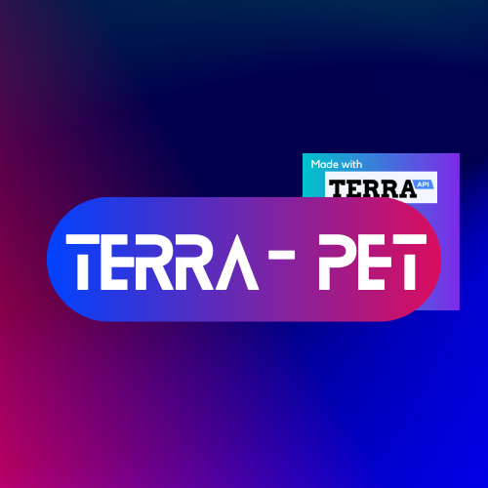
Welcome to Terra – Pet
Made by Harsh, Hari, Mohammed, Maneet and Neel

Slide 2



What is Terra – Pet?
Terra-Pet is a fitness app that uses the Terra API to collect health-related data from users and help them stay committed to their fitness goals.
The app rewards users for achieving their weekly goals by growing a virtual pet, which improves as the user becomes healthier and more active.

Slide 3
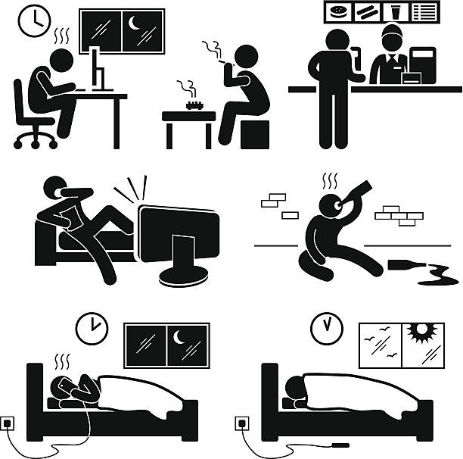
Problem
Sedentary lifestyles are leading to increasing rates of obesity and other health problems.

Slide 4

Solution
Terra – Pet encourages physical activity and healthy habits by making fitness fun and engaging.

Slide 5



Working
If your goal for the week is 70,000 steps for a week, a progress bar is shown next to your pet which is linked to the data received from your FitBit and AppleWatch.
If you achieve your goal by the designated time, your pet evolves.

Slide 6

Features
Players must engage in physical activities to keep their virtual pet healthy and happy.
The game uses data from wearables like Fitbit and Apple Watch to track players' fitness progress and adjust gameplay accordingly.
Players can compete against friends or other players to see who can keep their virtual pet the healthiest.

Slide 7



Benefits
Encourages physical activity and healthy habits.
Appeals to a wide audience, including both children and adults.
Can be monetized through in-app purchases and sponsorships.

Slide 8

Market Potential
The global health and fitness app market is expected to reach $14.64 billion by 2026.
The market for virtual pet games is also growing, with games like Nintendogs and Tamagotchi selling millions of copies worldwide.

Slide 9

Competitive Landscape
There are currently no major players in the virtual pet game market that specifically focus on promoting health and fitness.
Our unique selling proposition is our ability to combine fun and engaging gameplay with a focus on physical activity and healthy habits.

Slide 10
Thank you
Any questions?

