Slide 1

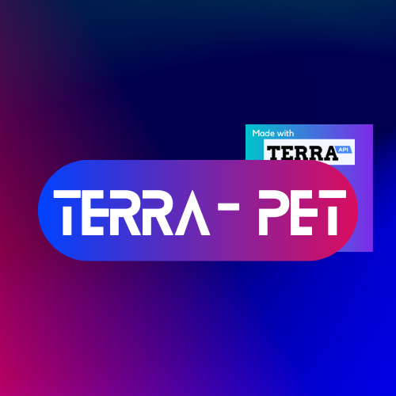
Welcome to Terra – Pet
Made by Harsh, Hari, Mohammed, Maneet and Neel

Slide 2



What is Terra – Pet?
Terra-Pet is a fitness app that uses the Terra API to collect health-related data from users and help them stay committed to their fitness goals.
The app rewards users for achieving their weekly goals by growing a virtual pet, which improves as the user becomes healthier and more active.

Slide 3
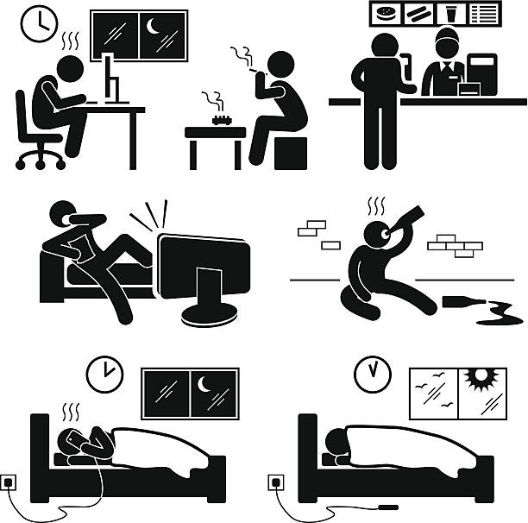
Problem
Sedentary lifestyles are leading to increasing rates of obesity and other health problems.

Slide 4

Solution
Terra – Pet encourages physical activity and healthy habits by making fitness fun and engaging.

Slide 5



Working
If your goal for the week is 70,000 steps for a week, a progress bar is shown next to your pet which is linked to the data received from your FitBit and AppleWatch.
If you achieve your goal by the designated time, your pet evolves.

Slide 6

Features
Players must engage in physical activities to keep their virtual pet healthy and happy.
The game uses data from wearables like Fitbit and Apple Watch to track players' fitness progress and adjust gameplay accordingly.
Players can compete against friends or other players to see who can keep their virtual pet the healthiest.

Slide 7



Benefits
Encourages physical activity and healthy habits.
Appeals to a wide audience, including both children and adults.
Can be monetized through in-app purchases and sponsorships.

Slide 8


Future Developments V1
Currency is going to be called PetCoins. equation to calculate PetCoins: (0.25 x activity seconds + 0.75 x steps walked)/100
When a new egg is purchased, it takes time to hatch it and create the pet.
The user should be allowed to use steps walked to speed up the hatching process.
This can be achieved by implementing a timer and displaying the remaining time to the user using a progress bar.
When the timer reaches 0, the egg should hatch and the new pet should be added to the users collection.

Slide 9

Future Developments V2
As of now, only the steps walked contribute to calculating PetCoins. In the future, we envision this app to be able to use data from other activities such as swimming and cycling for example. This can be implemented by adding additional filters in our JSON filtering program.
Fitness streak that record the consecutive days a user has met their goal. This can be implemented using a timestamp to ensure that the daily streak is maintained.

Slide 10

Market Potential
The global health and fitness app market is expected to reach $14.64 billion by 2026.
The market for virtual pet games is also growing, with games like Nintendogs and Tamagotchi selling millions of copies worldwide.

Slide 11
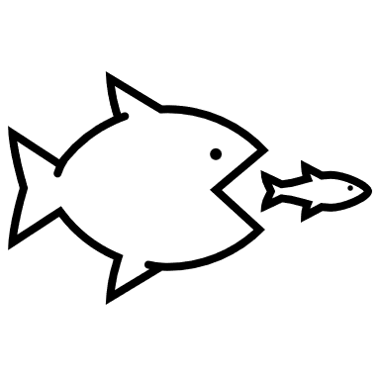
Competitive Landscape
There are currently no major players in the virtual pet game market that specifically focus on promoting health and fitness.
Our unique selling proposition is our ability to combine fun and engaging gameplay with a focus on physical activity and healthy habits.

Slide 12
Thank you
Any questions?

