Slide 1
Flight Booker Bot:
A Demo
By Karl Davidson
June 26th, 2020

Slide 2
Presentation Breakdown
Background
Process
Training
NER Methodology
Demo (in Colab)
Next Steps and Conclusion

Slide 3
Background
Objective:
Build a chatbot that extracts flight booking information (depart/return times, origin/destination location and budget) and outputs an example booking from an external API.
Chatbot Framework
Chatterbot
NER Library
SpaCy
Training Data
English Corpus (Chatterbot)
API
Amadeus

Slide 4
Process Outline
Researched chatbot libraries and the basics of their construction.
Discovered different methods of learning and applied different sets of training data.
For demonstration, used a sample set of flight booking conversations, and the english corpus.
Used SpaCy Pattern matching to extract dates, locations and budget.
Input gathered information into API call.
Notes:
I don’t know if this slide fits.

Slide 5


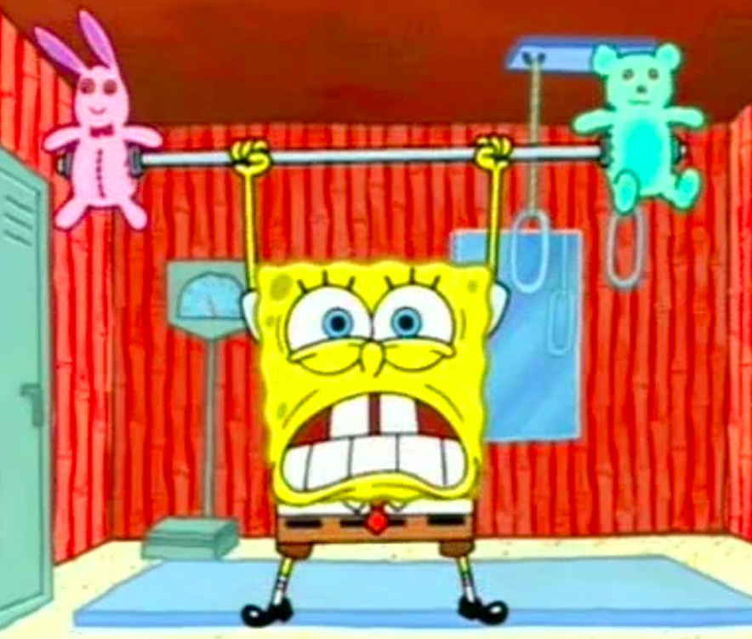
Training was unfortunately nonoptimal
The goal of this portion was to train with a large amount of data.
So instead, I trained on a small set of sample conversations, that were more generalized, as well as the English Corpus from the Chatterbot Library
Though unfortunately, the bot would only output full sentences which best matched the user input. This made a large portion of the training data unusable.

Slide 6
SpaCy very effective for NER
Named Entity Recognition.
Parsed user input for named entities.
Used SpaCy library and its pattern matching package.
Matched based on characters or specific words that preceded the entities
I.e. to/from
$ for budgets

Slide 7
Demo time!
Switch to Colab...

Slide 8
Next Steps
Find a better way to utilize training data.
Consider NLU framework rather than just NLP.
Gradually remove scripted aspects of the bot
Expand on info returned by API.
Refine and expand upon pattern matching for better precision.
Look into more powerful system for training chatbot.

Slide 9
Thank you
Questions? Comments? Concerns?... Insults? Email me: karldsdavidson@gmail.com

