Slide 1
SIE - Report
IEEE Café
Manuel Cerqueira da Silva,
Mestrado em Engenharia Electrotécnica e de Computadores
up201806391

Slide 2
The purpose
As stated in the main page:
“At IEEE, we believe that innovation should be powered by great ideas and, of course, a great cup of coffee right in the comfort of the IEEE room at University of Porto. This website manages our coffee capsule machine and showcases custom-designed mugs tailored specifically for our lounge.”
This work emerges in the context of creating a web application for managing a coffee capsule machine, which is currently under development, in the IEEE lounge at the University of Porto. Furthermore, I consider this to be a great opportunity to showcase some of the custom-designed personal mugs created specifically to keep in this room.

Slide 3
Information sources
IEEE room, like the ideias and the picture of the mugs
The image of the coffee capsule came from the Nespresso webpage
The current image of a mug in the current mockup is a temporary sample image, because it’s been difficult to take pictures of the mugs that fit in this project like the sample image
The logo is a mixture of Java programming language logo (from https://www.freepik.com/) and IEEE’s logo
Fontify.com was used for font combination
The colors pallet were inspired in: https://www.pinterest.com/pin/578571883364336416/

Slide 4
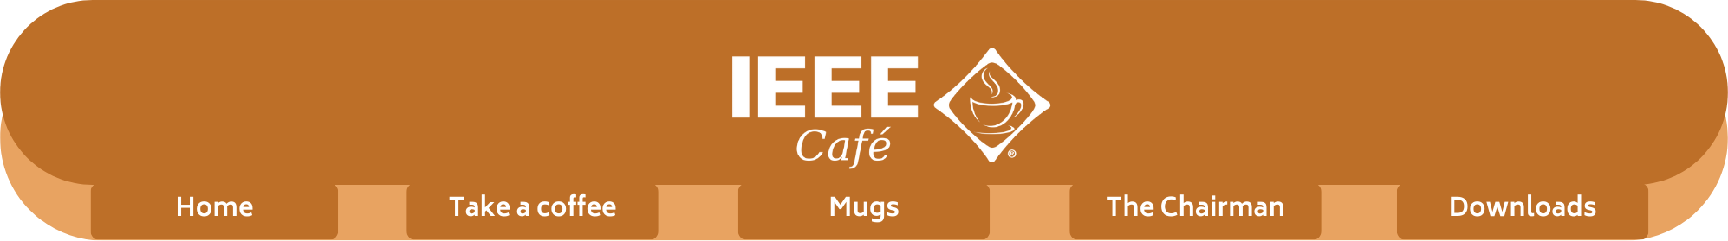
Structure
Home: Explain the purpose of the webpage.
Take a coffee: Where can the user ask for a capsule from the machine.
Mugs: Show some of the special mugs from the IEEE University of Porto members.
Chairman: Info about me.
Downloads: To download the code and the report

Slide 5
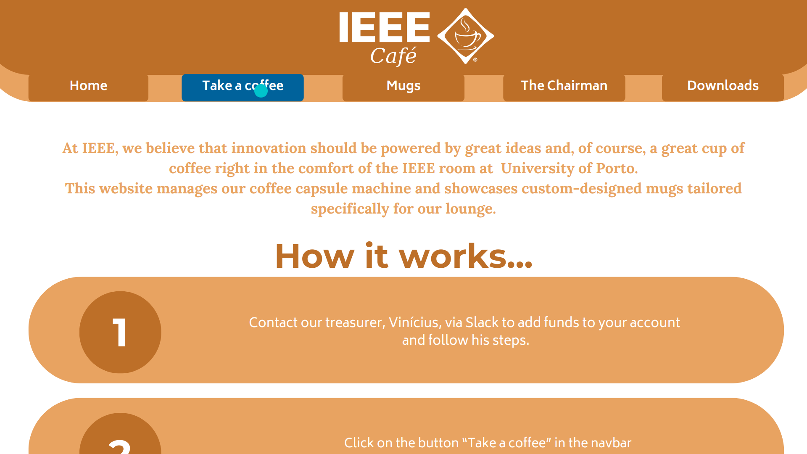
Header
Button
Button on hover
Navbar
Content container
Subtitle
Title
Paragraph

Slide 6
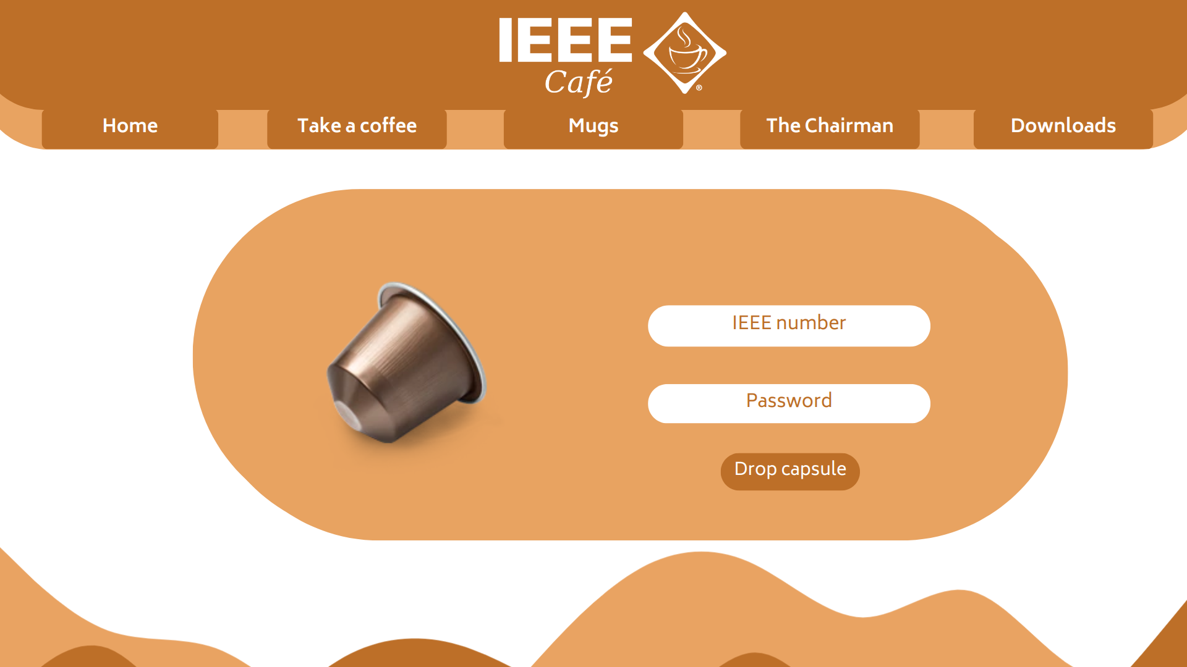
Content container
Text box
Botton
Coffee waves footer

Slide 7
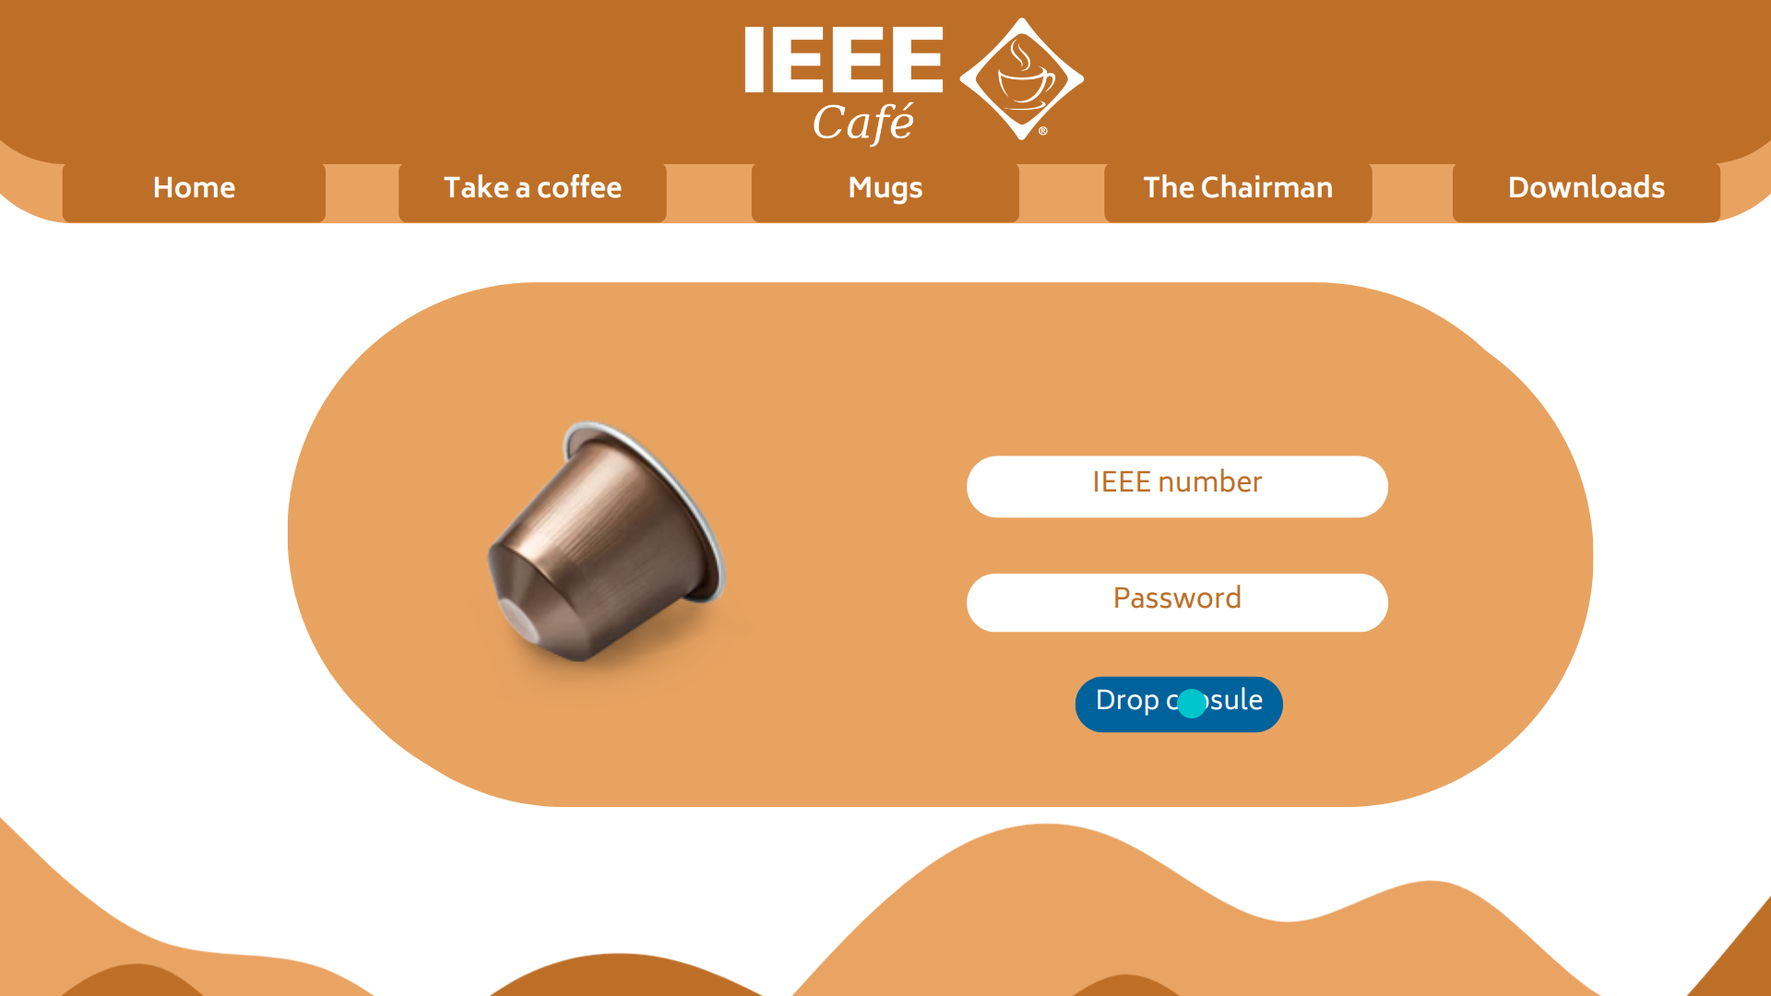
Button on hover

Slide 8
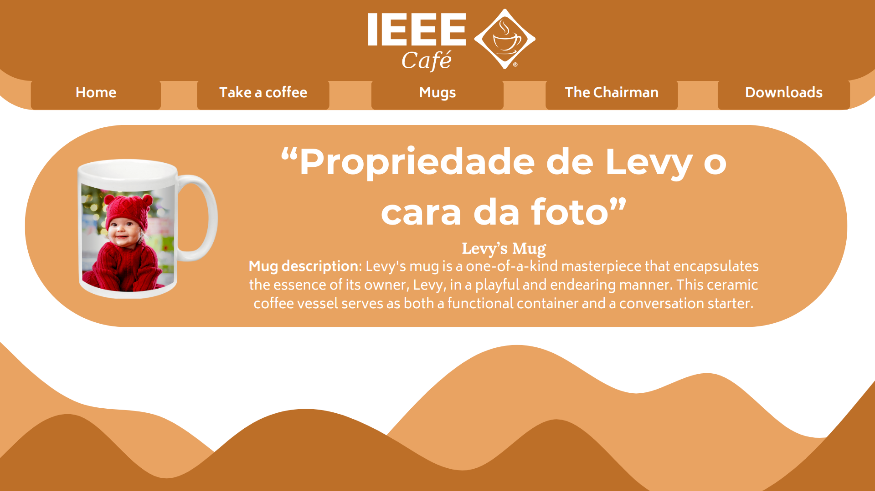
Title
Content container
Subtitle
Slideshow
Paragraph

Slide 9
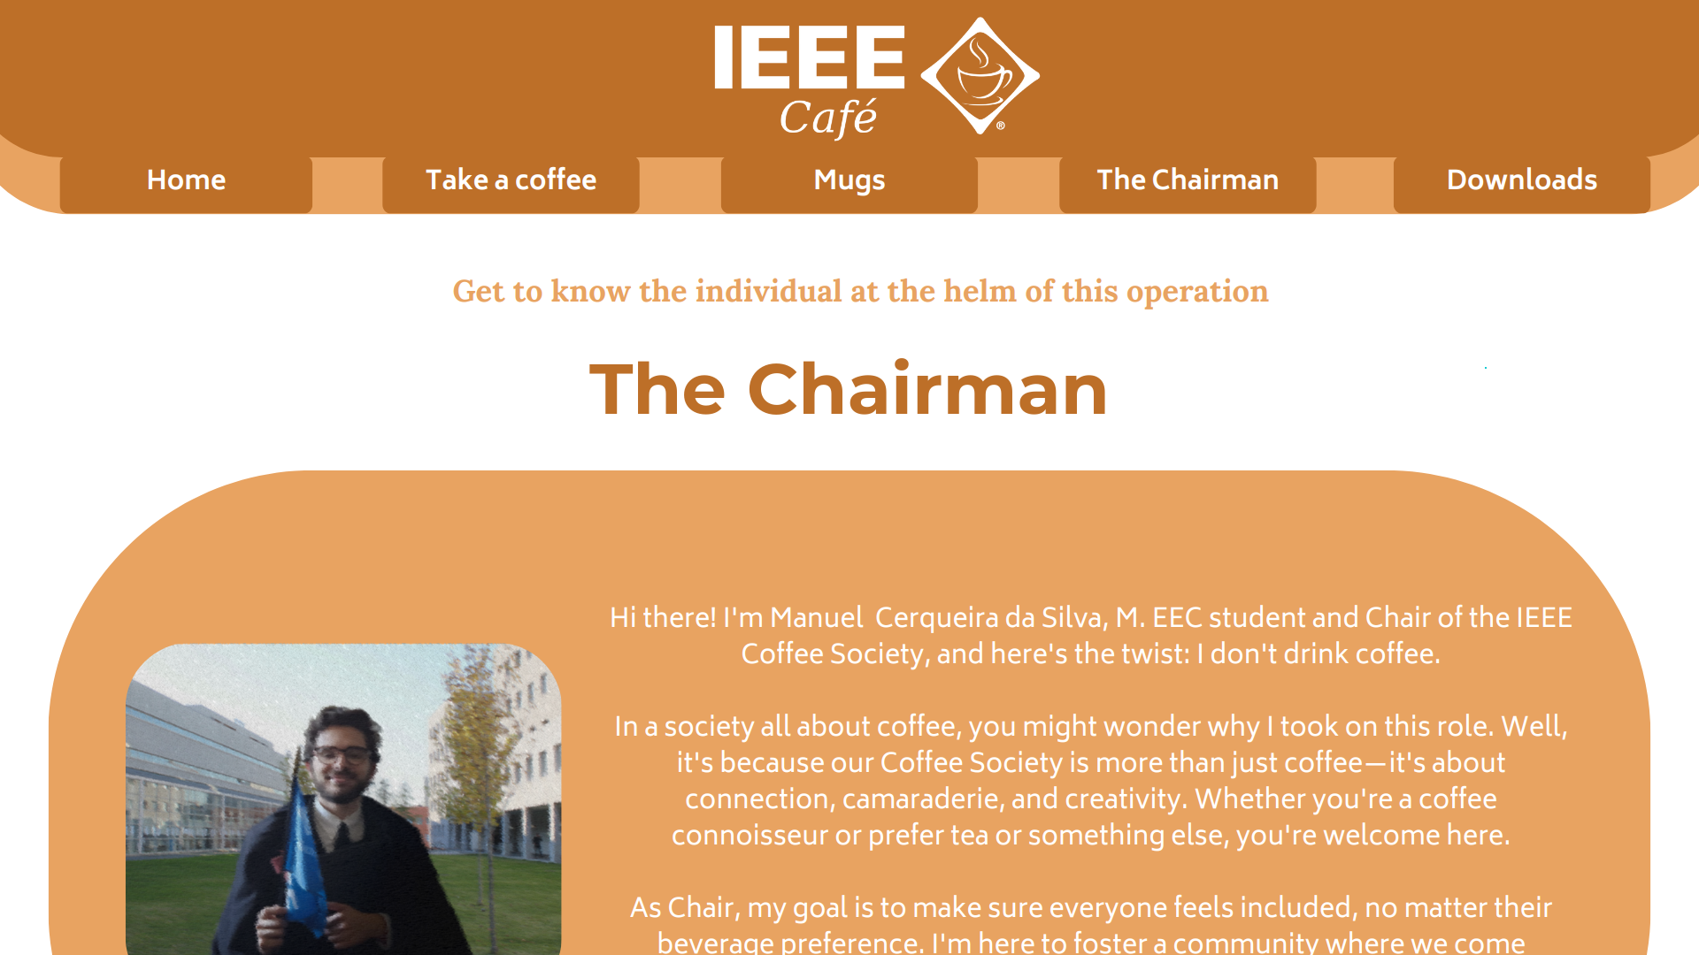
Subtitle
Title
Content container
Paragraph

Slide 10
Colors and Fonts
I used a total of four colors:
#1 Coffee
#2 Iced coffee
#3 White
#4 IEEE blue
And for different fonts
Monteserrat
Lora
Biryani (This is not Biryani)

Slide 11
Text
I used 3 types of text configuration templates:
.title {
color: #bd6f28; /* Color #1*/
font-family: 'Montserrat', sans-serif;
/* Font #1*/
}
.subtitle {
color: #e8a361;
/* Color #2*/
font-family: 'Lora', serif;
/* Font #2*/
}
.paragraph {
color: white;
/* Color #3*/
font-family: 'Biryani', sans-serif;
/* Font#3*/
}

Slide 12
Header
.header {
background-color: #bd6f28;
/* Color #1*/
border-bottom-left-radius: 20px;
/* Adjust the radius as needed */
border-bottom-right-radius: 20px;
/* Adjust the radius as needed */
}
.logo {
max-width: 100%;
height: auto;
}

Slide 13
The navbar
I opted to choose I simple navigation scheme using a navbar in the top of every page. In my opinion, this simplicity make the website be easy to navigate and to implement. The template of the CSS is very similar to the header
.header {
background-color: #bd6f28;
/* Color #1*/
border-bottom-left-radius: 20px;
/* Adjust the radius as needed */
border-bottom-right-radius: 20px;
/* Adjust the radius as needed */
}

Slide 14
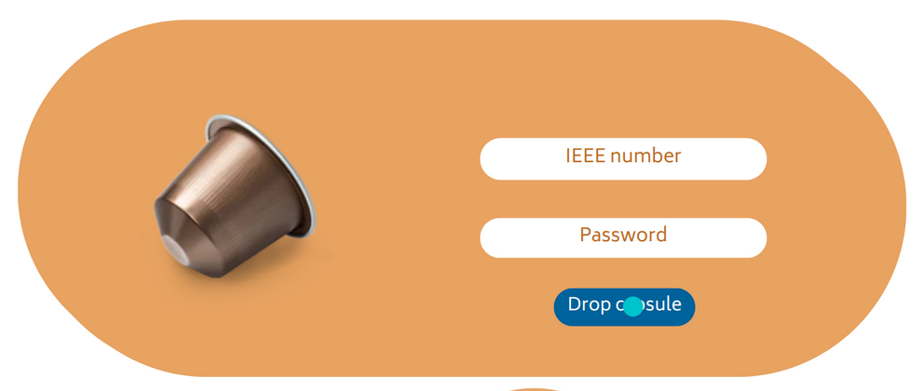
Content container
The “Content Container” is designed to hold the majority of the website's content and is one of the most frequently used HTML structures.
.container {
background-color: #e8a361; /* The color #2*/
border-radius: 10px; /* Adjust the radius as needed */
padding: 20px; /* Add padding for spacing inside the container */
}

Slide 15


Button
All the button in the website follows this template, including the ones in the navbar
.button {
background-color: #bd6f28;
/*Color #1*/
color: #fff; /*Color #2*/
border-radius: 5px; /* Adjust the radius as needed */
}
button:hover {
background-color: #e8a361;
/* Change the color on hover to the color #3*/
}

Slide 16

Fotter
The footer is adorned with a captivating image, resembling the gentle ripples of a freshly brewed cup of coffee.
.footer {
background-image: url('coffee_waves.jpg');
with: 100%
}

Slide 17
Changes
Image Replacement in "Take a Coffee" Page: Initially, I used a capsule image in the "Take a Coffee" page. However, based on feedback of my classmates and design considerations, I replaced it with the coffee cup presented in the website's logo. This change aligns the design with the rest of the website identity and enhances visual consistency.
Switch from Display Flex to Static Elements: I initially used display flex for layout in both the "Take a Coffee" and "Mugs" pages. This choice was driven by the simplicity and ease of styling, and it ensures a consistent design experience.
Introducing a Parent Div for Positioning: To enhance control over positioning and styling, I introduced a parent <div> element that encapsulates the content container. This parent div simplifies the organization of our webpage structure and streamlines the application of styles.

Slide 18
Changes
Removal of Slideshow Feature: Originally, I planned to implement a slideshow feature on the website. However, given the limitations of using HTML and CSS alone, I decided to remove the slideshow component. Future iterations of the project may consider incorporating JavaScript to address this feature.
Dedicated CSS for Text Styling: I developed a dedicated CSS file exclusively for text styling. This approach allows to maintain a cleaner and more organized codebase, making it easier to manage and update text-related styles across the website.
Change of Button Color: As part of design adjustments, we substituted the IEEE blue color with brown for the buttons on the website. This change offers a more cohesive and appealing user experience.

Slide 19
Navbar implementation
This is a brief explanation how my navbar was implemented regarding html and css:
HTML Structure: The navigation bar is structured with a <nav> element containing an unordered list (<ul) that holds a list of navigation items.
List Items: Each list item (<li>) represents a navigation link. These links are defined using anchor (<a>) elements with href attributes pointing to different pages.
CSS Styling: The CSS code styles the navigation bar:
Removes bullet points from the list.
Arranges list items horizontally using flexbox.
Styles list items as buttons with rounded corners and hover effects.
Makes the anchor elements block-level for better clickability.
Navigation Links: Each link directs users to specific pages on the website. One link allows users to download a file with the specified filename.

Slide 20
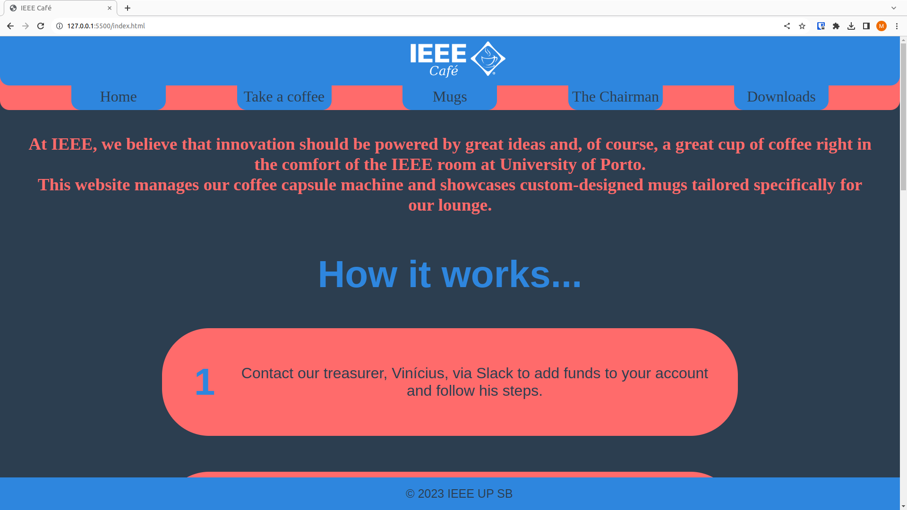
Key aspects for evaluation
This webpage has been tested and is compatible with Google Chrome and Firefox. For the best user experience, please use a screen resolution of 1920x1080 pixels.
The implementation of style sheets allows for quick and easy adjustments to the website's appearance by modifying both the color palette and text styles.
As an illustration, consider the
following alternative theme:

