Slide 1
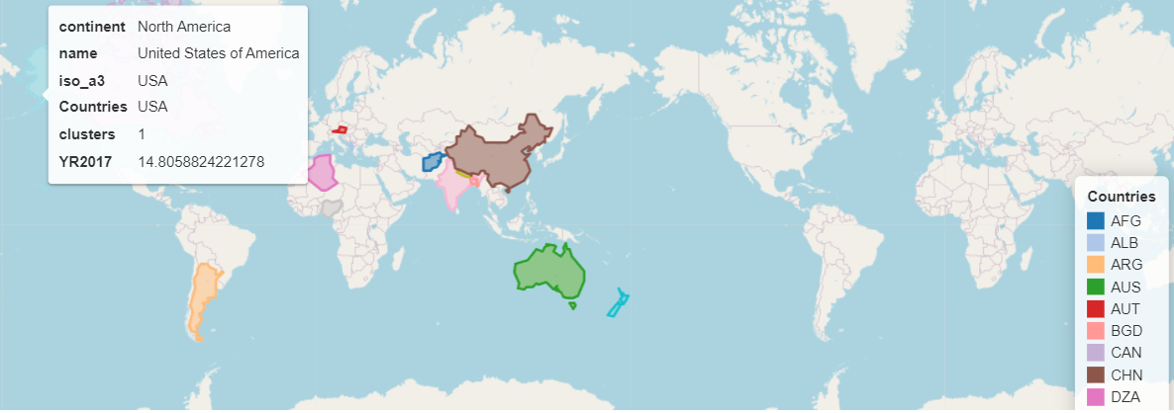
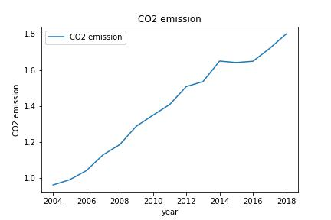
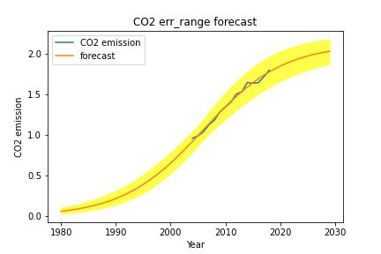
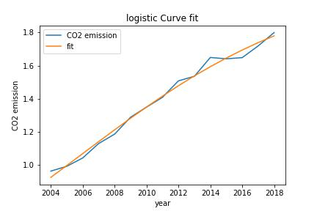
CO2 EMISSION CLUSTERING & FITTING FOR DEFFERENT COUNTRIES
INTRODUCTION
Carbon dioxide emissions are those which are produced from the burning of fossil fuels. They include carbon dioxide produced during consumption of solid, liquid, and gas fuels and gas flaring. some sources of Co2 emissions are decomposition, ocean release and respiration. This Investigation looks at Co2 emissions that are produced over a period of years between 1980-2030 in various countries. We have formed two clusters in order to achieve this requirement. The main advantage of this activity I is we can estimate the risk of Co2 emissions and can take necessary steps in order to keep them in control.
Fig.1 - world map for clustering
Fig.2-CO2 emission
In fig.1 From the geographical graph, some countries like newzealand, china, india, Afghanistan, Albania, austria, Algeria are segregated intocluster 1 and countries like USA, canada, australia are segregated into 2nd cluster.
In fig.2 By using the above plot, we are checking the trend of range of co2 emissions from 2004-2018 and we can see the emissions are increasing every year.
Fig.3-CO2 error ranges forecast
From the figure.3 by applying curve fit, we are trying to identify large interval of data for which the proportional growth rate is linear. We can exactly see this phenomenon from the graph for features co2 emissions and year for the country India.
Fig.3 Curve fit
from the above plot we are trying to figure the co2 emission from years ranging from 1980-2030 and forecast is consistent between the period.
Conclusion:
Post data is taken from world bank and dividing it to two clusters with the help of K means clustering and after analyzing the clusters and observing various correlations between the features, we are able to find out the forecast of co2 emissions for the coming years based on historic data evidence. This helps as an indication and helps in predicting the growth of Co2 emissions country wise in coming years. Results are same with applying normalization or with out normalization. Post applying the curve fit we have calculated the err_ranges and values obtained for err_ranges is 1.88919 -2.19177 and predictions of c02 emissions are found out for years 1980-2030.
References:
[1]-Sudhir Singh, Dr. Nasib Singh Gill,Comparative Study Of Different Data Mining Techniques : A Review, www. ijltemas.in, Volume II, Issue IV, APRIL 2013 IJLTEMAS ISSN 2278 – 2540.
[2]-N.K. Lünsdorf and J.O. Lünsdorf 2016 Journal of Coal Geology 160–161 51
[3]-Narkhede, Rajkumar & Rastogi, Prabha. (2020). Analysis of Curve Fitting for Case Studies for Indian Power Sector. IOP Conference Series: Materials Science and Engineering.
Notes:
B curve the same for most SN Ia, other bands have distinct features, such as twin peaks etc.
Type II 30 times fainter, 3 magnitudes fainter than Ia

Slide 2
CO2 EMISSION CLUSTERING & FITTING FOR DEFFERENT COUNTRIES

