Slide 1
Project Overview OpenBuildingControl: Performance Evaluation, Specification, and Verification of Building Control Sequences
Philip Haves & Michael Wetter, LBNL
1st TAG Meeting
2/2/2017

Slide 2
Presentation Contents
Goals and Objectives
Process
Technical Approach
Challenges
Team and Structure
Technical Advisory Group and ASHRAE GPC 36
Schedule and Budget

Slide 3
Problem Statement
No generic design tools for control strategies
No tools to generate sequences of operation from strategies
No way to ensure, or verify, that sequences get implemented correctly
Other industries have these tools, and depend on them.
Notes:
Design tool: create/edit strategies and compare/evaluate performance
Other industries – automotive, aeronautical … - do have these tools, and depend on them to produce robust controls through automatic implementation of validated sequences

Slide 4
Goals and Objectives
Develop a process and a set of tools to enable:
Design of effective strategies and sequences
Automated generation of vendor-specific code
Verification of correct implementation
Traceability from design to installation and operation, including changes
Key characteristics:
Open standards
Open source
Vendor neutral
Long term vision: automated control system design, including:
Component selection
Network configuration
Notes:
SLOW
Approach: develop a process that is technically sound and works from a business perspective – TAG!
Develop set of software tools to support this process

Slide 5
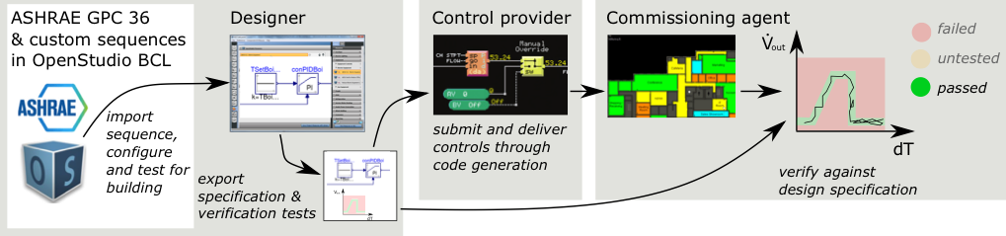
Technical Approach
Process:
Tools:
Controls design tool: whole building → local loop
Generates sequences in open-standard controls description language (CDL)
Support for industry development of tools to interpret CDL
Functional verification tool
Notes:
First step: develop a generic computer language to express sequences of operation - controls description language (CDL) – resemble most block programming languages for building controls
Next step: develop a design tool that spans the range from whole building to local loop – based on DOE’s radical re-architecting of its EnergyPlus building simulation program
The tool will evaluate control strategies and generates sequences in CDL
We will also develop a toolkit that can be used by controls manufacturers to produce simple translators from CDL to their proprietary languages, enabling automatic generation of control programs for their products.
We plan to enable verification of correct implementation by incorporating functional testing algorithms in the sequences
Ultimately, the tool will

Slide 6
Challenges
Define a technical process based on viable business model(s) quickly enough to specify tool requirements
Controls design tool:
Computationally efficient modeling of local loop control in a whole building model
Projects with no envelope + systems model
Controls specification language:
Vendor-neutral but easily mapped to proprietary products
Extensible to support new technology (e.g. MPC) and new control system architectures
Engage critical mass of vendors, designers, contractors and owners to ensure wide adoption
Notes:
… quickly enough … without holding up the project
Larger buildings – manage the complexity and computational burden of hundreds or even thousands of loops
Many projects have no energy model by the start of DD’s, so we will use prototype building models – configurable in terms of climate, use patterns, basic geometry and system types
CDL: generic but easily mappable to proprietary products
Extensible, hand off to ASHRAE for care and feeding
TAG!

Slide 7
Team and Structure
LBNL: project management, software development
Partners:
Arup
CBRE
ControlCo
(Genetech)
Integral Group
kW Engineering
Oracle
Stanford
Subcontractors:
Integral Group: specification and testing of standard sequences
Arup: process definition, testing and demonstration, GUI spec, international
(PNNL: project organization)
Taylor Engineering: specification and testing review, ASHRAE
Facility Dynamics Engineering: TAG chair, review
Notes:
CBRE: ESI controls integrators – part of Global Workplace Solutions in Global Energy & Sustainability in CBRE
Oracle and Stanford facilities departments

Slide 8
Technical Advisory Group and ASHRAE GPC 36
TAG:
Vendors and other stakeholders
Technical and business feedback
Chair: Jay Santos (FDE)
Quarterly meetings
1st meeting: 2/2/2017
ASHRAE GPC 36:
Chair: Mark Hydeman (Google)
Multiple members from project
Two-way feedback

Slide 9
Schedule and Budget
DOE: $2M
CEC: $1M(?)
In-kind cost share: $413k US + $75k UK
Notes:
3 year project
Main funding from DOE – won in a competitive solicitation
CEC! (MW?)

Slide 10
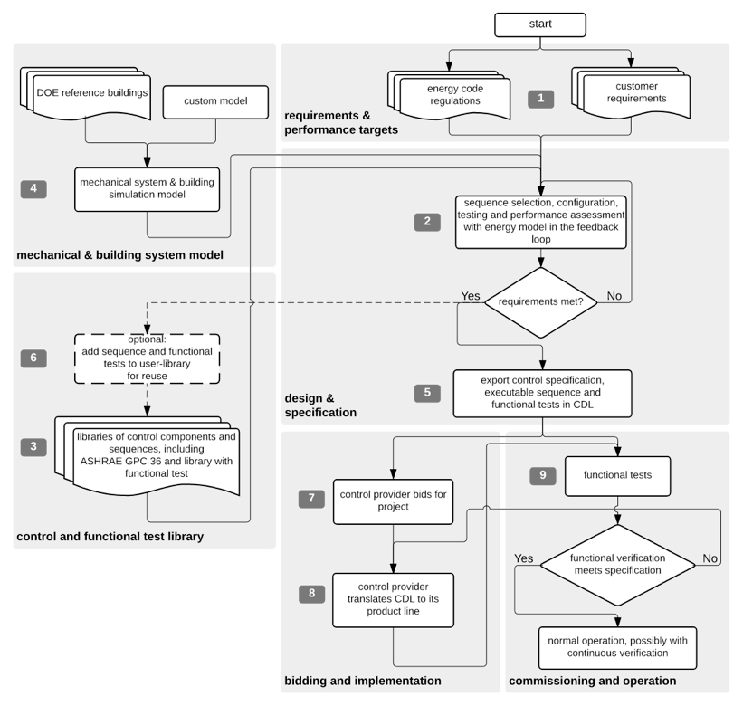
Process
Notes:
Skip (return?)

