Slide 1
Advanced Programming
Lab 9, Class(1)
廖琪梅，王大兴, 于仕琪，王薇

Slide 2
Topic
Class in C++
Class constructor and destructor
Static member variables and static member functions
Const member variables and const member functions
Exercises

Slide 3
Class Constructors
A class constructor is a special member function:
1. Has exact same name as the class
2. No return value
3. It is a public member function of the class
4. Invoked whenever you create objects of that class
Constructors can be very useful for setting initial values for certain member variables.
If you do not provide a constructor, C++ compiler generates a default constructor (has no parameters and an empty body) for you.
Note:The constructor can be overloaded, be careful the constructor with default arguments.

Slide 4
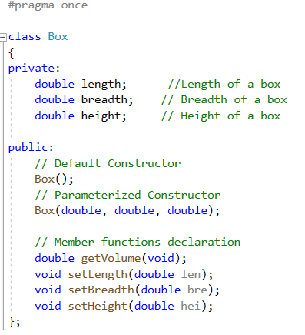
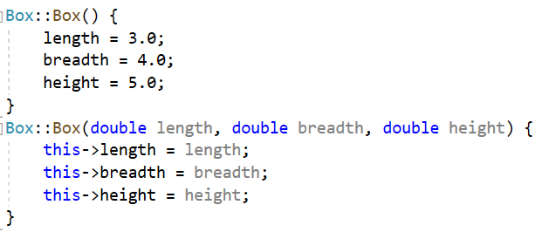
Implementation of functions using the scope resolution operator(::)
“this” is a pointer points to the object itself

Slide 5
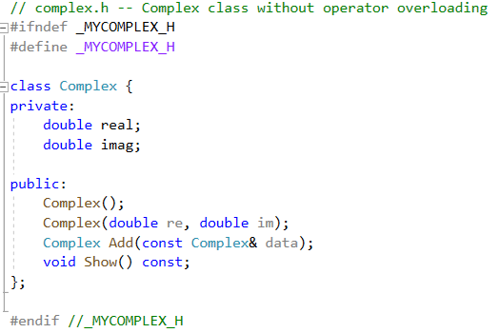
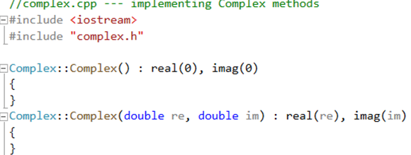
initialization list
The member initialization list is set off from the parameter list by a colon. It is a comma-separated list in which the value to be assigned the member is placed in parentheses following the member's name.
The member initialization list is used primarily to pass arguments to member class object constructors.

Slide 6
Default constructor
A default constructor is a constructor that is used to create an object when you don’t provide
explicit initialization values. If you do not provide any constructors, the compiler will automatically
supplies a default constructor. It’s an implicit version of a default constructor, and it does nothing.
There is only one default constructor in a class.
If you define any constructor for a class, the compiler will not provide default constructor. You must define your own default constructor that takes no arguments.
You can define a default constructor two ways. One is to provide default values for all the arguments to the existing constructor:
Box(double len = 1.0, double bre = 1.0, double hei = 1.0);
The second is to use function overloading to define a second constructor that has no arguments:
Box( );
NOTE: You can have only one default constructor, so be sure that you don’t do both.

Slide 7


Creating objects
When you create an object, the constructor will be invoked automatically. If you define default constructor, you can declare object variables without initializing them explicitly.
You shouldn’t be misled by implicit form of the non-default constructor.
second() is a function that returns a Box object.
When you implicitly call the default constructor, do not use parentheses.

Slide 8
Class Destructors
A class destructor is also a special member function:
1.A destructor name is the same as the classname but begins with tilde(~) sign.
2. Destructor has no return value.
3. A destructor has no arguments.
4. There can be only one destructor in a class.
5. The compiler always creates a default destructor if you fail to provide one for a class.
6. Invoke when an object goes out of scope or the delete is applied to a pointer to the object.
Destructor can be very useful for releasing resource before coming out of the program like closing files, releasing memories etc.
Note:The destructor can not be overloaded.

Slide 9
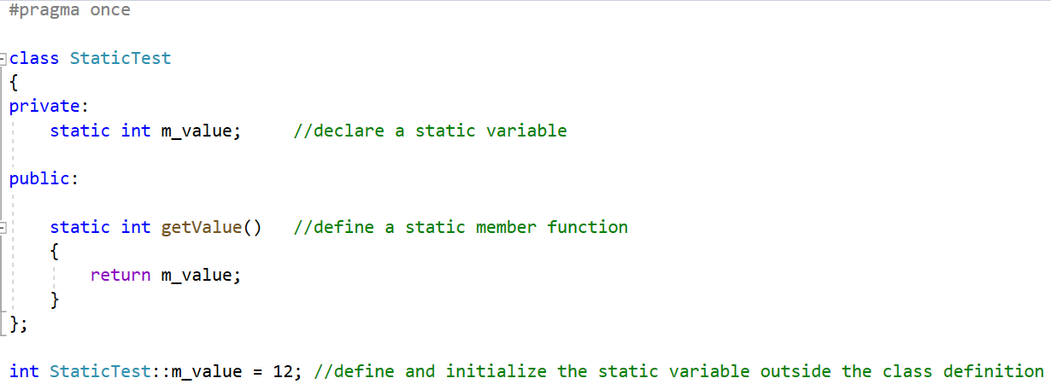
Static member variables
The static member variables in a class are shared by all the class objects as there is only one copy of them in the memory, regardless of the number of objects of the class.You must provide an explicit definition of that instance within a program text file. The definition looks like the global definition of an object except that its name is qualified with the class scope operator ::
static member variable can not be initialized when it is defined
static member variable must be initialized outside the class definition

Slide 10
Static member functions
A static member function can be invoked independently of a class object in exactly this way. A member function can be declared as static only if it does not access any non-static class members. We make it static by prefacing its declaration within the class definition with the keyword static
Define a static member function

Slide 11
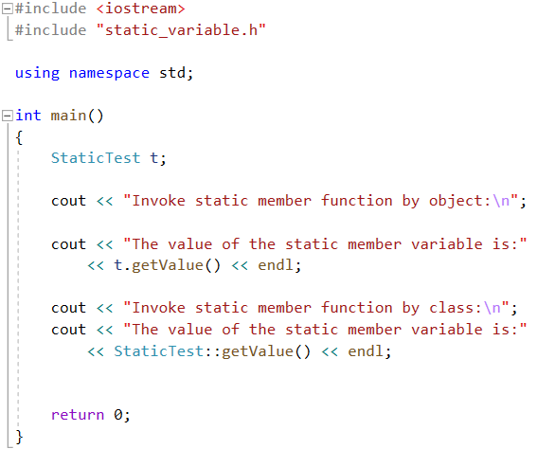
You can use object or class to access the static members.

Slide 12
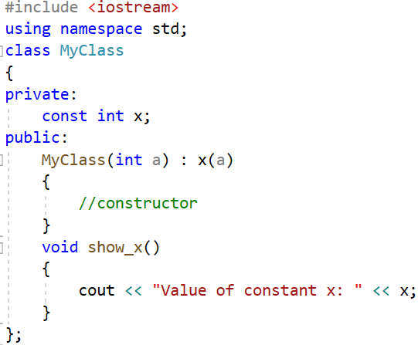
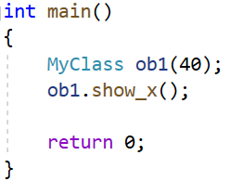
Const member variables
The const keyword specifies that a variable’s value is constant and tells the compiler to prevent the programmer from modifying it. If some member variables need not be modified, these variables can be defined as const. These const member variables can be initialized by initialization list in the constructor.
const member variable
Initialize the const member variable by initialization list
Create an object of MyClass, initialize the
value of x 40.

Slide 13
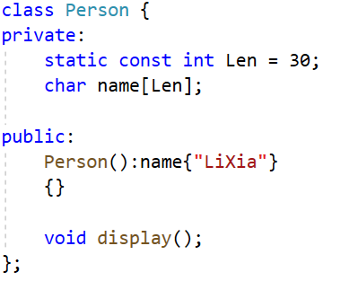
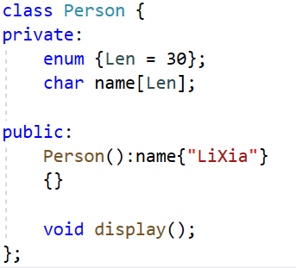
Const member variables
static const member variable can be initialized when it is defined
Define an enumeration

Slide 14
Const member functions
The const modifier follows the parameter list of the function, such function is called const member function. const indicates that the data of the class would not be modified by the function.
A const member function defined outside the class body must specify the const modifier in both its declaration and definition.

Slide 15

Const member functions

Slide 16
#include<iostream>
using namespace std;
class Demo
{
private:
int id;
void display(){
cout<<"this is: "<<this<<", id is:"<<this->id<<endl;
}
public :
Demo(int cid){
this->id=cid;
}
static int num;
void display()
{
cout<<"The value of the static num is: "<<num<<endl;
}
};
int main()
{
Demo obj;
Demo obj1(1);
obj.display();
obj1.display();
Demo::display();
return 0;
}
Exercises 1
Will the program below execute successfully? Explain why or why not.
Modify the program as follows:
Fix any errors in the code.
Ensure that when a member function is called by an object, it displays the value of the this​ pointer and the member variable id.
Ensure that when the function is called using the class name, it displays the value of the static variable num.
int main()
{
Demo obj;
obj.display();
return 0;
}

Slide 17
Exercises 2
What is the result of running the program below?
What happens if you uncomment the commented line in the main()function? Explain why.
#include <iostream>
using namespace std;
class ConstMember
{
private:
const int m_a;
public:
ConstMember(int a) : m_a(a) {}
void display() const
{
cout << "The value of the const member variable m_a is: " << m_a << endl;
} };
int main()
{
ConstMember o1{666};
ConstMember o2{42};
o1.display();
o2.display();
// o1 = o2;
return 0;
}

Slide 18
Exercises 3
Define a class named Complex​ to represent and perform arithmetic operations with complex numbers. A complex number is expressed in the form:
realPart + imaginaryPart * i
Use two member variables​ to store the private data of the class (representing the real and imaginary parts).
Provide a constructor​ that allows an object to be initialized when it is declared. The constructor should include default values for both parts in case no initial values are provided.
Implement public member functions​ to perform at least the following tasks:
add:​ Add two Complex numbers.
subtract:​ Subtract two Complex numbers.
display:​ Print a Complex number in a human-readable format, such as a + bi or a - bi, where a is the real part and b is the imaginary part.
Write a main function to thoroughly test all the implemented functionality of your Complex class.

