Slide 1
Modelling The Data Coverage

Slide 2
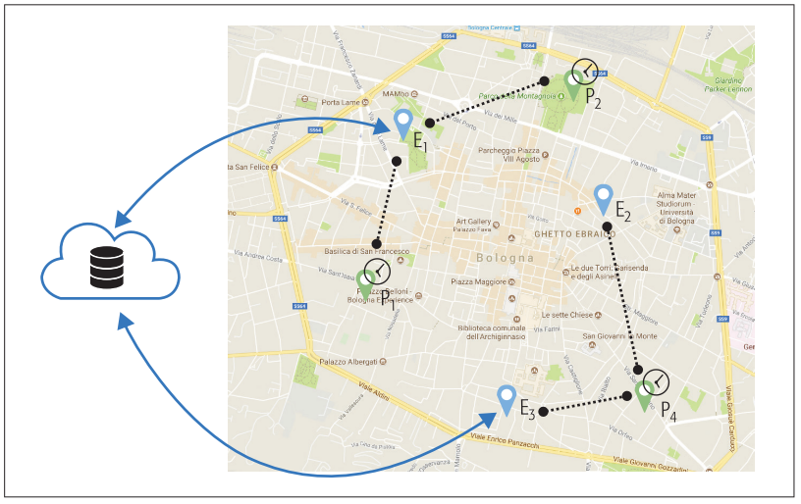
Mobile CrowdSensing
The Back-end
The users
The devices
Tasks:
No user involvement
Active user participation

Slide 3
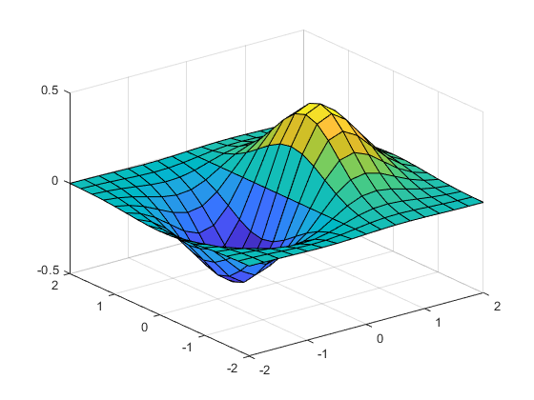
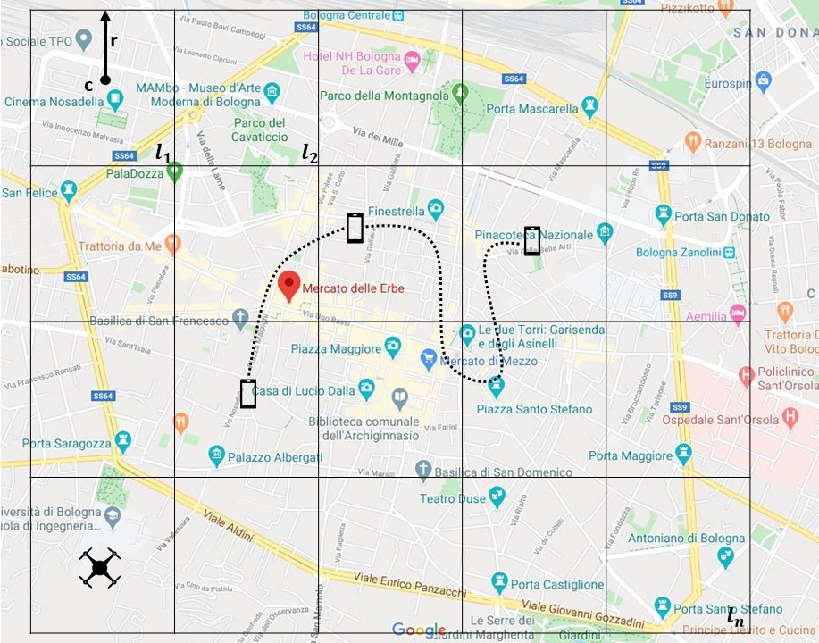
The problem
Data coverage
Drone increasing the data coverage

Slide 4
Problems
Measuring the data coverage with a probabilistic model (T. Colella)
Optimize the deployment of a UAV station able to maximize the location highly uncovered (E. Cipullo)

Slide 5
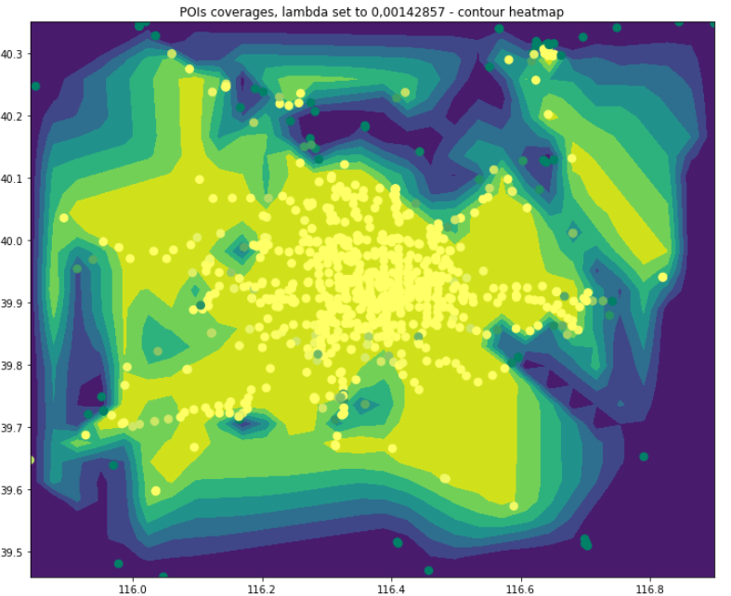
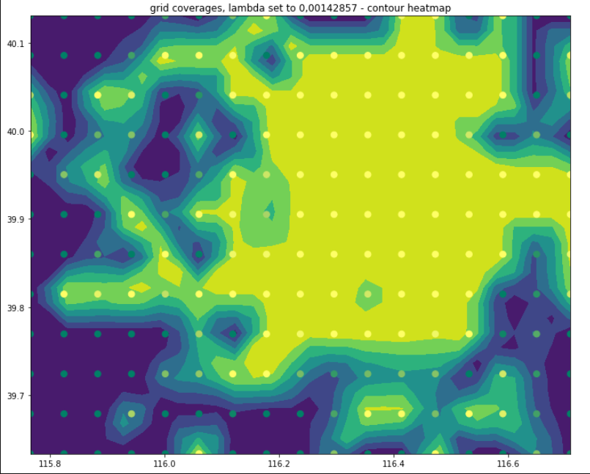
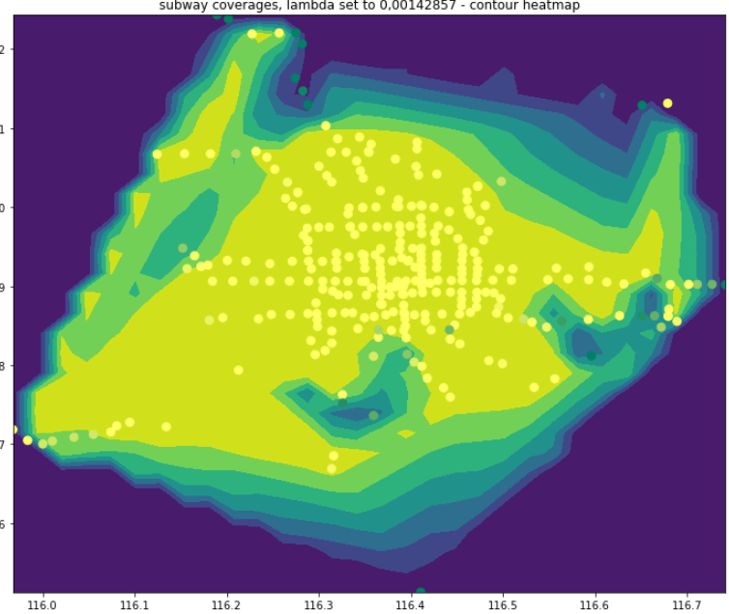
1 -Coverage Model
We computed the coverage for 3 of locations in our data set:
Points of interests (museum, shopping map, squares etc)
GRID deployment of the locations (locations deployed as a regular grid)
Subways stations
Meshgrid N x M where (x,y) provides the coverage score [0,1]

Slide 6
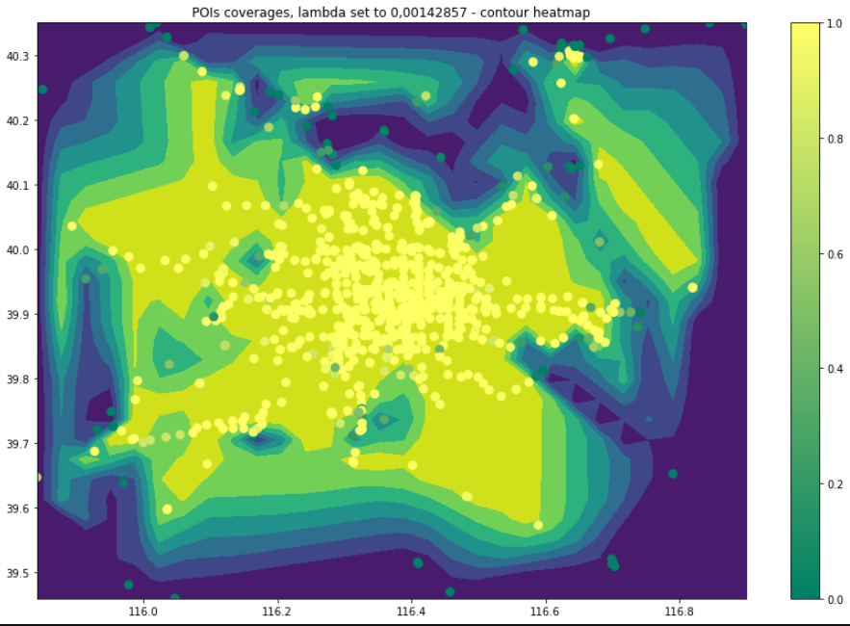

2 – UAV Station Deployment
Goal: Given {L}, the target locations with coverage < k
Deploy a UAV station such that:
the distance from locations in L is minimal
maximise the number of target locations considered
$$\min\left\{d\left(S, x\right)\right\}, ∀x∈X$$

