Slide 1
Smartphone as a security token
© Templateswise.com
Group 18
David Gonçalves
Leonardo Troeira
Francisco do Carmo

Slide 2



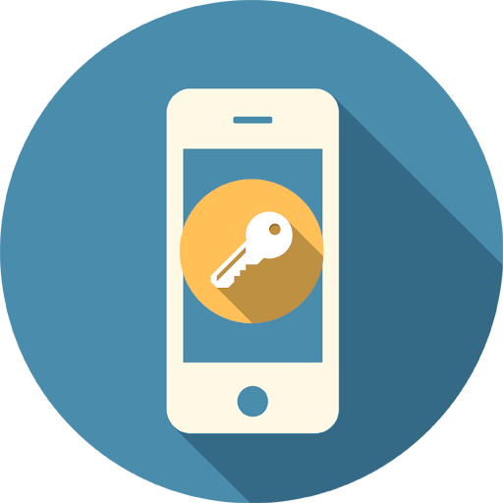




System architecture
Smartphone
Client
Server
WiFi
WPA2
Custom
Secure Channel

Slide 3


System architecture - VMs
Smartphone
Client
Gateway
Server
Subnet 1
Subnet 2

Slide 4
Solution
Password strength, XSS, SQLI
2FA
Custom Secure Channel
Proximity

Slide 5
Password strength, XSS, SQLI
Not the focus of our project, but still:
we use use PHP's password_hash which uses bcrypt.
we require a minimum of 10 characters with lowercase, uppercase, digit and symbol.
we escape HTML characters directly or indirectly provided by a user when output to the screen.
we use SQL prepared statements.

Slide 6
Solution
Password strength, XSS, SQLI
2FA
Custom Secure Channel
Proximity

Slide 7
Two-factor authentication
Smartphone
Client
Server
1. Server
challenges
client
6. Client sends
response to
server who
verifies
4. Smartphone
responds
2. Client sends
challenge to Duo
3. Duo challenges
smartphone
5. Duo sends
response to
client

Slide 8
Solution
Password strength, XSS, SQLI
2FA
Custom Secure Channel
Proximity

Slide 9
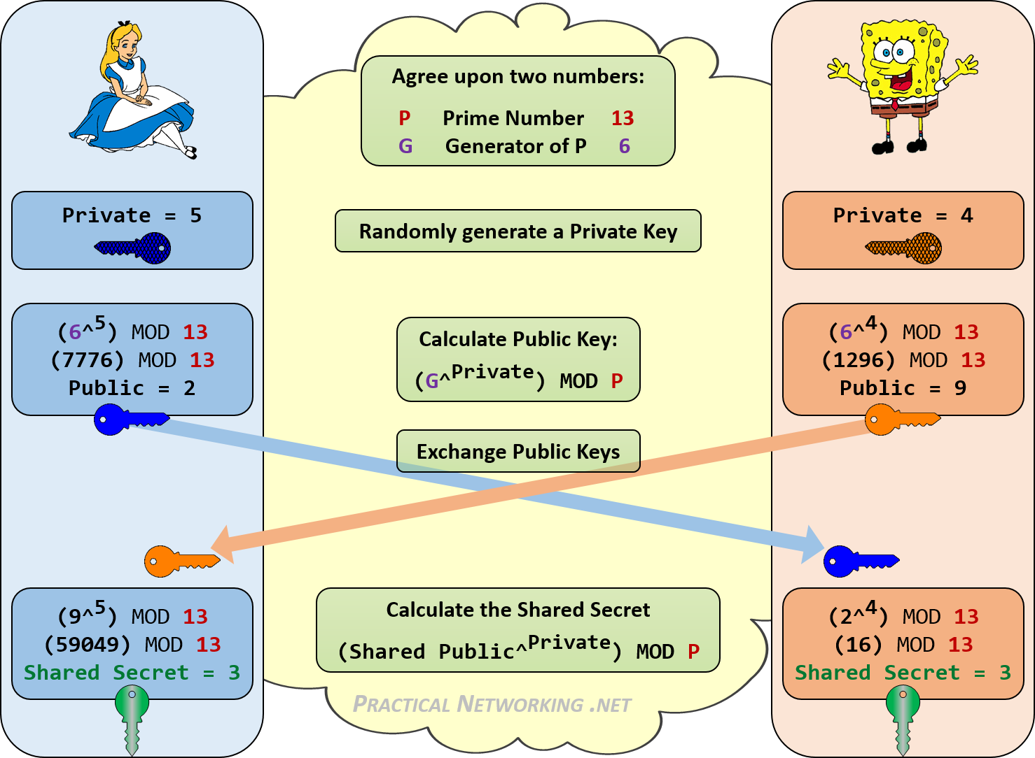
Diffie-Hellman
P is large, e.g. 2048 bits
Private is large and random
G is a primitive root modulo P

Slide 10
Ephemeral Diffie-Hellman (DHE)
Grants perfect forward secrecy by computing new private and public values for each session
If a session key is discovered only that session is compromised.
If a long-term private key is compromised, past sessions are not compromised.

Slide 11
Ephemeral Diffie-Hellman with RSA (DHE-RSA)
Client acts as middle man
due to the lack of JS crypto
and smartphone proximity
* clicks Register button *
request DH
1. Smartphone verifies if RSA pub.'s certificate is signed by a CA. (not implemented)
2. Verifies DH pub. key signature
2. Smartphone computes its own DH pub. and shared secret.
login to smartphone
1. Server verifies DH pub. key signature except on registration
2. Server computes shared secret.
P, G, nº bits of P, server DH pub. key (plain and signed), RSA pub. key
P, G, nº bits of P, server DH pub. key (plain and signed), RSA pub. key
Smartphone's DH pub. key (plain and signed)
Smartphone's DH pub. key (plain and signed)
Request encrypt [username, password]
Ek[username, password, RSA public key]
Ek[username, password, RSA public key]

Slide 12
AES Galois/Counter Mode (AES-GCM)
DH only finds a shared secret that can be used as a symmetric key, it is not an encryption algorithm.
GCM is an authentication encryption mode of operation, it is composed by two separate functions: one for encryption (AES-CTR) and one for integrity and authentication (GMAC).

Slide 13
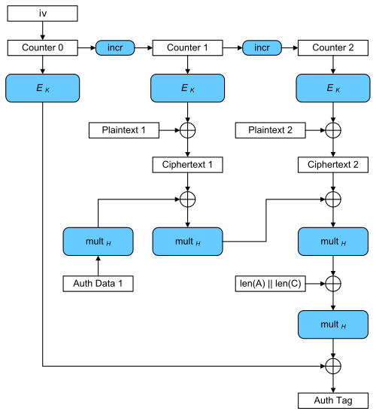

Slide 14
Solution
Password strength, XSS, SQLI
2FA
Custom Secure Channel
Proximity

Slide 15
Proximity
The client can only communicate with the server with the smartphone close by.
Smartphone contains RSA private key and all cryptographic methods.
Client application logs out as soon as connection with the smartphone is lost.
Encrypted .txt files are decrypted to volatile memory only (garbage collected as soon as smartphone connection is lost). (not implemented)
Decrypted binary files are encrypted again as soon as smartphone connection is lost. (not implemented)

Slide 16
Conclusion
Aside from:
1. Not verifying if the server's RSA public key is inside a certificate signed by a Certification Authority;
2. Not having implemented file encryption / decryption in time;
3. Not associating the user's account with Duo at registration;
We have also not encrypted the HTTP headers including the session cookie!
But otherwise we consider our implementation to be a start and our design logic robust.

Slide 17
Problem
Password-based authentication is vulnerable (phishing, XSS, SQLI, rainbow tables, dictionary attacks, brute force, ...)
Secure communication to prevent MITM (ARP Cache Poisoning, DNS Spoofing, ...)
Proximity as a multi-factor authentication (stolen password, session cookie, ...)

Slide 18
Requirements
Prevent XSS and SQLI.
The system must have 2FA.
Communication between client and server must be done through a custom secure channel.
Communication between the smartphone and client application must be done using a secure protocol.
User files must be stored encrypted and can be viewed only if the user has their smartphone nearby the client application.
The system must provide fault tolerance. If the smartphone gets out of reach, the files should not be encrypted again if unencrypted.

Slide 19
Password strength
Login screen: dictionary and brute force attacks
Patterns - we could have a list with most common passwords and not let user choose one of those, but still new patterns appear every day. (not implement)
Hash of password with 8 characters, lowercase, uppercase, digits and symbols can take as little as 4 hours to brute force with a supercomputer or botnet. A 10 character one would take 3 years. Although lenghty characters are inconvenient. (Reference: https://thycotic.force.com/support/s/article/Calculating-Password-Complexity)
Better solution is to have a limit of attempts within a time frame. (not implement)

Slide 20
Password strength
Server: dictionary and brute force attacks
Hash - Password is not exposed. But rainbow tables crack most common passwords.
Salt - Protects against rainbow tables, but on modern computers computing hashes is very fast and takes 4 hours to brute force a password with 8 characters, lowercase, uppercase, digits and symbols with a supercomputer or botnet. So we really should have minimum 10 characters.
PBKDF2 - Mitigates brute force attacks by having a a sliding computational cost.
(We use PHP's password_hash which uses bcrypt.)

Slide 21
XSS
We escape all HTML special characters when we display text from a smartphone message, server message or user input, using the following function:
function htmlEntities(str) {
return String(str).replace(/&/g, '&amp;').replace(/</g, '&lt;').replace(/>/g, '&gt;').replace(/"/g, '&quot;');
}

Slide 22
SQLI
We prevent SQL injections by using prepared statements.
$stmt = $conn->prepare(" INSERT INTO users (username, password, pub_key) VALUES (:username, :password, :pub_key) ");
$stmt->bindValue(':username', $username, PDO::PARAM_STR);
$stmt->bindValue(':password', password_hash($password, PASSWORD_DEFAULT), PDO::PARAM_STR);
$stmt->bindValue(':pub_key', $pubKeyRSA_PEM, PDO::PARAM_STR);

Slide 23
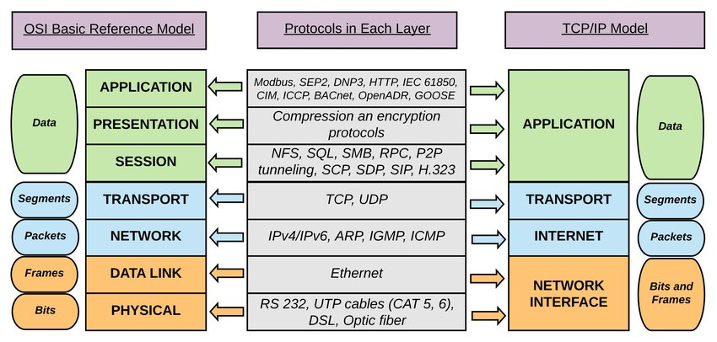
OSI
We operate
on this layer

