Slide 1
Sip
Drink-level reviews for coffee, tea, and matcha
Midpoint Evaluation · CSE 4333/5333 Cloud Computing
Oscar Barrios Jimenez (oxb3281) · Evan Willsey (exw1419)
Notes:
Thirty seconds. Name the project, name the team, move on.

Slide 2
The problem, and what we built instead
Yelp and Google rate the coffee shop — a blend of ambiance, seating, Wi-Fi, and service. Drink quality is buried inside a single star score.
A four-star shop tells you nothing about whether its oat milk latte is good.
Sip rates the drink. Search "Oat Milk Latte" and see every version across the metro, ranked on drink quality alone.
Reviews attach to a preloaded menu item, not free text. That constraint is what makes cross-location aggregation possible — and what incumbents cannot retrofit onto millions of free-text reviews.
Notes:
One minute. The last bullet is the defensible part — lead with it if asked about competitors.

Slide 3
Current architecture
Client
Browser / Expo
Amazon Cognito
User pool, issues JWT
API Gateway (HTTP)
JWT validated at the edge
presigned PUT
S3: photos
originals/ and thumbs/
s3:ObjectCreated
VPC · private subnets, two availability zones · no NAT gateway
processPhoto
Lambda, S3-triggered
presignUpload
Lambda
createReview
Lambda, in VPC
listRankings
Lambda, in VPC
RDS PostgreSQL
private, encrypted at rest
Notes:
Ninety seconds. Three design decisions worth naming: photos bypass Lambda via presigned URLs; the Cognito authorizer validates JWTs before our code runs; an S3 gateway endpoint carries photo traffic privately. Together those are why there is no NAT gateway, which would have cost about thirty-two dollars a month outside the free tier.

Slide 4
Services in use, and why
Service | Role in Sip
Cognito | Email sign-in; issues the JWT every API call carries
API Gateway (HTTP API) | Routing plus JWT validation before any function runs
Lambda ×4 | Presign, create review, rank drinks, process photo
S3 | Review photos; object-created events drive thumbnailing
RDS PostgreSQL | Reviews, drinks, locations, and the aggregation query
VPC + security groups | Database reachable only from the Lambda security group
CloudFormation / SAM | Whole stack defined in one template, deployed by one command
Notes:
Forty-five seconds. Do not read the table — point at it and name the two or three you want credit for.

Slide 5
Infrastructure as code
The entire stack — VPC, subnets, security groups, RDS, S3, Cognito, API Gateway, and four Lambdas — lives in one SAM template under version control.
sam build && sam deploy rebuilds the environment from scratch. We tore ours down and redeployed it twice while developing.
Secrets are deploy-time parameters, never committed. The repo ships .env.example; .env is gitignored.
Database schema is a checked-in SQL file, so the structure is reviewable in a pull request rather than clicked into a console.
Notes:
Thirty seconds. "Reproducible from one command" is the line that matters here.

Slide 6
What works today
Sign-up and sign-in through Cognito, with API calls rejected without a valid token.
Photo upload straight to S3 through a presigned URL, expiring in five minutes.
Review creation, including the one-review-per-drink constraint — posting twice updates the first review rather than creating a duplicate.
Event-driven processing: an upload triggers a Lambda that strips EXIF data, builds a thumbnail, and writes it back to the review row.
The core feature end to end — one drink name, every location serving it, ranked by average rating.
Notes:
One minute. This is the technical-progress slide; the demo backs it up, so keep it brisk.

Slide 7
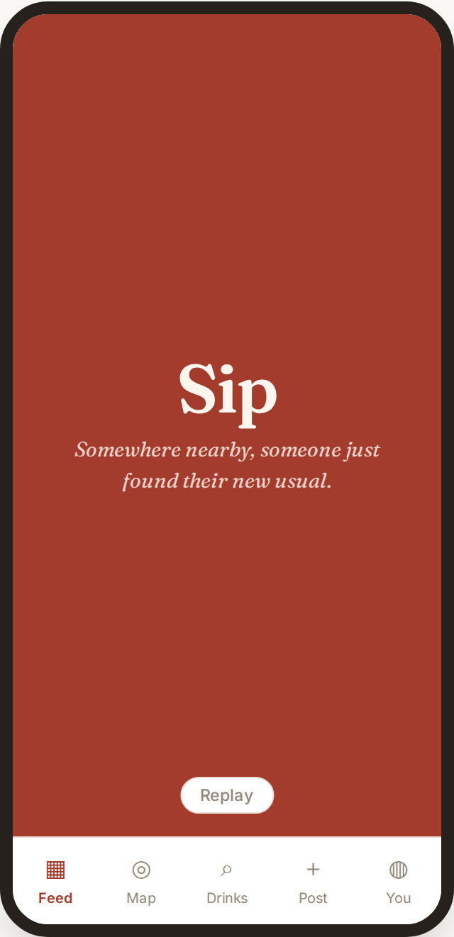
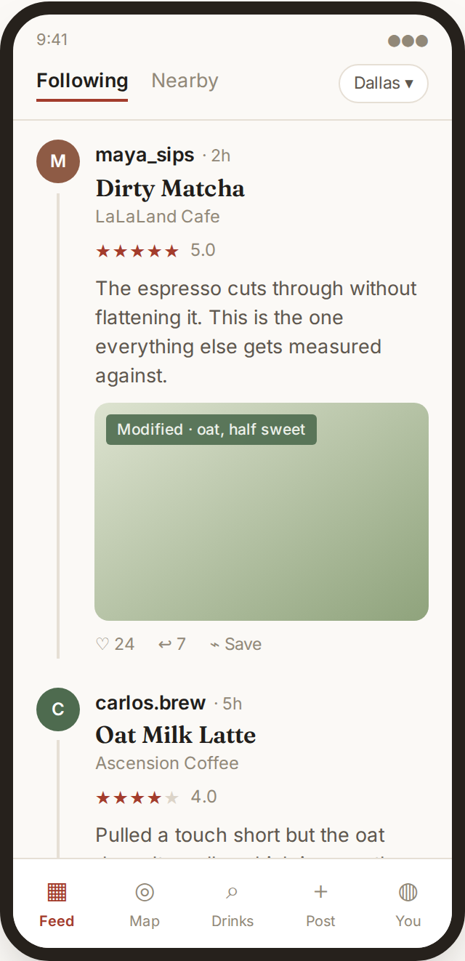
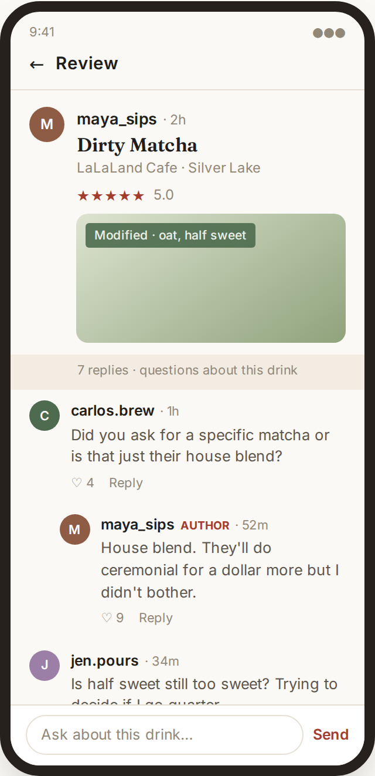
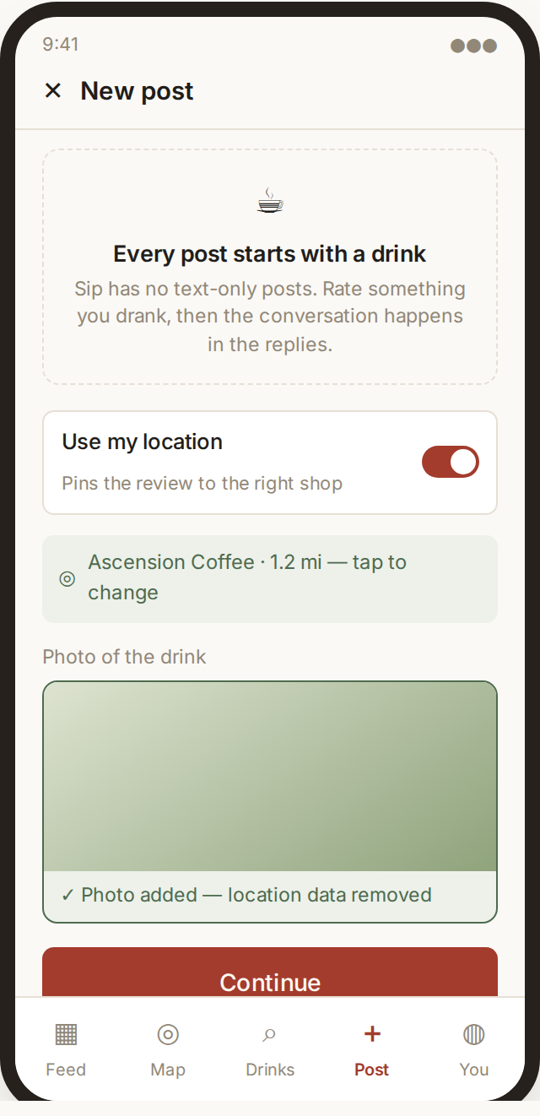
The app: arriving
Interface design — not yet built. Today’s working prototype is the API and data layer behind it.
Launch
Wordmark and a rotating line ride up on the pour, then the feed.
Feed
The drink is the headline; the shop sits under it in grey.
Replies
Questions answered by whoever was just there, threaded under the review.
Post tab
No blank composer anywhere — every post starts with a drink.
Notes:
Thirty seconds. Say plainly this is design, not running code. The Post tab is the one worth pausing on: requiring a review before you can speak is the moderation strategy.

Slide 8
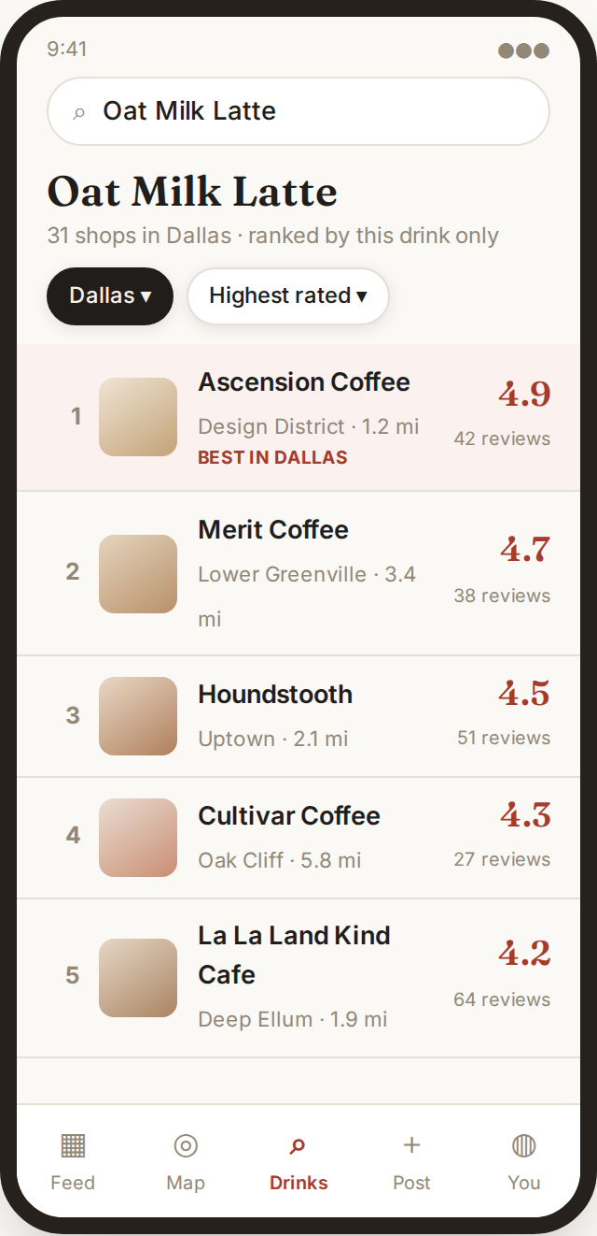
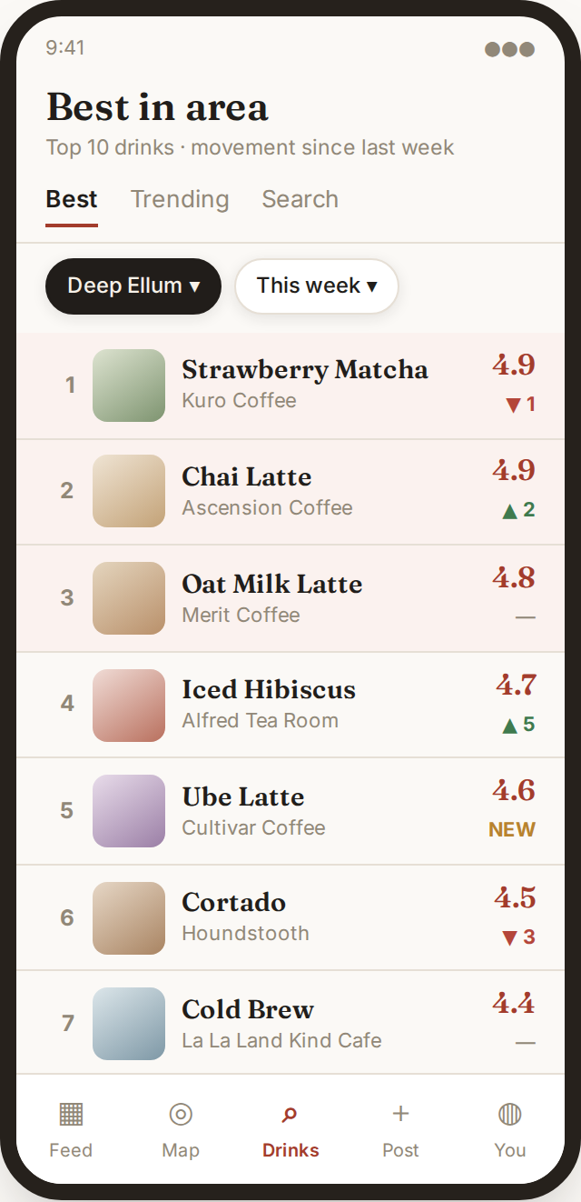
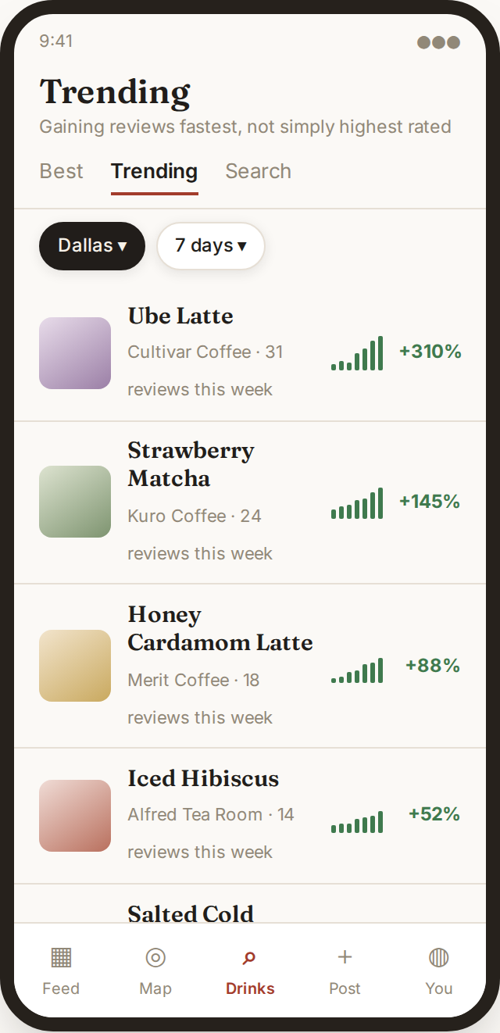
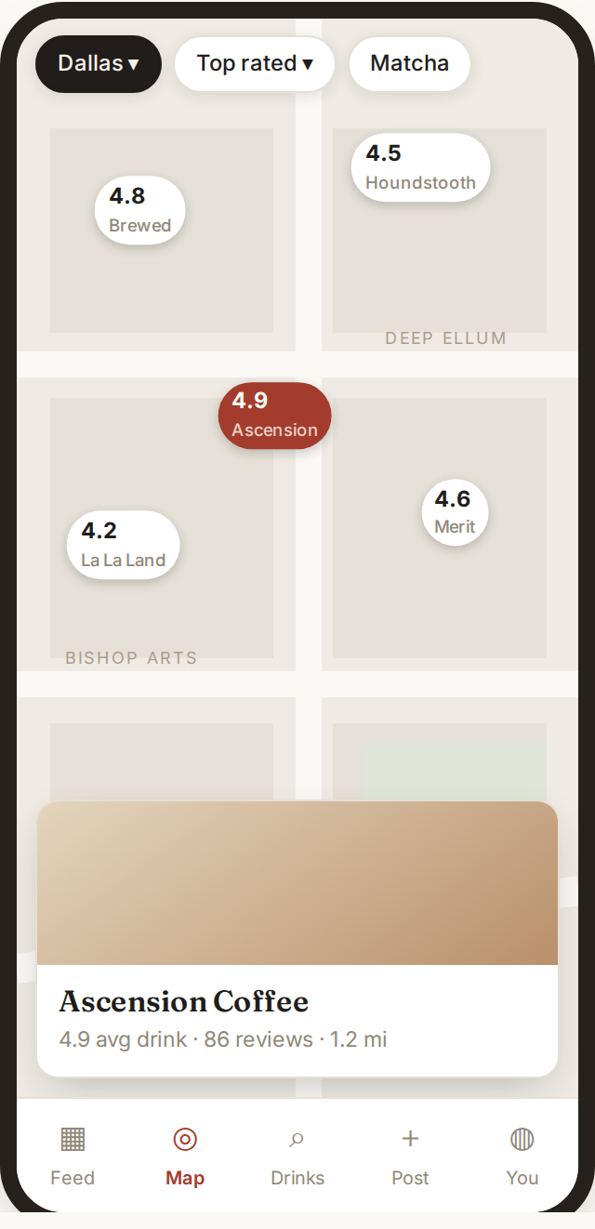
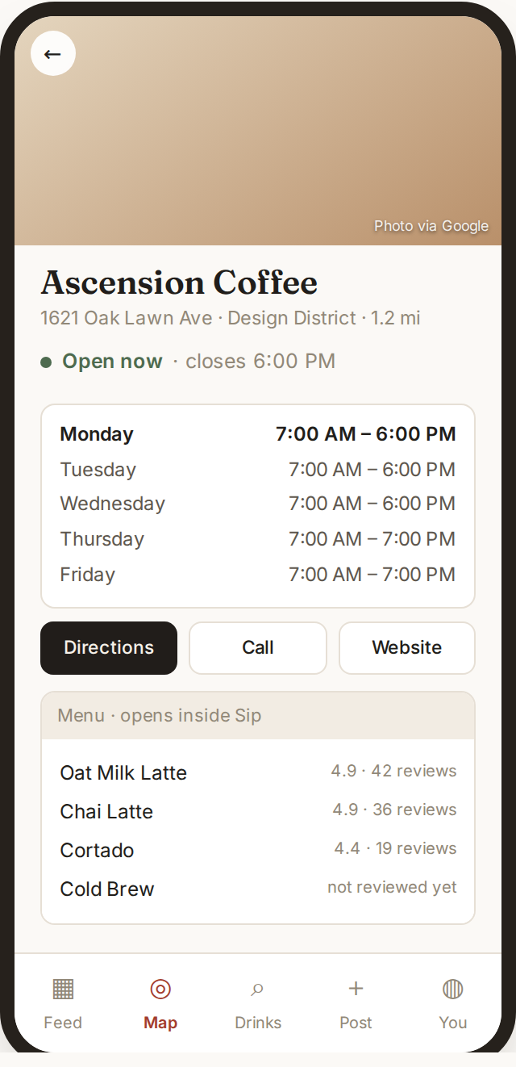
The app: finding a drink
Compare
One drink, every shop that makes it, ranked on that drink alone.
Best in area
Top ten by neighbourhood, with movement since last week.
Trending
Ranked by how fast reviews arrive, not by rating.
Map
Score pins rather than logos; tapping one opens the shop below.
Location
Hours and photo from Google Places; the menu is built from reviews.
Notes:
Forty-five seconds. Compare is the whole product — lead with it. Location detail is where Google Places integration lands, and the menu there carries ratings their real menu never will.

Slide 9
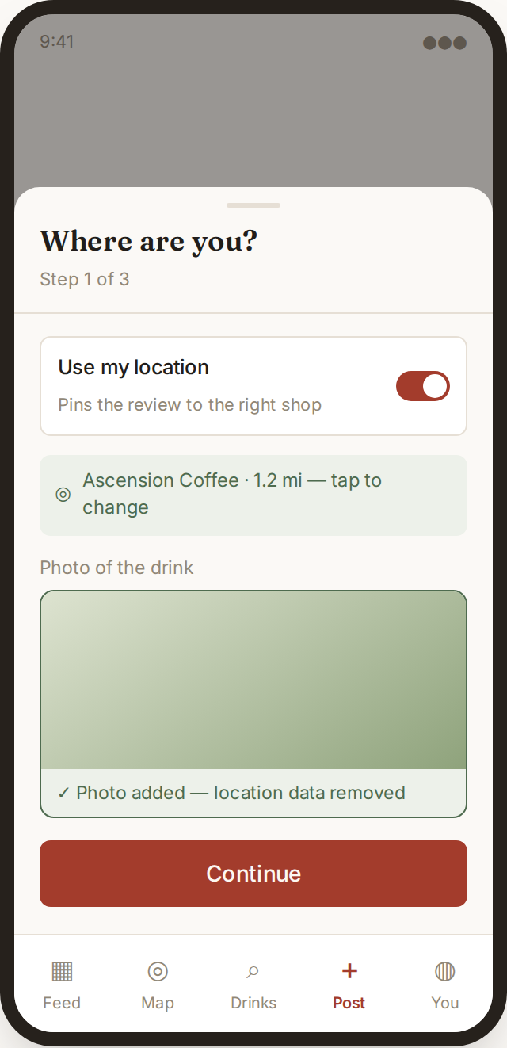
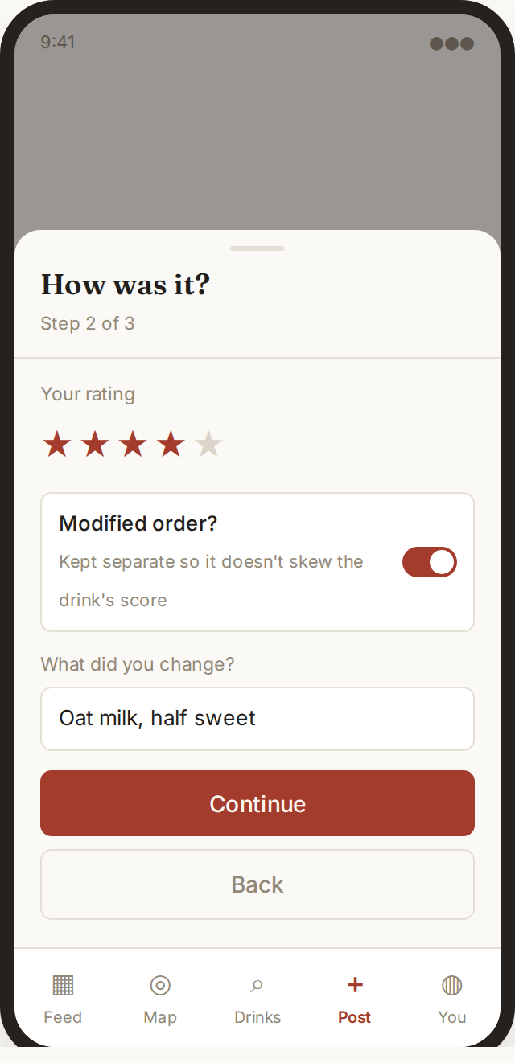
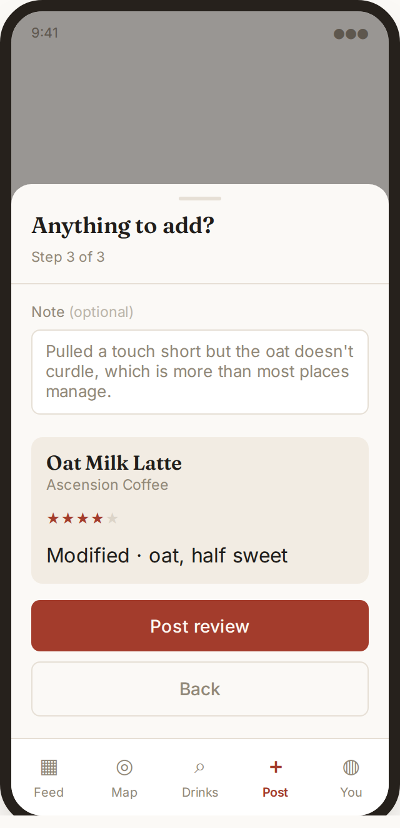
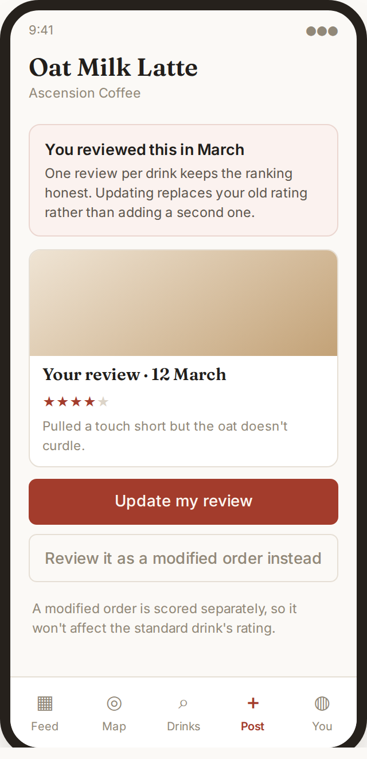
The app: posting a review
Step 1
Location confirmed rather than silently taken. Photo required, EXIF stripped.
Step 2
Rating, and whether the order was modified. Modified drinks score separately.
Step 3
Optional note, then a summary before posting.
Review again
Posting the same drink twice updates the first review instead of duplicating.
Notes:
Forty-five seconds. The modified toggle protects the integrity of the aggregate. Review again is the partial unique index made visible — and that constraint is already working in the deployed API.

Slide 10
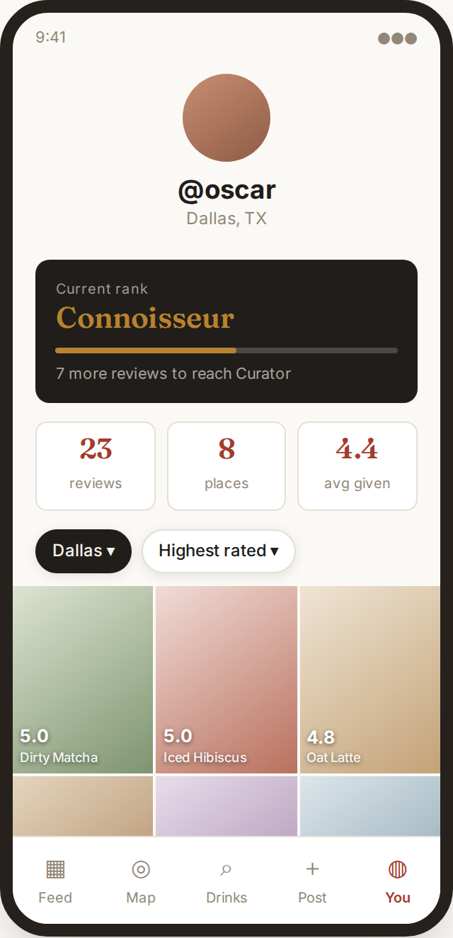
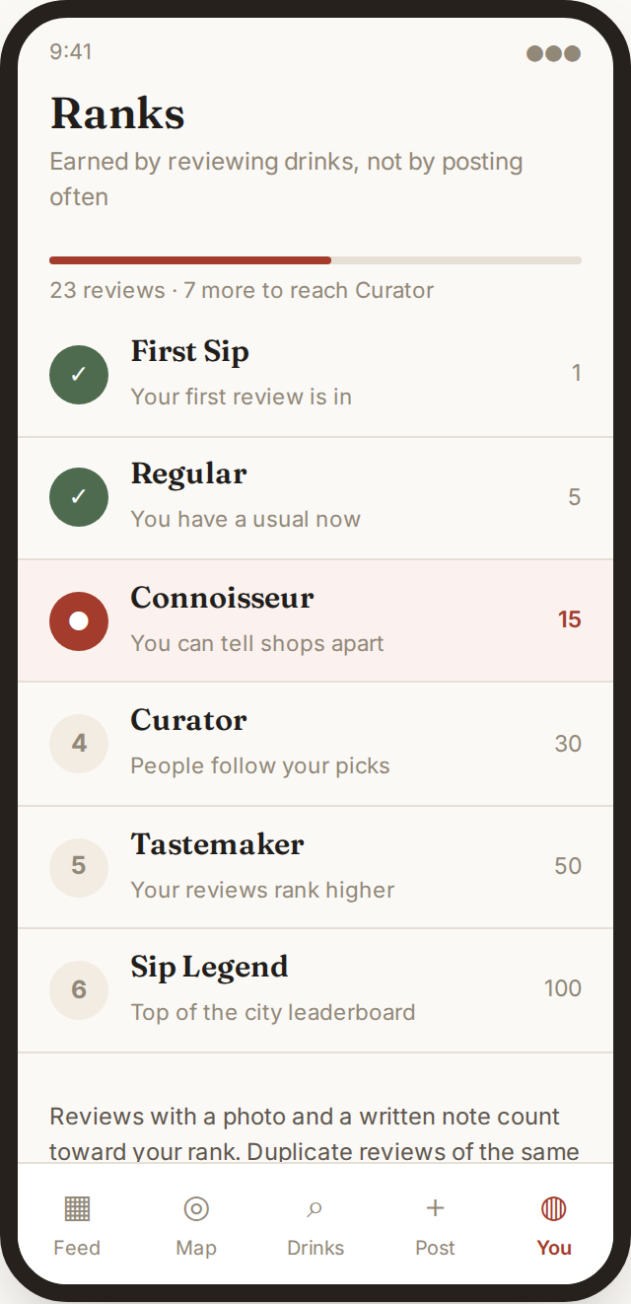
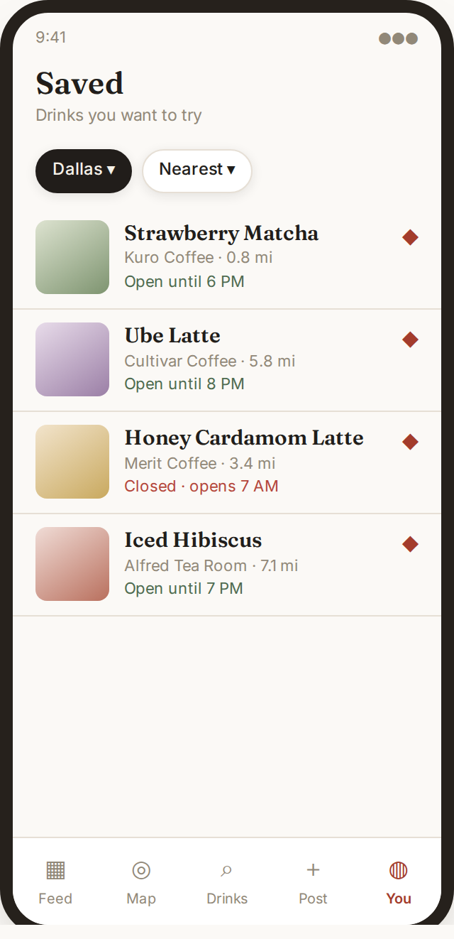
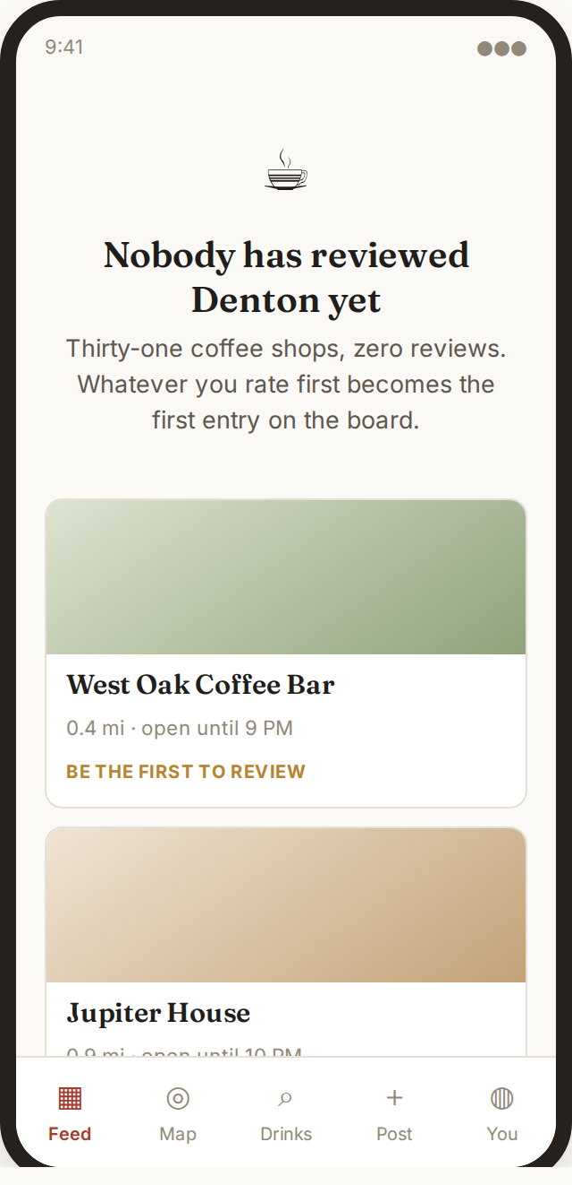
The app: coming back
Profile
Rank, three stats, then a grid with each score burned into the tile.
Ranks
Six tiers, earned by reviews with a photo and a note. Replies do not count.
Saved
Drinks to try, with open-now status so the list is actionable.
Empty state
Names nearby unreviewed shops and asks the user to be first.
Notes:
Thirty seconds. Ranks deliberately exclude replies — ranking on comments turns a review app into a comment farm. The empty state is our answer to cold start.

Slide 11
What was harder than expected
A Lambda inside a VPC has no route to the internet. Our first design called Cognito from inside the function, which meant a NAT gateway at about $32/month. Moving validation to the API Gateway authorizer removed the dependency entirely.
CloudFormation refused the stack over a circular dependency: every function referenced the photo bucket, while the bucket referenced the thumbnail function for its event trigger. Fixed by naming the bucket deterministically and declaring the S3 notification explicitly.
An organisation policy denies most services in us-east-1, so the stack runs in us-east-2. A service control policy cannot be overridden by IAM permissions.
Expressing "one review per unmodified drink" took a partial unique index rather than a plain constraint, since modified drinks are deliberately allowed to duplicate.
Notes:
Forty-five seconds. The NAT story and the circular dependency are the two worth telling — one is a cost decision, the other shows you understand how CloudFormation orders resources.

Slide 12
Remaining work, risks, and the plan
To build
Expo client replacing the demo page
Menu import so drinks are not seeded by hand
CloudFront in front of the photo bucket
Risks
Menu data entry is manual work, not a coding problem — mitigated by seeding a handful of shops rather than all of DFW
Two-person team with overlapping deadlines; scope is deliberately narrow
Notes:
Forty-five seconds. Naming the menu-entry problem before anyone asks reads as planning, not as a gap.

