Slide 1
Model mutant p53 transcriptional activity using features from biophysical simulation
Mangalalaxmy Subramanian
Data Science Career Track – Nov’19
Springboard

Slide 2

Background
Cell Growth
Cancer
Gene Mutations
Programmed Cell death
P53 proteins trigger death of affected cells and destroy tumor
Wild Type
Mutation in B
Mutation in A
P53 protein
A
B
Disrupts interaction
Restores interaction

Slide 3
Data Set Description
mutation
5408 features
Type
31,420
entries
1-6 pt
active
4826 - 2D
1181 – 3D
inactive
Distance features 1,2,3,4,5
a119e
1 pt.
a119e_l125p
2 pt.
distance1
-----_-----_-----
3 pt.
distance1, distance2
----_----_----_----
4 pt.
distance1, distance2, distance3
----_----_----_----_----
5 pt.
distance1, 2, 3, 4
----_----_----_----_----_----
6 pt.
distance1, 2, 3, 4, 5

Slide 4
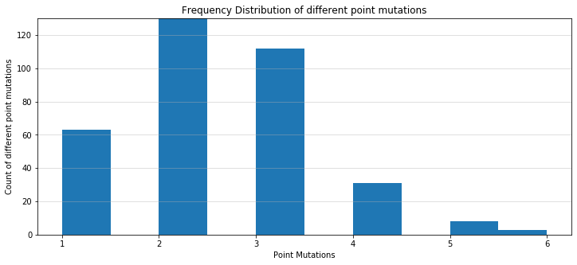
Exploratory data Analysis
2 pt. mutations maximum
30877
Imbalanced Data Set
Mutations Count | Inactive | Active | Total
1 | 55 | 8 | 63
2 | 30877 | 65 | 30942
3 | 49 | 63 | 112
4 | 24 | 7 | 31
5 | 2 | 6 | 8
6 | 1 | 2 | 3

Slide 5
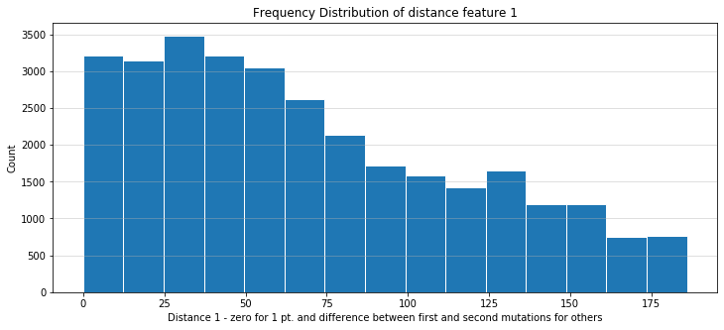
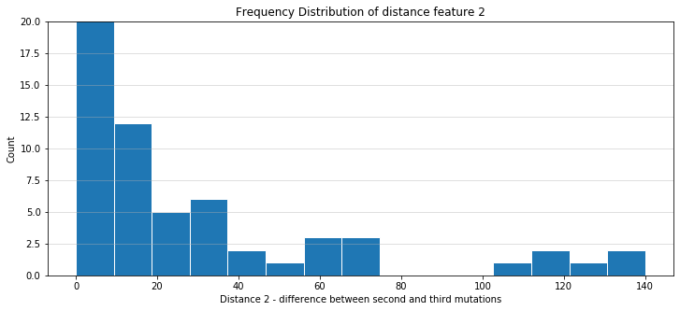
Mutations are mostly close
Mutations are mostly close

Slide 6
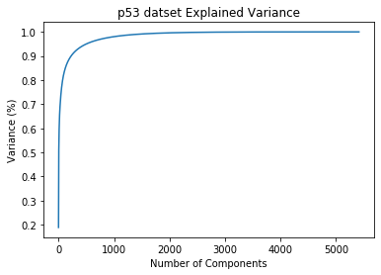
Dimensionality Reduction - PCA
Feature Selection – Correlation matrix
Cutoff Selection
0.7 – dropped 3744 features
0.9 – dropped 1625 features
Feature Extraction – PCA

Slide 7
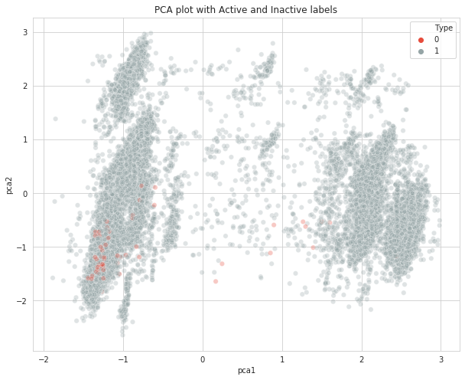
Distribution of the active & inactive classes in the PCs space
active
active

Slide 8
Plan of Action
LG
NB
RF
SVM
GB
XGB
F1 score, Precision and Recall, MCC
Class Imbalance
LG
RF
SVM
XGB
Hyperparameter tuning Cross validation
LG
SVM
XGB
Ensemble Classifier

Slide 9
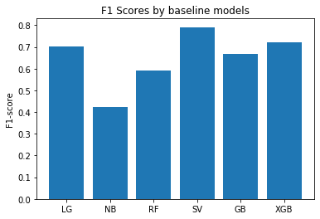
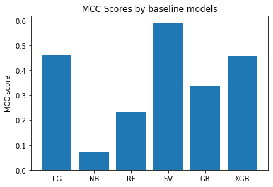
Baseline Model
Models | Precision | Recall | f1 macro | MCC
LG | 0.28 | 0.78 | 0.7 | 0.46
NB | 0.01 | 0.8 | 0.42 | 0.07
RF | 0.5 | 0.11 | 0.59 | 0.23
SVM-l | 0.51 | 0.69 | 0.79 | 0.59
GB | 0.34 | 0.33 | 0.67 | 0.33
XGB | 0.59 | 0.36 | 0.72 | 0.46

Slide 10
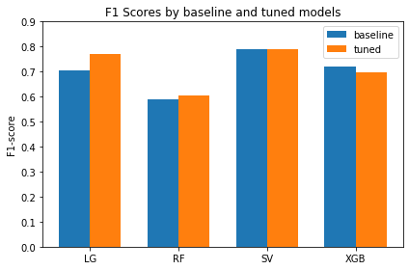
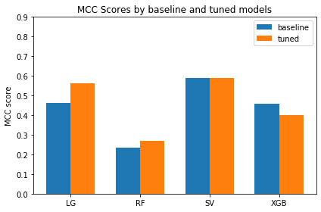
Hyperparameter tuning
Models | Precision | Recall | f1 macro | MCC
LG | 0.42 | 0.76 | 0.77 | 0.56
RF | 0.55 | 0.13 | 0.61 | 0.27
SVM-l | 0.51 | 0.69 | 0.79 | 0.59
XGB | 0.49 | 0.67 | 0.78 | 0.57

Slide 11
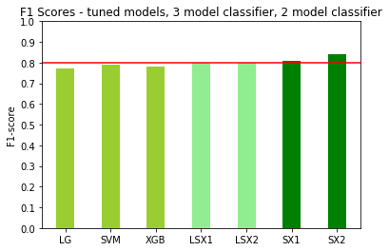
Ensemble Classifier

Slide 12
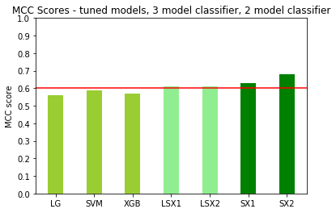
Ensemble Classifier

Slide 13
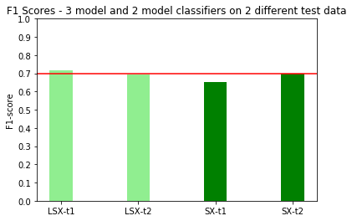
Ensemble Classifier

Slide 14
Concluding Thoughts
Computational resources – AWS
Feature importance
Parameter grid – more combinations
Class imbalance – weights, over sampling, SMOTE
Other Ensemble classifiers – Stacking, Blending
Thank You!

