Slide 1

WhisprNet
A Privacy Friendly Chatting app

Slide 2
Team & Project Identity
Team Apk_Allies
Team Member | Registration No. | Batch | Department | Year | Contribution
Manglam Goutam Sinha | 22BCB0046 | 22 | SCOPE | 3rd | Final development, developed the later versions of application, PPT
Subhranshu Sharma | 23BAI10252 | 23 | SCAI | 2nd | Early development, developed first draft of the application, Demo Video

Slide 3
Problem Overview
Problem Identification
Market Gap Analysis
Privacy concerns in digital communication are at an all-time high. Current messaging platforms collect extensive user data, require permanent accounts, and store conversation histories indefinitely. Users need a way to communicate privately without leaving digital footprints, creating temporary conversations that disappear completely after use, and connecting without revealing personal information or creating permanent accounts.
Current messaging solutions fail to address true privacy needs. Existing platforms like WhatsApp, Telegram, and Signal still require:
Phone number registration creating traceable identities
Permanent message storage on servers
Account creation with personal information
Complex encryption setup that average users find difficult
The opportunity exists for a truly anonymous, temporary messaging solution that requires no registration and leaves no trace.

Slide 4



Solution Overview
Core Innovation
Key Benefits
Technical Edge
Zero-trace messaging platform that enables anonymous communication through temporary chat rooms. No sign-ups, no data storage, no digital footprints - just secure conversations that vanish when participants leave.
Complete privacy protection with instant room creation, real-time messaging, and automatic data destruction. Users share only a secret room code to connect, ensuring conversations remain truly private and temporary.
Realtime Firebase Databse -powered real-time architecture with Kotlin-based Android development, ensuring reliable message delivery, seamless user experience, and robust performance across all Android devices.
WhisprNet revolutionizes private communication by making anonymity simple, secure, and accessible to everyone.

Slide 5




Technical Implementation
Layouts
Android XML-based UI design with LinearLayout, RecyclerView and custom adapters for responsive chat interfaces, message bubbles
Data Binding
Kotlin data classes and Firebase integration for seamless message handling
Networking
Firebase Realtime Database for instant message delivery
Storage
Zero persistent storage - Messages exist only in memory during active sessions.

Slide 6
Now let’s see the Demo

Slide 7
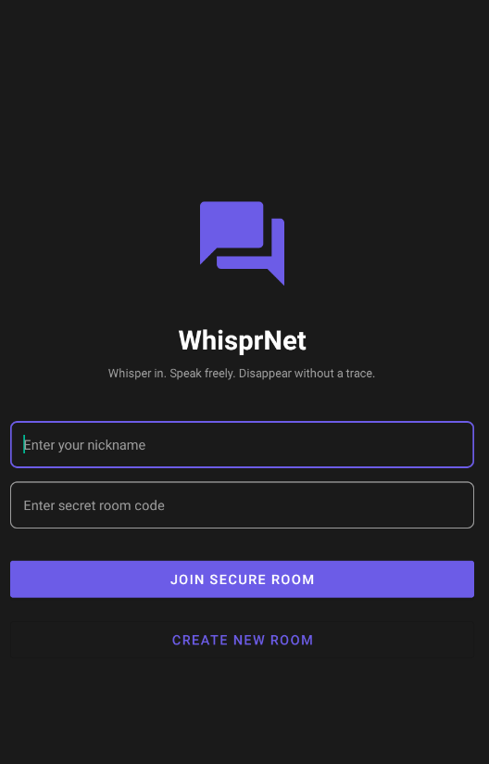
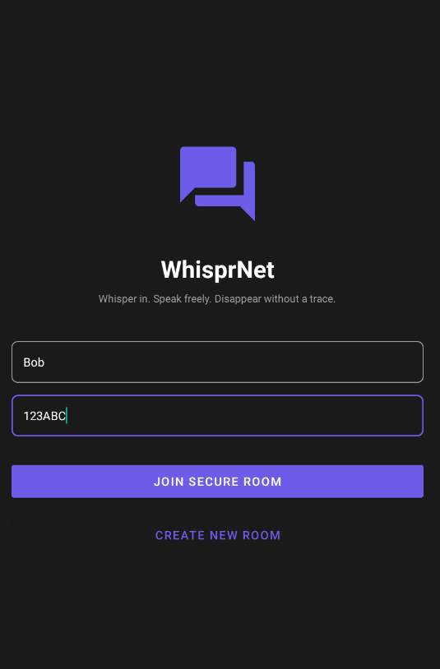
Home Screen

Slide 8
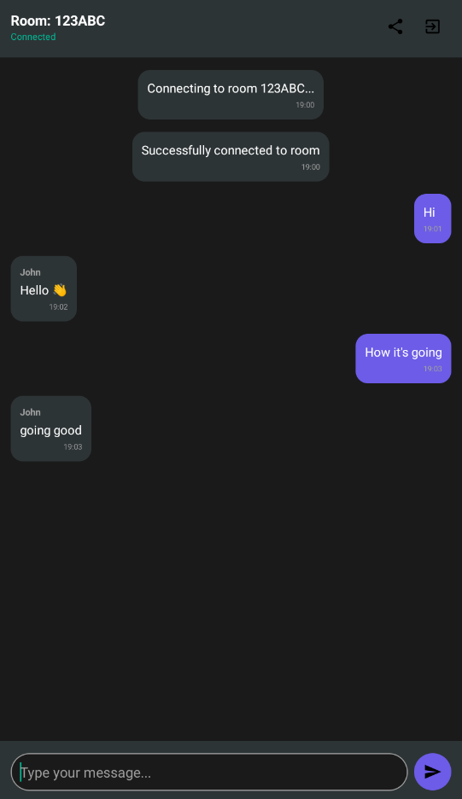
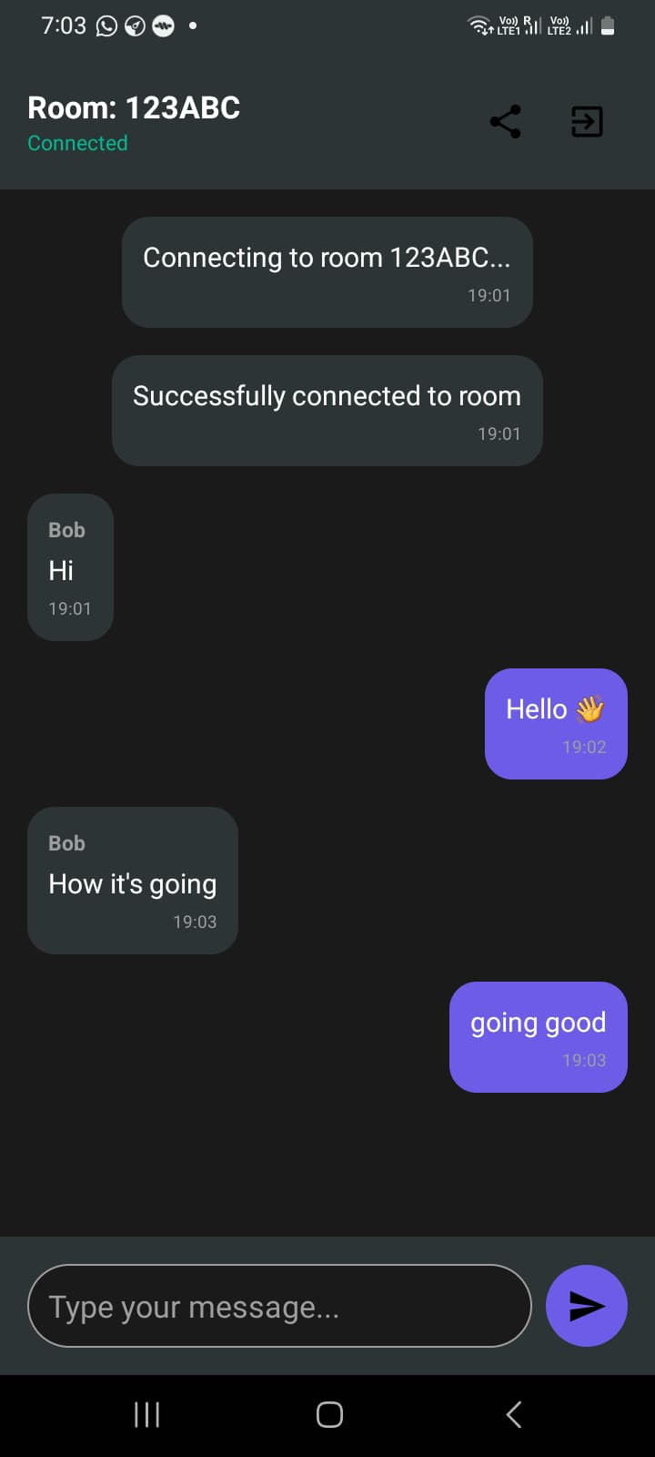
Chat Screen

Slide 9
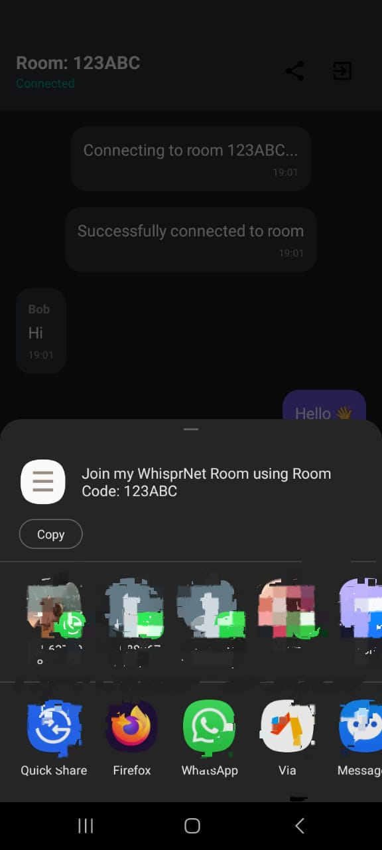
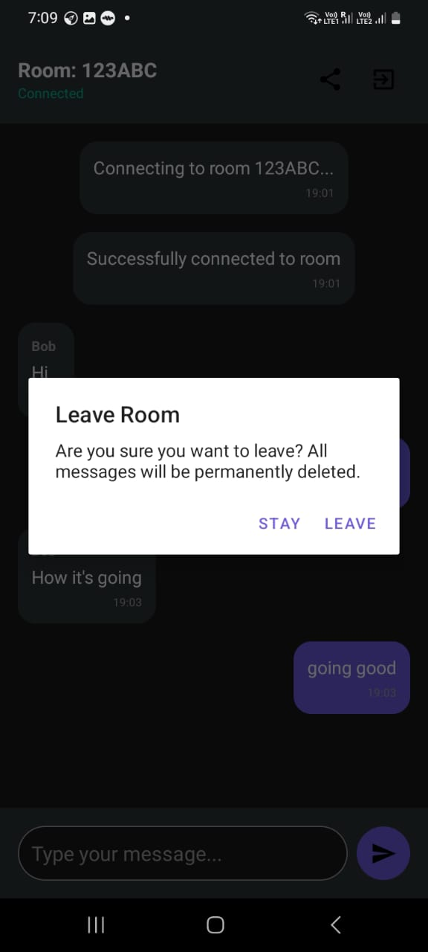
Share the Room Code
Leave Room

Slide 10
Thank You

