Slide 1
Natural Language processing Final Assignment
Group no 8
Himanshu Gupta (23PGAI0087)
Himanshu Singh (23PGAI0098)
Mangaleswara Muthukrishnan
(23PGAI0027)
Nanda Kishore (23PGAI0111)

Slide 2
Methodology
Pre processing
Techniques
NLTK
Result Adaptation
Converted text to lowercase
Regular Expressions
Removed punctuations, stop words, Common words
Web Scraping (beautifulsoup, requests)
POS tagging
Bigrams and Key words matching
Corpus (our own)
JSON file
GUI (tkinter)
Lemmatization (NLTK)

Slide 3
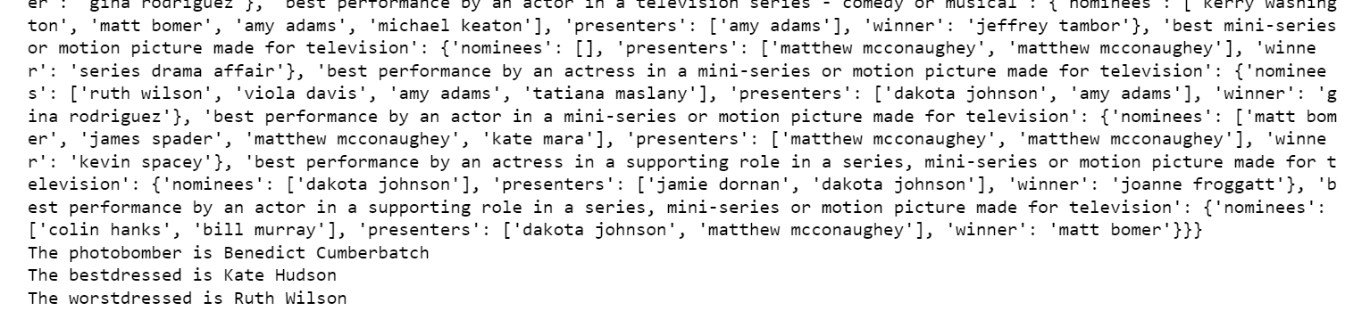
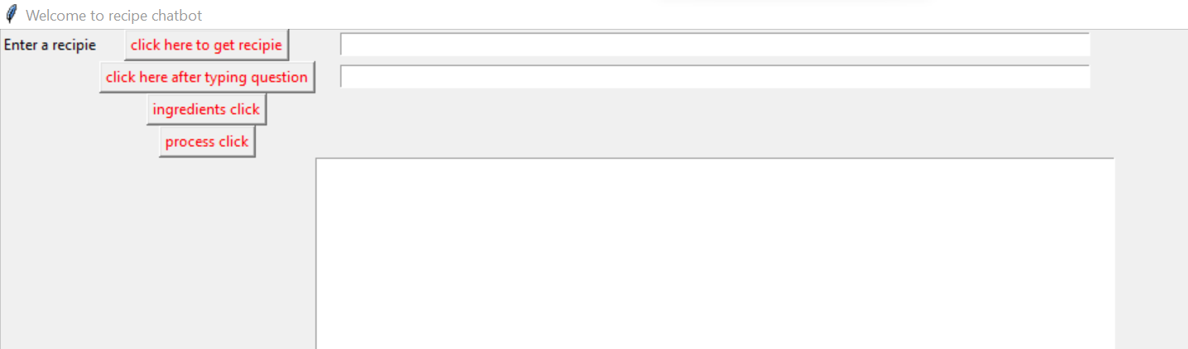
Results

Slide 4
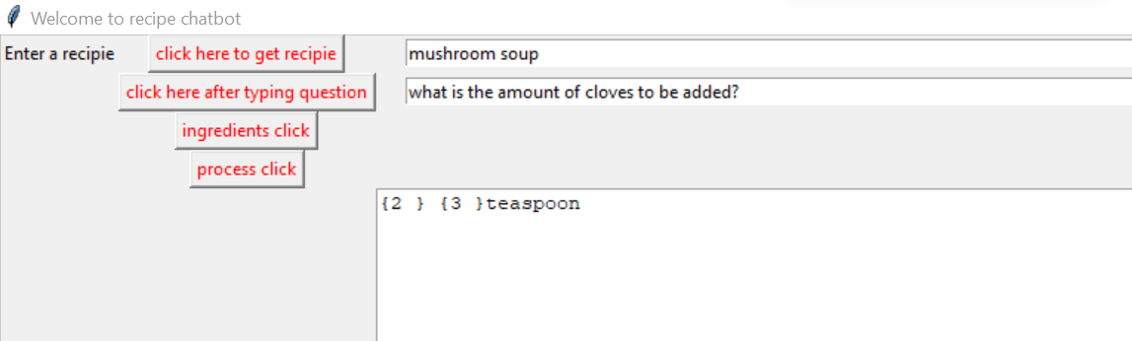
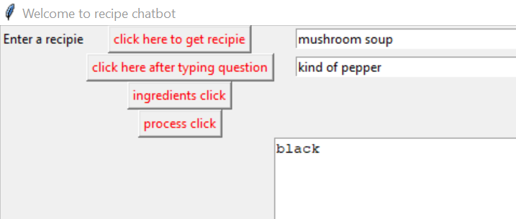
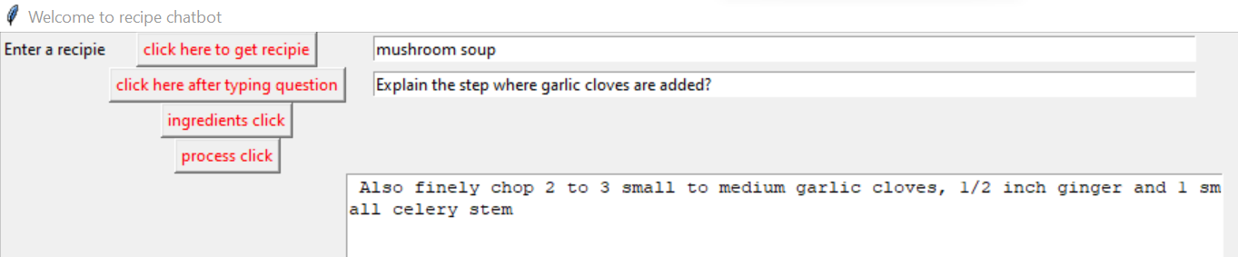
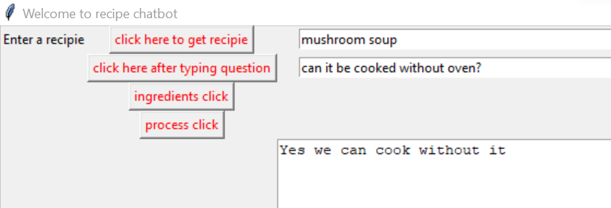
Examples

Slide 5
Error Analysis
Voice controlled chat bot could have been done
Better front end using HTML, Javascript for front end
Some questions can handle dynamic variables
More questions like for different servings and recipe transformations could have been done.
Handling multiple questions simultaneously.

