Slide 1
ML Assignment Sepsis
Pre
processing
Feature
Engineering
Model
Fitting
Hyper
parameter
Tuning
Data Insights
Metrics
Team Members
Anishka Sharma
Mangaleswara Siddarth Muthukrishnan
Mayank Khurana
Pushkar pushp
Process

Slide 2
DATA INSIGHTS
The exploratory data analysis and insights were done by taking a small sample in Tableau to find various insights
Some of them are like:
Respiratory rate, Heart rate ,Creatinine, Bilirubin(total),troponin levels of sepsis patients’ are higher than normal patients
Platelets, Age were lower compared in Sepsis patients compared to normal patients
PRE PROCESSING
Outlier removal
Values which were more than 3 times standard deviation were removed before imputation
Imputation
Formula
KNN with n=1
High Missing column removal
Removed columns where more than 98% values are missing. EG EtCO2, troponin, Fibrinogen etc…
MAP= 0.33*SBP+0.66*SBP
Forward fill for Sepsis shift
We tried out different imputation methods like miceforest, ARIMA, Kalman, group by patient mean, forward and backward fill and different values of k for KNN. Out of all KNN with n=1 gave the best results.
We first did formula imputation followed by KNN. We imputed without sepsis label and did imputation separately for test, training and validation sets, thereby preventing target leakage

Slide 3
Feature Engineering
Difference of 2 hours
Heart rate
Respiration rate
Index
Shock= HR/SBP
Sofa
Quick- Resp, SBP
SPO2
Temperature
SBP
MAP
DBP
GI = Age *Platelets
Partial- Platelet, Bilirubin total,
Total of 11 feature were engineered as per exploratory data analysis. As per research, platelets value drop drastically for patients above the age of 60. So, even very low platelets values are not great sign for sepsis, so we created a new index G (age) index which is multiplication of age and platelets count.
Test-Train split
We have used 1.4 million data points for training, validation and 0.1 million for testing our models

Slide 4
MODEL FITTING
Visualization
Normal Models
Gaussian Naïve Bayes
Logistic Regression SMOTE with Over sampling does better
Ensemble
Models
MDS
TSNE
K means
Decision tree
LightGBM SMOTE with Under sampling does better
Extratrees
XGBoost
New Technique
Support Vector Machines in pre-processed data by LDA SMOTE with Under sampling does better
Random Forest
SVM on pre-processed data with LDA
We performed SVM on SMOTE with under sampled data which is pre-processed using LDA. This gave us a very high accuracy of 83% and recall of 31% for Sepsis prediction before 12 hours

Slide 5
HYPERPARAMETER TUNING
For SVM, we have many kernels and hyperparameters values like c and gamma. We used all kernels to find best kernel and used gridsearchCV to find best gamma and c value. Similarly hyperparameter tuning were done for other models.
METRICS FOR 6 HOURS BEFORE
Model | Accuracy (%) | Recall for sepsis label 1(%) | No of features | F1 score(%)
Gaussian Naïve bayes | 77 | 56 | 13 | 48
SVM on pre-processed data with LDA | 87 | 37 | 13 | 52
Logistic regression | 55 | 71 | 13 | 38
Gaussian Naïve bayes-more features | 69 | 65 | 44 | 45
Extratrees | 40 | 85 | 44 | 31
XG boost | 41 | 80 | 44 | 32
Lightgbm | 36 | 85 | 44 | 28
Random Forest | 32 | 88 | 44 | 26
Decision tree | 43 | 69 | 44 | 32
k-means | 48 | 43 | 44 | 34

Slide 6
Now we really got to know that why Naïve bayes is the most used algorithm in data science. However, the overall F1 score of 52% (including both classes) makes SVM pre-processed with LDA to be a very competitor.
METRICS FOR 12 HOURS BEFORE
Model | Accuracy (%) | Recall for sepsis label 1(%) | No of features | F1 score(%)
SVM on pre-processed data with LDA | 85 | 43 | 13 | 54
Gaussian Naïve bayes | 76 | 57 | 13 | 50
Logistic regression | 55 | 77 | 44 | 40
Extratrees | 41 | 84 | 44 | 33
Lightgbm | 36 | 87 | 44 | 29
Random Forest | 39 | 68 | 44 | 31
k-means | 48 | 45 | 44 | 35
Here SVM pre-processed with LDA with 13 features is the best one

Slide 7
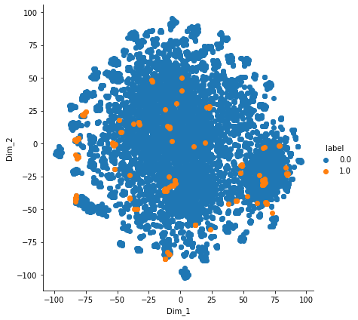
SUMMARY
Thus we our best model would be:
Gaussian Naïve bayes for sepsis prediction before 6 hours with 13 features
SVM on pre-processed data with LDA for sepsis prediction before 12 hours with 13 features
TSNE

