Slide 1
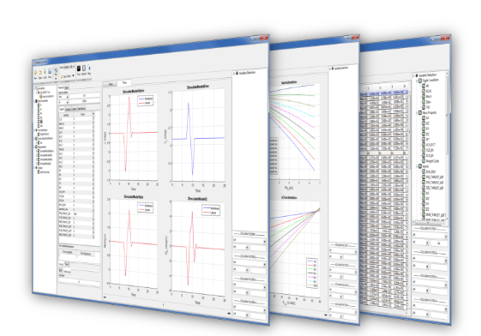
Quick User’s Guide
Nonlinear Flight Dynamics Analysis

Slide 2

Typical Analysis
Derive longitudinal and lateral-directional stability & control characteristics
Simulate open-loop and closed-loop flight maneuvers to demonstrate compliance with requirements for Civil and Military Aircraft
Support air vehicle configuration development
Conduct failure effects analysis
Trim and generate linear models for the FLIGHT Control software

Slide 3
Key Features
Automated fast and accurate trimming, and linear model generation
Automated trim database generation throughout flight envelope
Linear versus nonlinear simulation comparison
Automated nonlinear flight dynamics simulation analysis
Flying qualities analysis
Longitudinal stability & control analysis
Lateral-Directional stability & control analysis
User defined trim, linearization and simulation types

Slide 4
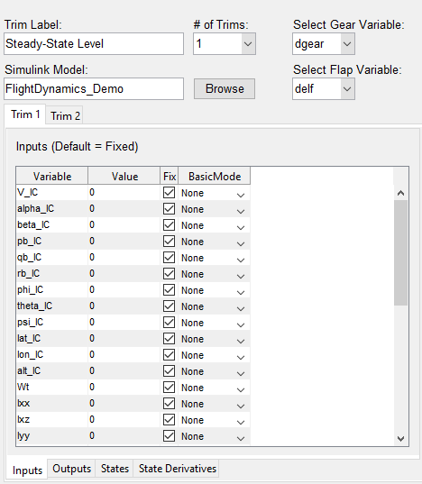
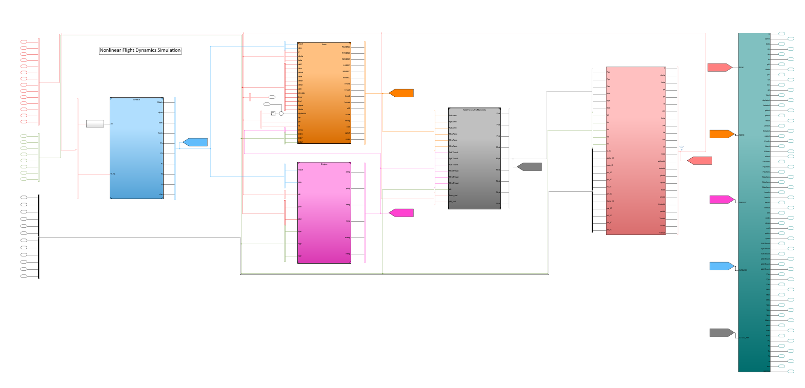
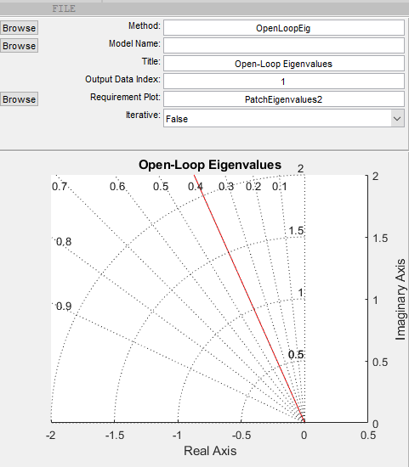
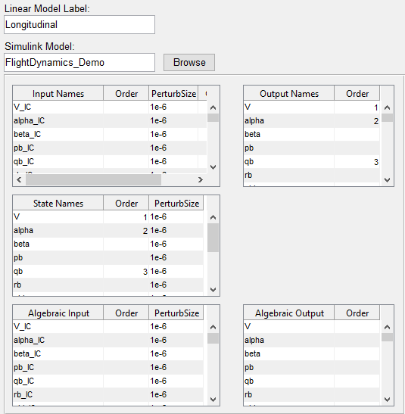

Analysis Task Workflow
Trim Definition
Nonlinear Flight Dynamics Simulink Model
ANALYSIS TASK
Trim nonlinear model
Output
Generate linear state-space models
Trim/Linear Analysis Method
Linear Model Definition
dataflow
Perform Analysis on Trims and/or linear models
Run Nonlinear Simulations
Simulation Method/Post-Sim Method
Perform post-simulation analysis

Slide 5
Setup
Trim Definitions
Linear Model Definitions
Methods
Simulations
Analysis Tasks

Slide 6
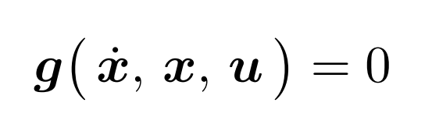
General Trim Problem
Air vehicle state equations can be expressed by the following implicit set of equations:
Equilibrium point or trim point is defined when:
Tool includes a gradient search method which finds the trim condition if it is feasible
Number of Trim Equations ≡ Number of Trim Variables

Slide 7
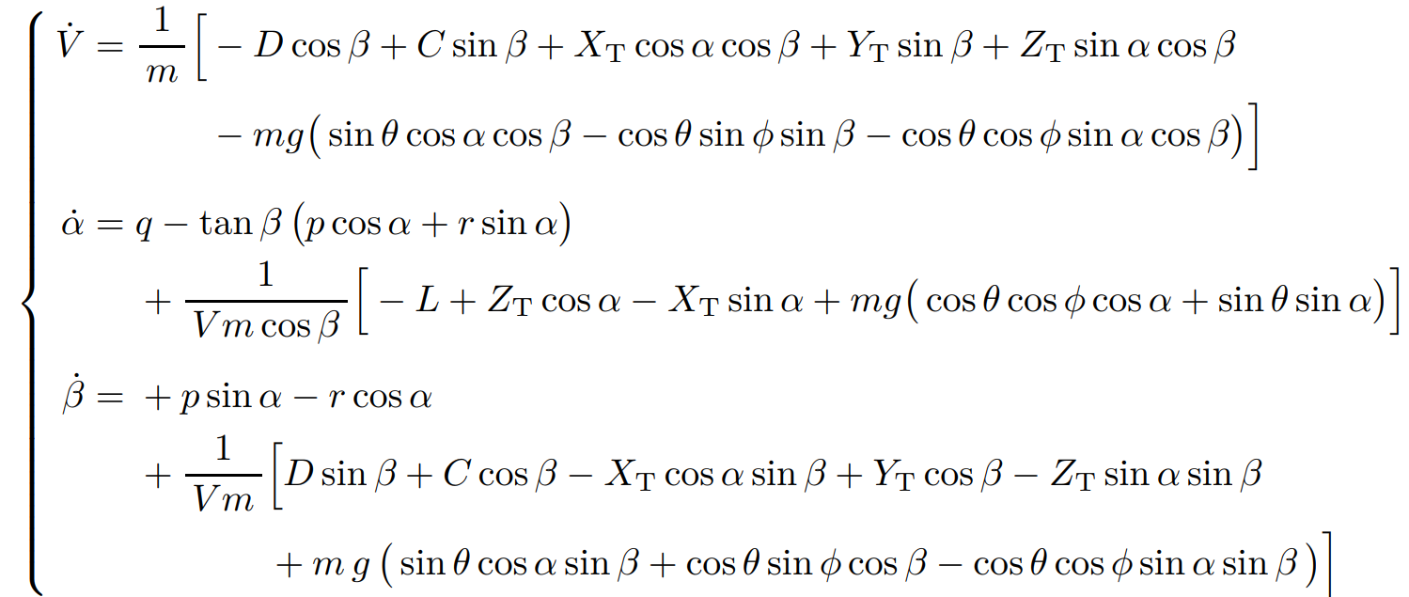
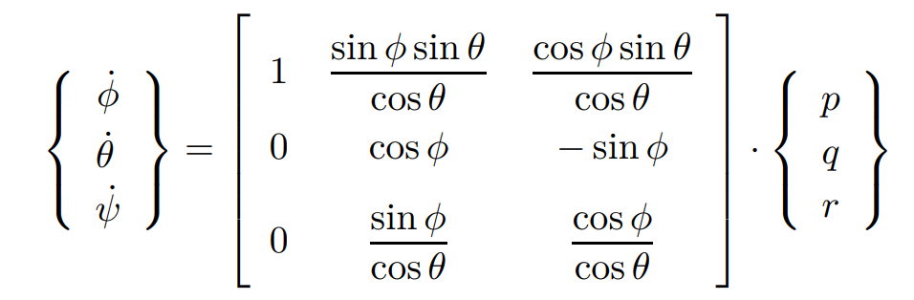
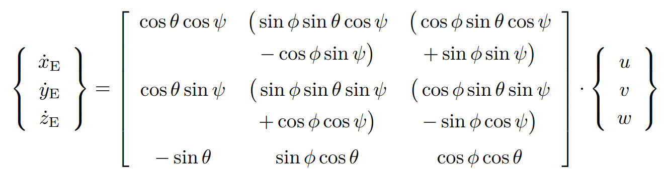
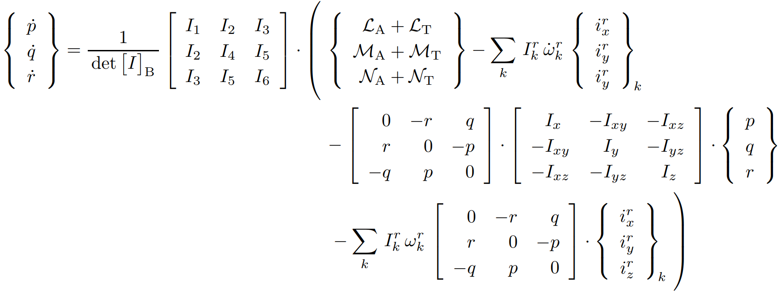
Air Vehicle Equations of Motion
Force Equations
Kinematic Equations
Navigation/Position Equations
Moment Equations

Slide 8
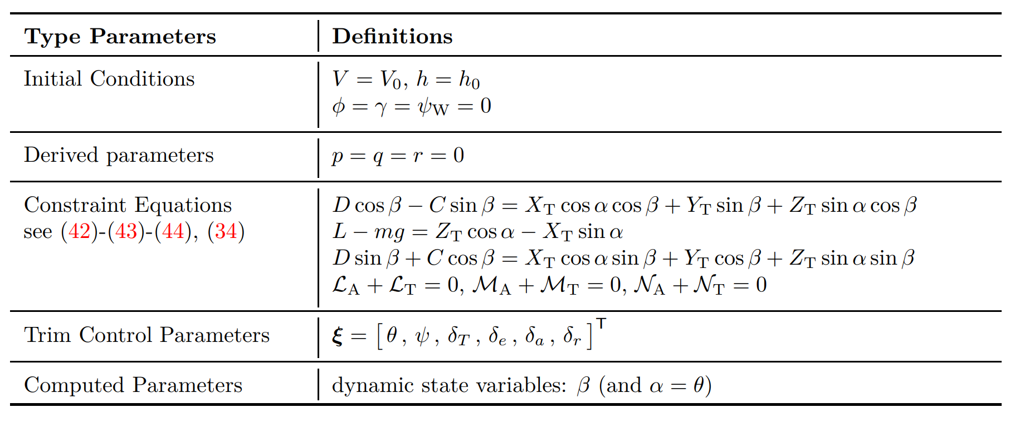
Straight and Level Flight Trim

Slide 9
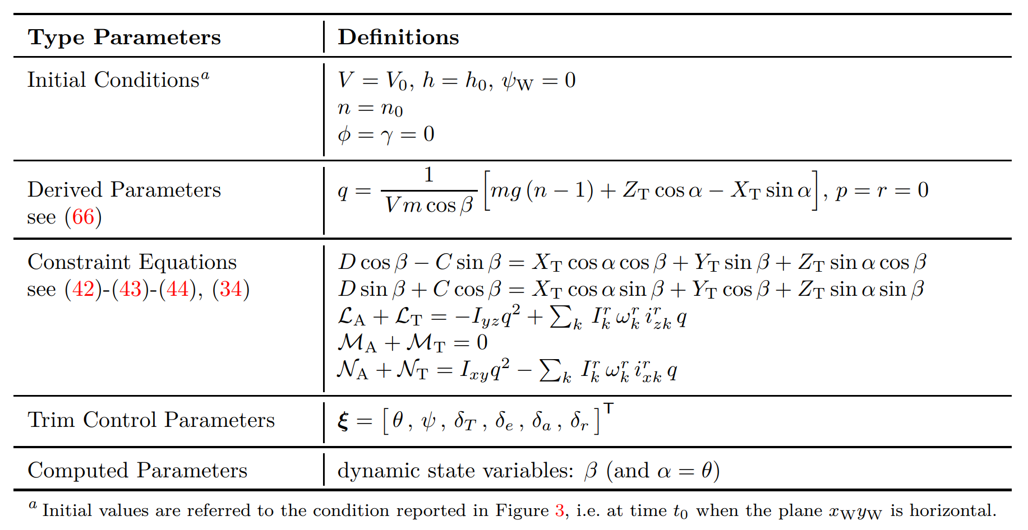
Push Over/Pull-Up

Slide 10
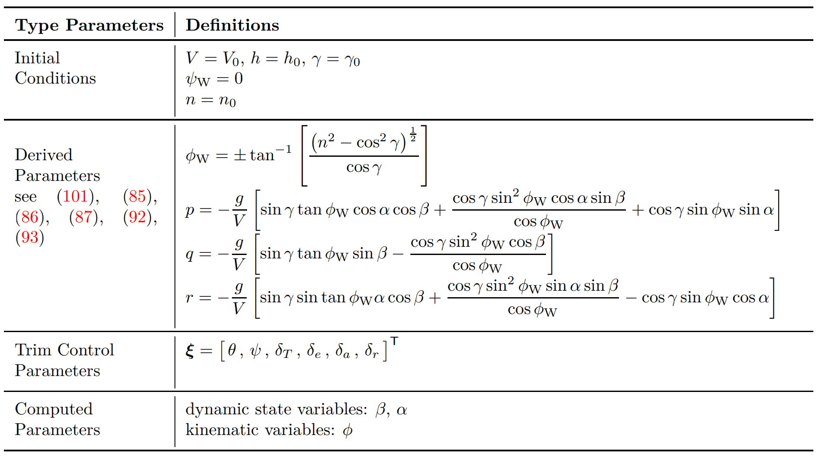
Steady State Turn

Slide 11
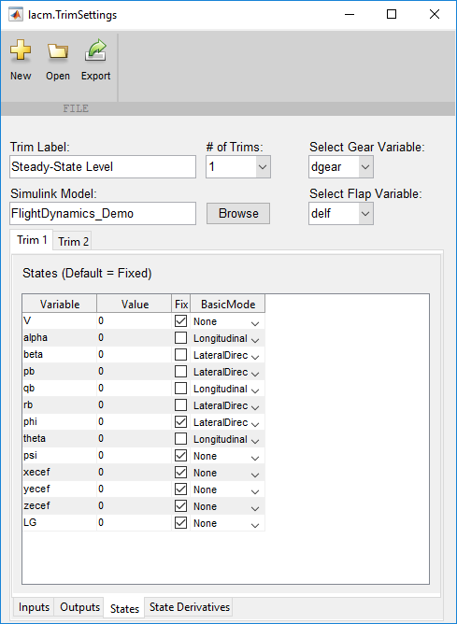
Setup Trim Definition
User Defined Name
Gear & Flap Variable Mapping
Nonlinear Flight Dynamics Simulink Model
Input Ports, Output Ports, States, and State Derivatives Read from Simulink Model

Slide 12
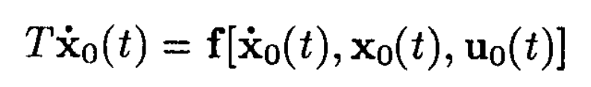
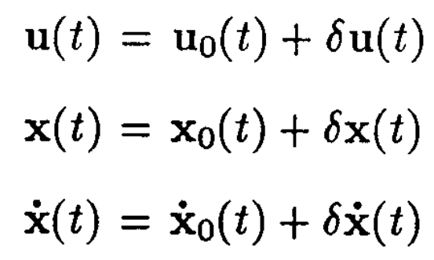
General Linear Model
Nonlinear State Equations:
Input, state, and state derivative perturbations:
Taylor series expansion:

Slide 13
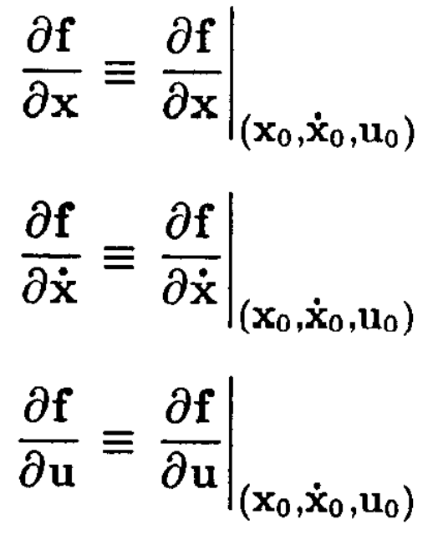
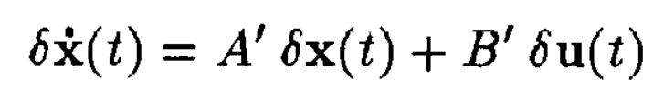
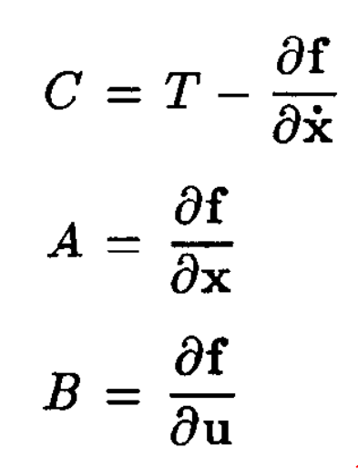
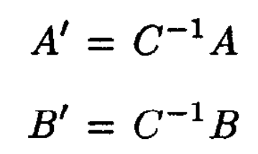
General Linear Model (Cont’d)
Taylor series expansion definitions:
After some algebraic manipulation (and neglecting higher order terms):
Where:

Slide 14
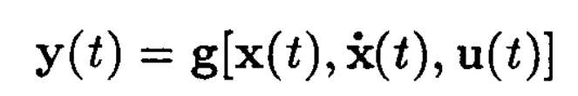
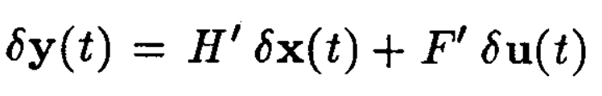
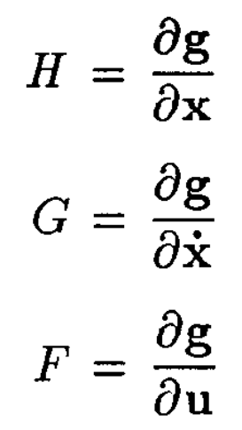
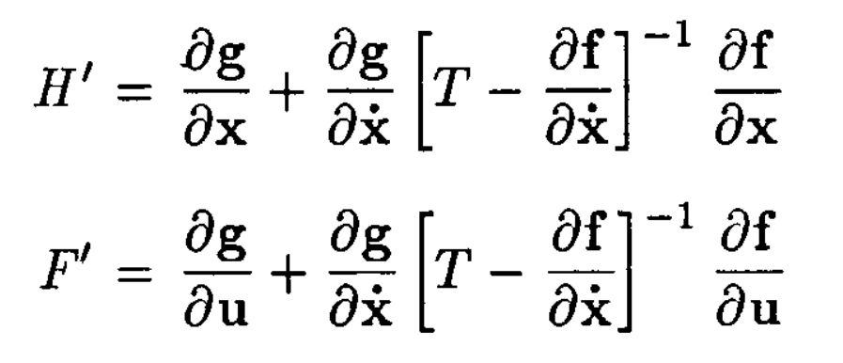
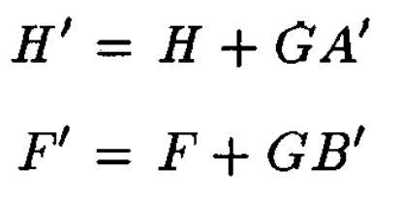
General Linear Model (Cont’d)
Same technique is applied for observation (output) equation:
Taylor series expansion:
Similarly for the linear output:
Where:

Slide 15
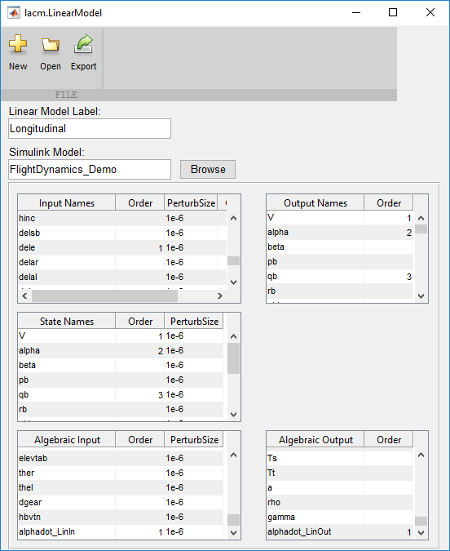
Setup Linear Model Definition
User Defined Name
Nonlinear Flight Dynamics Simulink Model
Select Output and Order
Select Input, Order, and Perturbation Size
Select States, Order, and Perturbation Size
Select Algebraic Output
(needs to match Algebraic Input)
Select Algebraic Input and Perturbation Size

Slide 16
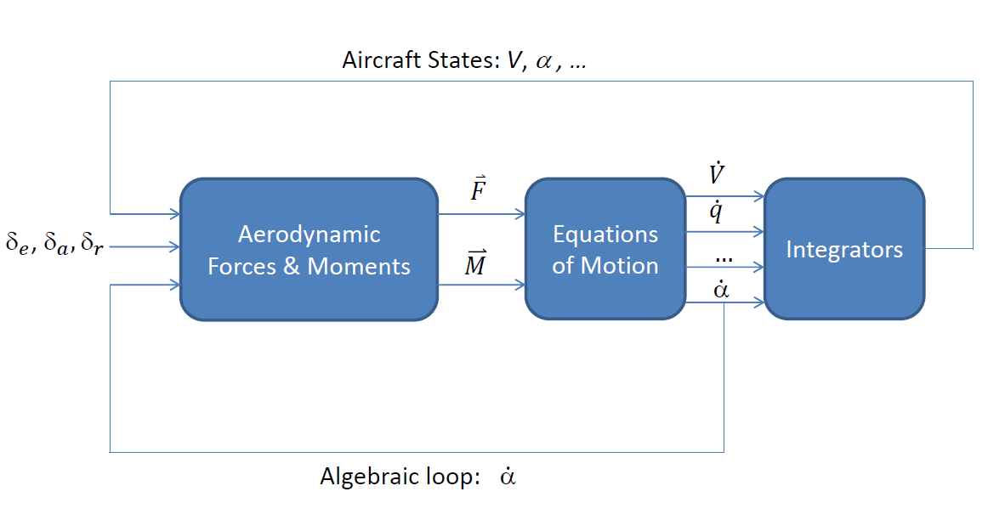
Algebraic Loop
Example: Aerodynamic force is a function of $\dot{α}$

Slide 17
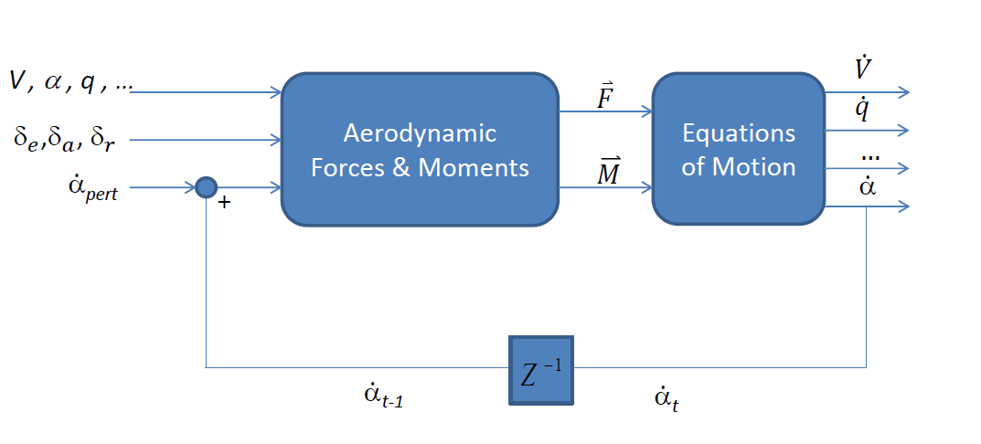
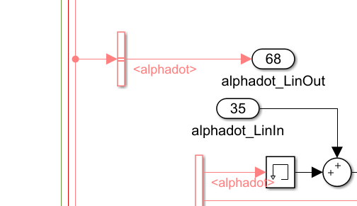

Algebraic Loop in Simulink
Simulink implementation
Memory block is one way to break the algebraic loop in Simulink, or use a first order lag with a relative high break frequency.
Normal Jacobian linearization (perturbation method) does not include the effect of the algebraic variable (in this example )
Additional operations are required in order to include the effects of the algebraic variable when memory block is used to break the algebraic loop in Simulink
$$\dot{α}$$

Slide 18
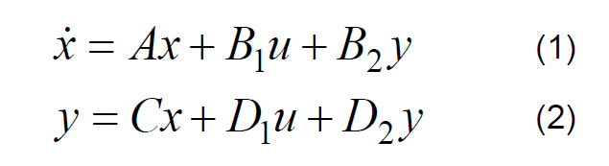
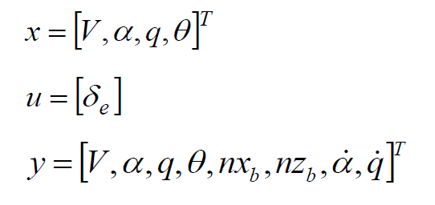
Elimination of Algebraic Variables in State-Space Representation
State-Space Representation:
Where, for example:

Slide 19
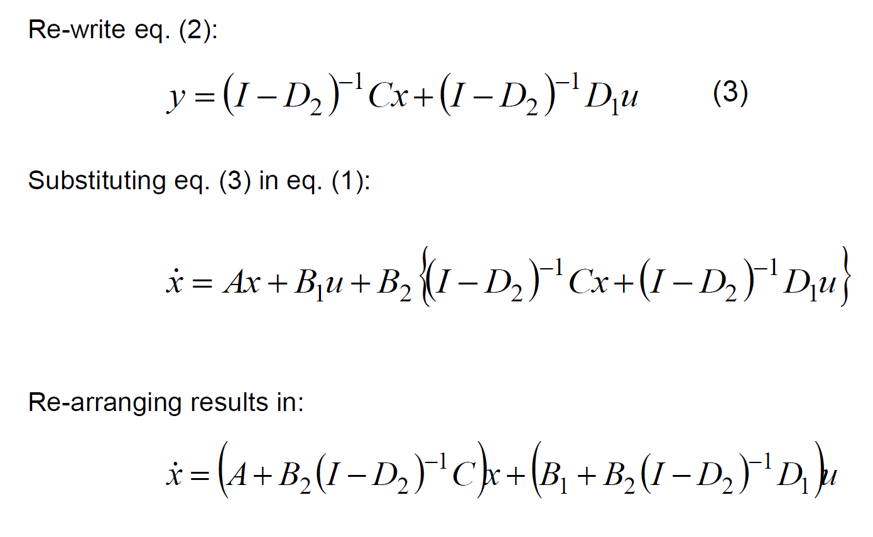
Elimination of Algebraic Variables in State-Space Representation (Cont’d)

Slide 20
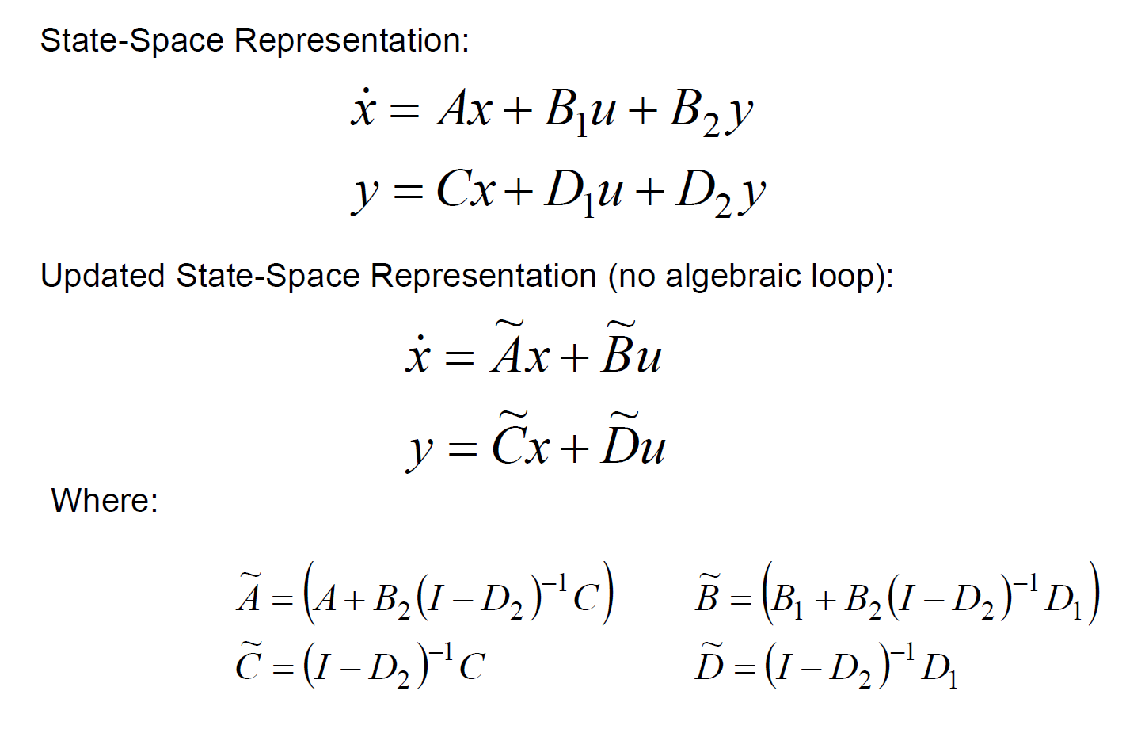
Elimination of Algebraic Variables in State-Space Representation (Cont’d)
This operation is performed inside the tool if the user specified the algebraic input and output variables

Slide 21
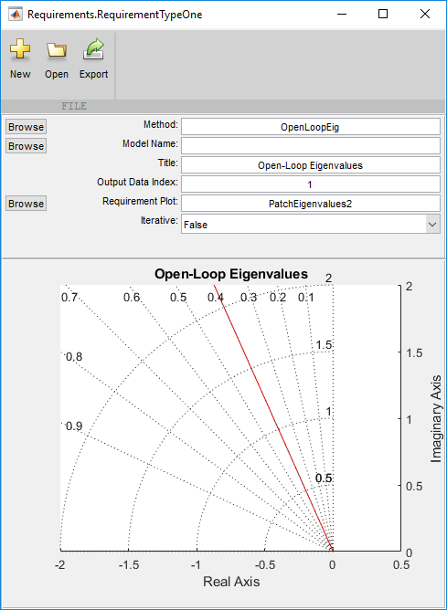
Setup Requirement Method
Method script (m-file) – see next slide
Simulink model name passed as input to the method script
Select output data index – see next slide
Title will show on plot
User defined background plot
Iterative method is a method which runs after each trim condition (i.e. inside for loop)
Collective method is a method which gets executed after all trims are generated (i.e. outside for loop)
Preview

Slide 22
Methods – Requirement Option 1
function [line] = OpenLoopEig(operCond)
Input Arguments
operCond – lacm.OperatingCondtion object
Output Arguments
line - Requirements.NewLine object
Requirements.NewLine object contains all information need to create a line or a points on a plot

Slide 23
Requirements.NewLine
Constructor
Any properties can be used as name value pairs.
Requirements.NewLine(‘XData’,[0:1:10],’YData’,[0.1:0.1:1],’Color’,[0,1,0])
Requirements.NewLine(0:1:10],[0.1:0.1:1],’Color’,[0,1,0])
Properties and default Values
XData = [0,1]
YData = [0,1]
ZData = []
LineStyle = '-'
LineWidth = 0.5
Color %= [0,0,0]
Marker = 'none'
MarkerSize = 6
MarkerEdgeColor = 'auto'
MarkerFaceColor = 'b'
DisplayName = ‘’ - This will appear in the legend
UserData = []

Slide 24
Building a method (collective)
function [line] = OpenLoopEig(operCond)
for i = 1:length(operCond)
A = operCond(i).LinearModel.A;
poles = eig(A);
X = real(poles);
Y = imag(poles);
newLine = Requirements.NewLine(X,Y);
newLine.LineStyle = 'none';
newLine.MarkerSize = 10;
newLine.Marker = 'sq';
line(i) = newLine;
end
end
Input Arguments:
operCond
trim conditions object with all properties of the trim condition
This is an example of a collective method and is executed after generating ALL trim points.
User can build any method using Matlab syntax and define any line using standard line properties.

Slide 25
Building a method (iterative)
function [line] = OpenLoopEig(operCond)
A = operCond.LinearModel.A;
poles = eig(A);
X = real(poles);
Y = imag(poles);
newLine = Requirements.NewLine(X,Y);
newLine.LineStyle = 'none';
newLine.MarkerSize = 10;
newLine.Marker = 'sq';
line(i) = newLine;
end
Input Arguments:
operCond
trim conditions object with all properties of the trim condition
This is an example of a iterative method and this method is executed after each trim point.
User can build any method using Matlab syntax and define any line using standard line properties.

Slide 26
Building a Background Plot
Background plot function is executed once.
function PatchAlphaSpeed(axH)
set(get(axH,'XLabel'),'String','Speed (KCAS)');
set(get(axH,'YLabel'),'String','Alpha (deg)');
grid(axH,'on');
set(axH,'XLim',[100 230]);
end
Input Arguments:
axH
Axis handle
Matlab syntax can be used to modify the background plot (e.g. set axes limits, add patches, grid operations, etc.)

Slide 27
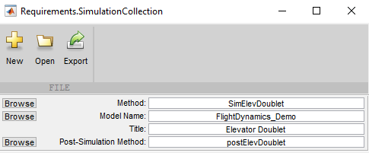
Setup Simulation
Simulation Method script (m-file)
Simulink model name passed as input to the method script
Title will show on plots
Post simulation method which operates on the time history
function [Input] = SimElevDoublet(operCond)
%% Specify trim condition to use
Input.trimStruct = operCond.Inputs; % Trim Condition
% Rebuild model referencing
% 0 - 'Never' rebuild model references
% Use if no changes have been made.
% Fastest simulation start
% 1 - 'If changes detected' rebuild if changes are detected
% Use if changes have been made
% Slower simulation start
% 2 - 'Always' rebuild model references
Input.ReBuildMDLRef = 1;
% INPUTS
% Pitch
Input.dele = -.1*[ 0 0 1 1 -1 -1 0 0 ]';
% Simulation time vector
Input.time = [ 0 1 1.01 2 2.01 3 3.01 10]';
Operating conditions (trims) mapped to input ports
Define profile for a user defined input. Input name should match the inport name

Slide 28
Methods - Simulation
Function [Input] = elevDoublet(operCond)
Input Arguments
operCond – lacm.OperatingCondtion object
Output Arguments
- Input
Structure with the following fields:
trimStruct – property of Operating Condition class, “Inputs”
ReBuildMDLRef – Default to 1, saves time if set to 0 but it will not show take any recent changes
time
Any input ports that you want to overwrite – Simulink input port name
* Any input port not set above will be set to 0

Slide 29
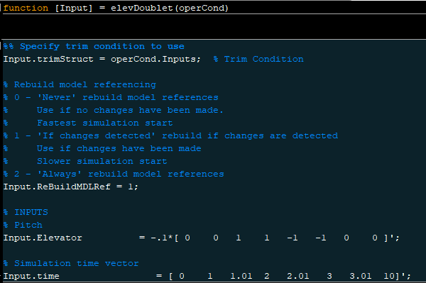
Methods – Simulation – Another Example

Slide 30
Post Simulation Method
function lineColl = postElevDoublet(operCond,simOut,simIn)
%% Run linear model
A = operCond.LinearModel.A;
B = operCond.LinearModel.B;
C = operCond.LinearModel.C;
D = operCond.LinearModel.D;
syslon = ss(A,B,C,D);
lA = strcmp(simIn.name,'dele');
tvec = simIn.time;
uvec = simIn.signals(lA).values-simIn.signals(lA).values(1);
tlin = tvec(1):0.01:tvec(end);
ulin = interp1(tvec,uvec,tlin);
[Y,T,~] = lsim(syslon,ulin,tlin);
tlin = T;
Vlin = Y(:,1);
alphalin = Y(:,2)*180/pi;
qlin = Y(:,3)*180/pi;
%thetalin = Y(:,4);
nzblin = Y(:,6);
outputSignals = simOut(1).get('Outports');
alpha = outputSignals.getElement('alpha').Values;
qb = outputSignals.getElement('qb').Values;
nzb = outputSignals.getElement('Nzb').Values;
line(1) = Requirements.NewLine(tlin,alphalin+alpha.Data(1),'DisplayName','Linear');
line(2) = Requirements.NewLine(alpha.Time,alpha.Data,'DisplayName','Nonlinear');
lineColl(1) = Requirements.NewLineCollection(line,'Title','Angle of Attack','XLabel','Time','YLabel','\alpha (deg)');
line(1) = Requirements.NewLine(tlin,qlin+qb.Data(1),'DisplayName','Linear');
line(2) = Requirements.NewLine(qb.Time,qb.Data,'DisplayName','Nonlinear');
lineColl(2) = Requirements.NewLineCollection(line,'Title','Pitch Rate','XLabel','Time','YLabel','q_{b} (deg/sec)');
line(1) = Requirements.NewLine(tlin,nzblin+nzb.Data(1),'DisplayName','Linear');
line(2) = Requirements.NewLine(nzb.Time,nzb.Data,'DisplayName','Nonlinear');
lineColl(3) = Requirements.NewLineCollection(line,'Title','Load Factor','XLabel','Time','YLabel','Nz_{b} (g''s)');
Simulation output, input, and operating conditions are an input to the post simulation method
User can perform any operations on the trim conditions, linear models, and simulation input, and output
This example shows a method to compare the linear vs nonlinear model response.

Slide 31
Requirements.NewLineCollection
Constructor
Any properties can be used as name value pairs.
Ex> Requirements.NewLineCollection(line,'Title','Angle of Attack','XLabel','Time','YLabel','\alpha (deg)’)
** Use in Post Simulation methods only
Important Properties
Name | Class | Description
NewLine | Requirements.NewLine | Array of new line objects that can be plotted
XLim | double [1x2] | limit of the x-axis
YLim | double [1x2] | limit of the y-axis
ZLim | double [1x2] | limit of the z-axis
XLabel | char | label of the x axis
YLabel | char | label of the y axis
yAxisLocation | char | location of the y axis display
GridFunction | funhandle | method to set up a grid on the axes
Grid | boolean | show grid
XScale | char | x axis scaling
YScale | char | y axis scaling
ZScale | char | z axis scaling
Title | char | title of the axis

Slide 32
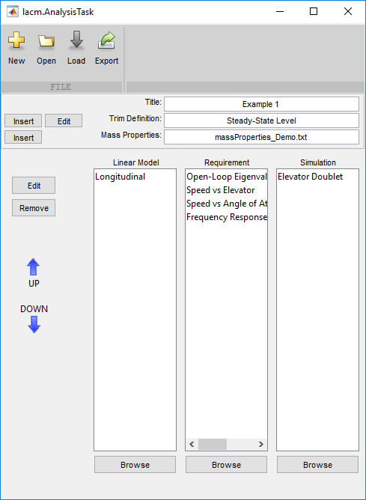
Setup Analysis Task
Names should match with input ports for proper mapping
Trim Definition
Mass Properties (ASCII file)
WeightCode Label Wt xCG yCG zCG Ixx Iyy Izz Ixz
<STRING> <STRING> <Value> <Value> <Value> <Value> <Value> <Value> <Value> <Value>
<STRING> <STRING> <Value> <Value> <Value> <Value> <Value> <Value> <Value> <Value>
...
<STRING> <STRING> <Value> <Value> <Value> <Value> <Value> <Value> <Value> <Value>
Methods
Simulations
Linear model definitions

Slide 33
Key Features
Automated fast and accurate trimming, and linear model generation
Automated trim database generation throughout flight envelope
Linear versus nonlinear simulation comparison
Automated nonlinear flight dynamics simulation analysis
Flying qualities analysis
Longitudinal stability & control analysis
Lateral-Directional stability & control analysis
User defined trim, linearization and simulation types

Slide 34
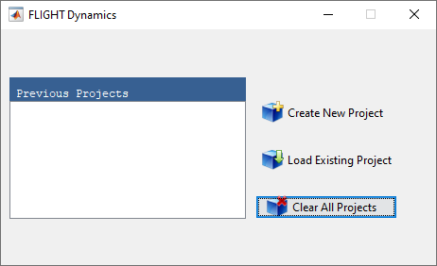
Loading Project
The list box on the left-hand-side shows all the previous projects which were loaded into the FLIGHT Dynamics software. The user has three options:
Create New Project: By selecting this option the file browser will pop up and the user can navigate to and specify the new project file name.
Load Existing Project: By selecting this option the file browser will pop up and the user can navigate to and select the project file.
Clear All Projects: By selecting this option the previous projects list, if any, will be cleared from the list box on the left-hand-side. Note, the actual project files will not be deleted.

Slide 35
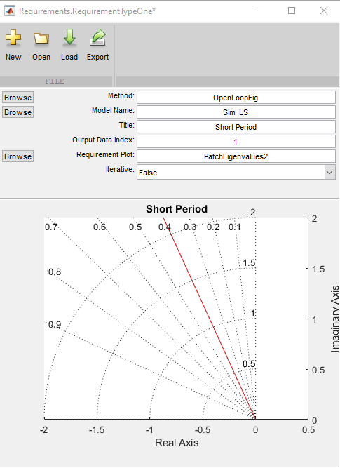
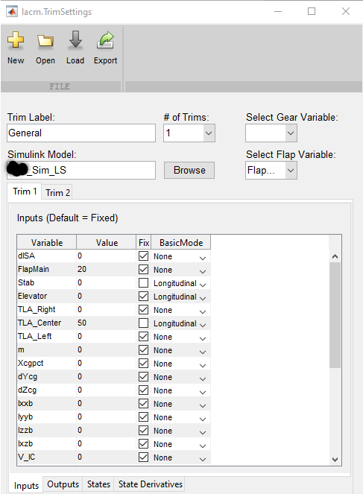
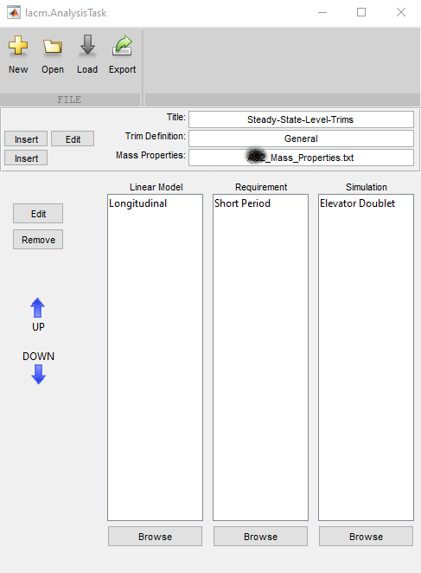
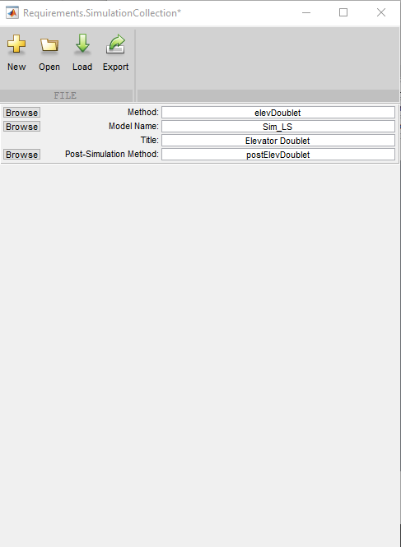
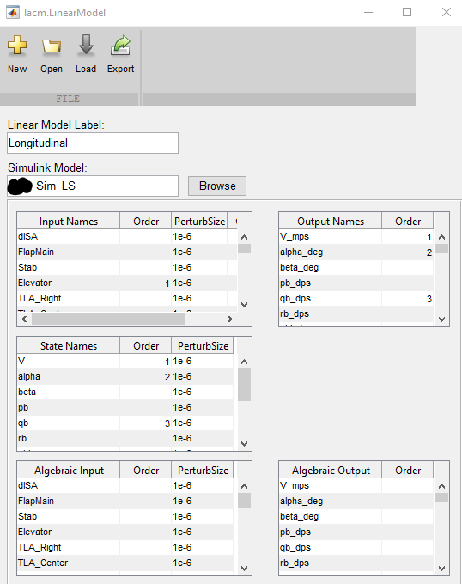
Analysis Task

Slide 36
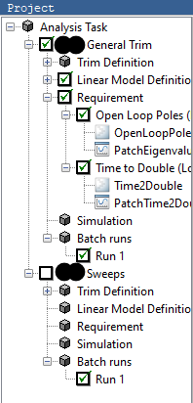
Project Tree
Select the analysis task that you want to run. In this example “Closed-Loop Sim” analysis task is selected. If you included a Simulation select/deselect it.

Slide 37
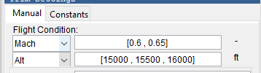
Basic Trim Settings – Flight Condition
Flight condition
Select the flight condition units.
Input the flight condition using a scalar or standard Matlab vector format.

Slide 38

Basic Trim Settings – Flap and Gear
Input flap and gear settings
Gear is grayed out when no variable is attached to the gear selector in the trim definition editor.

Slide 39
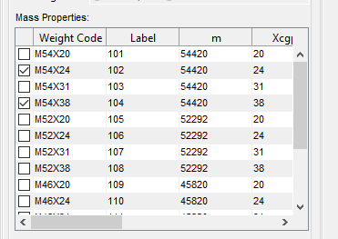
Basic Trim Settings – Mass Properties
Select the mass properties that will be used for the trim
Note: Column labels are dependent on your mass properties file definition.

Slide 40
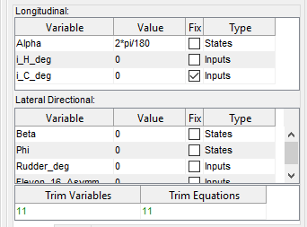
Basic Trim Settings – Set Conditions
Set fix the inputs, outputs, states, and/or state derivatives
Note: the number of trim variables should be equal to the number of trim equations

Slide 41

Basic Trim Settings – Label and Run
Add a label to the current run
If you are ready to run hit the “Run”
button in the tool bar
Or hit Add run cases to continue to building cases to run.

Slide 42
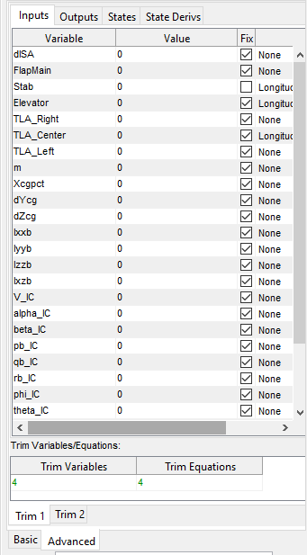
Advanced Trim Settings
In the advanced section the user may use any configuration.
It is divided up into two main trim tabs and each trim tab is then divided into four sections (Inputs, Outputs, States, State Derivatives), the parameters in each section correspond to their respective location withing the Simulink model.
Again, The values may be scalar or standard Matlab vector format.
To assist the user in selecting the correct number of trim equations, the selected number of Trim Variables and Trim equations are displayed. They must be equal.

Slide 43
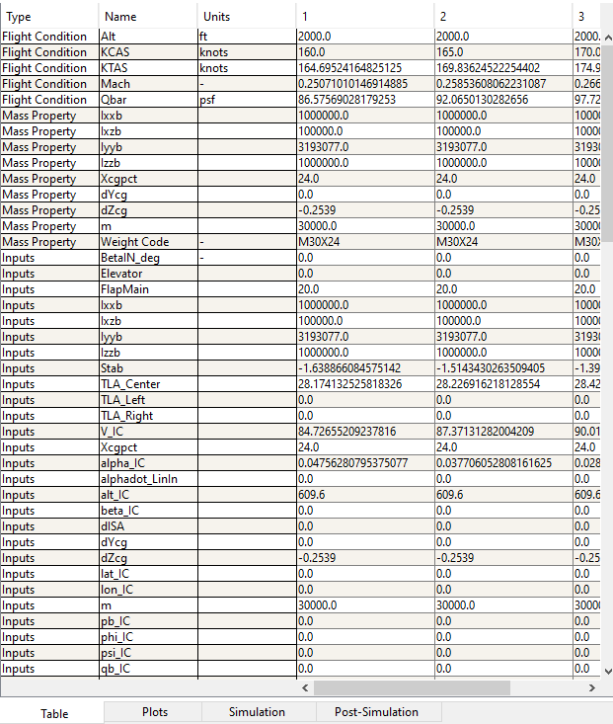
Results Table

Slide 44
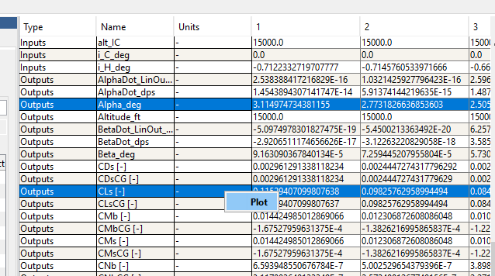

Results Table - Plotting

Slide 45
Results – Quick Plotting
Plotting Results
The results can be plotted in several ways:
Select 1 row and right click the selected row and choose “Plot”.
Select 2 rows by holding down shift and selecting, then choose “Plot”. The first will be the independent variable (x) in the plot and the second selected will be the dependent variable (y).
Select 3 or more rows by holding down shift and selecting, then choose “Plot”. The first will be the independent variable (x) in the plot and the remaining selected variables will be the dependent variables (y).
Select 3 rows by holding down shift and selecting, then choose “ Carpet Plot”. The first will be the independent variable (x) in the plot and the second selected will be the dependent variable (y) and third will be the independent variable (legend).

Slide 46


Results – Filtering
It’s also possible to filter the results. The Variable Selection panel (shown below) selects the visible rows in the table.
The Column filter allow you to filter columns out by numerical value. First select a variable to filter on. Next select a value.

Slide 47

Results – Requirement Plots

Slide 48

Results – Simulation Plots

Slide 49

Results – Post Simulation

Slide 50


Results – Parameters
All Parameters shown here are written to the base workspace at run time.
Selecting the “D” column allow the parameter to be viewed and changed in the main window.
Selecting the “Edit” button opens a popup GUI containing the constant parameters

Slide 51
Operating Condition Class
Important Properties
Name | Class | Description
Label | char | User Defined Label
ModelName | char | Simulink Model used to create the Operating Condition
States | lacm.Condition | Model States
Inputs | lacm.Condition | Model Inputs
Outputs | lacm.Condition | Model Outputs
StateDerivs | lacm.Condition | Model State Derivatives
FlightCondition | lacm.FlightCondition | Flight Condition for operating point
MassProperties | lacm.MassProperties | Mass properties for operating point
LinearModel | lacm.LinearModel | Linearized model around the operating point ( This also includes the settings used to create the linear model)
TrimSettings | lacm.TrimSettings | Settings used to create the trim
Methods
Name | Description
eq ( == ) | Compare operating condition object to each other. By definition they are equal if the flight conditions are equal and the mass properties are equal.
setdiff | Overrides the built in Matlab setdiff, compares flight condition and mass properties.

Slide 52
Flight Condition Class
Important Properties
Name | Class | Description
Mach | double | Mach number for operating condition
Qbar | double | Dynamic Pressure for operating condition
Alt | double | Altitude for operating condition
KCAS | double | Knots of calibrated airspeed for operating condition
Methods
Name | Description
eq ( == ) | Compare flight condition object to each other. By definition they are equal if all the properties are equal.

Slide 53
Mass Properties Class
Important Properties
Name | Class | Description
Label | char | Label for the mass properties- user defined
WeightCode | char | Additional label for mass properties - user defined
Parameter | lacm.Condition | Any additional parameters such as weights and inertias
Methods
Name | Description
get | Returns the value of any parameter in the mass properties object Ex> w = massProp.get(‘Weight’)
setdiff | Overrides the built in Matlab setdiff, compares flight condition and mass properties.

Slide 54

Tool Ribbon
1
2
3
4
5
6
8
9
10
11
13
15
7
12
14
New – Create a new Requirement (Task, Trim, Linear Model, Requirement, Simulation)
Open – Open a Requirement (Task, Trim, Linear Model, Requirement, Simulation)
Load – Loads an existing project
Save – Save the project or save the operating conditions
Run – Run all Tasks selected in the tree.
Add New Run Case – Addeds new run case using the current settings in the manual tab
Table Options – Allows the user to clear the table or export it as a .csv
Opens the Analysis Task Editor
Opens the Trim Task Editor
Opens the Linear Model Editor
Opens the Requirement Editor
Opens the Simulation Editor

Slide 55
Tool Ribbon
1
2
3
4
5
6
8
9
10
11
13
15
7
12
14
Show Invalid Trims - Invalid trims will populate the table along with valid trims
Display Logged Signals - Shows internally logged signals from inside the Simulink model. (This requires additional time to run)
Units – Detemines if the units will be in metric or English. This directly affect the EOM.

