Slide 1

FLIGHTdynamics Manual

Slide 2
FLIGHTDynamics

Slide 3
Title
Writing methods for
Simulation
Post Simulation Methods
Requirements
Inputs and output arguments
Plotting
Line class
X,Y,Marker
Line Collection
Output Index
Describe the OC class
Examples
Properties
Get methods
A,B,C,D linear model access
Get name
Trimming
6 dof model requirements
States – Integators
Simulation
Initial conditions must be top level inputs for Simulation
V, Alt, X_ECEF
Tool Ribbon
Units
Related to V and Alt
Parameters ( how the work)
How to set up Analysis Task
Start with trim Def
Mass Properities
Name match with input ports
Options
Linear Model
Requierment
Simulation

Slide 4
Title
Table
-plotting

Slide 5
Methods - Simulation
Function [Input] = elevDoublet(operCond)
Input Arguments
operCond – lacm.OperatingCondtion object
Output Arguments
- Input
Structure with the following fields:
trimStruct – property of
ReBuildMDLRef – Default to 1, saves time if set to 0 but it will not show take any recent changes
time
Any input ports that you want to overwrite – Simulink input port name
* Any input port not set above will be set to 0

Slide 6
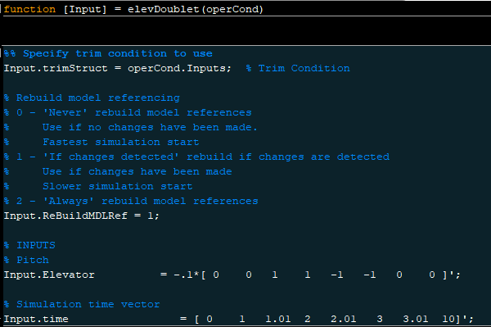
Methods – Simulation - Example

Slide 7
Methods – Requirement Option 1
function [line] = OpenLoopEig(operCond)
Input Arguments
operCond – lacm.OperatingCondtion object
Output Arguments
line - Requirements.NewLine object
Requirements.NewLine object contains all information need to create a line or a point on a plot

Slide 8
Requirements.NewLine
Constructor
Any properties can be used as name value pairs.
Ex> Requirements.NewLine(‘XData’,[0:1:10],’YData’,[0.1:0.1:1],’Color’,[0,1,0])
Ex2> Requirements.NewLine(0:1:10],[0.1:0.1:1],’Color’,[0,1,0])
Properties and default Values
XData = [0,1]
YData = [0,1]
ZData = []
LineStyle = '-'
LineWidth = 0.5
Color %= [0,0,0]
Marker = 'none'
MarkerSize = 6
MarkerEdgeColor = 'auto'
MarkerFaceColor = 'b'
DisplayName = ‘’ - This will appear in the legend
UserData = []

Slide 9
Requirements.NewLineCollection
Constructor
Any properties can be used as name value pairs.
Ex> Requirements.NewLine(‘XData’,[0:1:10],’YData’,[0.1:0.1:1],’Color’,[0,1,0])
Ex2> Requirements.NewLine(0:1:10],[0.1:0.1:1],’Color’,[0,1,0])
Properties and default Values
XData = [0,1]
YData = [0,1]
ZData = []
LineStyle = '-'
LineWidth = 0.5
Color %= [0,0,0]
Marker = 'none'
MarkerSize = 6
MarkerEdgeColor = 'auto'
MarkerFaceColor = 'b'
DisplayName = ‘’ - This will appear in the legend
UserData = []

Slide 10
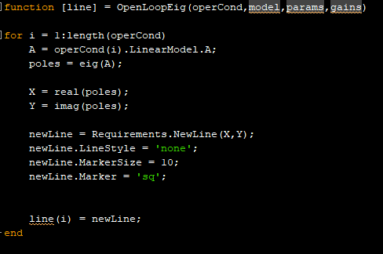
Methods – Simulation - Example

Slide 11
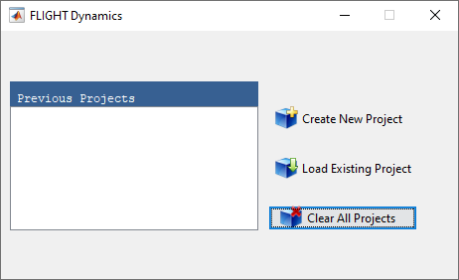
Loading Project
The list box on the left-hand-side shows all the previous projects which were loaded into the FLIGHT Dynamics software. The user has three options:
Create New Project: By selecting this option the file browser will pop up and the user can navigate to and specify the new project file name.
Load Existing Project: By selecting this option the file browser will pop up and the user can navigate to and select the project file.
Clear All Projects: By selecting this option the previous projects list, if any, will be cleared from the list box on the left-hand-side. Note, the actual project files will not be deleted.

Slide 12
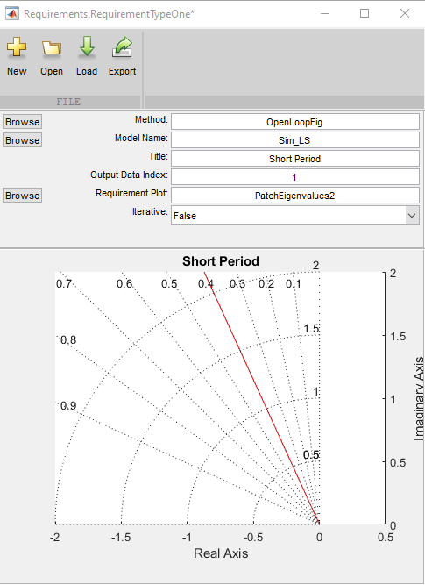
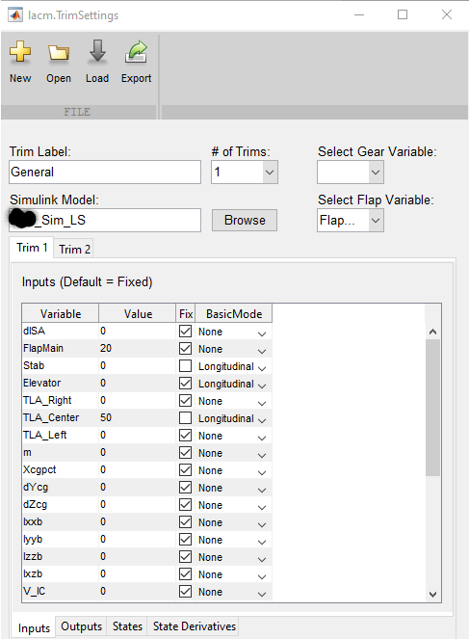
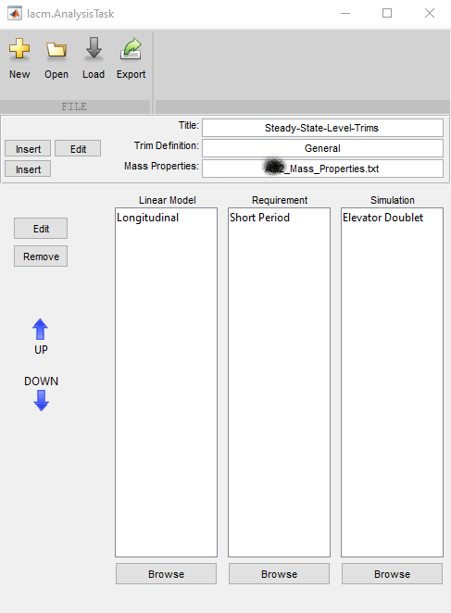
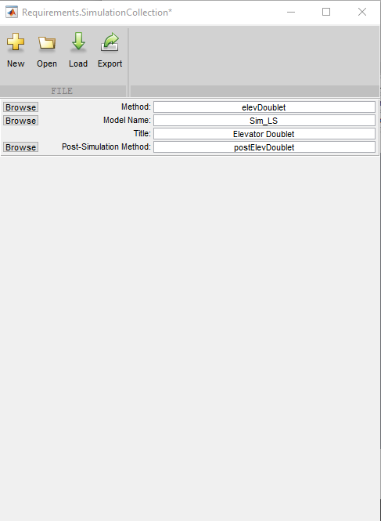
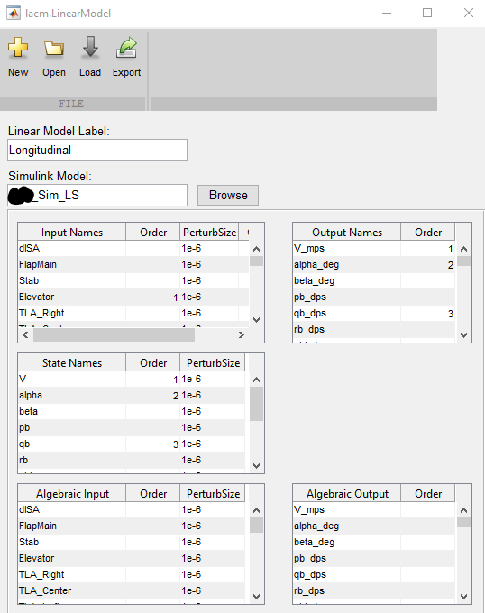
Analysis Task

Slide 13
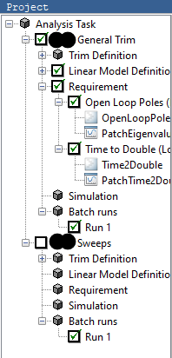
Project Tree
Select the analysis task that you want to run. In this example “Closed-Loop Sim” analysis task is selected. If you included a Simulation select/deselect it.

Slide 14
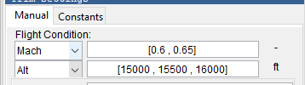
Basic Trim Settings – Flight Condition
Flight condition.
Select the flight condition units.
Input the flight condition using a scalar or standard Matlab vector format. Must be a 1 x N numeric where N is greater than 1. N will be the number of trim conditions run.

Slide 15

Basic Trim Settings – Flap and Gear
Input flap and gear settings.
Gear is grayed out when no variable is attached to the gear selector in the trim definition editor.

Slide 16
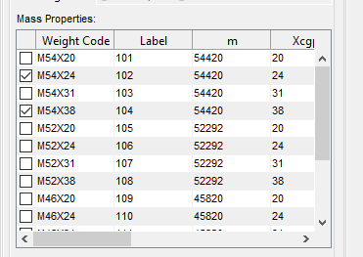
Basic Trim Settings – Mass Properties
Select the mass properties that will be used for the trim
*Column labels are dependent on your mass properties file definition.

Slide 17
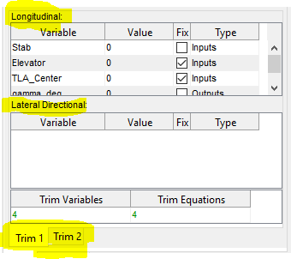
Basic Trim Settings – Set Conditions
Set any conditions for the simuilation inputs/outputs for both trim 1 and trim 2. The values may be scalar or standard Matlab vector format. Must be a 1 x N numeric where N is greater than 1. N will be the number of trim conditions run

Slide 18

Basic Trim Settings – Label and Run
Add a label to the current run
If you are ready to run hit the “Run”
button in the tool bar
Or hit Add run cases to continue to build up the trim.

Slide 19
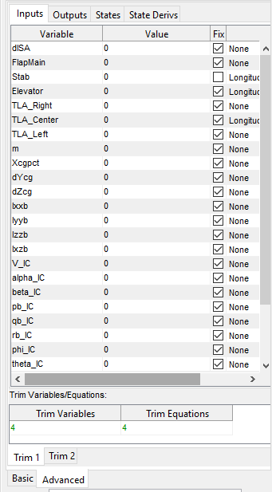
Advanced Trim Settings
In the advanced section the user may use any configuration.
It is divided up into two main trim tabs and each trim tab is then diveded into four sections ( Inputs, Outputs, States, StateDerivs), the parameters in each section corespnd to their respective location withing the simulink model.
Again, The values may be scalar or standard Matlab vector format. Must be a 1 x N numeric where N is greater than 1. N will be the number of trim conditions run.
To assist the user in selecting the correct number of trim equations, the selected number of Trim Variables and Trim equations are displayed. They must be equal.

Slide 20
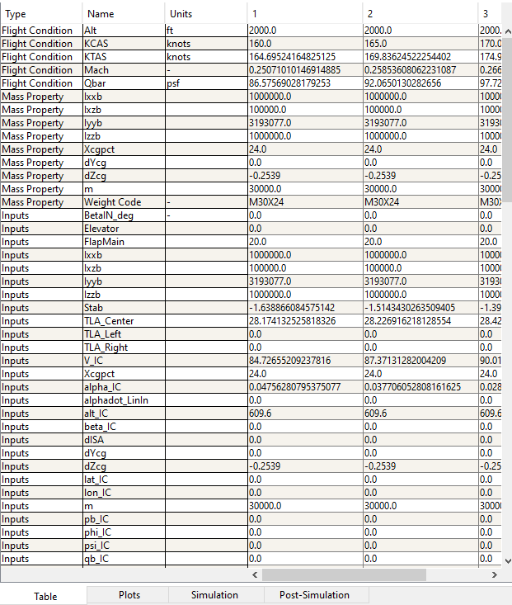
Results

Slide 21
Results – Quick Plotting
Plotting results
The results can be plotted in several ways:
Select 1 row and right click the selected row and choose “Plot”.
Select 2 rows by holding down shift and selecting, then choose “Plot”. The first will be the dependent variable in the plot and the second selected will be the independent variable.
Select 3 or more rows by holding down shift and selecting, then choose “Plot”. The first will be the dependent variable in the plot and the remaining selected variables will be the independent variables.
Select 3 rows by holding down shift and selecting, then choose “ Carpet Plot”. The first will be the dependent variable in the plot and the second selected will be the independent variable and the 3rd with be the z axis.

Slide 22
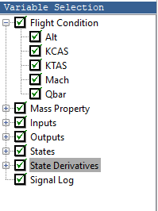
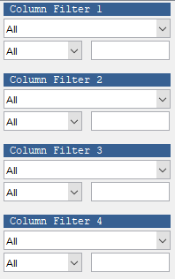
Results – Filtering
It’s also possible to filter the results. The Variable Selection panel (shown below) selects the visible rows in the table.
The Column filter allow you to filter columns out by numerical value. First select a variable to filter on. Next select a value.

Slide 23
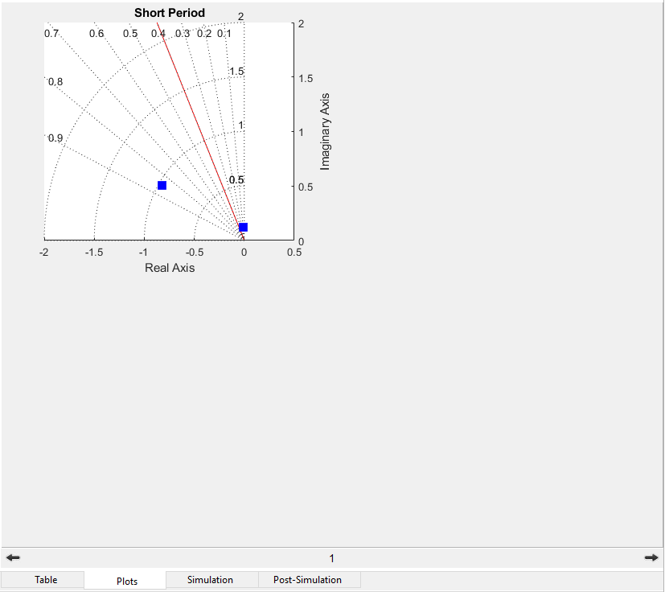
Results – Requirement Plots

Slide 24
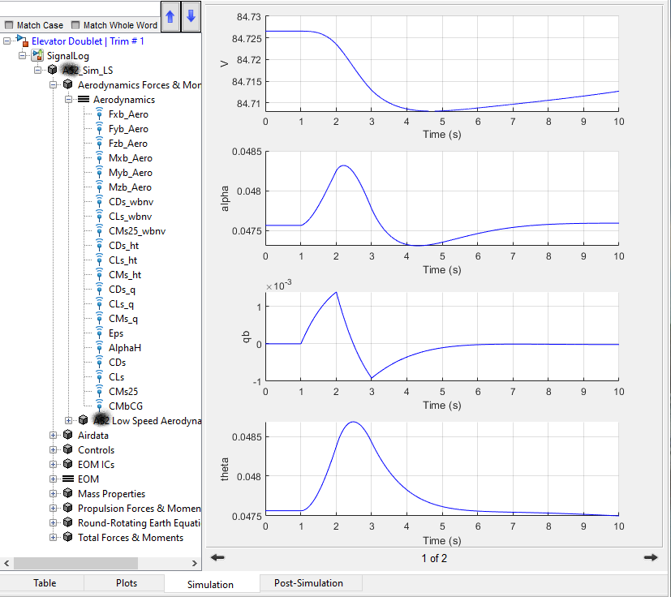
Results – Simulation Plots

Slide 25
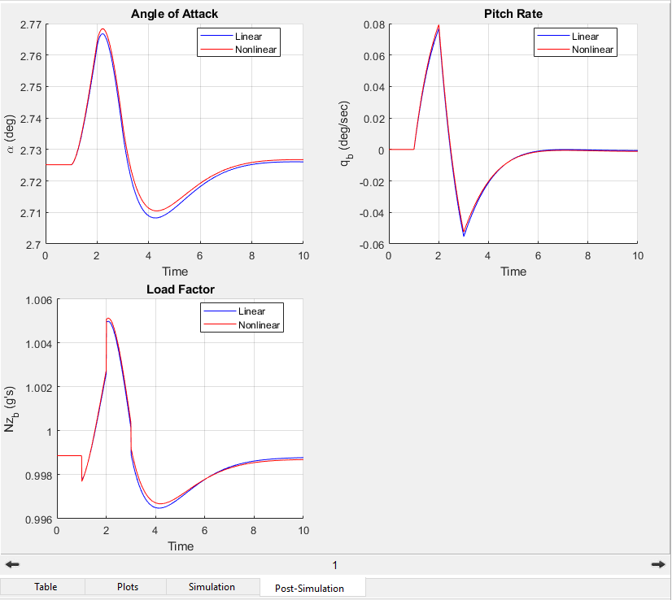
Results – Post Simulation

Slide 26
Operating Condition Class
Important Properties
Name | Class | Description
Label | char | User Defined Label
ModelName | char | Simulink Model used to create the Operating Condition
States | lacm.Condition | Model States
Inputs | lacm.Condition | Model Inputs
Outputs | lacm.Condition | Model Outputs
StateDerivs | lacm.Condition | Model State Derivatives
FlightCondition | lacm.FlightCondition | Flight Condition for operating point
MassProperties | lacm.MassProperties | Mass properties for operating point
LinearModel | lacm.LinearModel | Linearized model around the operating point ( This also includes the settings used to create the linear model)
TrimSettings | lacm.TrimSettings | Settings used to create the trim
Methods
Name | Description
eq ( == ) | Compare operating condition object to each other. By definition they are equall if the flight conditions are equal and the mass properties are equal.
setdiff | Overrides the built in Matlab setdiff, compares flight condition and mass properties.

Slide 27
Flight Condition Class
Important Properties
Name | Class | Description
Mach | double | Mach number for operating condition
Qbar | double | Dynamic Pressure for operating condition
Alt | double | Altitude for operating condition
KCAS | double | Knots of calibrated airspeed for operating condition
Methods
Name | Description
eq ( == ) | Compare flight condition object to each other. By definition they are equal if all the properties are equal.

Slide 28
Mass Properties Class
Important Properties
Name | Class | Description
Label | char | Label for the mass properties- user defined
WeightCode | char | Additional label for mass properties - user defined
Parameter | lacm.Condition | Any additional parameters such as weights and inertias
Methods
Name | Description
get | Returns the value of any parameter in the mass properties object Ex> w = massProp.get(‘Weight’)
setdiff | Overrides the built in Matlab setdiff, compares flight condition and mass properties.

Slide 29
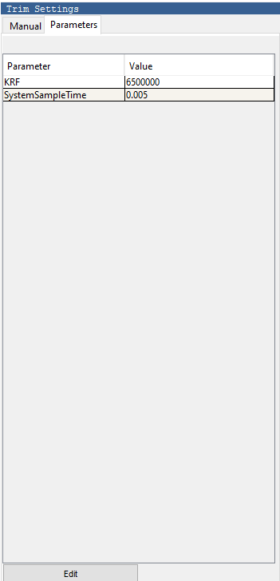
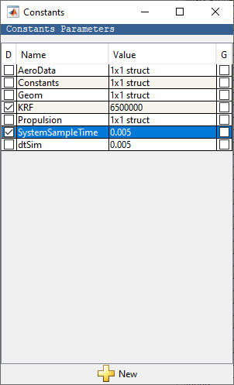
Results – Parameters
All Parameters shown here are written to the base workspace at run time.
Selecting the “D” column allow the parameter to be viewed and changed in the main window.
Selecting the “Edit” button opens a popup GUI containing the constant parameters

Slide 30

Tool Ribbon
1
2
3
4
5
6
8
9
10
11
14
16
7
13
15
17
New – Create a new Requirement (Task, Trim, Linear Model, Requirement, Simulation)
Open – Open a Requirement (Task, Trim, Linear Model, Requirement, Simulation)
Load – Loads an existing project
Save – Save the project or save the operating conditions
Run – Run all Tasks selected in the tree.

