Slide 1


Softsmith
Open Learning - EJB
21-Nov-2008

Slide 2

Enterprise Java Beans
Introduction
  Application Server
  Java 2 Enterprise Edition
What is an Enterprise Bean ?
  EJB Properties
  EJB Overview
  Deployment Phase
  Type of beans
Client access with interfaces
  Remote access
  Local Access

Slide 3
Enterprise Java Beans
Contents of an Enterprise Bean
EJB Example
EJB vs MTS
A few EJB implementations
What’s new in EJB 2.0
Bibliography

Slide 4
Introduction
Enterprise Java Beans ( EJB ) is
  a middleware component model for Java and CORBA
  a specification for creating server-side, scalable, transactional, multi-user and secure enterprise-level applications
  one of several Java APIs in the Java
Presented by Sun in the 1999, they are easier than other technologies as RMI or Corba

Slide 5
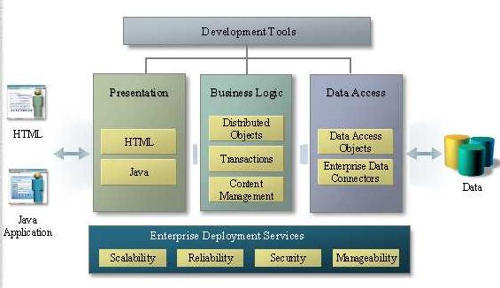
Introduction
This is the three level structure for Application Server

Slide 6
Applicaton Server
Presentation
  HTML Application
  Java Application
Business Logic
Data Access

Slide 7
Presentation
HTML
  Generated server-side HTML
  Runs on any Web browser
  Less client-side power
Java
  Required Java virtual Machine
  More client side power
  Runned on a page
  Security (Applet)
  Launched from a browser or a standalone application

Slide 8
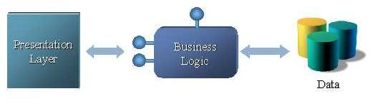
Business Logic
Implements the logic of the application defining all the function that may be used from a client
  Change Business Rules Easily
  Re-use components
  Make complex applications manageable
  Secure Data hiding

Slide 9
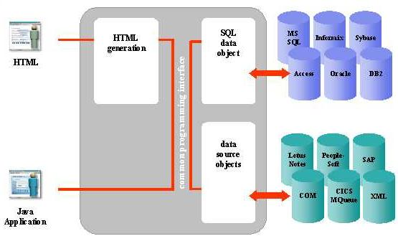
Data Access
Utility to access external datas such as Database or other Web component
Access other SOA

Slide 10
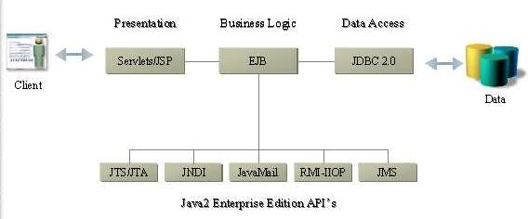
J2EE Application Server
Java 2 Enterprise Edition standardizes interfaces for Application Server components

Slide 11
What is an Enterprise Bean ?
Is a server side component written in Java Language
Industry standard distribuited component model
Incorporates the business logic of an application ( the code that implements the purpose of the application)
Replicates the table model as objects

Slide 12
EJB Properties
Bean writers need not write
  Remote access Protocols
  Transactional Behaviour
  Threads
  Security
  State Management
  Object life cycle
  Resource pooling
  Persistence
  Native queries execution

Slide 13
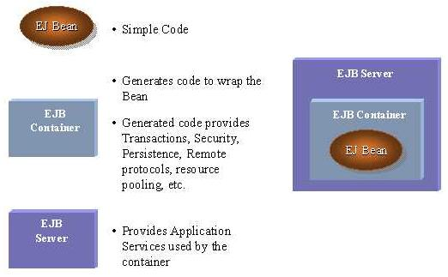
EJB Overview

Slide 14
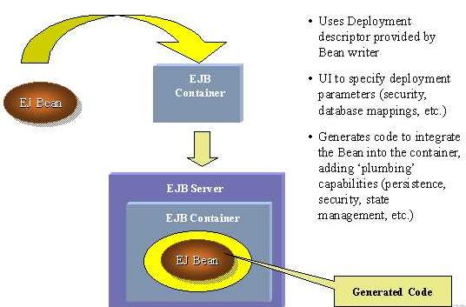
Deployment Phase

Slide 15
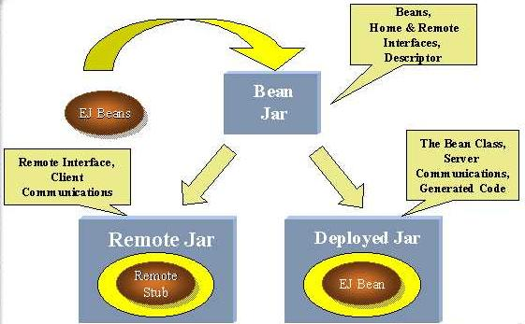
Deployment Phase

Slide 16
When to use Enterprise bean
The application must be scalable.It will run on different machine and their location will remain transparent to the client
Transaction requirement
The application will have lot of different type of clients
Multilevel security layer

Slide 17
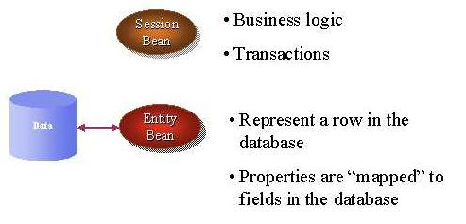
Type of beans
Session Bean
Entity Bean
Message Driven Bean

Slide 18
Session Bean
Represents a single client inside the server
The client calls the session bean to invoke methods of an application on the server
Perform works for its client, hiding the complexity of interaction with other objects in the server
Is not shared
Is not persistent
When the client stops the session,the bean can be assigned to another client from the server
Unique to each client

Slide 19
Session Bean
Stateful session bean
Stateless session bean

Slide 20
Stateful Session Bean
Contains the state of a single client session:
  Information on the client
  On method called
  Return values
  This state is called conversational state and is not retained when the session ends, also if the client not removes the bean
  - Remembers previous request, and response of session

Slide 21
Stateless Session Bean
Not maintain a conversational state for a particular client
Contains values only for the duration of the single invocation
Except during method invocation, all instances of stateless session bean are equivalent
Pooled

Slide 22
Entity Bean
Represents a business object in a persistent storage mechanism such as a relational database
Usually is a table in the database and each instance of that entity bean is a row in that table
Properties:
    Persistent
    Allow shared access
    Have primary key
    Have relationship with other entity beans.
    Auto commit.

Slide 23
Entity Bean persistent
Bean managed persistence
Container managed persistence

Slide 24
Bean managed persistence
Who write the bean’s code must access the database and save his own data
you will have more control over how the entity bean accesses a database

Slide 25
Container managed persistence
The container save the data
There is no code in the bean for access the database
The container handles all database access required for the bean
Links between beans are created using a structure called abstract schema
the EJB container transparently and implicitly manages the persistent state

Slide 26
Entity bean’s shared access
Entity beans can be used by different clients
It’s important that they work whithin transactions
The EJB container provides transaction management
The transaction’s attribute are specified in the bean’s deployment description
Concurrency management

Slide 27
Entity bean’s primary key
Each entity bean has a unique object identifier like a key in a database table
Each instance represents as Row in table

Slide 28
Entity bean’s relationship
Container managed persistent
  The container performs all the operation to create relationship
Bean managed persistent
  The code to perform relations must be written in the bean

Slide 29
Message Driven bean
Allows applications to process messages asynchronously
The messages may be sent by :
  An application client
  Another enterprise bean
  A Web component
  A JMS Client

Slide 30
Message Driven bean
Retain no data or conversational state for a specific client
All instances are equivalent, allowing the EJB container to assign a message to any message-driven bean instance. The container can pool these instances.
The instance variables of the message-driven bean e can contain some state across the handling of client messages--for example, a JMS API connection, an open database connection, or an object reference to an ejb.

Slide 31
Message Driven bean
A client can’t access directly to a message driven bean
When a message arrive, the container gives it to a message driven bean
The bean process the message
The onMessage method may call helper methods, or it may invoke a session or entity bean to process the information in the message or to store it in a database

Slide 32
Client access with interfaces
A client may access a session or an entity bean only through the methods defined in the bean's interfaces
They define the client's view of a bean
Public business methods declared in Bean interface’s can be visible to client, to invoke
Types of access:
  Remote access
  Local access

Slide 33
Remote access
A remote client of an enterprise bean has the following traits:
  It may run on a different machine and a different Java virtual machine than the enterprise bean it accesses (It is not required to run on a different JVM )
  It can be a Web component
  It can be another enterprise bean
  It can be RMI object

Slide 34
Remote access
To create an enterprise bean with remote access, you must :
  Code a remote interface
    Business methods
  Code a home interface
    Finder methods
    Home methods
    Utility methods (to get home)

Slide 35
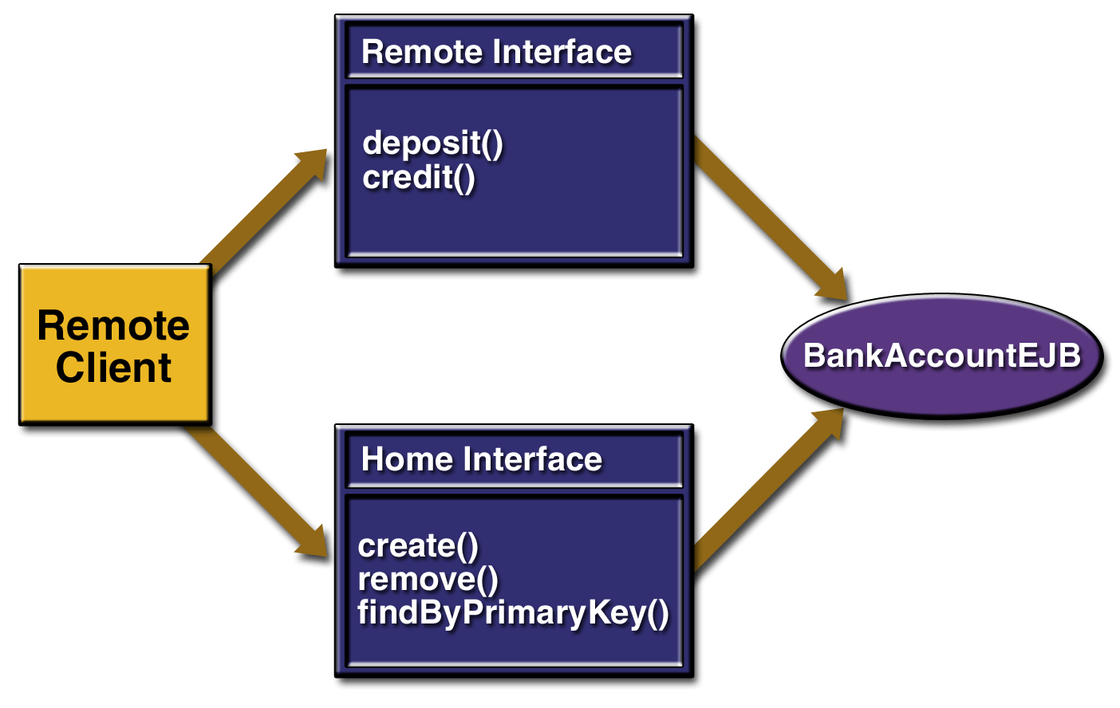
Remote access example

Slide 36
Local access
A local client has these characteristics
  It must run in the same JVM as the enterprise bean it accesses
  It may be a Web component or another enterprise bean
  To the local client, the location of the enterprise bean it accesses is not transparent
  It is often an entity bean that has a container-managed relationship with another entity bean

Slide 37
Local access
To create an enterprise bean with local access, you must :
  Code the local interface
    Bean's business methods
  Code the local home interface
    Life cycle
    Finder methods
    Utility methods

Slide 38
Local interfaces
If an entity bean is the target of a container managed relationship it MUST have local interfaces
An EJB can use local client view only if it is really guaranteed that other enterprise beans or clients will only address the bean within a single JVM

Slide 39
Contents of an Enterprise Bean
Deployment descriptor
  Persistence type
  Transaction attribute
Enterprise bean class
Interfaces
Helper classes
  Exception
  Utility classes

Slide 40
EJB Example
The OnLine Bank
We will take a not completed system to give an idea to how choose if a component is an entity, session or message driven bean.

Slide 41
EJB Example
Virtual Bank
Security
Accounts
Services
Client

Slide 42
EJB Example
The example has three component:
  Services: what the client can do in the system such as see the foreign currency , listed shares or make operations on his hown account.
  Accounts: a database containing the accounts of all the clients of the bank with information about credit,debit,access etc..
  Security: is a subsystem that receives all the alarm caused from wrong access and performs action about the situation
  ( calls police and stops operation of that client keeping information about him )

Slide 43
EJB Example
In this example is easy to create an EJB structure.
  Client will have a web page at client side to insert values and connect the system.This will be done using JSP ( Java Servlet Pages )
  Services will be a Statefull Session Bean and it will be different for each client connecting the system mantaining data about the client connected.
  Accounts will be formed by an Entity Bean for each account in the system with a code-account as primary key.
  Security will be a Message driven bean and will be called only from container if some operation are abnormal for result or the autentification for the same client fails too much times.

Slide 44
A few EJB implementations
WebLogic
Bluestone
Novera
Persistence
Oracle AS
Oracle8i

Slide 45
What’s new in EJB 2.0
Released On April 26, 2001
Integration with JavaTM Message Service (JMS) -- Asynchronous Capabilities Streamline Systems
  Send asynchronous messages via the JMS API
Container-Managed Persistence (CMP) -- Simplifying and Expediting Application Development
  Used to isolate the application developer from the physical database schema
  Introduces for the first time a portable query language, based on the abstract schema
  No need to worry about data access code

Slide 46
What’s new in EJB 2.0
Local Interfaces -- Streamlining Calls Between Local Beans
  The local interface may be defined for a bean during development, to allow streamlined calls to the bean if a caller is in the same container
  Uses when Client and bean reside in same JVM
Inter-Server Interoperability -- Enabling Heterogeneous Environments
  Takes the benefit of cross-server application portability
  Able to deploy the EJB technology-based application across a heterogeneous environment mixing application servers from different vendors

Slide 47
The EJB architecture
Consists of:
  An EJB server
  EJB containers that run within the server
  Home objects
  Remote EJBObjects
  Enterprise Beans
  EJB clients
  Auxiliary systems like
    Java Naming and Directory Interface (JNDI)
    Java Transaction Service (JTS)
    Security services
    Threading
    Pooling

Slide 48
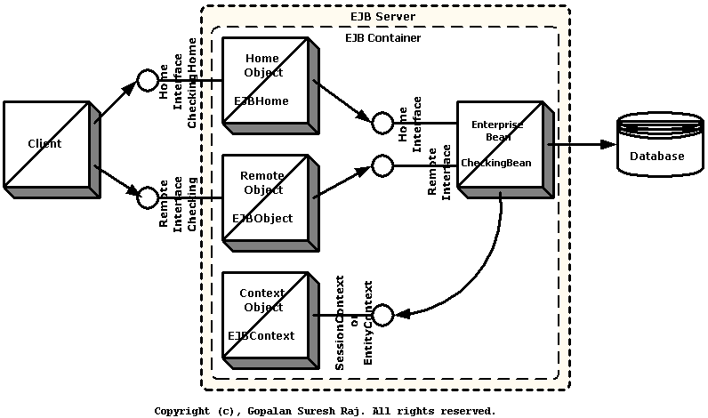
The EJB architecture

Slide 49
Stateful session bean’s life cycle
The client invoke the create method
The EJB container :
  Instantiates the bean
  Invokes the setSessionContext
  Invokes ejbCreate
The bean is ready
Business methods ready to be called

Slide 50
Stateful session bean’s life cycle
While in the ready state
  EJB container may passivate the bean moving it from memory to secondary storage
  A client may invoke a business method
  EJB container may activate a bean,moving it back to the ready stage, and then calls the bean's ejbActivate method
  A client may invoke the remove method and the container calls the bean's ejbRemove method
  Client cannot invoke passivate

Slide 51
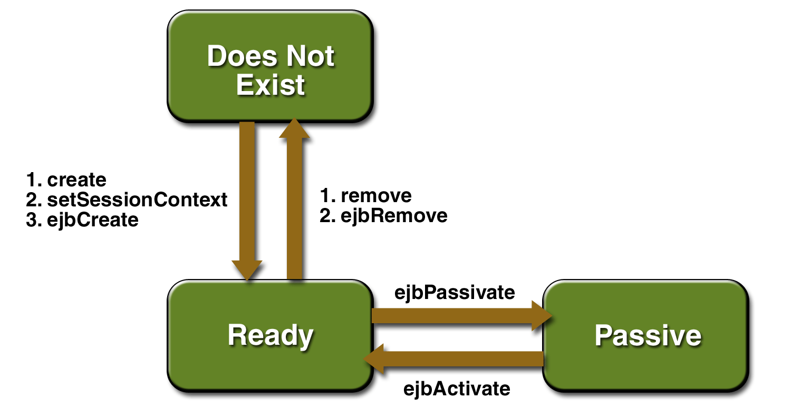
Stateful session bean’s life cycle

Slide 52
Stateless session bean’s life cycle
The client invoke the create method
The EJB container :
  Instantiates the bean
  Invokes the setSessionContext
  Invokes ejbCreate
The bean is ready

Slide 53
Stateless session bean’s life cycle
While in the ready state
  A client may invoke a business method
  A client may invoke the remove method and the container calls the bean's ejbRemove method
  It’s never passivate
  It’s can be pooled

Slide 54
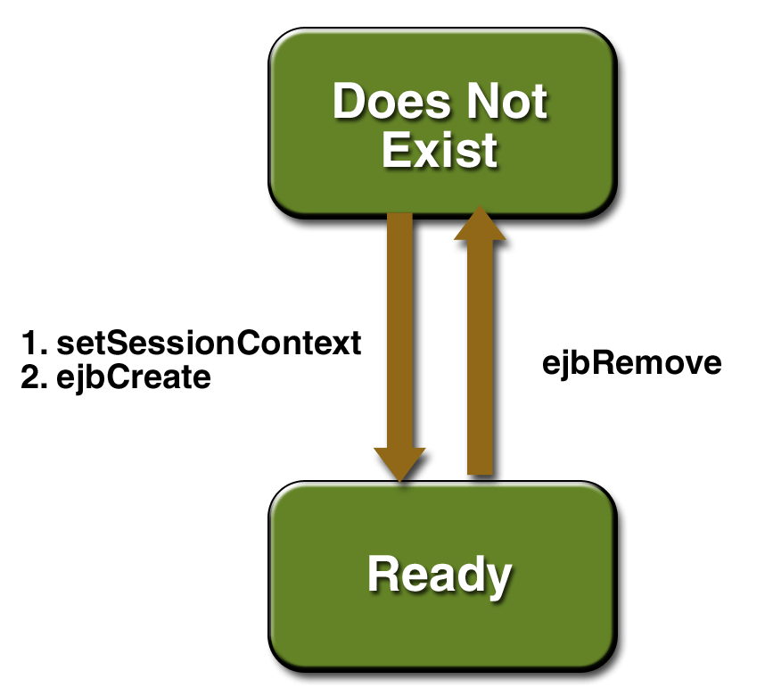
Stateless session bean’s life cycle

Slide 55
Entity bean’s life cycle
The EJB container :
  Creates the instance
  Calls the setEntityContext
The entity bean moves to a pool of available instances

Slide 56
Entity bean’s life cycle
While in the pool :
  Instance is not associated with any particular object identity
  All instances in the pool are identical
  EJB container may assign an identity to an instance when moving it to the ready stage invoking the ejbActivate method
  A client may invoke the create method
    EJB container calls ejbCreate and ejbPostCreate
  EJB container may remove the instance invoking unsetEntityContext
  Same bean instance (row) shared by all client

Slide 57
Entity bean’s life cycle
While in the ready state :
  A client may invoke entity bean's business methods
  A client may invoke the remove method
    EJB container calls the ejbRemove method
  EJB container may invoke the ejbPassivate method

Slide 58
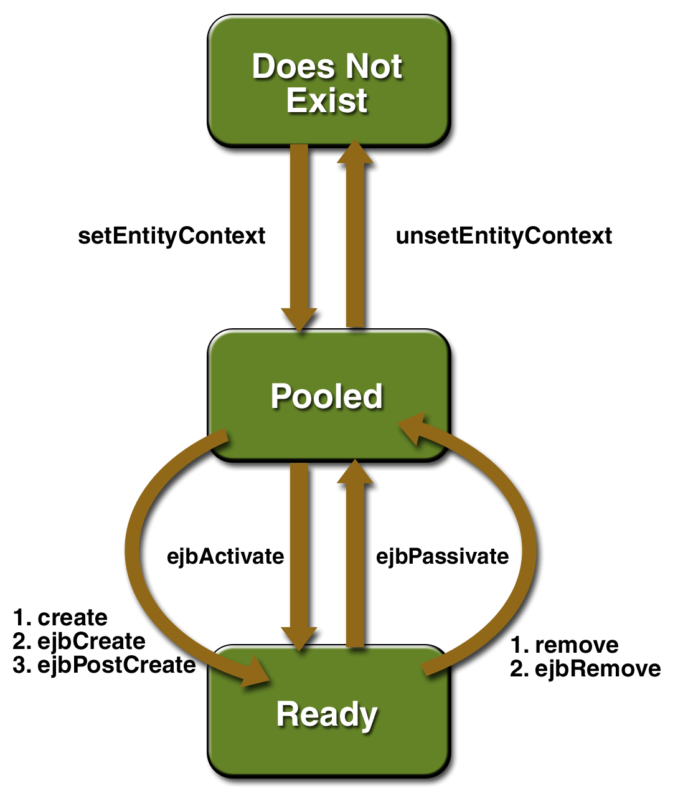
Entity bean’s life cycle

Slide 59
Message driven bean’s life cycle
EJB container creates a pool of message-driven bean instances
For each instance, the EJB container instantiates the bean :
  It calls the setMessageDrivenContext
  It calls the instance's ejbCreate
Like a stateless session bean,it’s never passivated, It has only two states:
  Nonexistent
  Ready to receive messages.
  is only a bean class – no interfaces

Slide 60
Message driven bean’s life cycle
While in the ready state :
  EJB container may call onMessage
  EJB container may call the ejbRemove

Slide 61
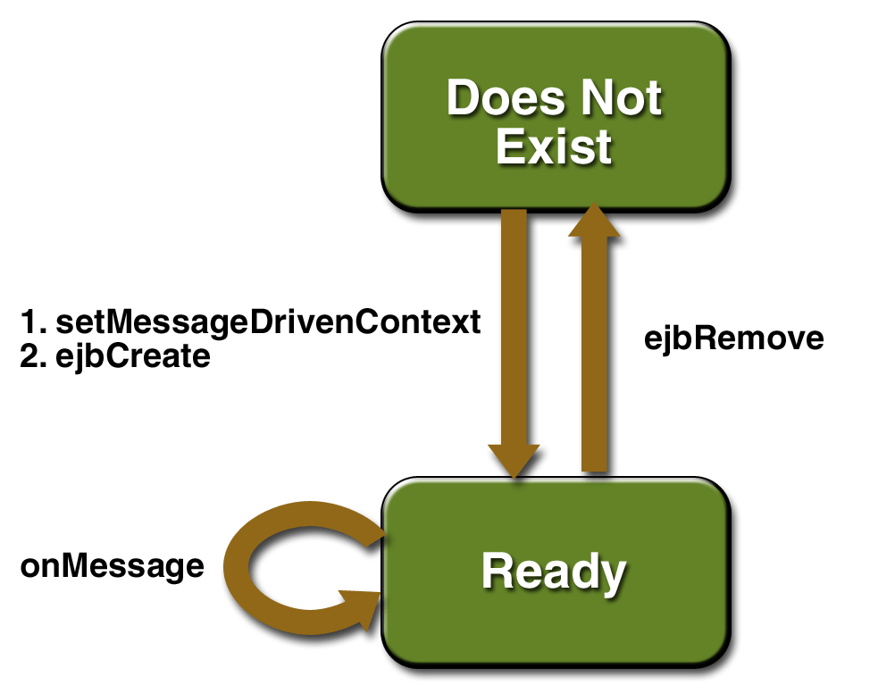
Message driven bean’s life cycle

