Slide 1
JSP
Java Server Pages

Slide 2


Slide 3
JSP
JavaServer Pages (JSP) is a technology that helps software developers create dynamically generated web pages based on HTML, XML, or other document types. Released in 1999 by Sun Microsystems, JSP is similar to PHP, but it uses the Java programming language.
JSP technology is used to create web application just like Servlet technology. It can be thought of as an extension to servlet because it provides more functionality than servlet such as expression language, jstl etc.
A JSP page consists of HTML tags and JSP tags. The jsp pages are easier to maintain than servlet because we can separate designing and development. It provides some additional features such as Expression Language, Custom Tag etc.

Slide 4
Advantage of JSP over Servlet
1) Extension to Servlet: JSP technology is the extension to servlet technology. We can use all the features of servlet in JSP. In addition to, we can use implicit objects, predefined tags, expression language and Custom tags in JSP, that makes JSP development easy.
2) Easy to maintain: JSP can be easily managed because we can easily separate our business logic with presentation logic. In servlet technology, we mix our business logic with the presentation logic.
3) Fast Development: No need to recompile and redeploy : we don't need to recompile and redeploy the project. The servlet code needs to be updated and recompiled if we have to change the look and feel of the application.
4) Less code than Servlet: we can use a lot of tags such as action tags, jstl, custom tags etc. that reduces the code. Moreover, we can use EL, implicit objects etc

Slide 5
Life cycle of a JSP Page
Translation of JSP Page
Compilation of JSP Page
Classloading (class file is loaded by the classloader)
Instantiation (Object of the Generated Servlet is created).
Initialization ( jspInit() method is invoked by the container).
Reqeust processing ( _jspService() method is invoked by the container).
Destroy ( jspDestroy() method is invoked by the container).

Slide 6
***Life Cycle methods of JSP
jspInit()
_jspService()
jspDestroy()

Slide 7
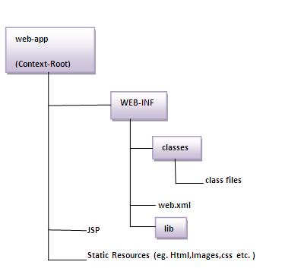
Directory structure of JSP

Slide 8
The JSP API
The JSP API consists of two packages:
javax.servlet.jsp
javax.servlet.jsp.tagext

Slide 9
javax.servlet.jsp package
Interfaces:
JspPage
HttpJspPage
Classes:
JspWriter
PageContext
JspFactory
JspEngineInfo
JspException
JspError

Slide 10
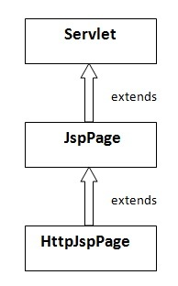
JspPage interface

Slide 11
Methods of JspPage interface
public void jspInit(): It is invoked only once during the life cycle of the JSP when JSP page is requested firstly. It is used to perform initialization. It is same as the init() method of Servlet interface.
public void jspDestroy(): It is invoked only once during the life cycle of the JSP before the JSP page is destroyed. It can be used to perform some clean up operation.

Slide 12
HttpJspPage interface
The HttpJspPage interface provides the one life cycle method of JSP. It extends the JspPage interface.
Method of HttpJspPage interface:
public void _jspService(): It is invoked each time when request for the JSP page comes to the container. It is used to process the request. The underscore _ signifies that you cannot override this method.

Slide 13
Creating a simple JSP Page
To create the first jsp page, write some html code as given below, and save it by .jsp extension. We have save this file as index.jsp. Put it in a folder and paste the folder in the web-apps directory in apache tomcat to run the jsp page.

Slide 14
Index.jsp
<html>
<body>
<% out.print(2*5); %>
</body>
</html>
//It will print 10 on the browser

Slide 15
How to run a simple JSP Page ?
Start the server
put the jsp file in a folder and deploy on the server
visit the browser by the url http://localhost:portno/contextRoot/jspfile e.g. http://localhost:8888/myapplication/index.jsp

Slide 16
Do I need to follow directory structure to run a simple JSP ?
No, there is no need of directory structure if you don't have class files or tld files. For example, put jsp files in a folder directly and deploy that folder.It will be running fine.

Slide 17
Note
if you are using bean class, Servlet or tld file then directory structure is required.

Slide 18
JSP Scripting Elements

Slide 19
JSP Scripting Elements
The scripting elements provides the ability to insert java code inside the jsp. There are three types of scripting elements:
scriptlet tag
expression tag
declaration tag

Slide 20
JSP scriptlet tag
A scriptlet tag is used to write java source code in JSP.
Syntax is as follows: <% java source code %>

Slide 21
Example of JSP scriptlet tag
<html>
<body>
<% out.print("welcome to jsp"); %>
</body>
</html>

Slide 22
Note
JSP code is internally converted in to servlet code.
Web container generates the servlet code for jsp.

Slide 23
Where does Eclipse store generated servlet files for Tomcat?
Doubleclick the server entry in Servers view and check the path represented by Server path.
Path:
workspace Directory/.metadata/.plugins/org.eclipse.wst.server.core/tmp0/work/catalina/localhost/Project name
Ex: C:\Montana\Workspace\.metadata\.me_tcat\work\Catalina\localhost\JSPLearning\org\apache\jsp

Slide 24
Example of JSP scriptlet tag that prints the user name
In this example, we have created two files index.html and welcome.jsp. The index.html file gets the username from the user and the welcome.jsp file prints the username with the welcome message.

Slide 25
Index.html
<html>
<body>
<form action="welcome.jsp">
<input type="text" name="uname">
<input type="submit" value="go"><br/>
</form>
</body>
</html>

Slide 26
Welcome.jsp
<html>
<body>
<%
String name=request.getParameter("uname");
out.print("welcome "+name);
%>
</form>
</body>
</html>

Slide 27
2. JSP Expression Tag
The code placed within JSP expression tag is written to the output stream of the response. So you need not write out.print() to write data. It is mainly used to print the values of variable or method.
Syntax:
<%= statement %>

Slide 28
Example of JSP expression tag
<html>
<body>
<%= "welcome to jsp" %>
</body>
</html>

Slide 29
Note:
Do not end your statement with semicolon in case of expression tag.

Slide 30
Example of JSP expression tag that prints current time
Index.jsp
<html>
<body>
Current Time: <%= java.util.Calendar.getInstance().getTime() %>
</body>
</html>

Slide 31
Example of JSP expression tag that prints the user name
In this example, we are printing the username using the expression tag. The index.html file gets the username and sends the request to the welcome.jsp file, which displays the username.

Slide 32
Index.jsp
<html>
<body>
<form action="welcome.jsp">
<input type="text" name="uname"><br/>
<input type="submit" value="go">
</form>
</body>
</html>

Slide 33
welcome.jsp
<html>
<body>
<%= "Welcome "+request.getParameter("uname") %>
</body>
</html>

Slide 34
3. JSP Declaration Tag
The JSP declaration tag is used to declare fields and methods.
The code written inside the jsp declaration tag is placed outside the service() method of auto generated servlet.
So it doesn't get memory at each request.

Slide 35
Syntax of JSP Declaration Tag
<%! field or method declaration %>

Slide 36
Example of JSP declaration tag that declares field
<html>
<body>
<%! int data=50; %>
<%= "Value of the variable is:"+data %>
</body>
</html>

Slide 37
Example of JSP declaration tag that declares method
<html>
<body>
<%!
int cube(int n){
return n*n*n*;
}
%>
<%= "Cube of 3 is:"+cube(3) %>
</body>
</html>

Slide 38
***9 implicit objects
Object | Type
out | JspWriter
request | HttpServletRequest
response | HttpServletResponse
config | ServletConfig
application | ServletContext
session | HttpSession
pageContext | PageContext
page | Object
exception | Throwable

Slide 39
1) JSP out implicit object
For writing any data to the buffer, JSP provides an implicit object named out. It is the object of JspWriter. In case of servlet you need to write:
PrintWriter out=response.getWriter();

Slide 40
Example of out implicit object
<html>
<body>
<% out.print("Today is:"+java.util.Calendar.getInstance().getTime()); %>
</body>
</html>

Slide 41
What is difference between JspWriter and Servlet PrintWriter?
PrintWriter is the actual object responsible for writing the content in response. JspWriter uses the PrintWriter object behind the scene and provide buffer support. When the buffer is full or flushed, JspWriter uses the PrintWriter object to write the content into response

Slide 42
2. JSP request implicit object
The JSP request is an implicit object of type HttpServletRequest i.e. created for each jsp request by the web container. It can be used to get request information such as parameter, header information, remote address, server name, server port, content type, character encoding etc.
It can also be used to set, get and remove attributes from the jsp request scope.

Slide 43
Example of JSP request implicit object
Let's see the simple example of request implicit object where we are printing the name of the user with welcome message.

Slide 44
Index.html
<form action="welcome.jsp">
<input type="text" name="uname">
<input type="submit" value="go"><br/>
</form>

Slide 45
welcome.jsp
<%
String name=request.getParameter("uname");
out.print("welcome "+name);
%>

Slide 46
3) JSP response implicit object
In JSP, response is an implicit object of type HttpServletResponse. The instance of HttpServletResponse is created by the web container for each jsp request.
It can be used to add or manipulate response such as redirect response to another resource, send error etc.

Slide 47
Example of response implicit object
Let's see the example of response implicit object where we are redirecting the response to the Google.

Slide 48
Index.html
<a href=“welcome.jsp”>Click here to go to google from welcome jsp file</a>

Slide 49
welcome.jsp
<%
response.sendRedirect("http://www.google.com");
%>

Slide 50
4) JSP config implicit object
In JSP, config is an implicit object of type ServletConfig. This object can be used to get initialization parameter for a particular JSP page. The config object is created by the web container for each jsp page.
Generally, it is used to get initialization parameter from the web.xml file.

Slide 51
Example of config implicit object:

Slide 52
Index.html
<form action="welcome">
<input type="text" name="uname">
<input type="submit" value="go"><br/>
</form>

Slide 53
Web.xml
<web-app>
<servlet>
<servlet-name>wcjsp</servlet-name>
<jsp-file>/welcome.jsp</jsp-file>
<init-param>
<param-name>dname</param-name>
<param-value>sun.jdbc.odbc.JdbcOdbcDriver</param-value>
</init-param>
</servlet>
<servlet-mapping>
<servlet-name>wcjsp</servlet-name>
<url-pattern>/welcome</url-pattern>
</servlet-mapping>
</web-app>

Slide 54
welcome.jsp
<%
out.print("Welcome "+request.getParameter("uname"));
String driver=config.getInitParameter("dname");
out.print("driver name is="+driver);
%>

Slide 55
***How can we avoid direct access of JSP pages from client browser?
We know that anything inside WEB-INF directory can’t be accessed directly in web application, so we can place our JSP pages in WEB-INF directory to avoid direct access to JSP page from client browser. But in this case, we will have to configure it in deployment descriptor just like Servlets. Sample configuration is given below code snippet of web.xml file.
<servlet>
<servlet-name>Test</servlet-name>
<jsp-file>/WEB-INF/test.jsp</jsp-file>
<init-param>
<param-name>test</param-name>
<param-value>Test Value</param-value>
</init-param>
</servlet>
<servlet-mapping>
<servlet-name>Test</servlet-name>
<url-pattern>/Test.do</url-pattern>
</servlet-mapping>

Slide 56
What are different types of comments in JSP?
JSP pages provide two types of comments that we can use:
HTML Comments: Since JSP pages are like HTML, we can use HTML comments like <-- HTML Comment -->. These comments are sent to client also and we can see it in HTML source. So we should avoid any code level comments or debugging comments using HTML comments.
JSP Comments: JSP Comments are written using scriptlets like <%-- JSP Comment --%>. These comments are present in the generated servlet source code and doesn’t sent to client. For any code level or debugging information comments we should use JSP comments.

Slide 57
Can we use JSP implicit objects in a method defined in JSP Declaration?
No we can’t because JSP implicit objects are local to service method and added by JSP Container while translating JSP page to servlet source code. JSP Declarations code goes outside the service method and used to create class level variables and methods and hence can’t use JSP implicit objects.

Slide 58
Can we define a class in a JSP Page?
It’s not a good practice though, but we can define a class inside a JSP Page. Below is the sample code for this:
<%!
private static class NestedClass { //static is better because Servlet is multi-threaded
private final int num = 0;
public int getNum() {
return num;
}
}
%>

Slide 59
or
<%
class Person {
//this will go inside method body, so can't be public
}
%>

Slide 60
How can we disable java code or scripting in JSP page?
We can disable scripting elements in JSP pages through deployment descriptor configuration like below.
<jsp-config>
<jsp-property-group>
<url-pattern>*.jsp</url-pattern>
<scripting-invalid>true</scripting-invalid>
</jsp-property-group>
</jsp-config>

Slide 61
How to ignore the EL expression evaluation in a JSP?
Using page directive as <%@ page isELIgnored="true" %>
or
Configuring in web.xml – better approach when you want to disable EL evaluation for many JSP pages.
<jsp-config>
<jsp-property-group>
<url-pattern>*.jsp</url-pattern>
<el-ignored>true</el-ignored>
</jsp-property-group>
</jsp-config>

Slide 62
What is jsp-config in deployment descriptor?
jsp-config element is used to configure different parameters for JSP pages. Some of it’s usage are:
We can control scripting elements in JSP pages.
We can control JSP Expression Language (EL) evaluation in JSP pages.
We can define the page encoding for URL pattern.
To define the buffer size to be used in JSP page out object.
To denote that the group of resources that match the URL pattern are JSP documents, and thus must be interpreted as XML documents.

Slide 63
5) JSP application implicit object
In JSP, application is an implicit object of type ServletContext.
The instance of ServletContext is created only once by the web container when application or project is deployed on the server.
This object can be used to get initialization parameter from configuaration file (web.xml). It can also be used to get, set or remove attribute from the application scope.
This initialization parameter can be used by all jsp pages.

Slide 64
Example of application implicit object:

Slide 65
Index.html
<form action="welcome">
<input type="text" name="uname">
<input type="submit" value="go"><br/>
</form>

Slide 66
web.xml file
<web-app>
<servlet>
<servlet-name>AMR</servlet-name>
<jsp-file>/welcome.jsp</servlet-class>
</servlet>
<servlet-mapping>
<servlet-name>AMR</servlet-name>
<url-pattern>/welcome</url-pattern>
</servlet-mapping>
<context-param>
<param-name>dname</param-name>
<param-value>sun.jdbc.odbc.JdbcOdbcDriver</param-value>
</context-param>
</web-app>

Slide 67
Welcome.jsp
<%
out.print("Welcome "+request.getParameter("uname"));
String driver=application.getInitParameter("dname");
out.print("driver name is="+driver);
%>

Slide 68
6) session implicit object
In JSP, session is an implicit object of type HttpSession.The Java developer can use this object to set,get or remove attribute or to get session information.

Slide 69
Example of session implicit object

Slide 70
Index.html
<html>
<body>
<form action="welcome.jsp">
<input type="text" name="uname">
<input type="submit" value="go"><br/>
</form>
</body>
</html>

Slide 71
Welcome.jsp
<html>
<body>
<%
String name=request.getParameter("uname");
out.print("Welcome "+name);
session.setAttribute("user",name);
<a href="second.jsp">second jsp page</a>
%>
</body>
</html>

Slide 72
Second.jsp
<html>
<body>
<%
String name=(String)session.getAttribute("user");
out.print("Hello "+name);
%>
</body>
</html>

Slide 73
How can we prevent implicit session creation in JSP?
By default JSP page creates a session but sometimes we don’t need session in JSP page. We can use JSP page directive session attribute to indicate compiler to not create session by default. It’s default value is true and session is created. To disable the session creation, we can use it like below.
<%@ page session ="false" %>

Slide 74
7) pageContext implicit object
In JSP, pageContext is an implicit object of type PageContext class.The pageContext object can be used to set,get or remove attribute from one of the following scopes:

Slide 75
Note
In JSP, Page scope is default scope

Slide 76
Index.html
<html>
<body>
<form action="welcome.jsp">
<input type="text" name="uname">
<input type="submit" value="go"><br/>
</form>
</body>
</html>

Slide 77
Welcome.jsp
<html>
<body>
<%
String name=request.getParameter("uname");
out.print("Welcome "+name);
pageContext.setAttribute("user",name,PageContext.SESSION_SCOPE);
<a href="second.jsp">second jsp page</a>
%>
</body>
</html>

Slide 78
Second.jsp
<html>
<body>
<%
String name=(String)pageContext.getAttribute("user",PageContext.SESSION_SCOPE);
out.print("Hello "+name);
%>
</body>
</html>

Slide 79
8) page implicit object:
In JSP, page is an implicit object of type Object class.This object is assigned to the reference of auto generated servlet class. It is written as:
Object page=this;
For using this object it must be cast to Servlet type.For example:
<% (HttpServlet)page.log("message"); %>
Since, it is of type Object it is less used because you can use this object directly in jsp.For example:
<% this.log("message"); %>

Slide 80
9) exception implicit object
In JSP, exception is an implicit object of type java.lang.Throwable class. This object can be used to print the exception. But it can only be used in error pages.It is better to learn it after page directive.

Slide 81
Example: error.jsp
<%@ page isErrorPage="true" %>
<html>
<body>
Sorry following exception occured:<%= exception %>
</body>
</html>

Slide 82
Note
We execute full example of exception handling in java after the JSP Directives.

Slide 83
Which implicit object is not available in normal JSP pages?
JSP exception implicit object is not available in normal JSP pages and it’s used in JSP error pages only to catch the exception thrown by the JSP pages and provide useful message to the client.

Slide 84
JSP directives

Slide 85
JSP Directives
The jsp directives are messages that tells the web container how to translate a JSP page into the corresponding servlet.

Slide 86
Types of directives
page directive
include directive
taglib directive

Slide 87
Syntax of JSP Directive
<%@ directive attribute="value" %>

Slide 88
1. JSP Page Directive
The page directive defines attributes that apply to an entire page

Slide 89
Syntax of JSP page directive
<%@ page attribute="value" %>

Slide 90
Attributes of JSP page directive
import
contentType
extends
info
buffer
language
isELIgnored
isThreadSafe
session
pageEncoding
errorPage
isErrorPage
autoflush

Slide 91
import
The import attribute is used to import class,interface or all the members of a package.It is similar to import keyword in java class or interface.

Slide 92
Example of import attribute
<html>
<body>
<%@ page import="java.util.Date" %>
Today is: <%= new Date() %>
</body>
</html>

Slide 93
contentType
The contentType attribute defines the MIME(Multipurpose Internet Mail Extension) type of the HTTP response.The default value is "text/html;charset=ISO-8859-1".

Slide 94
Example of contentType attribute
<html>
<body>
<%@ page contentType=application/msword %>
Today is: <%= new java.util.Date() %>
</body>
</html>

Slide 95
extends
The extends attribute defines the parent class that will be inherited by the generated servlet.It is rarely used.

Slide 96
info
This attribute simply sets the information of the JSP page which is retrieved later by using getServletInfo() method of Servlet interface.

Slide 97
Example of info attribute
<html>
<body>
<%@ page info="composed by AMR" %>
Today is: <%= new java.util.Date() %>
</body>
</html>

Slide 98
Note
The web container will create a method getServletInfo() in the resulting servlet.For example:
public String getServletInfo() {
return "composed by AMR";
}

Slide 99
buffer
The buffer attribute sets the buffer size in kilobytes to handle output generated by the JSP page.The default size of the buffer is 8Kb.
Note: Buffer size can’t be mentioned in other than kb
buffer= 2048 kb – valid
buffer = 2mb – invalid
JspWriter has getBufferSize() method to return default buffer size of the servers

Slide 100
autoflush
autoFlush is one of the 14 attributes, JSP supports.
It takes boolean values of true or false.
It indicates the container to flush the data or not when the buffer gets filled to be sent to client.
Syntax: <%@ page autoFlush="true/false" %>
Default autoFlush value is true
When set to false, the autoFlush raises exception when the buffer is full

Slide 101
performance aspect of buffer size?
Any response data is stored first in a buffer memory on server-side before sending to client. If the buffer size is set to less, many number of times the data is flushed to client. The client’s browser renders fast. Partial output can be seen on the browser.

Slide 102
Important points about buffer and autoflush
Anything generated by the JSP page is stored in a buffer.
When the buffer is full, it's sent back to the client (browser).
When the buffer is flushed once, the response will be committed ,redirection or forwarding won't work because all changes to the HTTP response header must occur the first time a buffer is sent to the client.
Similarly you cannot add cookies to the response after the first flush.
The buffer size also affects performance

Slide 103
What should be the optimal (best or most favorable) buffer size
It should be greater than or equal the underlying socket buffer size.
The optimal size also depends on your application.
The less buffer size that you use, the performance is better for client side browsers.

Slide 104
Set both buffer and autoflush values
<%@ page buffer=”8kb" autoFlush="false"%>
Here If the buffer is fulled, Exception will be thrown as flushing is not happening.

Slide 105
There is dependency between autoflush and buffer
See the following scenarios.

Slide 106
Redirection is success As buffer is not flushed.
<html>
<body>
<% for (int i=1; i<5000; i++) { %>AMR THE POWER <br/><% } %>
<%
try {
response.sendRedirect("results.jsp");
}
catch(Exception e) {
e.printStackTrace();
}
%>
</body>
</html>

Slide 107
Redirection is Failed. As default buffer size is full and buffer is flushed. java.lang.IllegalStateException: Cannot call sendRedirect() after the response has been committed
<html>
<body>
<% for (int i=1; i<10000; i++) { %>AMR THE POWER <br/><% } %>
<%
try {
response.sendRedirect("results.jsp");
}
catch(Exception e) {
e.printStackTrace();
}
%>
</body>
</html>

Slide 108
buffer=none and autoFlush=false are bad combinations Exception is thrown: jsp.error.page.badCombo
<html>
<body>
<%@ page buffer="none" autoFlush="false" %>
<% for (int i=1; i<10000; i++) { %>AMR THE POWER <br/><% } %>
<%
try {
response.sendRedirect("results.jsp");
}
catch(Exception e) {
e.printStackTrace();
}
%>
</body>
</html>

Slide 109
Redirection is success As Buffer size is big and buffer is not flushed.
<html>
<body>
<%@ page buffer="100kb" %>
<% for (int i=1; i<10000; i++) { %>AMR THE POWER <br/><% } %>
<%
try {
response.sendRedirect("results.jsp");
}
catch(Exception e) {
e.printStackTrace();
}
%>
</body>
</html>

Slide 110
Exception is thrown : As autoflush value is false and buffer size is full
<html>
<body>
<%@ page autoFlush="false" %>
<% for (int i=1; i<10000; i++) { %>AMR THE POWER <br/><% } %>
<%
try {
response.sendRedirect("results.jsp");
}
catch(Exception e) {
e.printStackTrace();
}
%>
</body>
</html>

Slide 111
Redirection is successful : Set autoflush value false and write code to manually flush the buffer
<html>
<body>
<%@ page autoFlush="false" %>
<% for (int i=1; i<10000; i++) { %>AMR THE POWER <br/><%
if(i%100==0){
out.flush();
}
} %>
<%
try {
response.sendRedirect("results.jsp");
}
catch(Exception e) {
e.printStackTrace();
}
%>
</body>
</html>

Slide 112
language
The language attribute specifies the scripting language used in the JSP page. The default value is "java".

Slide 113
isELIgnored
We can ignore the Expression Language (EL) in jsp by the isELIgnored attribute. By default its value is false i.e. Expression Language is enabled by default. We see Expression Language later.
<%@ page isELIgnored="true" %>//Now EL will be ignored

Slide 114
isThreadSafe
Servlet and JSP both are multithreaded.If you want to control this behaviour of JSP page, you can use isThreadSafe attribute of page directive.The value of isThreadSafe value is true.If you make it false, the web container will serialize the multiple requests, i.e. it will wait until the JSP finishes responding to a request before passing another request to it.If you make the value of isThreadSafe attribute like:
<%@ page isThreadSafe="false" %>

Slide 115
The web container in such a case, will generate the servlet as:
public class SimplePage_jsp extends HttpJspBase
implements SingleThreadModel{
.......
}

Slide 116
errorPage
The isErrorPage attribute is used to declare that the current page is the error page.

Slide 117
Example of isErrorPage Attribute
//myerrorpage.jsp
<html>
<body>
<%@ page isErrorPage="true" %>
Sorry an exception occured!<br/>
The exception is: <%= exception %>
</body>
</html>

Slide 118
Note
The exception object can only be used in the error page.

Slide 119
2. Jsp Include Directive
The include directive is used to include the contents of any resource it may be jsp file, html file or text file. The include directive includes the original content of the included resource at page translation time (the jsp page is translated only once so it will be better to include static resource).

Slide 120
Advantage of Include directive
Code Reusability

Slide 121
Syntax of include directive
<%@ include file="resourceName" %>

Slide 122
Example of include directive
<html>
<body>
<%@ include file="header.html" %>
Today is: <%= java.util.Calendar.getInstance().getTime() %>
</body>
</html>

Slide 123
Note
The include directive includes the original content, so the actual page size grows at runtime.

Slide 124
3. JSP Taglib directive
The JSP taglib directive is used to define a tag library that defines many tags. We use the TLD (Tag Library Descriptor) file to define the tags. In the custom tag section we will use this tag so it will be better to learn it in custom tag.

Slide 125
Syntax JSP Taglib directive
<%@ taglib uri="uriofthetaglibrary" prefix="prefixoftaglibrary" %>

Slide 126
Example of JSP Taglib directive
In this example, we are using our tag named currentDate. To use this tag we must specify the taglib directive so the container may get information about the tag.
<html>
<body>
<%@ taglib uri="http://www.myit.com/tags" prefix="mytag" %>
<mytag:currentDate/>
</body>

Slide 127
Exception Handling in JSP

Slide 128
Exception Handling in JSP
The exception is normally an object that is thrown at runtime. Exception Handling is the process to handle the runtime errors. There may occur exception any time in your web application. So handling exceptions is a safer side for the web developer. In JSP, there are two ways to perform exception handling:
By errorPage and isErrorPage attributes of page directive
By <error-page> element in web.xml file

Slide 129
1. Example of exception handling in jsp by the elements of page directive
In this case, We must define and create a page to handle the exceptions, as in the error.jsp page. The pages where may occur exception, define the errorPage attribute of page directive, as in the process.jsp page.
There are 3 files:
index.jsp for input values
process.jsp for dividing the two numbers and displaying the result
error.jsp for handling the exception

Slide 130
index.jsp
<form action="process.jsp">
No1:<input type="text" name="n1" /><br/><br/>
No1:<input type="text" name="n2" /><br/><br/>
<input type="submit" value="divide"/>
</form>

Slide 131
process.jsp
<%@ page errorPage="error.jsp" %>
<%
String num1=request.getParameter("n1");
String num2=request.getParameter("n2");
int a=Integer.parseInt(num1);
int b=Integer.parseInt(num2);
int c=a/b;
out.print("division of numbers is: "+c);
%>

Slide 132
error.jsp
<%@ page isErrorPage="true" %>
<h3>Sorry an exception occured!</h3>
Exception is: <%= exception %

Slide 133
2. Example of exception handling in jsp by specifying the error-page element in web.xml file
This approach is better because you don't need to specify the errorPage attribute in each jsp page. Specifying the single entry in the web.xml file will handle the exception. In this case, either specify exception-type or error-code with the location element. If you want to handle all the exception, you will have to specify the java.lang.Exception in the exception-type element. Let's see the simple example:
There are 4 files:
web.xml file for specifying the error-page element
index.jsp for input values
process.jsp for dividing the two numbers and displaying the result
error.jsp for displaying the exception

Slide 134
1) web.xml file if you want to handle any exception
<web-app>
<error-page>
<exception-type>java.lang.Exception</exception-type>
<location>/error.jsp</location>
</error-page>
</web-app>
Note: This approach is better if you want to handle any exception.

Slide 135
1.1) web.xml file if you want to handle the exception for a specific error code
<web-app>
<error-page>
<error-code>500</error-code>
<location>/error.jsp</location>
</error-page>
</web-app>

Slide 136
index.jsp
<form action="process.jsp">
No1:<input type="text" name="n1" /><br/><br/>
No1:<input type="text" name="n2" /><br/><br/>
<input type="submit" value="divide"/>
</form>

Slide 137
Process.jsp
<%
String num1=request.getParameter("n1");
String num2=request.getParameter("n2");
int a=Integer.parseInt(num1);
int b=Integer.parseInt(num2);
int c=a/b;
out.print("division of numbers is: "+c);
%>
Now, you don't need to specify the errorPage attribute of page directive in the jsp page

Slide 138
error.jsp
<%@ page isErrorPage="true" %>
<h3>Sorry an exception occured!</h3>
Exception is: <%= exception %>

Slide 139
JSP Action Tags

Slide 140
JSP Action Tags
There are many JSP action tags or elements. Each JSP action tag is used to perform some specific tasks.
The action tags are used to control the flow between pages and to use Java Bean

Slide 141
JSP Action Tags List
JSP Action Tags | Description
jsp:forward | forwards the request and response to another resource.
jsp:include | includes another resource.
jsp:useBean | creates or locates bean object.
jsp:setProperty | sets the value of property in bean object.
jsp:getProperty | prints the value of property of the bean.
jsp:plugin | embeds another components such as applet.
jsp:param | sets the parameter value. It is used in forward and include mostly.
jsp:fallback | can be used to print the message if plugin is working. It is used in jsp:plugin.

Slide 142
Note
The jsp:useBean, jsp:setProperty and jsp:getProperty tags are used for bean development. So we will see these tags in bean developement.

Slide 143
jsp:forward action tag
The jsp:forward action tag is used to forward the request to another resource it may be jsp, html or another resource.

Slide 144
Syntax of jsp:forward action tag without parameter
<jsp:forward page="relativeURL />

Slide 145
Syntax of jsp:forward action tag with parameter
<jsp:forward page="relativeURL">
<jsp:param name="parametername" value="parametervalue " />
</jsp:forward>

Slide 146
Example of jsp:forward action tag without parameter
In this example, we are simply forwarding the request to the printdate.jsp file.

Slide 147
Index.jsp
<html>
<body>
<h2>this is index page</h2>
<jsp:forward page="printdate.jsp" />
</body>
</html>

Slide 148
printDate.jsp
<html>
<body>
<% out.print("Today is:"+java.util.Calendar.getInstance().getTime()); %>
</body>
</html>

Slide 149
Example of jsp:forward action tag with parameter
In this example, we are forwarding the request to the printdate.jsp file with parameter and printdate.jsp file prints the parameter value with date and tim

Slide 150
Index.jsp
<html>
<body>
<h2>this is index page</h2>
<jsp:forward page="printdate.jsp" >
<jsp:param name="name" value=“RAMU" />
</jsp:forward>
</body>
</html>

Slide 151
printDate.jsp
<html>
<body>
<% out.print("Today is:"+java.util.Calendar.getInstance().getTime()); %>
<%= request.getParameter("name") %>
</body>
</html>

Slide 152
jsp:include action tag
The jsp:include action tag is used to include the content of another resource it may be jsp, html or servlet.
The jsp include action tag includes the resource at request time so it is better for dynamic pages because there might be changes in future.
The jsp:include tag can be used to include static as well as dynamic pages.

Slide 153
Advantage of jsp:include action tag
Code reusability : We can use a page many times such as including header and footer pages in all pages. So it saves a lot of time.

Slide 154
Difference between jsp include directive and include action
JSP include directive | JSP include action
includes resource at translation time. (static time) | includes resource at request time. (run time)
better for static pages. | better for dynamic pages.
includes the original content in the generated servlet. Ex: <%@ page file=“header.html” %> | calls the include method. Ex: <jsp:include page=“header.jsp” />

Slide 155
Syntax of jsp:include action tag without parameter
<jsp:include page="relativeURL” />

Slide 156
Syntax of jsp:include action tag with parameter
<jsp:include page="relativeURL">
<jsp:param name="parametername" value="parametervalue />
</jsp:include>

Slide 157
Example of jsp:include action tag without parameter
In this example, index.jsp file includes the content of the printdate.jsp file.

Slide 158
Index.jsp
<h2>this is index page</h2>
<jsp:include page="printdate.jsp" />
<h2>end section of index page</h2>

Slide 159
printDate.jsp
<% out.print("Today is:"+java.util.Calendar.getInstance().getTime()); %>

Slide 160
Java Bean

Slide 161
Java Bean
A Java Bean is a java class that should follow following conventions:
It should have a no-arg constructor.
It should be Serializable.
It should provide methods to set and get the values of the properties, known as getter and setter methods.

Slide 162
Why use Java Bean?
According to Java white paper, it is a reusable software component. A bean encapsulates many objects into one object, so we can access this object from multiple places. Moreover, it provides the easy maintenance.

Slide 163
Simple example of java bean class
package mypack;
public class Employee implements java.io.Serializable{
private int id;
private String name;
public Employee(){}
public void setId(int id){this.id=id;}
public int getId(){return id;}
public void setName(String name){this.name=name;}
public String getName(){return name;}
}

Slide 164
How to access the java bean class fields?
To access the java bean class, we should use getter and setter methods.

Slide 165
Example
package mypack;
public class Test{
public static void main(String args[]){
Employee e=new Employee();//object is created
e.setName("Arjun");//setting value to the object
System.out.println(e.getName());
}}

Slide 166
Note
There are two ways to provide values to the object, one way is by constructor and second is by setter method.

Slide 167
jsp:useBean action tag
The jsp:useBean action tag is used to locate or instantiate a bean class. If bean object of the Bean class is already created, it doesn't create the bean depending on the scope. But if object of bean is not created, it instantiates the bean.

Slide 168
Syntax of jsp:useBean action tag
<jsp:useBean id= "instanceName" scope= "page | request | session | application"
class= "packageName.className" type= "packageName.className"
beanName="packageName.className | <%= expression >" >
</jsp:useBean>

Slide 169
Attributes and Usage of jsp:useBean action tag
id: is used to identify the bean in the specified scope.
scope: represents the scope of the bean. It may be page, request, session or application. The default scope is page.
page: specifies that you can use this bean within the JSP page. The default scope is page.
request: specifies that you can use this bean from any JSP page that processes the same request. It has wider scope than page.
session: specifies that you can use this bean from any JSP page in the same session whether processes the same request or not. It has wider scope than request.
application: specifies that you can use this bean from any JSP page in the same application. It has wider scope than session.
class: instantiates the specified bean class (i.e. creates an object of the bean class) but it must have no-arg or no constructor and must not be abstract.
type: provides the bean a data type if the bean already exists in the scope. It is mainly used with class or beanName attribute. If you use it without class or beanName, no bean is instantiated.
beanName: instantiates the bean using the java.beans.Beans.instantiate() method.

Slide 170
Simple example of jsp:useBean action tag
In this example, we are simply invoking the method of the Bean class.

Slide 171
Calculator.java (Simple Bean Class)
package com.myit;
public class Calculator{
public int cube(int n){return n*n*n;}
}

Slide 172
Index.jsp
<jsp:useBean id="obj" class="com.myit.Calculator"/>
<%
int m=obj.cube(5);
out.print("cube of 5 is "+m);
%>

Slide 173
jsp:setProperty and jsp:getProperty action tags
The setProperty and getProperty action tags are used for developing web application with Java Bean. In web devlopment, bean class is mostly used because it is a reusable software component that represents data.
The jsp:setProperty action tag sets a property value or values in a bean using the setter method.

Slide 174
Syntax of jsp:setProperty action tag
<jsp:setProperty name="instanceOfBean" property= "*" |
property="propertyName" param="parameterName" value="AMR"
/>

Slide 175
Example of jsp:setProperty action tag if you have to set all the values of incoming request in the bean
<jsp:setProperty name="bean" property="*" />

Slide 176
Example of jsp:setProperty action tag if you have to set value of the incoming specific property
<jsp:setProperty name="bean" property="username" />

Slide 177
Example of jsp:setProperty action tag if you have to set a specific value in the property
<jsp:setProperty name="bean" property="username" value="Kumar" />

Slide 178
Jsp:getProperty action tag
The jsp:getProperty action tag returns the value of the property.

Slide 179
Syntax of jsp:getProperty action tag
<jsp:getProperty name="instanceOfBean" property="propertyName" />

Slide 180
Simple example of jsp:getProperty action tag
<jsp:getProperty name="obj" property="name" />

Slide 181
Example of bean development in JSP
In this example there are 3 pages:
index.html for input of values
process.jsp file that sets the incoming values to the bean object and prints the one value
User.java bean class that have setter and getter methods

Slide 182
Index.html
<form action="process.jsp" method="post">
Name:<input type="text" name="name"><br>
Password:<input type="password" name="password"><br>
Email:<input type="text" name="email"><br>
<input type="submit" value="register">
</form>

Slide 183
Userbean
package org.myit;
public class User {
private String name,password,email;
//setters and getters
}

Slide 184
Process.jsp
<jsp:useBean id="u" class="org.myit.User"></jsp:useBean>
<jsp:setProperty property="*" name="u"/>
Record:<br>
<jsp:getProperty property="name" name="u"/><br>
<jsp:getProperty property="password" name="u"/><br>
<jsp:getProperty property="email" name="u" /><br>

Slide 185
jsp:plugin action tag

Slide 186
jsp:plugin action tag
The jsp:plugin action tag is used to embed applet in the jsp file. The jsp:plugin action tag downloads plugin at client side to execute an applet or bean.

Slide 187
Syntax of jsp:plugin action tag
<jsp:plugin type= "applet | bean" code= "nameOfClassFile"
codebase= "directoryNameOfClassFile"
</jsp:plugin>

Slide 188
Example of displaying applet in JSP
In this example, we are simply displaying applet in jsp using the jsp:plugin tag. You must have MouseDrag.class file (an applet class file) in the current folder where jsp file resides. You may simply download this program that contains index.jsp, MouseDrag.java and MouseDrag.class files to run this application.

Slide 189
Index.jsp
<html>
<head>
<meta http-equiv="Content-Type" content="text/html; charset=UTF-8">
<title>Mouse Drag</title>
</head>
<body bgcolor="khaki">
<h1>Mouse Drag Example</h1>
<jsp:plugin align="middle" height="500" width="500"
type="applet" code="MouseDrag.class" name="clock" codebase="."/>
</body>
</html>

Slide 190
MouseDrag.java
public class MouseDrag extends Applet implements MouseMotionListener{
public void init(){
addMouseMotionListener(this);
setBackground(Color.red);
}
public void mouseDragged(MouseEvent me){
Graphics g=getGraphics();
g.setColor(Color.white);
g.fillOval(me.getX(),me.getY(),20,20);
}
public void mouseMoved(MouseEvent me){}
}

Slide 191
Expression Language (EL) in JSP

Slide 192
Expression Language
The Expression Language (EL) simplifies the accessibility of data stored in the Java Bean component, and other objects like request, session, application etc.
There are many implicit objects, operators and reserve words in EL.
It is the newly added feature in JSP technology version 2.0.

Slide 193
Syntax for Expression Language (EL)
${expression}

Slide 194
Implicit Objects in Expression Language (EL)
Implicit Objects | Usage
pageScope | it maps the given attribute name with the value set in the page scope
requestScope | it maps the given attribute name with the value set in the request scope
sessionScope | it maps the given attribute name with the value set in the session scope
applicationScope | it maps the given attribute name with the value set in the application scope
param | it maps the request parameter to the single value
paramValues | it maps the request parameter to an array of values
header | it maps the request header name to the single value
headerValues | it maps the request header name to an array of values
cookie | it maps the given cookie name to the cookie value
initParam | it maps the initialization parameter
pageContext | it provides access to many objects request, session etc.

Slide 195
Simple example of Expression Language that prints the name of the user
In this example, we create two files index.jsp and process.jsp. The index.jsp file gets input from the user and sends the request to the process.jsp which in turn prints the name of the user using EL.

Slide 196
Index.jsp
<form action="process.jsp">
Enter Name:<input type="text" name="name" /><br/><br/>
<input type="submit" value="go"/>
</form>

Slide 197
Process.jsp
Welcome, ${ param.name }

Slide 198
Example of Expression Language that prints the value set in the session scope
In this example, we printing the data stored in the session scope using EL. For this purpose, we have used sessionScope object.

Slide 199
Index.jsp
<h3>welcome to index page</h3>
<%
session.setAttribute("user",“AMR");
%>
<a href="process.jsp">visit</a>

Slide 200
Process.jsp
Value is ${ sessionScope.user }

Slide 201
Reserve words in EL
lt | le | gt | ge
eq | ne | true | false
and | or | not | instanceof
div | mod | empty | null

Slide 202
JSTL (JSP Standard Tag Library)

Slide 203
JSTL (JSP Standard Tag Library)
The JSP Standard Tag Library (JSTL) represents a set of tags to simplify the JSP development.

Slide 204
Advantage of JSTL
Fast Developement JSTL provides many tags that simplifies the JSP.
Code Reusability We can use the JSTL tags in various pages.
No need to use scriptlet tag It avoids the use of scriptlet tag.

Slide 205
5 Types of JSTL Tags
Tag Name | Description
core tags | The JSTL core tag provide variable support, URL management, flow control etc. The url for the core tag is http://java.sun.com/jsp/jstl/core . The prefix of core tag is c.
sql tags | The JSTL sql tags provide SQL support. The url for the sql tags is http://java.sun.com/jsp/jstl/sql and prefix is sql.
xml tags | The xml sql tags provide flow control, transformation etc. The url for the xml tags is http://java.sun.com/jsp/jstl/xml and prefix is x.
internationalization tags | The internationalization tags provide support for message formatting, number and date formatting etc. The url for the internationalization tags ishttp://java.sun.com/jsp/jstl/fmt and prefix is fmt.
functions tags | The functions tags provide support for string manipulation and string length. The url for the functions tags is http://java.sun.com/jsp/jstl/functionsand prefix is fn.

Slide 206
Note
For creating JSTL application, you need to load jstl.jar file.

Slide 207
JSTL Core Tags
miscellaneous tags: catch and out.
url management tags: import, redirect and url.
variable support tags: remove and set.
flow control tags: forEach, forTokens, if and choose.

Slide 208
Syntax for defining core tags
<%@ taglib uri="http://java.sun.com/jsp/jstl/core" prefix="c" %>

Slide 209
Note
To avoid server side exception make sure to use following uri
Use: Uri: http://java.sun.com/jsp/jstl/core
Don’t Use: Uri: http://java.sun.com/jstl/core

Slide 210
c:catch
It is an alternative apporach of global exception handling of JSP. It handles the exception and doesn't propagate the exception to error page. The exception object thrown at runtime is stored in a variable named var.

Slide 211
Example with out catch tag
JSP Execution will be terminated
<%
int a = 10 / 0;
%>

Slide 212
Example1 of c:catch JSP Execution won’t be terminated
<%@taglib uri="http://java.sun.com/jsp/jstl/core" prefix="d" %>
<d:catch>
<%
int a = 10 / 0;
%>
</d:catch>

Slide 213
Example2 of c:catch JSP Execution won’t be terminated and We can print exception details on screen
<%@taglib uri="http://java.sun.com/jsp/jstl/core" prefix="d" %>
<d:catch var="x">
<%
int a = 10 / 0;
%>
</d:catch>
<d:out value="${x}"/>

Slide 214
c:out
It is just like JSP expression tag but it is used for expression. It renders data to the page.

Slide 215
Example of c:out
Index.jsp
<form action="process.jsp" method="post">
FirstName:<input type="text" name="fname"/><br/>
LastName:<input type="text" name="lname"/><br/>
<input type="submit" value="submit"/>
</form>

Slide 216
process.jsp
<%@ taglib uri="http://java.sun.com/jsp/jstl/core" prefix="c" %>
First Name:<c:out value="${param.fname}"></c:out><br/>
Last Name:<c:out value="${param.lname}"></c:out>

Slide 217
c:import
It is just like jsp include but it can include the content of any resource either within server or outside the server.

Slide 218
Example of c:import
Let's see the simple example of c:import to display the content of other site.

Slide 219
index.jsp
<%@ taglib uri="http://java.sun.com/jsp/jstl/core" prefix="c" %>
<h1>ABC.com</h1>
<hr/>
<c:import url="http://www.google.com"></c:import>

Slide 220
Example of c:import to display the source code
<%@ taglib uri="http://java.sun.com/jsp/jstl/core" prefix="c" %>
<h1>ABC.com</h1>
<hr/>
<c:import var="data" url="http://www.google.com"></c:import>
<h2>Data is:</h2>
<c:out value="${data}"></c:out>

Slide 221
c:foreach
It repeats the nested body content for fixed number of times or over collection.

Slide 222
Example of c:forEach
<%@ taglib uri="http://java.sun.com/jsp/jstl/core" prefix="c" %>
<c:forEach var="number" begin="5" end="10">
<c:out value="${number}"></c:out>
</c:forEach>

Slide 223
C:if
It tests the condition.

Slide 224
Example of c:if
<%@ taglib uri="http://java.sun.com/jsp/jstl/core" prefix="c" %>
<c:set var="number" value="${200}">
<c:if test="${number<500}">
<c:out value="number is less than 500"></c:out>
</c:if>

Slide 225
C:redirect
It redirects the request to the given url.
<%@ taglib uri="http://java.sun.com/jsp/jstl/core" prefix="c" %>
<c:redirect url="http://www.google.com"></c:redirect>

Slide 226
How can we extend JSP technology?
We can extend JSP technology with custom tags to avoid scripting elements and java code in JSP pages

Slide 227
Custom Tags

Slide 228
Custom Tag
Custom tags are user-defined tags. They eliminates the possibility of scriptlet tag and separates the business logic from the JSP page.
The same business logic can be used many times by the use of custom tag.

Slide 229
Advantages of Custom Tags
Eliminates the need of scriptlet tag The custom tags eliminates the need of scriptlet tag which is considered bad programming approach in JSP.
Separation of business logic from JSP The custom tags separate the the business logic from the JSP page so that it may be easy to maintain.
Re-usability The custom tags makes the possibility to reuse the same business logic again and again.

Slide 230
Syntax to use custom tag
Two ways to use custom tag
1. <prefix:tagname attr1=value1....attrn=valuen />
2. <prefix:tagname attr1=value1....attrn=valuen >
body code
</prefix:tagname>

Slide 231
JSP Custom Tag API
The javax.servlet.jsp.tagext package contains classes and interfaces for JSP custom tag API.
The JspTag is the root interface in the Custom Tag hierarchy.

Slide 232
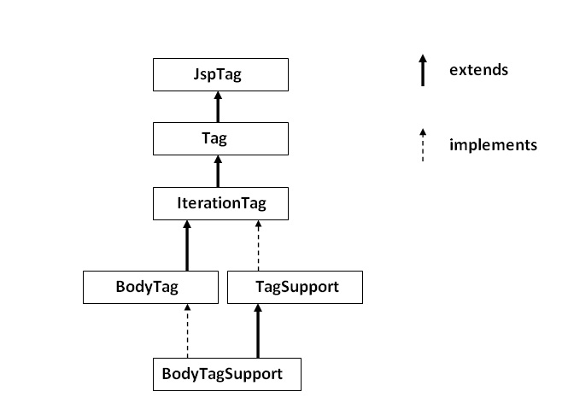
Hierarchy of Tags

Slide 233
JspTag interface
The JspTag is the root interface for all the interfaces and classes used in custom tag. It is a marker interface.

Slide 234
Tag interface
The Tag interface is the sub interface of JspTag interface. It provides methods to perform action at the start and end of the tag.

Slide 235
Fields of Tag interface
Field Name | Description
public static int EVAL_BODY_INCLUDE | it evaluates the body content.
public static int EVAL_PAGE | it evaluates the JSP page content after the custom tag.
public static int SKIP_BODY | it skips the body content of the tag.
public static int SKIP_PAGE | it skips the JSP page content after the custom tag.

Slide 236
Methods of Tag interface
Method Name | Description
public void setPageContext(PageContext pc) | it sets the given PageContext object.
public void setParent(Tag t) | it sets the parent of the tag handler.
public Tag getParent() | it returns the parent tag handler object.
public int doStartTag()throws JspException | it is invoked by the JSP page implementation object. The JSP programmer should override this method and define the business logic to be performed at the start of the tag.
public int doEndTag()throws JspException | it is invoked by the JSP page implementation object. The JSP programmer should override this method and define the business logic to be performed at the end of the tag.
public void release() | it is invoked by the JSP page implementation object to release the state.

Slide 237
IterationTag interface
The IterationTag interface is the sub interface of the Tag interface. It provides an additional method to reevaluate the body.

Slide 238
Field of IterationTag interface
There is only one field defined in the IterationTag interface.
public static int EVAL_BODY_AGAIN it reevaluates the body content.

Slide 239
Method of Tag interface
There is only one method defined in the IterationTag interface.
public int doAfterBody()throws JspException it is invoked by the JSP page implementation object after the evaluation of the body. If this method returns EVAL_BODY_INCLUDE, body content will be reevaluated, if it returns SKIP_BODY, no more body cotent will be evaluated.

Slide 240
TagSupport class
The TagSupport class implements the IterationTag interface. It acts as the base class for new Tag Handlers. It provides some additional methods also.

Slide 241
Example of JSP Custom Tag
In this example, we are going to create a custom tag that prints the current date and time. We are performing action at the start of tag.
For creating any custom tag, we need to follow following steps:
Create the Tag handler class and perform action at the start or at the end of the tag.
Create the Tag Library Descriptor (TLD) file and define tags
Create the JSP file that uses the Custom tag defined in the TLD file

Slide 242
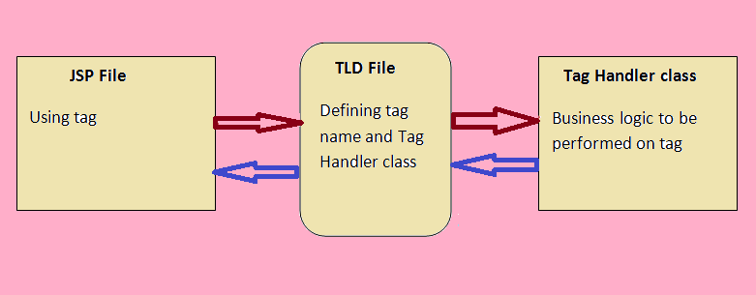
Understanding flow of custom tag in jsp

Slide 243
1) Create the Tag handler class
To create the Tag Handler, we are inheriting the TagSupport class and overriding its method doStartTag().To write data for the jsp, we need to use the JspWriter class.
The PageContext class provides getOut() method that returns the instance of JspWriter class. TagSupport class provides instance of pageContext bydefault.

Slide 244
1. MyTagHandler.java
package com.myit.handler;
public class MyTagHandler extends TagSupport{
public int doStartTag() throws JspException {
JspWriter out=pageContext.getOut();//returns the instance of JspWriter
try{
out.print(Calendar.getInstance().getTime());//printing date and time using JspWriter
}catch(Exception e){System.out.println(e);}
return SKIP_BODY;//will not evaluate the body content of the tag
}
}

Slide 245
2) Create the TLD file
Tag Library Descriptor (TLD) file contains information of tag and Tag Hander classes. It must be contained inside the WEB-INF directory.

Slide 246
MyTags.tld
<?xml version="1.0" encoding="ISO-8859-1" ?>
<!DOCTYPE taglib
PUBLIC "-//Sun Microsystems, Inc.//DTD JSP Tag Library 1.2//EN"
"http://java.sun.com/j2ee/dtd/web-jsptaglibrary_1_2.dtd">
<taglib>
<tlib-version>1.0</tlib-version>
<jsp-version>1.2</jsp-version>
<short-name>simple</short-name>
<tag>
<name>today</name>
<tag-class>com.myit.handler.MyTagHandler</tag-class>
</tag>
</taglib>

Slide 247
3) Create the JSP file
Let's use the tag in our jsp file. Here, we are specifying the path of tld file directly. But it is recommended to use the uri name instead of full path of tld file. We will learn about uri later.
It uses taglib directive to use the tags defined in the tld file.

Slide 248
Index.jsp
<%@ taglib uri="WEB-INF/mytags.tld" prefix="m" %>
Current Date and Time is: <m:today/>

Slide 249
Attributes in JSP Custom Tag
There can be defined too many attributes for any custom tag. To define the attribute, you need to perform two tasks:
Define the property in the TagHandler class with the attribute name and define the setter method
define the attribute element inside the tag element in the TLD file

Slide 250
Let's understand the attribute by the tag given below:
<m:cube number="4"></m:cube>
Here m is the prefix, cube is the tag name and number is the attribute.

Slide 251
Simple example of attribute in JSP Custom Tag
In this example, we are going to use the cube tag which return the cube of any given number. Here, we are defining the number attribute for the cube tag. We are using the three file here:
index.jsp
CubeNumber.java
mytags.tld

Slide 252
Index.jsp
<%@ taglib uri="WEB-INF/mytags.tld" prefix="m" %>
Cube of 4 is: <m:cube number="4"></m:cube>

Slide 253
CubeNumber.java
package com.myit.taghandler;
public class CubeNumber extends TagSupport{
private int number;
public void setNumber(int number) {
this.number = number;
}
public int doStartTag() throws JspException {
JspWriter out=pageContext.getOut();
try{
out.print(number*number*number);
}catch(Exception e){e.printStackTrace();}
return SKIP_BODY;
}
}

Slide 254
mytags.tld
<?xml version="1.0" encoding="ISO-8859-1" ?>
<!DOCTYPE taglib
PUBLIC "-//Sun Microsystems, Inc.//DTD JSP Tag Library 1.2//EN"
"http://java.sun.com/j2ee/dtd/web-jsptaglibrary_1_2.dtd">
<taglib>
<tlib-version>1.0</tlib-version>
<jsp-version>1.2</jsp-version>
<short-name>simple</short-name>
<uri>http://tomcat.apache.org/example-taglib</uri>
<description>A simple tab library for the examples</description>
<tag>
<name>cube</name>
<tag-class>com.myit.taghandler.CubeNumber</tag-class>
<attribute>
<name>number</name>
<required>true</required>
</attribute>
</tag>
</taglib>

Slide 255
Output
Cube of 4 is: 64

Slide 256
Custom URI in JSP Custom Tag
We can use the custom URI, to tell the web container about the tld file. In such case, we need to define the taglib element in the web.xml. The web container gets the information about the tld file from the web.xml file for the specified URI.

Slide 257
Example to use custom URI in JSP Custom Tag
In this example, we are going to use the custom uri in the JSP file. For this application, we need to focus on 4 files.
index.jsp
web.xml
mytags.tld
PrintDate.java

Slide 258
Index.jsp
<%@ taglib uri="mytags" prefix="m" %>
Today is: <m:today></m:today>

Slide 259
Web.xml
<web-app>
<jsp-config>
<taglib>
<taglib-uri>mytags</taglib-uri>
<taglib-location>/WEB-INF/mytags.tld</taglib-location>
</taglib>
</jsp-config>
</web-app>

Slide 260
Mytags.tld
<?xml version="1.0" encoding="ISO-8859-1" ?>
<!DOCTYPE taglib
PUBLIC "-//Sun Microsystems, Inc.//DTD JSP Tag Library 1.2//EN"
"http://java.sun.com/j2ee/dtd/web-jsptaglibrary_1_2.dtd">
<taglib>
<tlib-version>1.0</tlib-version>
<jsp-version>1.2</jsp-version>
<short-name>simple</short-name>
<uri>mytags</uri>
<description>A simple tab library for the examples</description>
<tag>
<name>today</name>
<tag-class>com.myit.taghandler.PrintDate</tag-class>
</tag>
</taglib>

Slide 261
PrintDate.java
package com.myit.tag
public class PrintDate extends TagSupport{
public int doStartTag() throws JspException {
JspWriter out=pageContext.getOut();
try{
out.print(java.util.Calendar.getInstance().getTime());
}catch(Exception e){e.printStackTrace();}
return SKIP_BODY;
}
}

Slide 262
Can we use JavaScript with JSP Pages?
Yes why not, I have seen some developers getting confused with this. Even though JSP is a server side technology, it’s used to generate client side response and we can add javascript or CSS code like any other HTML page.

Slide 263
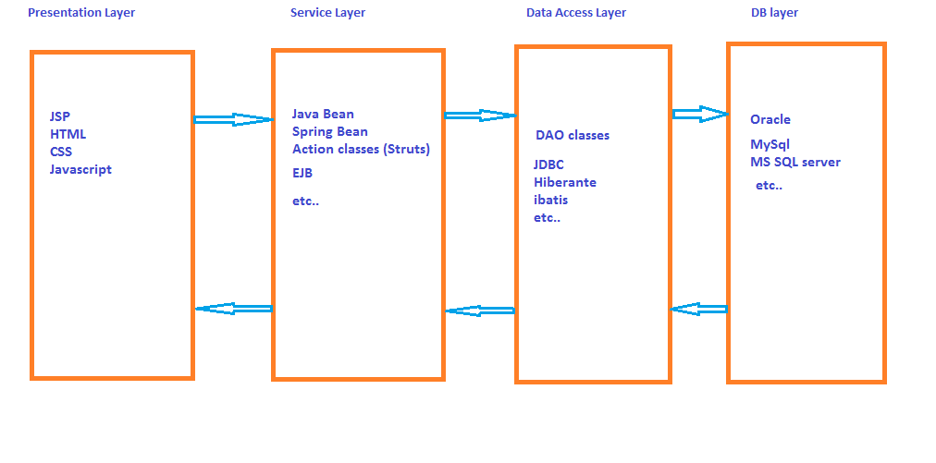
Web Application / Enterprise Application Layers

Slide 264
MVC in JSP

Slide 265
MVC in JSP
MVC stands for Model View and Controller. It is a design pattern that separates the business logic, presentation logic and data.
Controller acts as an interface between View and Model. Controller intercepts all the incoming requests.
Model represents the state of the application i.e. data. It can also have business logic.
View represents the presentation i.e. UI(User Interface).

Slide 266
MVC Architecture
The main intention of MVC architecture is: separation of presentation and business layer

Slide 267
Difference between MVC1 and MVC2 Architectures
There are no MVC1 and MVC2.
We have Model 1 and Model 2 architectures.
MVC is nothing but Model 2

Slide 268
***Difference between Model 1 and Model 2 Architecture
In model1 only JSP and Beans are involved . JSPs are used for logic and presentation and JSP decides the flow of control. beans work as model.
Whereas in Model2 there is servlet that act as a frontcontroller i.e. all the requests are handled by the frontcontroller and forwarded to JSPs or model . Therefore presentation and business logic remains separate in model2.
In Model 1 we can have multiple controller servlets but in mvc2 we can have only one controller servlet. For example struts frame work is built on mvc (model2) architecture, which is having only one controller i.e. ActionServlet.

Slide 269
Advantage of MVC (Model 2) Architecture
Navigation Control is centralized
Easy to maintain the large application
Separation of Business and Presentation logic.

Slide 270
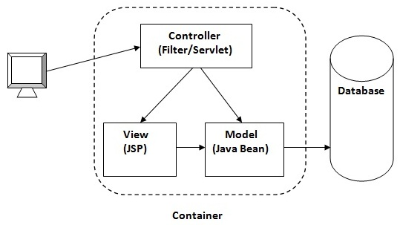
High-level MVC (Model 2) Architecture Flow

Slide 271
Example of following MVC in JSP
In this example, we are using servlet as a controller, jsp as a view component, Java Bean class as a model.
In this example, we have created 5 pages:
index.jsp a page that gets input from the user.
ControllerServlet.java a servlet that acts as a controller.
login-success.jsp and login-error.jsp files acts as view components.
web.xml file for mapping the servlet.

Slide 272
Index.jsp
<form action="ControllerServlet" method="post">
Name:<input type="text" name="name"><br>
Password:<input type="password" name="password"><br>
<input type="submit" value="login">
</form>

Slide 273
ControllerServlet
public class ControllerServlet extends HttpServlet {
protected void doPost(HttpServletRequest request, HttpServletResponse response)
throws ServletException, IOException {
response.setContentType("text/html");
PrintWriter out=response.getWriter();
String name=request.getParameter("name");
String password=request.getParameter("password");
LoginBean bean=new LoginBean();
bean.setName(name);
bean.setPassword(password);
request.setAttribute("bean",bean);
boolean status=bean.validate();

Slide 274
if(status){
RequestDispatcher rd=request.getRequestDispatcher("login-success.jsp");
rd.forward(request, response);
}
else{
RequestDispatcher rd=request.getRequestDispatcher("login-error.jsp");
rd.forward(request, response);
}
}
@Override
protected void doGet(HttpServletRequest req, HttpServletResponse resp)
throws ServletException, IOException {
doPost(req, resp);
}
}

Slide 275
LoginBean.java
package com.myit;
public class LoginBean {
private String name,password;
public String getName() {
return name;
}
public void setName(String name) {
this.name = name;
}
public String getPassword() {
return password;
}
public void setPassword(String password) {
this.password = password;
}
public boolean validate(){
if(password.equals("admin")){
return true;
}
else{
return false;
}
}

Slide 276
login-success.jsp
<%@page import="com.myit.LoginBean"%>
<p>You are successfully logged in!</p>
<%
LoginBean bean=(LoginBean)request.getAttribute("bean");
out.print("Welcome, "+bean.getName());
%>

Slide 277
loginError.jsp
<p>Sorry! username or password error</p>
<%@ include file="index.jsp" %>

Slide 278
web.xml
<web-app>
<servlet>
<servlet-name>s1</servlet-name>
<servlet-class>com.myit.ControllerServlet</servlet-class>
</servlet>
<servlet-mapping>
<servlet-name>s1</servlet-name>
<url-pattern>/ControllerServlet</url-pattern>
</servlet-mapping>
</web-app>

Slide 279
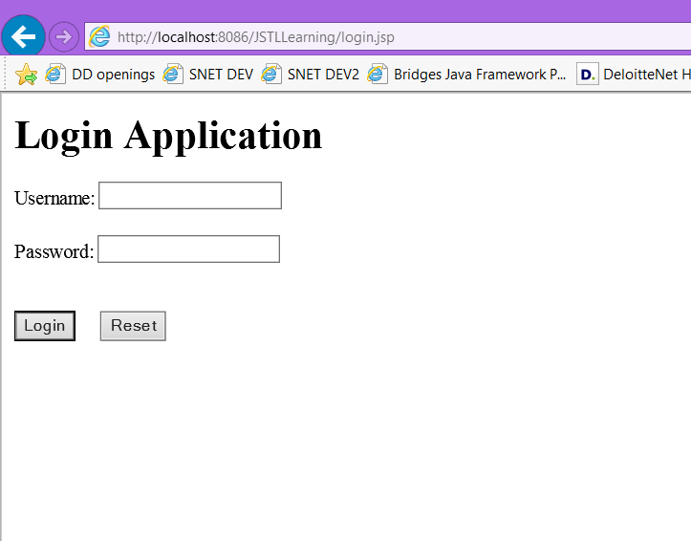
Input screen

Slide 280
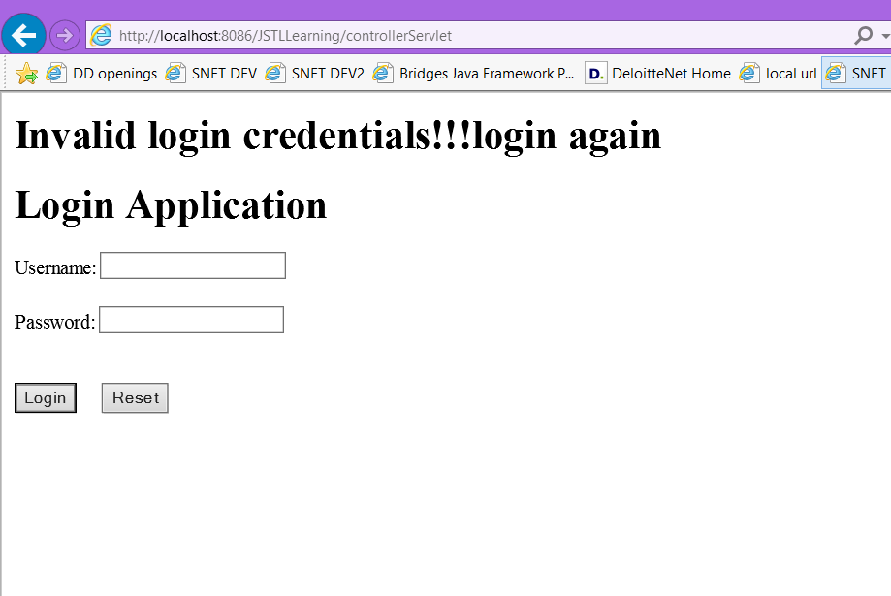
Failure Output screen

Slide 281
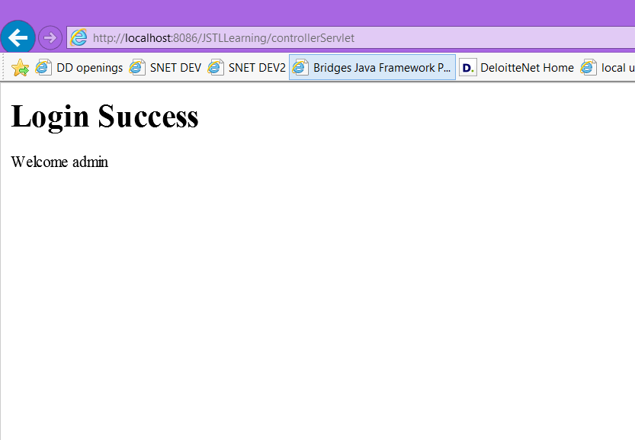
Success output screen

Slide 282
JSP Best Practices
Some of the JSP best practices are:
Avoid scripting elements in JSP pages. If JSP EL, action elements and JSTL not serve your needs then create custom tags.
Use comment properly, use JSP comments for code level or debugging purpose so that it’s not sent to client.
Avoid any business logic in JSP page, JSP pages should be used only for response generation for client.
Disable session creation in JSP page where you don’t need it for better performance.
Use page, taglib directives at the start of JSP page for better readability.
Proper use of jsp include directive or include action based on your requirements, include directive is good for static content whereas include action is good for dynamic content and including resource at runtime.
Proper exception handling using JSP error pages to avoid sending container generated response incase JSP pages throw exception in service method.
If you are having CSS and JavaScript code in JSP pages, it’s best to place them in separate files and include them in JSP page.
Most of the times JSTL is enough for our needs, if you find a scenario where it’s not then check your application design and try to put the logic in a servlet that will do the processing and then set attributes to be used in JSP pages.

