Slide 1
Hibernate
Sources: javatpoint.com, tutorialpoints.com, mkyong.com

Slide 2
Prerequisites
Knowledge on
1. JDBC
2. Database - SQL

Slide 3
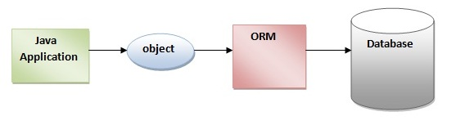
ORM
ORM simplifies the data creation, data manipulation and data access.
It is a programming technique that maps the object to the data stored in the database.
The ORM tool internally uses the JDBC API to interact with the database.

Slide 4
What is JPA?
Java Persistence API (JPA) is a Java specification that provides certain functionality and standard to ORM tools.
The javax.persistence package contains the JPA classes and interfaces.

Slide 5
ORM frameworks
Hibernate
iBatis :
Needs SQL statements to be coded in its Mapping files
Good when developer needs control over SQL
3. TopLink:
Very Similar and quite powerful but costs
4. EclipseLink
5. JDO
6. Open JPA

Slide 6
Hibernate (framework)
From Wikipedia, the free encyclopedia
Hibernate ORM (Hibernate in short) is an object-relational mapping framework for the Java language.
It provides a framework for mapping an object-oriented domain model to a relational database.
Hibernate solves object-relational impedance mismatch problems by replacing direct, persistent database accesses with high-level object handling functions.
Hibernate is free software that is distributed under the GNU Lesser General Public License 2.1.
Hibernate's primary feature is mapping from Java classes to database tables; and mapping from Java data types to SQL data types.
Hibernate also provides data query and retrieval facilities. It generates SQL calls and relieves the developer from manual handling and object conversion of the result set.

Slide 7
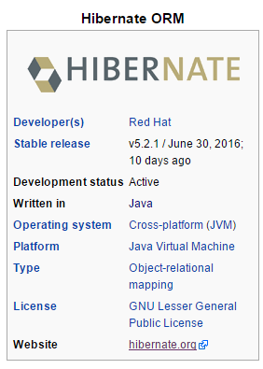
Source: wikipedia

Slide 8

Who developed Hibernate?
Jboss was also developed by him.

Slide 9
Main Points
Hibernate is an open source ORM framework.
Hibernate is light weight As It uses simple POJO classes to map table with the class
To run hibernate no server is required As It runs with or with out server.
It works on all applications like Desktop, Web , Enterprise, and Distributed Applications.
It’s an ORM framework that is developed on top of JDBC.
We have some drawbacks with JDBC. All those drawbacks are resolved with ORM framework.

Slide 10
Draw Backs of JDBC:
Actually if we don’t close the connection in the finally block, then jdbc doesn’t responsible to close that connection.
In JDBC we need to write SQL commands in various places, after the program has created if the table structure is modified then the JDBC program doesn’t work, again we need to modify and compile and re-deploy required, which is tedious.
JDBC used to generate database related error codes if an exception occurs, but java programmers are unknown about this error codes right.
In the Enterprise applications, the data flow with in an application from class to class will be in the form of objects, but while storing data finally in a database using JDBC then that object will be converted into text. Because JDBC doesn’t transfer objects directly.
In order to overcome above problems, Hibernate came into picture..!

Slide 11
JDBC vs Hibernate
JDBC stands for Java Database Connectivity which allows developers to connect, query and update a database using the Structured Query Language(SQL).
Hibernate is an Object-Relational Mapping (ORM) solution for JAVA. It is a powerful, high performance ORM framework.

Slide 12
Advantages of Hibernate Framework
1) Open source and Lightweight
2) Fast performance: The performance of hibernate framework is fast because cache is internally used in hibernate framework. There are two types of cache in hibernate framework first level cache and second level cache. First level cache is enabled by default.
3) Database Independent query: HQL (Hibernate Query Language) is the object-oriented version of SQL. It generates the database independent queries. So you don't need to write database specific queries. Before Hibernate, If database is changed for the project, we need to change the SQL query as well that leads to the maintenance problem.
4) Automatic table creation: Hibernate framework provides the facility to create the tables of the database automatically. So there is no need to create tables in the database manually.
5) Simplifies complex join: To fetch data form multiple tables is easy in hibernate framework.
6) Provides query statistics and database status: Hibernate supports Query cache and provide statistics about query and database status.

Slide 13
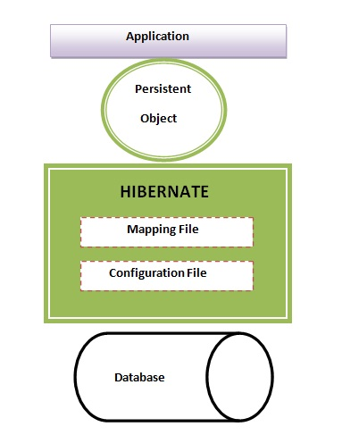
Simple Hibernate Architecture with 4 layers

Slide 14
Hibernate Architecture
The Hibernate architecture includes
persistent object,
session factory,
transaction factory,
connection factory,
session,
transaction etc.
There are 4 layers in hibernate architecture
1. java application layer,
2. hibernate framework layer,
3. backhand API layer and
4. database layer.
Let's see the diagram of hibernate architecture:

Slide 15
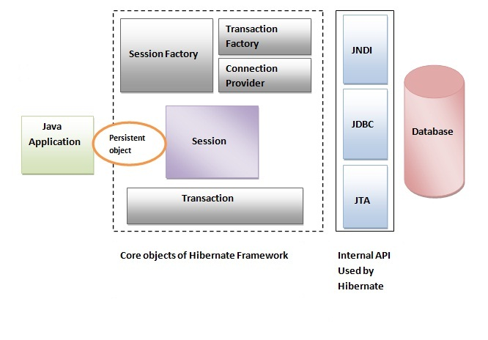
High level architecture of Hibernate with mapping file and configuration file.

Slide 16
Note
Hibernate framework uses many objects session factory, session, transaction etc. along with existing Java API such as JDBC (Java Database Connectivity), JTA (Java Transaction API) and JNDI (Java Naming Directory Interface).

Slide 17
Elements of Hibernate Architecture
SessionFactory
The SessionFactory is a factory of session and client of ConnectionProvider. It holds second level cache (optional) of data.
SessionFactory interface provides factory method to get the object of Session.
Session
The session object provides an interface between the application and data stored in the database. It is a short-lived object and wraps the JDBC connection. It is factory of Transaction, Query and Criteria. It holds a first-level cache (mandatory) of data. The org.hibernate.Session interface provides methods to insert, update and delete the object.
The org.hibernate.Session interface provides methods to insert, update and delete the object. It also provides factory methods for Transaction, Query and Criteria.

Slide 18
Session Interface Methods
S.N. | Session Methods and Description
1 | Transaction beginTransaction() Begin a unit of work and return the associated Transaction object.
2 | void cancelQuery() Cancel the execution of the current query.
3 | void clear() Completely clear the session.
4 | Connection close() End the session by releasing the JDBC connection and cleaning up.
5 | Criteria createCriteria(Class persistentClass) Create a new Criteria instance, for the given entity class, or a superclass of an entity class.
6 | Criteria createCriteria(String entityName) Create a new Criteria instance, for the given entity name.
7 | Serializable getIdentifier(Object object) Return the identifier value of the given entity as associated with this session.

Slide 19
8 | Query createFilter(Object collection, String queryString) Create a new instance of Query for the given collection and filter string.
9 | Query createQuery(String queryString) Create a new instance of Query for the given HQL query string.
10 | SQLQuery createSQLQuery(String queryString) Create a new instance of SQLQuery for the given SQL query string.
11 | void delete(Object object) Remove a persistent instance from the datastore.
12 | void delete(String entityName, Object object) Remove a persistent instance from the datastore.
13 | Session get(String entityName, Serializable id) Return the persistent instance of the given named entity with the given identifier, or null if there is no such persistent instance.
14 | SessionFactory getSessionFactory() Get the session factory which created this session.
15 | void refresh(Object object) Re-read the state of the given instance from the underlying database.

Slide 20
16 | Transaction getTransaction() Get the Transaction instance associated with this session.
17 | boolean isConnected() Check if the session is currently connected.
18 | boolean isDirty() Does this session contain any changes which must be synchronized with the database?
19 | boolean isOpen() Check if the session is still open.
20 | Serializable save(Object object) Persist the given transient instance, first assigning a generated identifier.
21 | void saveOrUpdate(Object object) Either save(Object) or update(Object) the given instance.
22 | void update(Object object) Update the persistent instance with the identifier of the given detached instance.
23 | void update(String entityName, Object object)Update the persistent instance with the identifier of the given detached instance.

Slide 21
Elements of Hibernate Architecture (contd..)
Transaction
The transaction object specifies the atomic unit of work. It is optional. The org.hibernate.Transaction interface provides methods for transaction management.
ConnectionProvider
It is a factory of JDBC connections. It abstracts the application from DriverManager or DataSource. It is optional.
TransactionFactory
It is a factory of Transaction. It is optional.

Slide 22
Steps to create Hibernate Application
1. Load hibernate jar files to the project
2. Create a Persistent class
3. Create a mapping file for Persistent class
4. Create a Configuration file
5. Create a Main class to perform DB operations

Slide 23
Load Hibernate jar files
Download hibernate jar files from http://www.hibernate.org/downloads
Hibernate.zip file can be downloaded. Extract the file.
Add jar files from lib/required folder of extracted folder to project build path.

Slide 24
Persistent class
A simple Persistent class should follow some rules:
A no-arg constructor: It is recommended that you have a default constructor at least package visibility so that hibernate can create the instance of the Persistent class by newInstance() method.
Provide an identifier property (optional): It is mapped to the primary key column of the database.
Declare getter and setter methods (optional): The Hibernate recognizes the method by getter and setter method names by default.

Slide 25
Mapping file for Persistence class
The mapping file name conventionally, should be class_name.hbm.xml. There are many elements of the mapping file.
hibernate-mapping is the root element in the mapping file.
class It is the sub-element of the hibernate-mapping element. It specifies the Persistent class.
id It is the subelement of class. It specifies the primary key attribute in the class.
generator It is the subelement of id. It is used to generate the primary key. There are many generator classes such as assigned (It is used if id is specified by the user), increment, hilo, sequence, native etc. We will learn all the generator classes later.
property It is the subelement of class that specifies the property name of the Persistent class.

Slide 26
Configuration file
The configuration file contains information about the database and mapping file. Conventionally, its name should be hibernate.cfg.xml .

Slide 27
show_sql
Enable the logging of all the generated SQL statements to the console
<!--hibernate.cfg.xml -->
<property name="show_sql">true</property>
EX:
insert into EMPLOYEE (LASTNAME, ID, FIRSTNAME) values (?, ?, ?)

Slide 28
format_sql
Format the generated SQL statement to make it more readable.
<!--hibernate.cfg.xml -->
<property name="format_sql">true</property>
Ex:
insert
into
EMPLOYEE
(LASTNAME, ID, FIRSTNAME)
values
(?, ?, ?)

Slide 29
use_sql_comments
Hibernate will put comments inside all generated SQL statements to hint what’s the generated SQL trying to do
<!--hibernate.cfg.xml -->
<property name="use_sql_comments">true</property>
Ex:
Hibernate:
/* insert com.mangaraoit.hb.Employee
*/ insert
into
EMPLOYEE
(LASTNAME, ID, FIRSTNAME)
values
(?, ?, ?)

Slide 30
hbm2ddl.auto property in Hibernate XML Config
It either creates or validates a database table. The possible values for hbm2ddl.auto are:
Create - first drops the existing table, then creates a new table and then executes operations on newly created table.
Validate - validates whether the table and columns are exist or not. If the table doesn’t exist then hibernate throws an exception.
Update - If the table doesn’t exist then hibernate update property creates the table. But in the case of value “update” hibernate doesn’t drop any existing table, here we don’t lose existing table data.
create-drop: first checks for a table and do the necessary operations and finally drops the table after all the operations are completed.
The value “create-drop” is given for unit testing the hibernate code.

Slide 31
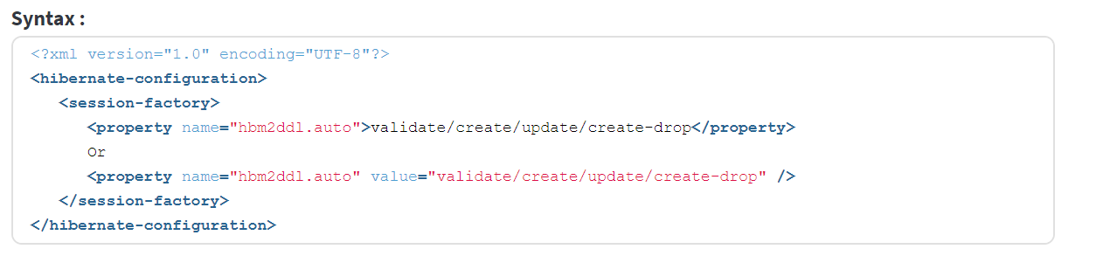
Syntax

Slide 32
SQL Dialects in Hibernate
The dialect specifies the type of database used in hibernate so that hibernate generate appropriate type of SQL statements. For connecting any hibernate application with the database, it is required to provide the configuration of SQL dialect.
Syntax of SQL Dialect
<property name="dialect">org.hibernate.dialect.Oracle9Dialect</property>

Slide 33
SQL Dialects in Hibernate
Database | Dialect Property
MySQL | org.hibernate.dialect.MySQLDialect
Oracle (any version) | org.hibernate.dialect.OracleDialect
Oracle 11g | org.hibernate.dialect.Oracle10gDialect
Oracle 10g | org.hibernate.dialect.Oracle10gDialect
Oracle 9i | org.hibernate.dialect.Oracle9iDialect
DB2 | org.hibernate.dialect.DB2Dialect
HSQLDB | org.hibernate.dialect.HSQLDialect
PostgreSQL | org.hibernate.dialect.PostgreSQLDialect
Progress | org.hibernate.dialect.ProgressDialect
SAP DB | org.hibernate.dialect.SAPDBDialect
Sybase | org.hibernate.dialect.SybaseDialect
Etc.……

Slide 34
Oracle (any version) org.hibernate.dialect.OracleDialect
Oracle9i org.hibernate.dialect.Oracle9iDialect
Oracle10g org.hibernate.dialect.Oracle10gDialect
MySQL org.hibernate.dialect.MySQLDialect
MySQL with InnoDB org.hibernate.dialect.MySQLInnoDBDialect
MySQL with MyISAM org.hibernate.dialect.MySQLMyISAMDialect
DB2 org.hibernate.dialect.DB2Dialect
DB2 AS/400 org.hibernate.dialect.DB2400Dialect
DB2 OS390 org.hibernate.dialect.DB2390Dialect
Microsoft SQL Server org.hibernate.dialect.SQLServerDialect
Sybase org.hibernate.dialect.SybaseDialect
Sybase Anywhere org.hibernate.dialect.SybaseAnywhereDialect
PostgreSQL org.hibernate.dialect.PostgreSQLDialect
SAP DB org.hibernate.dialect.SAPDBDialect
Informix org.hibernate.dialect.InformixDialect
HypersonicSQL org.hibernate.dialect.HSQLDialect
Ingres org.hibernate.dialect.IngresDialect
Progress org.hibernate.dialect.ProgressDialect
Mckoi SQL org.hibernate.dialect.MckoiDialect
Interbase org.hibernate.dialect.InterbaseDialect
Pointbase org.hibernate.dialect.PointbaseDialect
FrontBase org.hibernate.dialect.FrontbaseDialect
Firebird org.hibernate.dialect.FirebirdDialect

Slide 35
First Hibernate Application with Oracle database using XML in Eclipse
Create java project
Add Hibernate libraries to the project
Add ojdbc6.jar file for oracle
Create persistence class
Create mapping file
Create configuration file
Create Main class that retrieves or stores the persistent object
Run main class

Slide 36
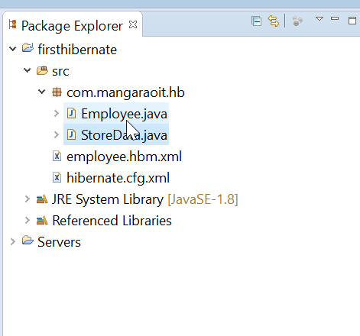
Project Structure

Slide 37
1) Create the java project
Create the java project by File Menu - New - project - java project .
Now specify the project name e.g. firsthibernate then next - finish .

Slide 38
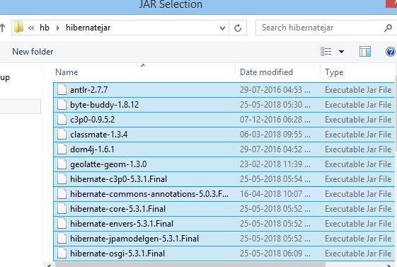
2) Add jar files for hibernate
To add the jar files Right click on your project - Build path - Add external archives. Now select all the jar files as shown in the image given below then click open.

Slide 39
Add ojdbc.jar
In this example, we are connecting the application with oracle database. So you must add the ojdbc6.jar file.

Slide 40
3) Create the Persistent class
Here, we are creating the same persistent class which we have created in the previous topic. To create the persistent class, Right click on src - New - Class - specify the class with package name (e.g. com.mangaraoit.hb) - finish .

Slide 41
Persistent class
package com.mangaraoit.hb;
public class Employee {
private int id;
private String firstName,lastName;
public int getId() {
return id;
}
public void setId(int id) {
this.id = id;
}
public String getFirstName() {
return firstName;
}
public void setFirstName(String firstName) {
this.firstName = firstName;
}
public String getLastName() {
return lastName;
}
public void setLastName(String lastName) {
this.lastName = lastName;
}}

Slide 42
4) Create the mapping file for Persistent class
Here, we are creating the same mapping file as created in the previous topic. To create the mapping file, Right click on src- new - file - specify the file name (e.g. employee.hbm.xml) - ok.
It must be outside the package.

Slide 43
employee.hbm.xml
<?xml version='1.0' encoding='UTF-8'?>
<!DOCTYPE hibernate-mapping PUBLIC
"-//Hibernate/Hibernate Mapping DTD 5.3//EN"
"http://hibernate.sourceforge.net/hibernate-mapping-5.3.dtd">
<hibernate-mapping>
<class name="com.mangaraoit.hb.Employee" table="EMPLOYEE">
<id name="id">
<generator class="assigned"></generator>
</id>
<property name="firstName"></property>
<property name="lastName"></property>
</class>
</hibernate-mapping>

Slide 44
5) Create the Configuration file
The configuration file contains all the informations for the database such as connection_url, driver_class, username, password etc.
The hbm2ddl.auto property is used to create the table in the database automatically.
We will have in-depth learning about Dialect class in next topics.
To create the configuration file, right click on src - new - file.
Now specify the configuration file name e.g. hibernate.cfg.xml.

Slide 45
hibernate.cfg.xml
<?xml version='1.0' encoding='UTF-8'?>
<!DOCTYPE hibernate-configuration PUBLIC
"-//Hibernate/Hibernate Configuration DTD 5.3//EN"
"http://hibernate.sourceforge.net/hibernate-configuration-5.3.dtd">
<hibernate-configuration>
<session-factory>
<property name="hbm2ddl.auto">update</property>
<property name="dialect">org.hibernate.dialect.OracleDialect</property>
<property name="connection.url">jdbc:oracle:thin:@localhost:1521:xe</property>
<property name="connection.username">system</property>
<property name="connection.password">manager</property>
<property name="connection.driver_class">oracle.jdbc.driver.OracleDriver</property>
<mapping resource="employee.hbm.xml"/>
</session-factory>
</hibernate-configuration>

Slide 46
6) Create the class that retrieves or stores the persistent object
In this class, we are simply storing the employee object to the database.

Slide 47
Main class - StoreData
package com.mangaraoit.hb;
import org.hibernate.Session;
import org.hibernate.SessionFactory;
import org.hibernate.Transaction;
import org.hibernate.boot.Metadata;
import org.hibernate.boot.MetadataSources;
import org.hibernate.boot.registry.StandardServiceRegistry;
import org.hibernate.boot.registry.StandardServiceRegistryBuilder;
public class StoreData {
public static void main(String[] args) {
StandardServiceRegistry ssr = new StandardServiceRegistryBuilder().configure("hibernate.cfg.xml").build();
Metadata meta = new MetadataSources(ssr).getMetadataBuilder().build();
SessionFactory factory = meta.getSessionFactoryBuilder().build();
Session session = factory.openSession();
Transaction t = session.beginTransaction();
Employee e1=new Employee();
e1.setId(101);
e1.setFirstName("MangaRao");
e1.setLastName("Arepalli");
session.save(e1);
t.commit();
System.out.println("The record is successfully saved");
factory.close();
session.close();
}}

Slide 48
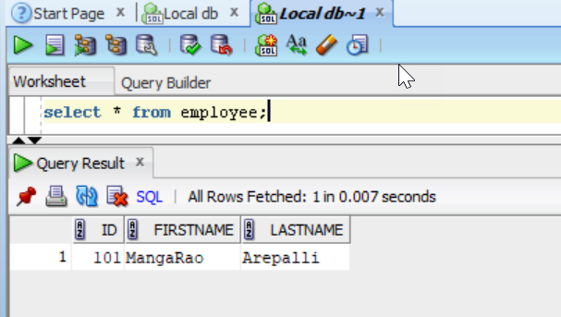
Run the application
To run the hibernate application, right click on the StoreData class - Run As - Java Application.
Output: The record is successfully saved

Slide 49
***What are the states of object in Hibernate?
Transient
Persistent
Detached

Slide 50

1. Transient Object State:
An object which is not associated with hibernate session and does not represent a row in the database is considered as transient.
An object that is created for the first time using the new() operator is in transient state. When the object is in transient sate then it will not contain any identifier (primary key value).
We have to use save, persist or saveOrUpdate methods to persist the transient object.
Ex:

Slide 51
2. Persistent Object State:
An object that is associated with the hibernate session is called as Persistent object. When the object is in persistent state, then it represent one row of the database and consists of an identifier value.
Ex:

Slide 52

3. Detached Object State
Object which is just removed from hibernate session is called as detached object. The sate of the detached object is called as detached state.
When the object is in detached sate then it contain identity but you can’t do persistence operation with that identity.
Any changes made to the detached objects are not saved to the database. The detached object can be reattached to the new session and save to the database using update, saveOrUpdate and merge methods.
Ex:

Slide 53
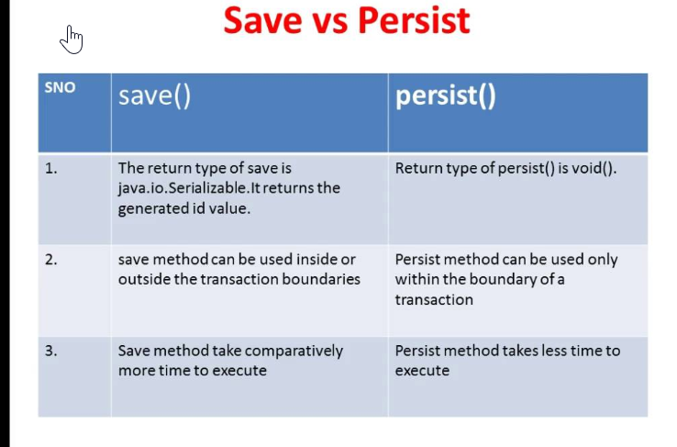
***Difference between save() and persist() methods
We can use bouth save() and Persist() methods to insert record in DB
Save() - returns that primary key id value which is generated by hibernate
Serializable id = session.save(e1);
Persist() - It doesn’t return any thing – return type is void.
session.persist(e1);

Slide 54
save(), update() nad saveOrUpdate() methods
save - always try to insert a row into a database.
update - always try to update a row in a database.
saveOrUpdate –
inserts a row if it does not exist in a database or update it if it does exist.

Slide 55
Add one more record use saveOrUpdate
Employee e1 = new Employee();
e1.setId(102);
e1.setFirstName(“Raju");
e1.setLastName(“Ramu");
session.saveOrUpdate(e1);
t.commit();
System.out.println("Record is updated successfully");

Slide 56
Code to update lastname of employee
Employee e1 = new Employee();
e1.setId(101);
e1.setFirstName(“MangaRao");
e1.setLastName(“A");
session.update(e1);
t.commit();
System.out.println("Record is updated successfully");

Slide 57
***Difference between update() and merge() methods
Update: Suppose we are dealing with any object in the same session then we should use update() or saveOrUpdate() method.
Merge: if you want to save your modifications at any time with out knowing about the state of an session, then use merge() in hibernate.

Slide 58
Code to delete an employee from the record
Employee e1 = new Employee();
e1.setId(101);
session.delete(e1);

Slide 59
List down all the employees
//We are using HQL query at present – will learn about it later chapter
import org.hibernate.Query;
Ex1:
String hql = "FROM Employee"; //class name should be used
Query query = session.createQuery(hql);
List list = query.list();
for (Employee employee : list) {
System.out.println("ID: "+employee.getId()+"First Name: "+employee.getFirstName()+"Last Name: "+employee.getLastName());
}

Slide 60
Example On Composite Primary Keys In Hibernate
Composite primary keys means having more than one primary key, let us see few points on this concept
If the table has a primary key then in the hibernate mapping file we need to configure that column by using <id /> element.
Even though the database table doesn’t have any primary key, we must configure one column as id (one primary key is must).
If the database table has more than one column as primary key then we call it as composite primary key, so if the table has multiple primary key columns , in order to configure these primary key columns in the hibernate mapping file we need to use one new element called
<composite-id …..>
<key-property/>
<key-property/>
…
</composite-id>
Composite-id class must implement Serializable

Slide 61
Use previously created project – Changes are only in
Persistent class – Employe
hibernate mapping file – employee.hbm.xml

Slide 62
Employee.java
package com.mangaraoit.hb;
import java.io.Serializable;
public class Employee implements Serializable{
private int id;
private String firstName,lastName;
public int getId() {
return id;
}
public void setId(int id) {
this.id = id;
}
public String getFirstName() {
return firstName;
}
public void setFirstName(String firstName) {
this.firstName = firstName;
}
public String getLastName() {
return lastName;
}
public void setLastName(String lastName) {
this.lastName = lastName;
}
}

Slide 63
employee.hbm.xml
<?xml version='1.0' encoding='UTF-8'?>
<!DOCTYPE hibernate-mapping PUBLIC
"-//Hibernate/Hibernate Mapping DTD 5.3//EN"
"http://hibernate.sourceforge.net/hibernate-mapping-5.3.dtd">
<hibernate-mapping>
<class name="com.mangaraoit.hb.Employee" table="EMPLOYEE">
<composite-id>
<key-property name="id" column="ID" />
<key-property name="firstName" column="FIRSTNAME" />
</composite-id>
<property name="lastName" column="LASTNAME" />
</class>
</hibernate-mapping>

Slide 64
Run the Main class
See the output and check created primary key in database.
DESC EMPLOYEE;

Slide 65
Get and load() methods
load() method requires the object’s primary key as an identifier, and it is mandatory to provide it.
The get() method is very much similar to load() method. The get() methods take an identifier and either an entity name or a class.
Session.get(): This method returns a persistence object of the given class with the given identifier. It will return null if there is no persistence object
Session.load(): This method returns a persistence object of the given class with the given identifier. It will throw an exception ObjectNotFoundException, if an entity does not exist in the database. The load() method may return a proxy object instead of a real persistence object

Slide 66
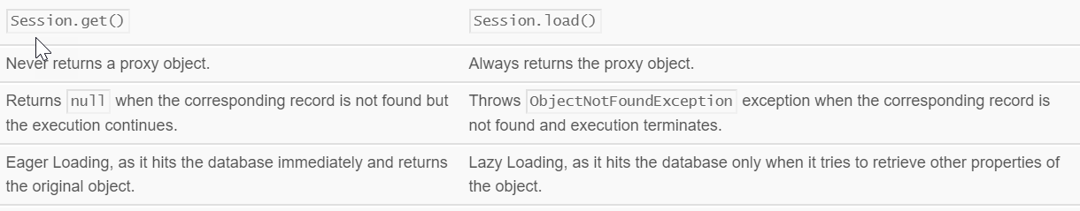
Get() vs. Load() Method

Slide 67
load method example
// Load The Employee Details Whose Emp Id is '101'
Employee emp1 = session.load(Employee.class, 101);
if (emp1 != null) {
System.out.print("Id: " + emp1.getId());
System.out.print(" First Name: " + emp1.getFirstName());
System.out.println(" Last Name: " + emp1.getLastName());
}
//Load The Employee Details Whose Emp Id is '111'. This Will Throw
// The 'ObjectNotFoundException' As Record Doesn't Exist In The Database
Employee emp2 = session.load(Employee.class, new Integer(123));
System.out.print("Id: " + emp2.getId());
System.out.print(" First Name: " + emp2.getFirstName());
System.out.println(" Last Name: " + emp2.getLastName());

Slide 68
get method example
// Load The Employee Details Whose Emp Id is '101'
Employee emp1 = session.get(Employee.class, 101);
if (emp1 != null) {
System.out.print("Id: " + emp1.getId());
System.out.print(" First Name: " + emp1.getFirstName());
System.out.println(" Last Name: " + emp1.getLastName());
}
//Load The Employee Details Whose Emp Id is '111'. This Will Throw Null Value
Employee emp2 = session.get(Employee.class, new Integer(123));
System.out.print("Id: " + emp2.getId());
System.out.print(" First Name: " + emp2.getFirstName());
System.out.println(" Last Name: " + emp2.getLastName());

Slide 69
Hibernate with Annotation
The hibernate application can be created with annotation. There are many annotations that can be used to create hibernate application such as @Entity, @Id, @Table etc.
Hibernate Annotations are based on the JPA 2 specification and supports all the features.
All the JPA annotations are defined in the javax.persistence.* package.
Hibernate EntityManager implements the interfaces and life cycle defined by the JPA specification.
The core advantage of using hibernate annotation is that you don't need to create mapping (hbm) file. Here, hibernate annotations are used to provide the meta data.

Slide 70
Annotations
@Entity annotation marks this class as an entity. So it must have a no-argument constructor that is visible with at least protected scope.
@Table annotation specifies the table name where data of this entity is to be persisted. If you don't use @Table annotation, hibernate will use the class name as the table name by default.
@Id annotation marks the identifier for this entity.
@Column annotation specifies the details of the column for this property or field. If @Column annotation is not specified, property name will be used as the column name by default.

Slide 71
Example to create the hibernate application with Annotation using Maven in Eclipse
1) Create the Maven Project
2) Add project information and configuration in pom.xml file.
3) Create the Persistence class.
4) Create the Configuration file
5) Create Main class that retrieves or stores the persistent object.
6) Run the application

Slide 72
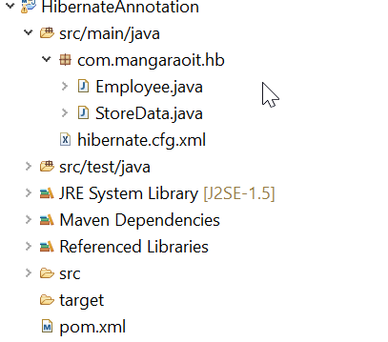
Directory structure

Slide 73
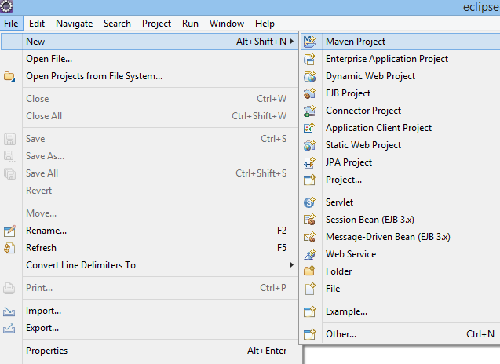
1) Create the Maven Project

Slide 74
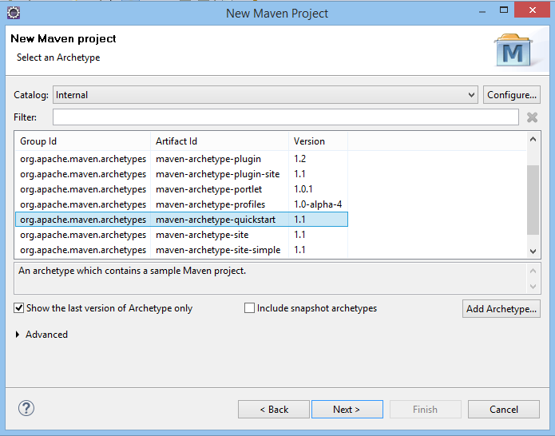

Slide 75
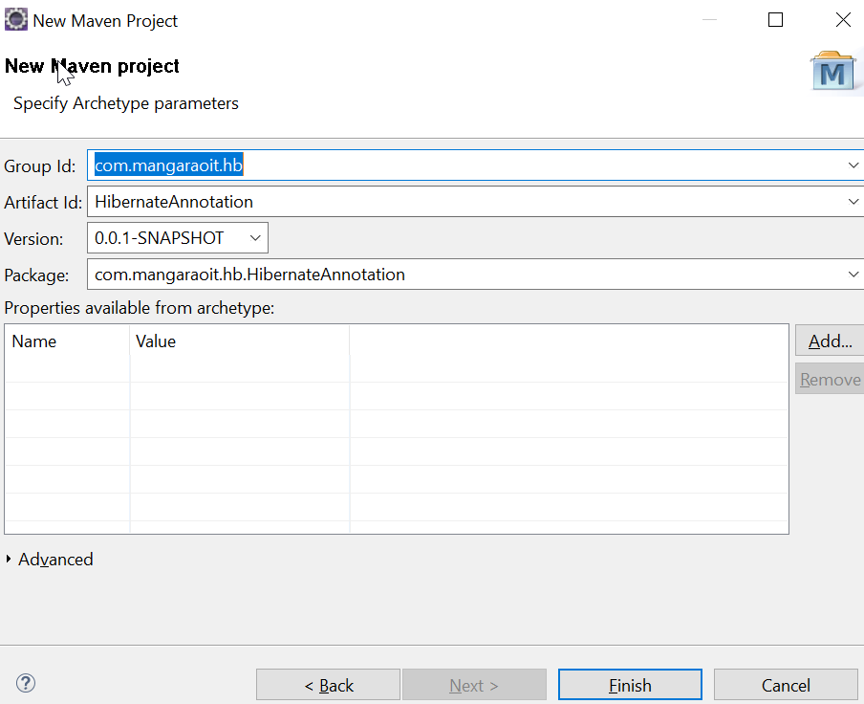
Now, specify the name of Group Id and Artifact Id. The Group Id contains package name (e.g. com.mangaraoit.hb) and Artifact Id contains project name (e.g. HibernateAnnotation). Then click Finish.

Slide 76
2) Add project information and configuration in pom.xml file.
Open pom.xml file and click source. Now, add the below dependency between <dependencies>....</dependencies> tag. The dependencies are used to add the jar files in Maven project.
<dependency>
<groupId>org.hibernate</groupId>
<artifactId>hibernate-core</artifactId>
<version>5.3.1.Final</version>
</dependency>

Slide 77
3) Create the Persistence class.
package com.mangaraoit.hb;
import javax.persistence.Entity;
import javax.persistence.Id;
import javax.persistence.Table;
@Entity
@Table(name = "EMPLOYEE")
public class Employee {
@Id
private int id;
private String firstName, lastName;
//setters and getters

Slide 78
4) Create the Configuration file
<?xml version='1.0' encoding='UTF-8'?>
<!DOCTYPE hibernate-configuration PUBLIC
"-//Hibernate/Hibernate Configuration DTD 5.3//EN"
"http://hibernate.sourceforge.net/hibernate-configuration-5.3.dtd">
<hibernate-configuration>
<session-factory>
<property name="hbm2ddl.auto">update</property>
<property name="dialect">org.hibernate.dialect.OracleDialect</property>
<property name="connection.url">jdbc:oracle:thin:@localhost:1521:xe</property>
<property name="connection.username">system</property>
<property name="connection.password">manager</property>
<property name="connection.driver_class">oracle.jdbc.driver.OracleDriver</property>
<mapping resource="employee.hbm.xml"/>
</session-factory>
</hibernate-configuration>

Slide 79
5. Main class - StoreData
package com.mangaraoit.hb;
import org.hibernate.Session;
import org.hibernate.SessionFactory;
import org.hibernate.Transaction;
import org.hibernate.boot.Metadata;
import org.hibernate.boot.MetadataSources;
import org.hibernate.boot.registry.StandardServiceRegistry;
import org.hibernate.boot.registry.StandardServiceRegistryBuilder;
public class StoreData {
public static void main(String[] args) {
StandardServiceRegistry ssr = new StandardServiceRegistryBuilder().configure("hibernate.cfg.xml").build();
Metadata meta = new MetadataSources(ssr).getMetadataBuilder().build();
SessionFactory factory = meta.getSessionFactoryBuilder().build();
Session session = factory.openSession();
Transaction t = session.beginTransaction();
Employee e1=new Employee();
e1.setId(101);
e1.setFirstName("MangaRao");
e1.setLastName("Arepalli");
session.save(e1);
t.commit();
System.out.println("The record is successfully saved");
factory.close();
session.close();
}}

Slide 80
6) Run the application
To run the hibernate application, right click on the StoreData - Run As - Java Application.
Output:
The record is successfully saved
Check DB to see the new record

Slide 81
Generator classes in Hibernate
The <generator> class is a sub-element of id. It is used to generate the unique identifier for the objects of persistent class. There are many generator classes defined in the Hibernate Framework.
All the generator classes implements the org.hibernate.id.IdentifierGenerator interface. The application programmer may create one's own generator classes by implementing the IdentifierGenerator interface.

Slide 82
Hibernate framework provides many built-in generator classes:
assigned
increment
sequence
Hilo
identity
native
seqhilo
uuid
guid
select
foreign
sequence-identity

Slide 83
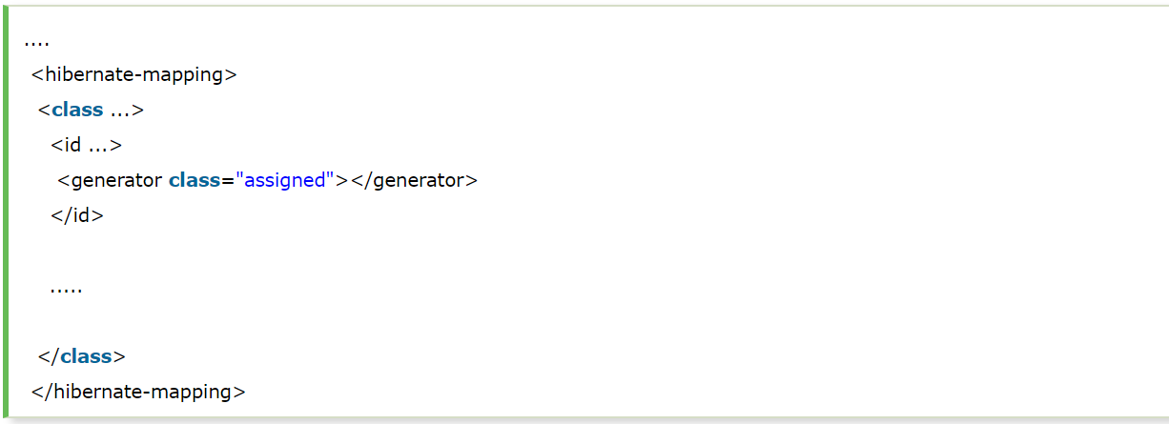
1) assigned
It is the default generator strategy if there is no <generator> element . In this case, application assigns the id. For example:

Slide 84
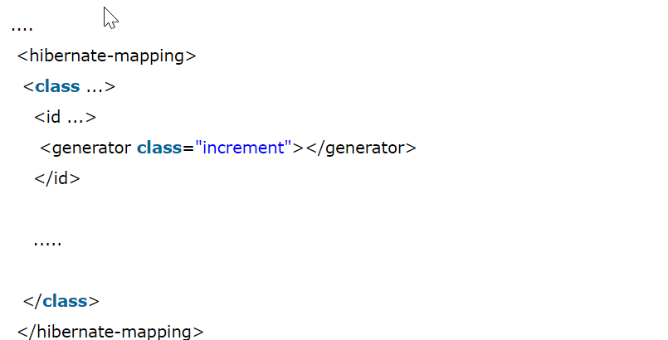
2) increment
It generates the unique id only if no other process is inserting data into this table. It generates short, int or long type identifier. If a table contains an identifier then the application considers its maximum value else the application consider that the first generated identifier is 1. For each attribute value, the hibernate increment the identifier by 1. Syntax:

Slide 85
Example on Increment generator
Change is only in hibernate mapping file and Persistence class

Slide 86
employee.hbm.xml
<?xml version='1.0' encoding='UTF-8'?>
<!DOCTYPE hibernate-mapping PUBLIC
"-//Hibernate/Hibernate Mapping DTD 5.3//EN"
"http://hibernate.sourceforge.net/hibernate-mapping-5.3.dtd">
<hibernate-mapping>
<class name="com.mangaraoit.hb.Employee" table="EMPLOYEE">
<id name="id">
<generator class="increment"></generator>
</id>
<property name="firstName"/>
<property name="lastName" column="LASTNAME" />
</class>
</hibernate-mapping>

Slide 87
Main Class
Employee e1 = new Employee();
//No need to set Id value
e1.setFirstName("Veera");
e1.setLastName("Raghava");
session.save(e1);

Slide 88
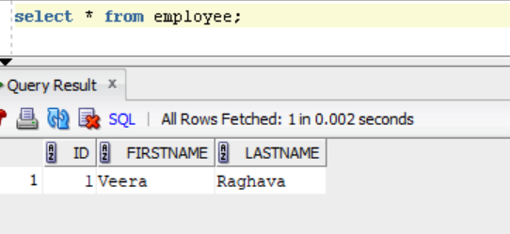
Output

Slide 89
3) sequence
It uses the sequence of the database. if there is no sequence defined, it creates a sequence automatically e.g. in case of Oracle database, it creates a sequence named HIBERNATE_SEQUENCE. In case of Oracle, DB2, SAP DB, Postgre SQL or McKoi, it uses sequence but it uses generator in interbase. Syntax:
.....
<id ...>
<generator class="sequence"></generator>
</id>
.....
For defining your own sequence, use the param subelement of generator.
.....
<id ...>
<generator class="sequence">
<param name="sequence">your_sequence_name</param>
</generator>
</id>
.....

Slide 90
4) hilo
It uses high and low algorithm to generate the id of type short, int and long. Syntax:
.....
<id ...>
<generator class="hilo"></generator>
</id>
.....

Slide 91
5) identity
It is used in Sybase, My SQL, MS SQL Server, DB2 and HypersonicSQL to support the id column. The returned id is of type short, int or long. It is responsibility of database to generate unique identifier.

Slide 92
6) native
It uses identity, sequence or hilo depending on the database vendor. Syntax:
.....
<id ...>
<generator class="native"></generator>
</id>
.....

Slide 93
7) seqhilo
It uses high and low algorithm on the specified sequence name. The returned id is of type short, int or long.

Slide 94
8) uuid
It uses 128-bit UUID algorithm to generate the id. The returned id is of type String, unique within a network (because IP is used). The UUID is represented in hexadecimal digits, 32 in length.

Slide 95
9) guid
It uses GUID generated by database of type string. It works on MS SQL Server and MySQL.

Slide 96
10) select
It uses the primary key returned by the database trigger.

Slide 97
11) foreign
It uses the id of another associated object, mostly used with <one-to-one> association.

Slide 98
12) sequence-identity
It uses a special sequence generation strategy. It is supported in Oracle 10g drivers only.

Slide 99
Hibernate Transaction Management
A transaction simply represents a unit of work. In such case, if one step fails, the whole transaction fails (which is termed as atomicity).
A transaction can be described by ACID properties (Atomicity, Consistency, Isolation and Durability).

Slide 100
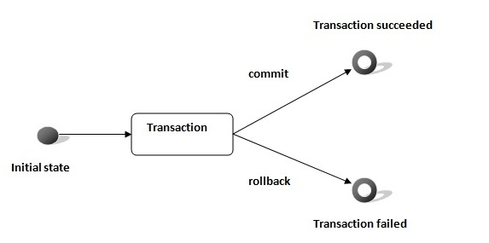

Slide 101
Transaction Interface in Hibernate
we have Transaction interface that defines the unit of work. It maintains abstraction from the transaction implementation (JTA,JDBC).
A transaction is associated with Session and instantiated by calling session.beginTransaction().
The methods of Transaction interface are as follows:
void begin() starts a new transaction.
void commit() ends the unit of work unless we are in FlushMode.NEVER.
void rollback() forces this transaction to rollback.
void setTimeout(int seconds) it sets a transaction timeout for any transaction started by a subsequent call to begin on this instance.
boolean isAlive() checks if the transaction is still alive.
void registerSynchronization(Synchronization s) registers a user synchronization callback for this transaction.
boolean wasCommited() checks if the transaction is commited successfully.
boolean wasRolledBack() checks if the transaction is rolledback successfully.

Slide 102
Example of Transaction Management in Hibernate
Session session = null;
Transaction tx = null;
try {
session = sessionFactory.openSession();
tx = session.beginTransaction();
//some action
tx.commit();
}catch (Exception ex) {
ex.printStackTrace();
tx.rollback();
}
finally {session.close();}

Slide 103
Hibernate Query Language (HQL)
Hibernate Query Language (HQL) is same as SQL (Structured Query Language) but it doesn't depends on the table of the database.
Instead of table name, we use class name in HQL. So it is database independent query language.
HQL is Database Independent language
HQL works with persistent objects and their properties.
HQL queries are translated by Hibernate into conventional SQL queries which in turns perform action on database.
Keywords like SELECT , FROM and WHERE etc. are not case sensitive but properties like table and column names are case sensitive in HQL.

Slide 104
Advantage of HQL
database independent
supports polymorphic queries
easy to learn for Java Programmer

Slide 105
Query Interface
It is an object oriented representation of Hibernate Query.
The object of Query can be obtained by calling the createQuery() method Session interface.

Slide 106
Query Interface methods
public int executeUpdate() is used to execute the update or delete query.
public List list() returns the result of the relation as a list.
public Query setFirstResult(int rowno) specifies the row number from where record will be retrieved.
public Query setMaxResult(int rowno) specifies the no. of records to be retrieved from the relation (table).
public Query setParameter(int position, Object value) it sets the value to the JDBC style query parameter.
public Query setParameter(String name, Object value) it sets the value to a named query parameter.

Slide 107
FROM Clause
Use FROM clause if you want to load a complete persistent objects into memory. Following is the simple syntax of using FROM clause:

Slide 108
Note
Use class name is the query not the table name
String hql = "FROM EMPLOYEE"; //wrong
String hql = "FROM Employee"; //correct

Slide 109
To retrieve all records from the table
import org.hibernate.Query;
Ex1:
String hql = "FROM Employee";
Query query = session.createQuery(hql);
List results = query.list();
Ex2: fully qualified class can be used.
String hql = "FROM com.mangaraoit.persistence.Employee";
Query query = session.createQuery(hql);
List results = query.list();

Slide 110
Example of HQL to get records with pagination
String hql = "FROM Employee";
Query query = session.createQuery(hql);
query.setFirstResult(5);
query.setMaxResults(10);
List<Employee> results = query.list();
for (Employee e : results) {
System.out.println("Id: "+e.getId()+" First Name: "+e.getFirstName()+" Last name: "+e.getLastName());
}

Slide 111
AS Clause
The AS clause can be used to assign aliases to the classes in your HQL queries, specially when you have long queries. For instance, our previous simple example would be the following:
Ex:
String hql = "FROM Employee AS E";
Query query = session.createQuery(hql);
List results = query.list();

Slide 112
SELECT Clause
The SELECT clause provides more control over the result set than the from clause. If you want to obtain few properties of objects instead of the complete object, use the SELECT clause. Following is the simple syntax of using SELECT clause to get just first_name field of the Employee object:
Ex:
String hql = "SELECT e.firstName FROM Employee AS e";
Query query = session.createQuery(hql);
List<String> results = query.list();
for (String fn : results) {
System.out.println("Frist Name: "+fn);
}

Slide 113
Where Clause
If you want to narrow the specific objects that are returned from storage, you use the WHERE clause. Following is the simple syntax of using WHERE clause:
Ex:
String hql = "FROM Employee where id=101";
Query query = session.createQuery(hql);
List<Employee> results = query.list();
for (Employee e : results) {
System.out.println("Id: "+e.getId()+" First Name: "+e.getFirstName()+" Last name: "+e.getLastName());
}

Slide 114
ORDER BY clause
To sort your HQL query's results, you will need to use the ORDER BY clause. You can order the results by any property on the objects in the result set either ascending (ASC) or descending (DESC). Following is the simple syntax of using ORDER BY clause:
String hql = "FROM Employee AS e ORDER BY e.firstName DESC";
Query query = session.createQuery(hql);
List<Employee> results = query.list();
for (Employee e : results) {
System.out.println("Id: "+e.getId()+" First Name: "+e.getFirstName()+" Last name: "+e.getLastName());
}

Slide 115
Example to count total number of employee ID
String hql = "SELECT count(id) Employee";
Query query = session.createQuery(hql);
String hql = "select count(id) FROM Employee";
Query query = session.createQuery(hql);
List<Integer> list = query.list();
System.out.println(list.get(0));

Slide 116
Using Named Paramters
Hibernate supports named parameters in its HQL queries. This makes writing HQL queries that accept input from the user easy and you do not have to defend against SQL injection attacks. Following is the simple syntax of using named parameters:
Ex:
String hql = "From Employee e where e.id=:employee_id";
Query query = session.createQuery(hql);
query.setParameter("employee_id", 101);
query.list();

Slide 117
Positional parameters
It’s use question mark (?) to define a named parameter, and you have to set your parameter according to the position sequence. See example…
String hql = "From Employee e where e.id=?1";
Query query = session.createQuery(hql);
List<Employee> empList = query.setInteger(1, 101).list();
for (Employee emp : empList) {
System.out.print("Id: "+emp.getId());
System.out.print(" First Name: "+emp.getFirstName());
System.out.println(" Last Name: "+emp.getLastName());
}

Slide 118
Conclusion
In Hibernate parameter binding, recommend one is always go for “Named parameters“, as it’s more easy to maintain, and the compiled SQL statement can be reuse (if only bind parameters change) to increase the performance.

Slide 119
HCQL (Hibernate Criteria Query Language)
Hibernate Criteria Queries

Slide 120
HCQL
The Hibernate Criteria Query Language (HCQL) is used to fetch the records based on the specific criteria. The Criteria interface provides methods to apply criteria such as retrieving all the records of table whose salary is greater than 50000 etc.

Slide 121
Advantage of HCQL
The HCQL provides methods to add criteria, so it is easy for the java programmer to add criteria. The java programmer is able to add many criteria on a query.

Slide 122
Criteria
The Criteria interface provides many methods to specify criteria. The object of Criteria can be obtained by calling thecreateCriteria() method of Session interface.

Slide 123
Syntax of createCriteria() method of Session interface
public Criteria createCriteria(Class c)

Slide 124
commonly used methods of Criteria interface
public Criteria add(Criterion c) is used to add restrictions.
public Criteria addOrder(Order o) specifies ordering.
public Criteria setFirstResult(int firstResult) specifies the first number of record to be retreived.
public Criteria setMaxResult(int totalResult) specifies the total number of records to be retreived.
public List list() returns list containing object.
public Criteria setProjection(Projection projection) specifies the projection.

Slide 125
Restrictions class Restrictions class provides methods that can be used as Criterion
public static SimpleExpression lt(String propertyName,Object value) sets the less than constraint to the given property.
public static SimpleExpression le(String propertyName,Object value) sets the less than or equal constraint to the given property.
public static SimpleExpression gt(String propertyName,Object value) sets the greater than constraint to the given property.
public static SimpleExpression ge(String propertyName,Object value) sets the greater than or equal than constraint to the given property.
public static SimpleExpression ne(String propertyName,Object value) sets the not equal constraint to the given property.
public static SimpleExpression eq(String propertyName,Object value) sets the equal constraint to the given property.
public static Criterion between(String propertyName, Object low, Object high) sets the between constraint.
public static SimpleExpression like(String propertyName, Object value) sets the like constraint to the given property

Slide 126
Criteria cr = session.createCriteria(Employee.class);
// To get records having salary more than 2000
cr.add(Restrictions.gt("salary", 2000));
// To get records having salary less than 2000
cr.add(Restrictions.lt("salary", 2000));
// To get records having fistName starting with zara
cr.add(Restrictions.like("firstName", "zara%"));
// Case sensitive form of the above restriction.
cr.add(Restrictions.ilike("firstName", "zara%"));
// To get records having salary in between 1000 and 2000
cr.add(Restrictions.between("salary", 1000, 2000));

Slide 127
// To check if the given property is null
cr.add(Restrictions.isNull("salary"));
// To check if the given property is not null
cr.add(Restrictions.isNotNull("salary"));
// To check if the given property is empty
cr.add(Restrictions.isEmpty("salary"));
// To check if the given property is not empty
cr.add(Restrictions.isNotEmpty("salary"));

Slide 128
Order class
The Order class represents an order
public static Order asc(String propertyName) applies the ascending order on the basis of given property.
public static Order desc(String propertyName) applies the descending order on the basis of given property.

Slide 129
Example of HCQL to get all the records
Criteria cr=session.createCriteria(Employee.class);
List<Employee> results = cr.list();
for (Employee e : results) {
System.out.println("Id: "+e.getId()+" First Name: "+e.getFirstName()+" Last name: "+e.getLastName());
}

Slide 130
Example of HCQL to get the records whose id is greater than 101
Criteria cr=session.createCriteria(Employee.class);
cr.add(Restrictions.gt("id", 101)); //id is property name
List<Employee> results = cr.list();
for (Employee e : results) {
System.out.println("Id: "+e.getId()+" First Name: "+e.getFirstName()+" Last name: "+e.getLastName());
}

Slide 131
Example of HCQL to get the 10th to 20th record
Criteria cr=session.createCriteria(Employee.class);
cr.setFirstResult(10);
cr.setMaxResults(15);
List<Employee> results = cr.list();
for (Employee e : results) {
System.out.println("Id: "+e.getId()+" First Name: "+e.getFirstName()+" Last name: "+e.getLastName());
}

Slide 132
Example of HCQL to get the records in ascending order on the basis of sidalary
Criteria cr=session.createCriteria(Employee.class);
cr.addOrder(Order.desc("id")); //id should be property name
List<Employee> results = cr.list();
for (Employee e : results) {
System.out.println("Id: "+e.getId()+" First Name: "+e.getFirstName()+" Last name: "+e.getLastName());
}

Slide 133
HCQL with Projection
We can fetch data of a particular column by projection such as name etc. Let's see the simple example of projection that prints data of firstName column of the table only.
Criteria cr=session.createCriteria(Employee.class);
cr.setProjection(Projections.property("firstName"));
List<String> results = cr.list();
for (String fn : results) {
System.out.println(fn);
}

Slide 134
End

