Slide 1
Java Basic Operators

Slide 2
Operator
It is a special symbol, It performs action on operands
Eg: +,-, &&, ||, etc

Slide 3
Operand
Operands are nothing but variable names
Expression:
A+B 🡪 A, B are operands, + is operator

Slide 4
Types of Operators based on operands
Unary Operator
Binary Operator
Ternary Operator

Slide 5
Unary Operator
Unary operator performs action on single operand
Ex: ++, --
A++, ++a, --a, a--

Slide 6
Binary Operator
It performs action on two operands
Ex: +, -, &&
A+b, a-b, a*b, a&&b

Slide 7
Ternary Operator
It performs action on 3 operands
Ex: ? :
Result = condition ? Result1 : result2;

Slide 8
Java provides a rich set of operators to manipulate variables. We can divide all the Java operators into the following groups:
Arithmetic Operators
Relational Operators
Logical Operators
Assignment Operators
Misc Operators

Slide 9
The Arithmetic Operators:
Arithmetic operators are used in mathematical expressions in the same way that they are used in algebra. The following table lists the arithmetic operators:
Assume integer variable A holds 10 and variable B holds 20, then:

Slide 10
Operator | Description | Example
+ | Addition - Adds values on either side of the operator | A + B will give 30
- | Subtraction - Subtracts right hand operand from left hand operand | A - B will give -10
* | Multiplication - Multiplies values on either side of the operator | A * B will give 200
/ | Division - Divides left hand operand by right hand operand | B / A will give 2
% | Modulus - Divides left hand operand by right hand operand and returns remainder | B % A will give 0
++ | Increment - Increases the value of operand by 1 | B++ gives 21
-- | Decrement - Decreases the value of operand by 1 | B-- gives 19

Slide 11
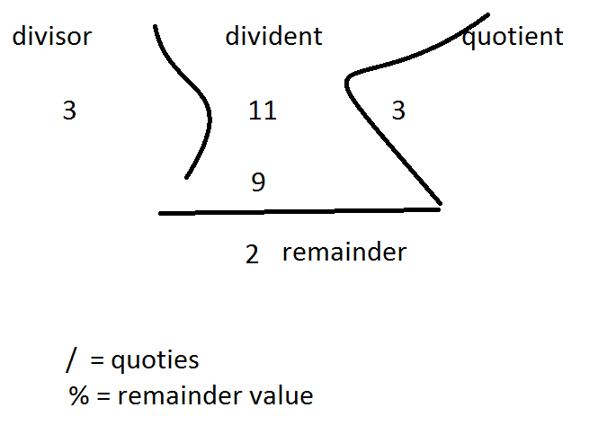

Slide 12
Pre Increment Operator
Pre Increment operator first increases the operand value by 1
Then result is assigned to the same operand
Ex: int a = 10;
++a; // a = a+1;

Slide 13
Post Increment operator
Post increment operator increase the operand value by 1 at the last
Ex: a ++;

Slide 14
Example
The following simple example program demonstrates the arithmetic operators. Copy and paste the following Java program in Test.java file and compile and run this program:

Slide 15
public class Test{
public static void main(String args[]){
int a =10;
int b =20;
int c =25;
int d =25;
System.out.println("a + b = "+(a +b));
System.out.println("a - b = "+(a -b));
System.out.println("a * b = "+(a *b));
System.out.println("b / a = "+(b /a));
System.out.println("b % a = "+(b %a));
System.out.println("c % a = "+(c %a));
System.out.println("a++ = "+(a++));
System.out.println("b-- = "+(a--));
// Check the difference in d++ and ++d
System.out.println("d++ = "+(d++));
System.out.println("++d = "+(++d));
}
}

Slide 16
This would produce the following result:
a+ b =30
a- b =-10
a* b =200
b/ a =2
b% a =0
c% a =5 a++=10 b--=11 d++=25
++d =27

Slide 17
The Relational Operators:
There are following relational operators supported by Java language:
Assume variable A holds 10 and variable B holds 20, then:
Relation operators are also called comparison operator.
i.e., we are comparing operands
Ex: a<b

Slide 18
Operator | Description | Example A = 10, B = 20
== | Checks if the values of two operands are equal or not, if yes then condition becomes true. | (A == B) is not true.
!= | Checks if the values of two operands are equal or not, if values are not equal then condition becomes true. | (A != B) is true.
> | Checks if the value of left operand is greater than the value of right operand, if yes then condition becomes true. | (A > B) is not true.
< | Checks if the value of left operand is less than the value of right operand, if yes then condition becomes true | (A < B) is true
>= | Checks if the value of left operand is greater than or equal to the value of right operand, if yes then condition becomes true. | (A >= B) is not true.
<= | Checks if the value of left operand is less than or equal to the value of right operand, if yes then condition becomes true | (A <= B) is true.

Slide 19
<=, >= Explanation
A <= B 🡪 A<B or A==B
A>=B 🡪 A>B or A==B

Slide 20
Example
public class Test{
public static void main(String args[]){ int a =10;
int b =20;
System.out.println("a == b = "+(a == b));
System.out.println("a != b = "+(a != b));
System.out.println("a > b = "+(a > b));
System.out.println("a < b = "+(a < b));
System.out.println("b >= a = "+(b >= a));
System.out.println("b <= a = "+(b <= a));
}
}

Slide 21
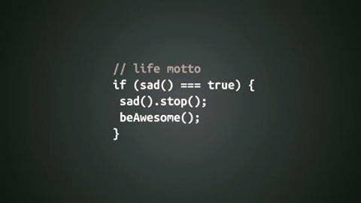
==

Slide 22
The Logical Operators
Operator | Description | Example
&& | Called logical AND operator. If the both operands are non zero then condition becomes true. | (A && B) is false.
|| | Called logical AND operator. If any of the two operands are non-zero then condition becomes true. | (A || B) is true.
! | Called logical OR. Use to reverse the logical state of its operand | !(A&&B) is true

Slide 23
&& (AND) truth table
 |  | &&
T | T | T&&T 🡪 T
T | F | T&&F 🡪F
F | T | F&&T 🡪 F
F | F | F&&F 🡪 F

Slide 24
Logical|| (OR ) operator
 |  | ||
T | T | T||T 🡪 T
T | F | T||F 🡪 T
F | T | F||T 🡪 T
F | F | F||F 🡪 F

Slide 25
Logical Not (!) operator
 | !
T | !T 🡪 F
F | !F 🡪 T

Slide 26
Example
public class Test{
public static void main(String args[]){
boolean a =true;
boolean b =false;
System.out.println("a && b = "+(a&&b));
System.out.println("a || b = "+(a||b));
System.out.println("!(a && b) = "+!(a && b));
}
}

Slide 27
The Assignment Operators:
Operator | Description | Example
= | Simple assignment operator | C = A + B will assign A+B value in to C

Slide 28
Composite Assignment operators
Operator | Description | Example
+= | Add AND assignment operator, It adds right operand to the left operand and assign the result to left operand | C += A is equivalent to C = C+ A;
-= | Subtract AND assignment operator, It subtracts right operand to the left operand and assign the result to left operand | C -=A is equivalent to C = C-A;
*= |  | C *=A C = C*A
/= |  | C/=A C=C/A
%= |  | C%=A C=C%A

Slide 29
Example
public class CompositeOperatorsDemo {
public static void main(String[] args) {
int a = 10;
System.out.println("a+=5: "+(a+=5)); //a=a+5;
System.out.println("a-=5: "+(a-=5)); //a=a-5;
System.out.println("a*=5: "+(a*=5)); //a=a*5;
System.out.println("a/=5: "+(a/=5)); //a=a/5;
System.out.println("a%=5: "+(a%=5)); //a=a%5;
}
}

Slide 30
Misc Operators
There are few other operators supported by Java Language
Conditional Operator (?:)
instanceof Operator

Slide 31
Conditional Operator (?:):
Conditional operator is also known as the ternary operator. This operator consists of three operands and is used to evaluate Boolean expressions. The goal of the operator is to decide which value should be assigned to the variable. The operator is written as:
Syntax: variable x =(expression)? value if true: value if false

Slide 32
Example
public class Test{
public static void main(String args[]){
int a , b;
a=10;
b=(a ==1)?20:30;
System.out.println("Value of b is : "+ b );
b =(a ==10)?20:40; System.out.println("Value of b is : "+ b );
}
}

Slide 33
Example to find biggest number of two numbers using if else
public class BiggestOfTwoNumbers {
public static void main(String[] args) {
int a = 10;
int b = 20;
if (a > b) {
System.out.println("a is big");
} else {
System.out.println("b is big");
}
}
}

Slide 34
Example to find biggest number of two numbers using conditional operator
int a = 20;
Int b = 30;
Int big;
big = a>b?a:b;
System.out.println(“big number is: “+big);
(or)
System.out.println((a>b)?("a is big"+a):("b is big"+b));

Slide 35
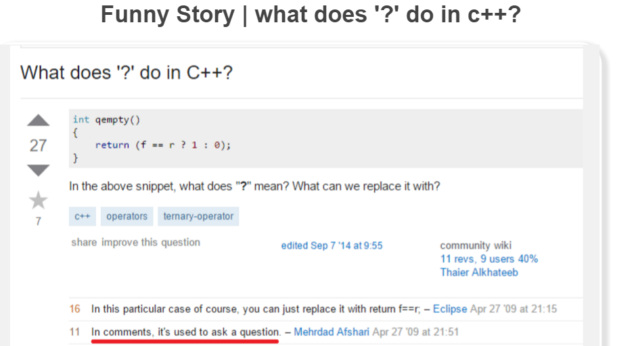
Guess the funny answer ???

Slide 36
instanceof Operator
This operator is used only for object reference variables. The operator checks whether the object is of a particular type(class type or interface type).
Instanceof is a keyword, it’s not a symbol
instanceof operator is wriiten as:
(Object reference variable ) instanceof (class/interface type)
Eg: name instanceof String

Slide 37
Example
public class InstanceOfOperatorDemo {
public static void main(String[] args) {
String name="James";
boolean result1 = name instanceof String;
System.out.println("result1: "+result1);
name=null;
boolean result2 = name instanceof String;
System.out.println("result2: "+result2);
}
}

Slide 38
Example 2
public class InstanceOfOperatorDemo {
public static void main(String[] args) {
Object number=101.23;
Object names[] = new String[1];
System.out.println(number instanceof Number);
System.out.println(number instanceof Integer);
System.out.println(number instanceof Float);
System.out.println(names instanceof String[]);
System.out.println(names instanceof Integer[]);
}
}

Slide 39
Precedence of Java Operators:
Operator precedence determines the grouping of terms in an expression. This affects how an expression is evaluated. Certain operators have higher precedence than others; for example, the multiplication operator has higher precedence than the addition operator:
For example, x = 7 + 3 * 2;
Here x is assigned 13, not 20 because operator * has higher precedence than +, so it first gets multiplied with 3*2 and then adds into 7.

Slide 40
Category | Operator | Associativity
Postfix | () [] . (dot operator) | Left toright
Unary | ++ - - ! ~ | Right to left
Multiplicative | * / % | Left to right
Additive | + - | Left to right
Shift | >> >>> << | Left to right
Relational | > >= < <= | Left to right
Equality | == != | Left to right
Bitwise AND | & | Left to right
Bitwise XOR | ^ | Left to right
Bitwise OR | | | Left to right
Logical AND | && | Left to right
Logical OR | || | Left to right
Conditional | ?: | Right to left
Assignment | = += -= *= /= %= >>= <<= &= ^= |= | Right to left
Comma | , | Left to right

Slide 41
Step by step calculation
20+50%2*(10-2)
20+50%2*8
20+0*8
20+0
20
int x = 20+50%2*(10-2);
System.out.println("x value: "+x);
Output: x value: 20

Slide 42
Difference between = and ==
= is assignment operator, it assigns value to the variable
== is comparison operator, it compares two values if both are same returns true, else returns false
Ex:
int a = 10;
int b = 10;
If(a==b){
System.out.println(“both are same”);
}

Slide 43
Quiz
public class Test {
public static void main(String[] args) {
Object no = 10.234;
String[] names = {"Srinu","Kiran"};
System.out.println(no instanceof Float);
System.out.println(no instanceof Double);
System.out.println(names instanceof String[]);
}
}

Slide 44
Output
False
True
True

Slide 45
Questions????????

Slide 46
Write a Program to swap two numbers
int a = 20, b = 10;
b = (a+b) - (a=b);

Slide 47
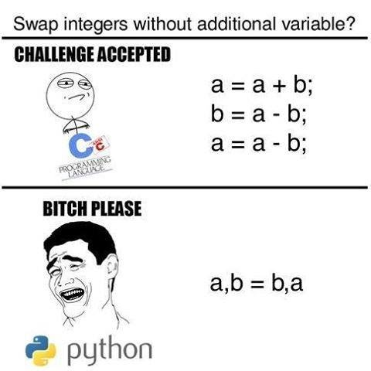
Swapping of two numbers??

Slide 48
Assignment ?
Write a program to swap two numbers with out using third variable??

Slide 49
Assignment
Write a program to find out the least number of two numbers (using conditional operator)

