Slide 1
Variables
Java variables

Slide 2
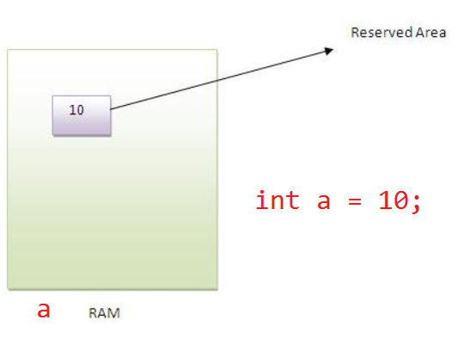
Variable
Variable is name of reserved area allocated in memory

Slide 3

Declare variable???

Slide 4
Types of Variable
local variables
instance variables
static variables
A variable that is declared inside the method or the constructor or block
A variable that is declared inside the class and outside of the method. It is not declared as static
A variable that is declared as static. It can’t be local

Slide 5
Notes
static methods doesn't allow non static variables.
Non static methods allow both static and non static variables

Slide 6
Understand the types of variables
class A{
int data=50;//instance variable
static int m=100;//static variable
void method(){
int n=90;//local variable
}
}//end of class

Slide 7
Best way of declaration of more than one variable
Int a=10;
int b=20;
int c=30;
int a=10,b=20,c=30;

Slide 8
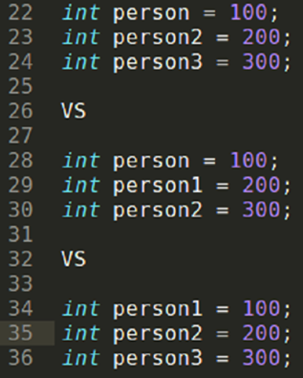
There are different type of persons

Slide 9


