Slide 1
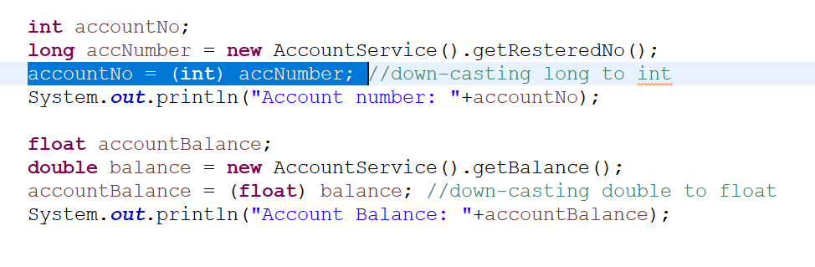
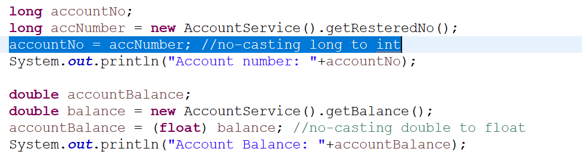
Down-casting may cause possible loss of actual value
Possible loss of actual value occurs when high value is assigned to the variable than it can hold which may result a defect. Best practice is to use higher range data type as per the requirement.
Non-Compliant code:
Compliant code with finally method:

Slide 2
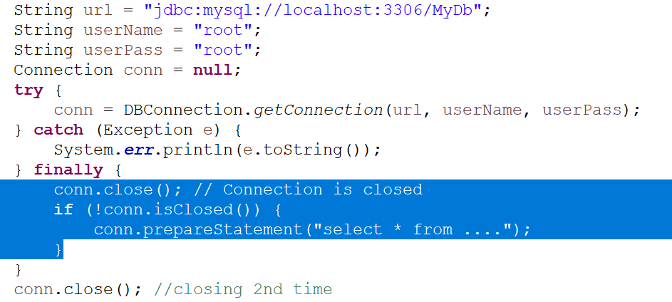

Released resource should not be used
All methods accessing closed SQL connections, Data Streams, Sessions is invalid which leads to incorrect result and a defect. The best practice is close resource objects at the end or use Auto Closeable feature added in Java 7th version.
Non-Compliant code:
Compliant code with finally method:

Slide 3
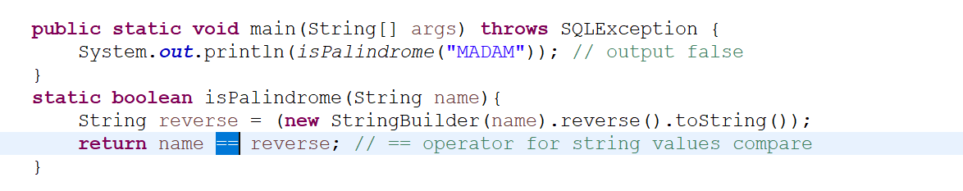
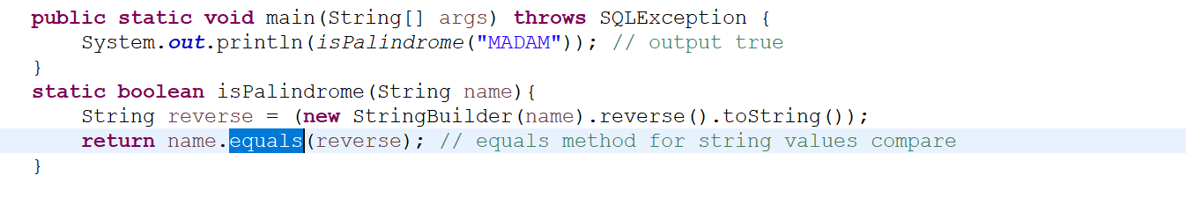
== operator for objects content comparison is not recommended
“==“ operator usage in the wrong place in the code may give unexpected/false results and which may lead to a defect. “==“ operator compares references of the objects but not the content. For string values comparison, equals() method should be used.
Non-Compliant code:
Compliant code with finally method:

Slide 4
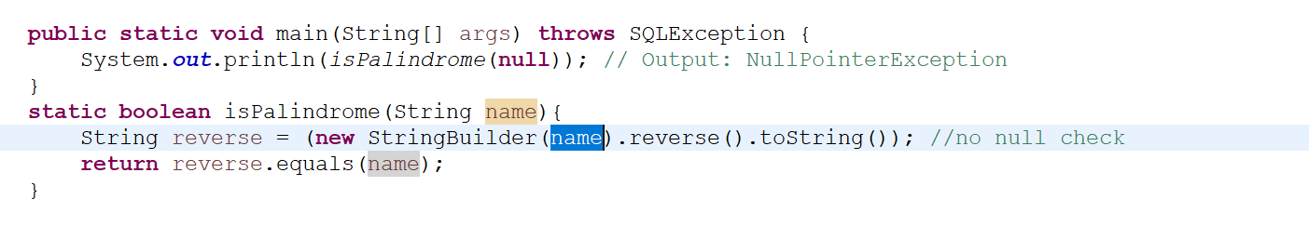
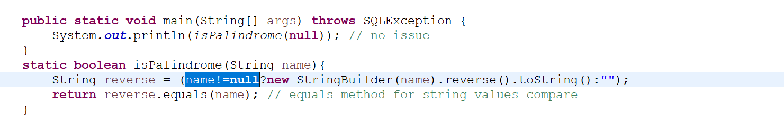
Null Pointer Issue without null check on Object
NullPointerException issue occurs when the program attempts to use an object that refers to the null value at runtime of the program and which may lead to a defect. The best practice is to have a null check before performing any action on the object.
Non-Compliant code:
Compliant code with finally method:

