Slide 1
Bootstrap

Slide 2
Bootstrap
Bootstrap was developed by Mark Otto and Jacob Thornton at Twitter, and released as an open source product in August 2011 on GitHub.
In june 2014, no. 1 project on GitHub.
Bootstrap is the most popular HTML, CSS, and JavaScript framework for developing responsive, mobile-first web sites.
Bootstrap is completely free to download and use!

Slide 3
What is a Responsive Web Design
Responsive web design is about creating web sites which automatically adjust themselves to look good on all devices, from small phones to large desktops.
Bootstrap gives you the ability to easily create responsive
designs.

Slide 4
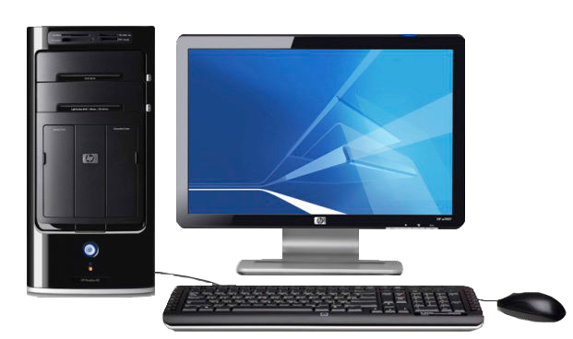
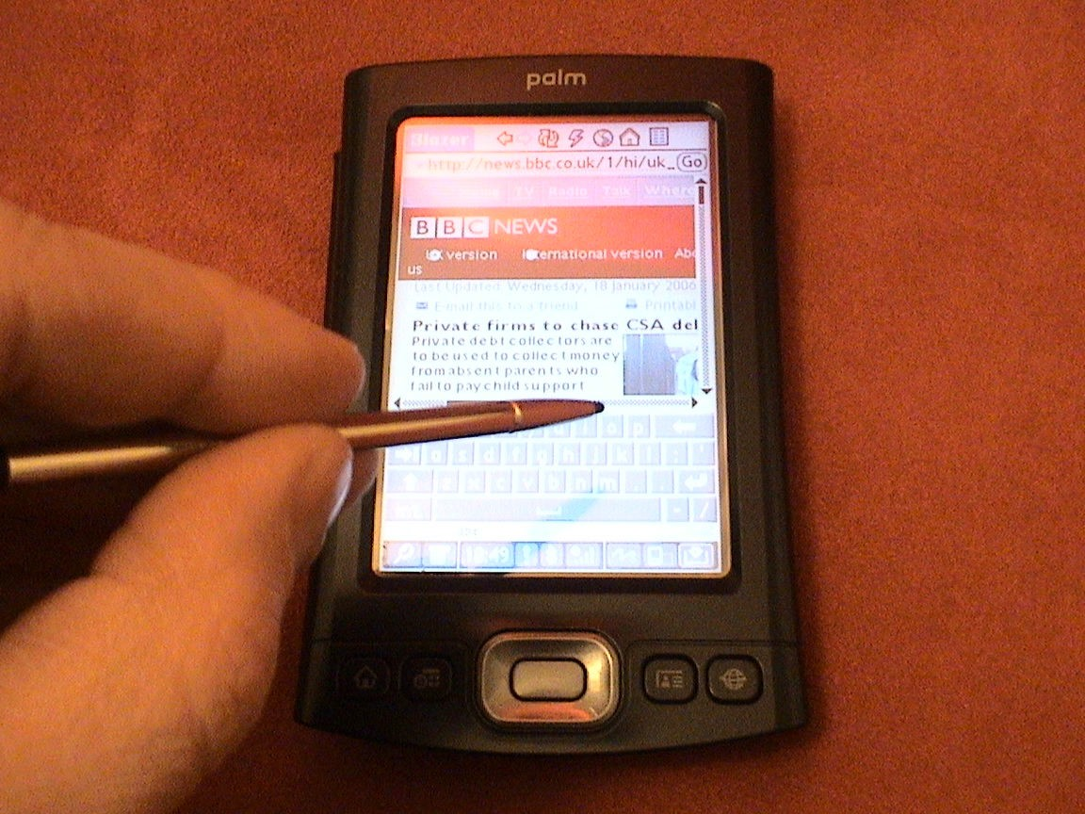
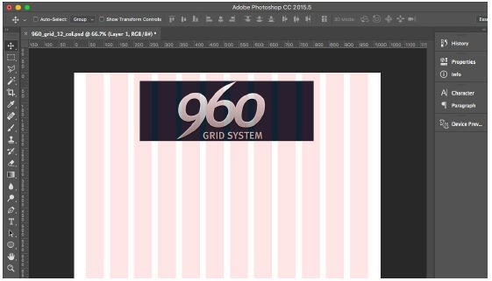
Bootstrap – Before iPhone
960 Grid - 1024px x 768px

Slide 5
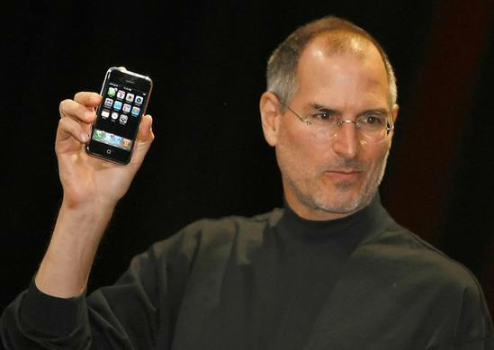
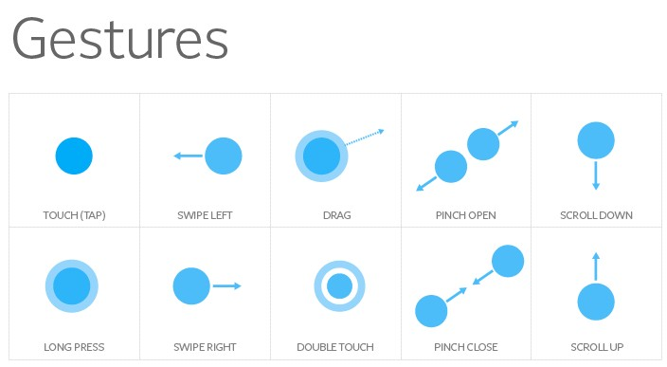
Bootstrap – After iPhone
Introduced:
Mobile browser (WebKit) with a full web experience
Touch gestures

Slide 6
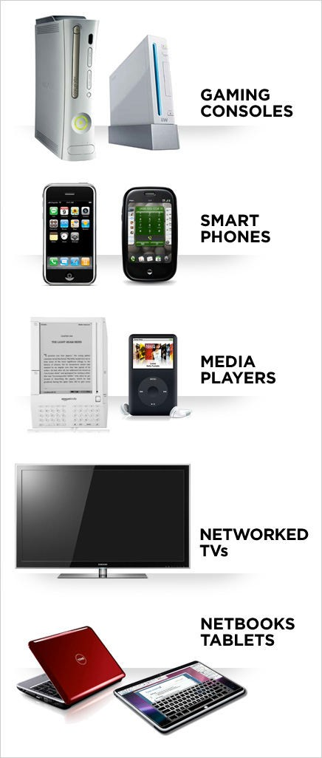
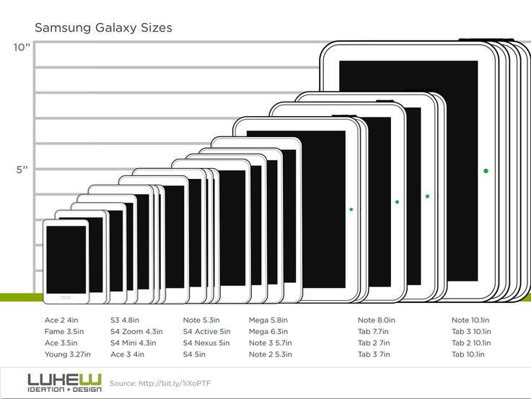

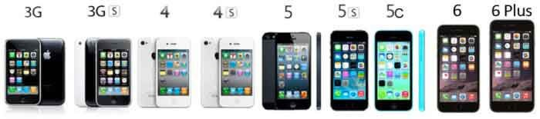
Bootstrap
Devices
X
CSS3 support is different
for each browser/ version

Slide 7
Solution: Responsive Web Design
<meta name="viewport" content="width=device- width, initial-scale=1, shrink-to-ﬁt=no”>
@media screen and (min-width:500px) { ... }
Fluid widths instead of ﬁxed widths (%, rems, ems, auto instead of px, pt)
CSS reset

Slide 8
Why Bootstrap?
Easy to use: Anybody with just basic knowledge of
HTML and CSS can start using Bootstrap
Responsive features: Bootstrap's responsive CSS
adjusts to phones, tablets, and desktops
Mobile-first approach: In Bootstrap 3, mobile-first
styles are part of the core framework
Browser compatibility: Bootstrap is compatible with all modern browsers

Slide 9

<!DOCTYPE html>
<html lang="en">
<head>
<meta charset="utf-8">
<meta name="viewport" content="width=device-width, initial-scale=1">
<link href="css/bootstrap.min.css" rel="stylesheet">
<link href=“css/style.css” rel="stylesheet>
<script src="https://ajax.googleapis.com/ajax/libs/jquery/1.11.3/jquery.min.js">
</script>
<script src="http://maxcdn.bootstrapcdn.com/bootstrap/3.3.5/js/bootstrap.min.js">
</script>
</head>
<body>
<h1>Bootstrap Heading</h1>
<p>Bootstrap Paragraph</p>
</body>
</html>

Slide 10

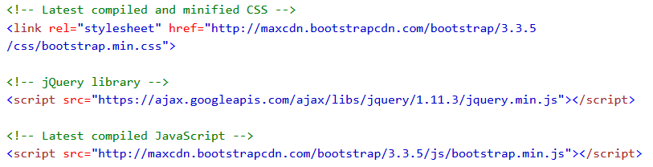
If you don't want to download and host Bootstrap yourself, you can include it from a CDN (Content Delivery Network).
MaxCDN provide CDN support for Bootstrap's CSS and
JavaScript. Also include jQuery:

Slide 11

Rows must be placed within a .container (fixed-width).
Rows must be placed within a .container-fluid (full-width).
Use rows to create horizontal groups of columns.
Predefined classes like .row and .col-sm-4 are available for quickly making grid layouts.

Slide 12

<div class="container">
<div class="row">
<div class="col-*-*"></div>
</div>
<div class="row">
<div class="col-*-*"></div>
<div class="col-*-*"></div>
<div class="col-*-*"></div>
</div>
<div class="row">
...
</div>
</div>

Slide 13

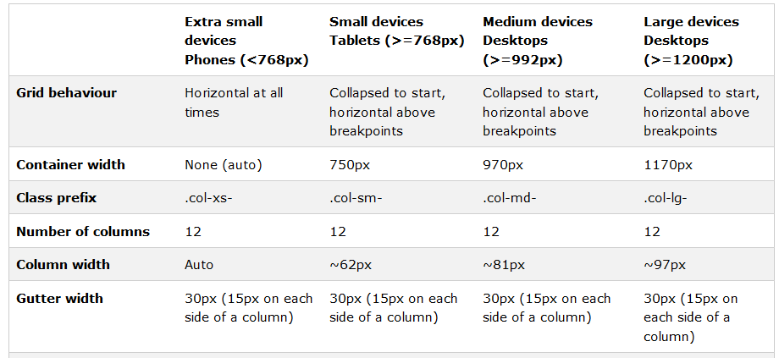

Slide 14

<div class="row">
<div class="col-md-8"> </div>
<div class="col-md-4"> </div>
</div>
<div class="row">
<div class="col-xs-6">.col-xs-6</div>
<div class="col-xs-6">.col-xs-6</div>
</div>

Slide 15
Bootstrap's Default Settings
Bootstrap's global default font-size is 14px, with a line- height of 1.428.
<blockquote>
To show the quote on the right, use the .blockquote- reverse class:

Slide 16
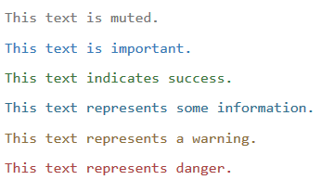
Contextual Colors and Backgrounds
The classes for text colors are:
.text-muted,
.text-primary,
.text-success,
.text-info,
.text-warning, and
.text-danger:

Slide 17
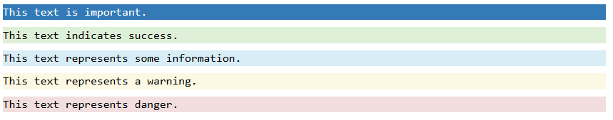
The classes for background colors are:
.bg-primary,
.bg-success,
.bg-info,
.bg-warning, and
.bg-danger:

Slide 18

Responsive Tables
The .table-responsive class creates a responsive table. The table will then scroll horizontally on small devices
<div class="table-responsive">
<table class="table">
...
</table>
</div>

Slide 19
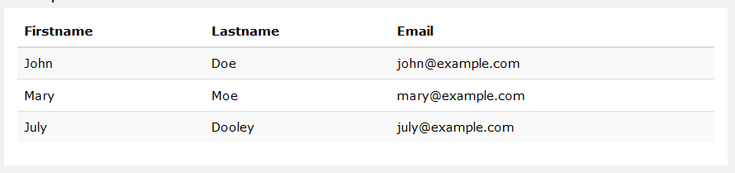
Striped Rows
The .table-striped class adds zebra-stripes to a table:

Slide 20

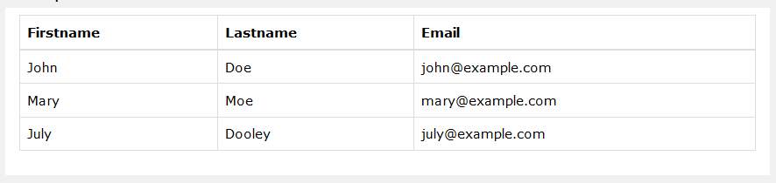
Bordered Table
The .table-bordered class adds borders on all sides of the table and cells:

Slide 21
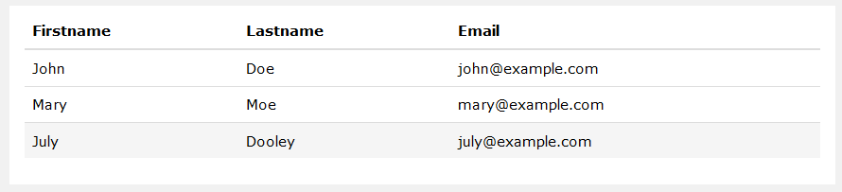
Hover Rows
The .table-hover class enables a hover state on table
rows:

Slide 22
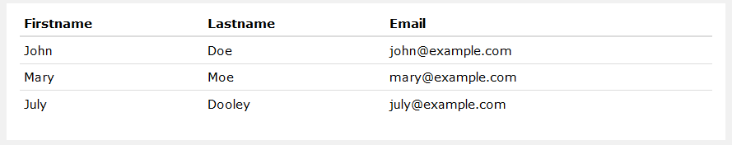
Condensed Table
The .table-condensed class makes a table more compact
by cutting cell padding in half:

Slide 23
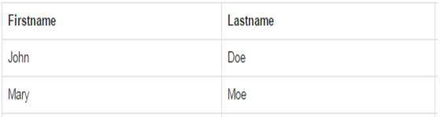
<!DOCTYPE html>
<html lang="en">
<head>
<title>Bootstrap Example</title>
<meta charset="utf-8">
<meta name="viewport" content="width=device-width, initial-scale=1">
<link rel="stylesheet" href="http://maxcdn.bootstrapcdn.com/bootstrap/3.3.5/css/bootstrap.min.css">
<script src="https://ajax.googleapis.com/ajax/libs/jquery/1.11.3/jquery.min.js"></script>
<script src="http://maxcdn.bootstrapcdn.com/bootstrap/3.3.5/js/bootstrap.min.js"></script>
</head>
<body>
<div class="container">
<h2>Bordered Table</h2>
<p>The .table-bordered class adds borders to a table:</p>
<table class="table table-bordered table-responsive">
<thead>
<tr>
<th>Firstname</th>
<th>Lastname</th>
· </tr>
</thead>
<tbody>
<tr>
<td>John</td>
<td>Doe</td>
· </tr>
<tr>
<td>Mary</td>
<td>Moe</td>
· </tr>
</tbody>
</table>
</div>
</body>
</html>

Slide 24
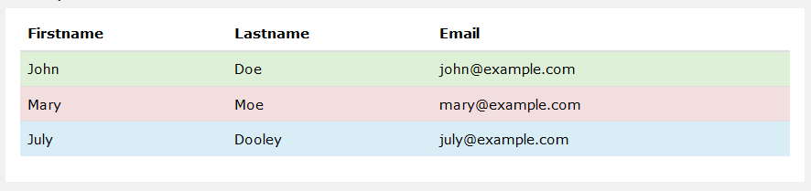
Contextual Classes
Contextual classes can be used to color table rows (<tr>)
or table cells (<td>):

Slide 25

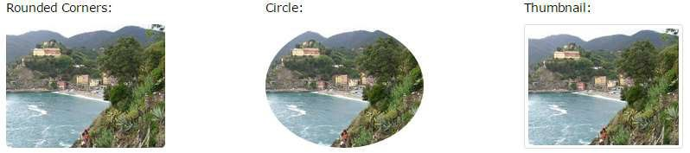
Create responsive images by adding an .img- responsive class to the <img> tag.
The .img-rounded class adds rounded corners to an image
The .img-circle class shapes the image to a circle
The .img-thumbnail class shapes the image to a thumbnail.

Slide 26

A jumbotron indicates a big box for calling extra attention
to some special content or information.
A jumbotron is displayed as a grey box with rounded
corners.
Its created with .jumbotron class.
Header created with .page-header class.
.jumbotron class may contain inside or outside of container

Slide 27

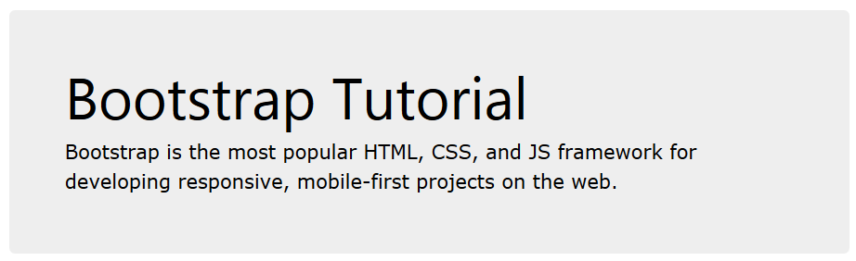
<div class="container">
<div class="jumbotron">
<h1>Bootstrap Tutorial</h1>
<p>Bootstrap is the most popular HTML, CSS, and JS framework for developing responsive, mobile-first projects on the web.</p>
</div>
<p>This is some text.</p>
<p>This is another text.</p>
</div>

Slide 28

The .well class adds a rounded border around an
element with a gray background color and some padding:
<div class="well">Basic Well</div>
<div class="well well-sm">Small Well</div>
<div class="well well-lg">Large Well</div>

Slide 29
Bootstrap's Default Settings
Bootstrap's global default font-size is 14px, with a line- height of 1.428.
<blockquote>
To show the quote on the right, use the .blockquote- reverse class:

Slide 30
Contextual Colors and Backgrounds
The classes for text colors are:
.text-muted,
.text-primary,
.text-success,
.text-info,
.text-warning, and
.text-danger:

Slide 31
The classes for background colors are:
.bg-primary,
.bg-success,
.bg-info,
.bg-warning, and
.bg-danger:

Slide 32
Responsive Tables
The .table-responsive class creates a responsive table. The table will then scroll horizontally on small devices
<div class="table-responsive">
<table class="table">
...
</table>
</div>

Slide 33
Striped Rows
The .table-striped class adds zebra-stripes to a table:

Slide 34
Bordered Table
The .table-bordered class adds borders on all sides of the table and cells:

Slide 35
Hover Rows
The .table-hover class enables a hover state on table
rows:

Slide 36
Condensed Table
The .table-condensed class makes a table more compact
by cutting cell padding in half:

Slide 37
<!DOCTYPE html>
<html lang="en">
<head>
<title>Bootstrap Example</title>
<meta charset="utf-8">
<meta name="viewport" content="width=device-width, initial-scale=1">
<link rel="stylesheet" href="http://maxcdn.bootstrapcdn.com/bootstrap/3.3.5/css/bootstrap.min.css">
<script src="https://ajax.googleapis.com/ajax/libs/jquery/1.11.3/jquery.min.js"></script>
<script src="http://maxcdn.bootstrapcdn.com/bootstrap/3.3.5/js/bootstrap.min.js"></script>
</head>
<body>
<div class="container">
<h2>Bordered Table</h2>
<p>The .table-bordered class adds borders to a table:</p>
<table class="table table-bordered table-responsive">
<thead>
<tr>
<th>Firstname</th>
<th>Lastname</th>
· </tr>
</thead>
<tbody>
<tr>
<td>John</td>
<td>Doe</td>
· </tr>
<tr>
<td>Mary</td>
<td>Moe</td>
· </tr>
</tbody>
</table>
</div>
</body>
</html>

Slide 38
Contextual Classes
Contextual classes can be used to color table rows (<tr>)
or table cells (<td>):

Slide 39
Create responsive images by adding an .img- responsive class to the <img> tag.
The .img-rounded class adds rounded corners to an image
The .img-circle class shapes the image to a circle
The .img-thumbnail class shapes the image to a thumbnail.

Slide 40
A jumbotron indicates a big box for calling extra attention
to some special content or information.
A jumbotron is displayed as a grey box with rounded
corners.
Its created with .jumbotron class.
Header created with .page-header class.
.jumbotron class may contain inside or outside of container

Slide 41
<div class="container">
<div class="jumbotron">
<h1>Bootstrap Tutorial</h1>
<p>Bootstrap is the most popular HTML, CSS, and JS framework for developing responsive, mobile-first projects on the web.</p>
</div>
<p>This is some text.</p>
<p>This is another text.</p>
</div>

Slide 42
The .well class adds a rounded border around an
element with a gray background color and some padding:
<div class="well">Basic Well</div>
<div class="well well-sm">Small Well</div>
<div class="well well-lg">Large Well</div>

