Slide 1
DATABRICKS HACKATHON 2026
CodeGenome AI
Modernization Intelligence Hub
AI-Powered Enterprise Mainframe Modernization Governance Platform
"Decoding Enterprise Legacy Systems with AI"
Team: CodeGenome Innovators Members: Mangayarkarasi Venkatachalam | Johar Ali Shaik
Databricks
GenAI
Streamlit
Delta Lake
Governance

Slide 2

THE CHALLENGE
Enterprise Legacy Modernization Challenges
Large enterprises rely on legacy ecosystems built on COBOL, JCL, DB2, IMS, MQ, and batch processing frameworks — systems that are decades old and increasingly costly to maintain.
71%
of enterprises still
run COBOL in production
Limited dependency visibility across programs
8–12
months avg. manual
modernization assessment
Manual impact analysis — weeks per assessment
Complex MQ / IMS integration flows undocumented
Governance and operational risk accumulation
No modernization intelligence or AI scoring
$330B
annual COBOL maintenance
cost globally
Delays in cloud / API-first transformation
Organizations need an AI-powered modernization governance platform to automate assessment, dependency intelligence, and enterprise risk visibility.

Slide 3

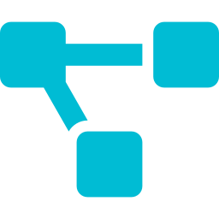
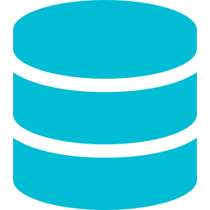
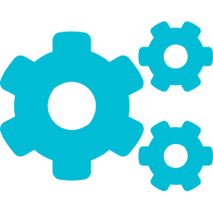
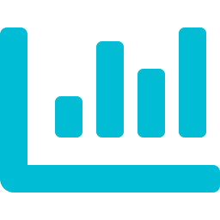


OUR SOLUTION
CodeGenome AI — Solution Overview
An AI-driven modernization intelligence platform built on Databricks Lakehouse
Ingest Legacy Assets
Dependency Extraction
DB2/MQ/IMS Lineage
JCL Orchestration
COBOL, JCL, DB2, Copybooks, IMS, MQ
Auto-map all program relationships
Full CRUD + queue lineage mapping
Batch flow + step sequencing analysis
Modernization Scoring
Risk Detection
AI Governance Alerts
Conversational GenAI
AI readiness + risk classification
Migration blockers + escalations
Zabbix + Teams real-time alerts
Natural language modernization Q&A

Slide 4
ARCHITECTURE
CodeGenome AI — Enterprise Architecture
1
Mainframe Legacy Assets
COBOL · JCL · DB2 SQL · Copybooks · CSV Files · IMS · MQ
2
Databricks Lakehouse Platform
Unity Catalog · Delta Lake · Delta Tables · Databricks SQL · Serverless Compute
3
AI Metadata Extraction Engine
Dependency Parsing · DB2 CRUD Lineage · JCL Flow Analysis · Business Rule Identification
4
Modernization Intelligence Layer
Readiness Scoring · Impact Analysis · Risk Classification · Cloud/API Recommendations
5
Executive AI Intelligence Hub
Dashboards · AI Risk Alerts · Streamlit UI · Conversational AI · Teams Notifications

Slide 5

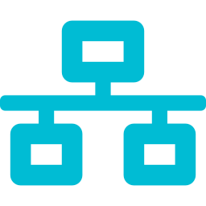
TECH STACK
Technology Stack
Data Platform
Storage
Databricks Lakehouse
Delta Lake
AI / GenAI
Processing
Genie AI / GenAI
Python · Pandas
Visualization
UI Layer
Plotly · Dashboards
Streamlit
Governance
Metadata
Zabbix + Teams + Power Automate
Unity Catalog
Built entirely on the Databricks ecosystem with enterprise governance integrations

Slide 6
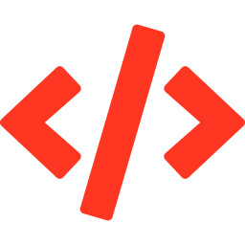

CORE CAPABILITY
AI-Powered Legacy Asset Intelligence
SUPPORTED ENTERPRISE ASSETS
AUTOMATED AI EXTRACTION
COBOL Programs
Dependency Analysis
Business logic & rule extraction
Full cross-program dependency graphs
JCL Workflows
MQ Queue Lineage
Batch scheduling & orchestration
Producer → consumer flow mapping
DB2 SQL Scripts
IMS Transaction Mapping
CRUD lineage & table dependencies
Transaction to segment relationship
MQ Queue Integrations
DB2 CRUD Lineage
Message flow & queue lineage
Table-level INSERT/UPDATE/DELETE tracking
IMS Transactions
JCL Orchestration
Transaction & segment analysis
JOB/EXEC step-sequencing intelligence
Copybooks & Metadata
Business Rule Extraction
Shared structure definitions
AI-discovered functional business rules

Slide 7
PLATFORM DEMO
Databricks AI Modernization Pipeline
01
02
Asset Ingestion
AI Metadata Extraction
Upload COBOL, JCL, DB2, Copybooks into Delta Lake via Databricks Notebooks
Python-based parsers extract dependencies, CRUD operations, and orchestration flows
03
04
Delta Table Storage
Risk Scoring Engine
Parsed results stored in Delta tables — program_inventory, db2_lineage, jcl_analysis
AI generates modernization readiness scores, risk flags, and cloud-readiness index
All pipeline stages run natively on Databricks with Unity Catalog governance and Delta Lake durability

Slide 8
DASHBOARD
Executive Modernization Dashboard
247
89%
34
63%
Total Programs
Analyzed
Dependency
Coverage
High-Risk
Applications
Cloud Migration
Readiness
RISK DISTRIBUTION
MIGRATION READINESS BY ASSET TYPE

Slide 9

ENTERPRISE UI
Streamlit Enterprise Modernization Application
Executive KPI Dashboard
Conversational AI Assistant
Teams Alert Center
Modernization metrics, file distribution, risk overview and migration readiness at a glance
Natural language queries — ask 'Which apps are high-risk?' and get AI-driven insights
One-click governance alert dispatch to Microsoft Teams channels via Power Automate
Risk Intelligence Center
DB2 Lineage Explorer
JCL Orchestration View
Interactive risk drill-down with remediation recommendations and AI-generated action plans
Visual CRUD lineage maps showing INSERT/UPDATE/DELETE flows across all DB2 tables
Batch job dependency graphs, EXEC step sequencing and complex workflow identification
Deployed as a Databricks App · Streamlit · Plotly · Enterprise-Ready

Slide 10
GOVERNANCE
Enterprise AI Governance Framework
GOVERNANCE ALERT FLOW
REAL-TIME GOVERNANCE ALERTS
High-Risk Modernization Alert
Databricks AI Risk Engine
PAYROLL.cbl → HIGH risk — phased modernization recommended
DB2 Critical Operation Alert
Zabbix Governance Connector
UPDATE on CUSTOMER_MASTER — impact review required
Dependency Escalation Alert
PAYROLL.cbl has 47 dependents — migration blocker flagged
Power Automate Workflow
Batch Orchestration Alert
JOB001.jcl complex orchestration — sequencing review needed
Microsoft Teams Notification
Migration Blocker Notification
IMS segment CUSTDB linked to 12 programs — plan required

Slide 11



BUSINESS VALUE
Business Impact & Enterprise Value
85%
70%
Real-Time
Faster Modernization
Assessment
Reduction in Manual
Dependency Analysis
AI Governance
Visibility
Faster Cloud Migration Readiness
Reduced Manual Documentation Effort
AI scoring accelerates go/no-go decisions for cloud-first transformation
Automated lineage & dependency extraction replaces weeks of manual work
Improved Impact Analysis Accuracy
AI-Assisted Governance Monitoring
AI-assisted analysis reduces errors in dependency and risk mapping
Real-time alerts prevent governance failures before they escalate
Accelerated Cloud/API Transformation
Enterprise Risk Visibility
Readiness scoring identifies optimal migration candidates faster
Executive dashboards deliver 360° modernization risk oversight

Slide 12

FUTURE & CLOSING
Future Roadmap & Closing Statement
Q3 2026
Q4 2026
Q1 2027
Multi-agent modernization orchestration
Live COBOL/MQ/IMS upload analysis
Automated migration blueprint creation
Real-time Unity Catalog integration
LLM-powered remediation generation
Advanced dependency graph visualization (Sankey)
CodeGenome AI transforms enterprise modernization from a manual assessment process into an AI-driven modernization intelligence and governance platform — built on Databricks.
Thank You · CodeGenome Innovators · Databricks Hackathon 2026

