Slide 2
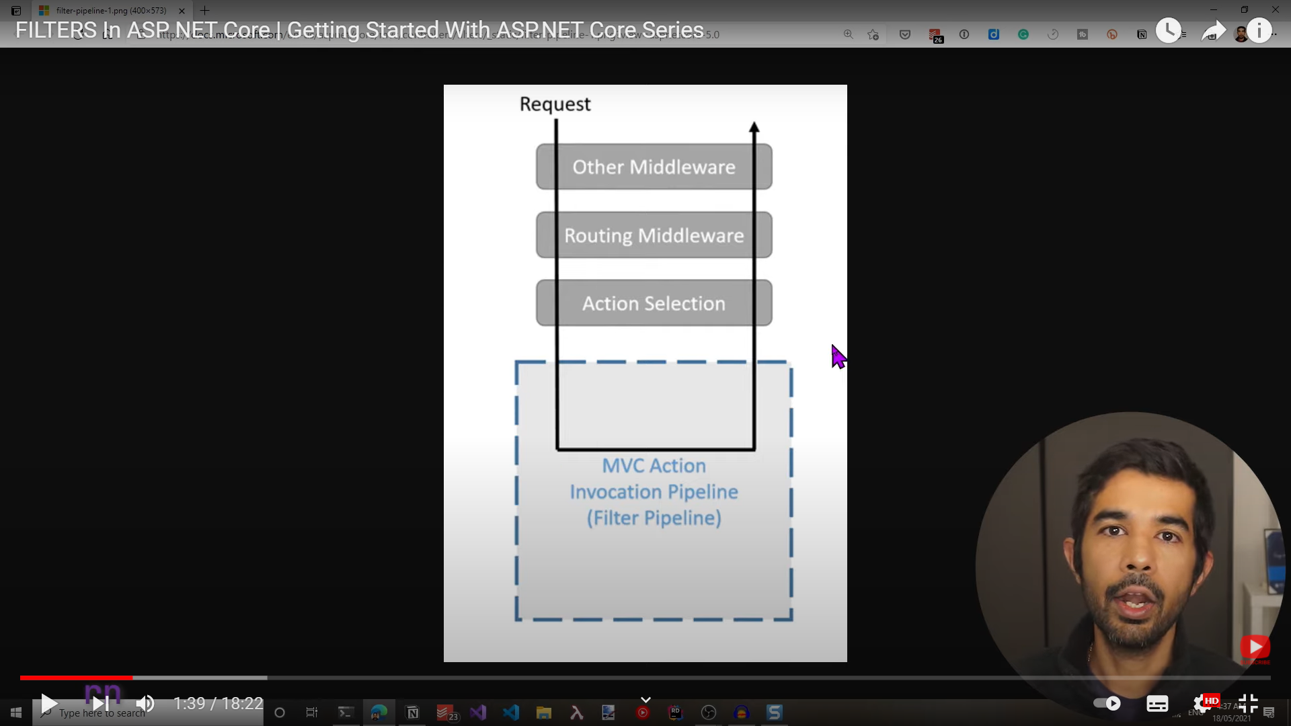

Slide 3
Global Action Filter:
Create a class MyActionFilter
Note: IAction filter interface implements these 2 methods
This will get executed for all action methods from any controller
You can see the output in output window (select project name inside it)
In startup.cs configure() disable swagger coding and in launch settings.json remove swagger and replace weatherforecast
public class MyActionFilter : IActionFilter
{
public void OnActionExecuted(ActionExecutedContext context)
{
Console.WriteLine("ACtion executed");
}
public void OnActionExecuting(ActionExecutingContext context)
{
Console.WriteLine("ACtion executing");
}
}

Slide 4
Refer class inside configureservices()
services.AddControllers(options=>
{
options.Filters.Add(new MyActionFilter());
});
Create another controller and test execution of Action Filter inside same controller
[ApiController]
[Route("[controller]")]
public class UserController : ControllerBase
{
public string Get()
{ return "Hello";}
}

Slide 5
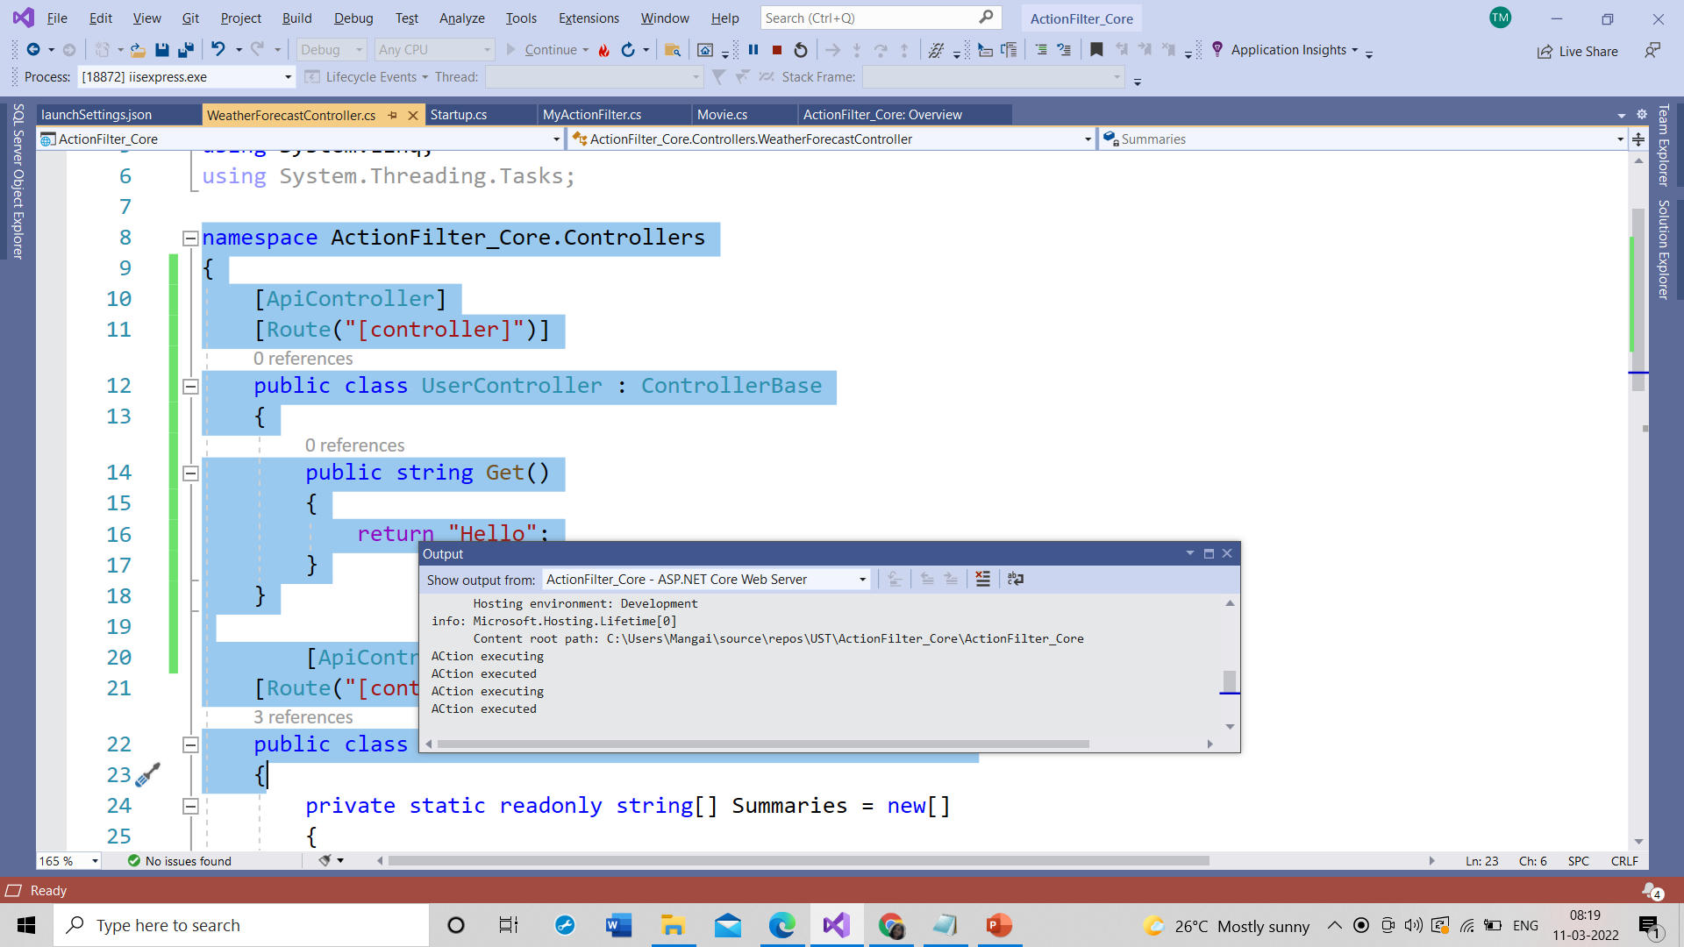

Slide 6
Attribute filters
To make it to attribute level inherit attribute to class/ also comment code in startup.cs as it is done globally
It can be applied in controller level and method level
public class MyActionFilter : Attribute, IActionFilter
{
public readonly string _name;
public MyActionFilter(string name)
{
_name= name;
}

Slide 7
public void OnActionExecuted(ActionExecutedContext context)
{
Console.WriteLine($"Action executed-{_name}");
}
public void OnActionExecuting(ActionExecutingContext context)
{
Console.WriteLine($"Action executing-{_name}");
}
Run the code call controllers in url one by one . You will be able to see only one time when we called weatherforecast controller action filter executed, because it is applied only there
[ApiController]
[Route("[controller]")]
[MyActionFilter("FilterParameter")]
public class WeatherForecastController : ControllerBase
{}

Slide 8
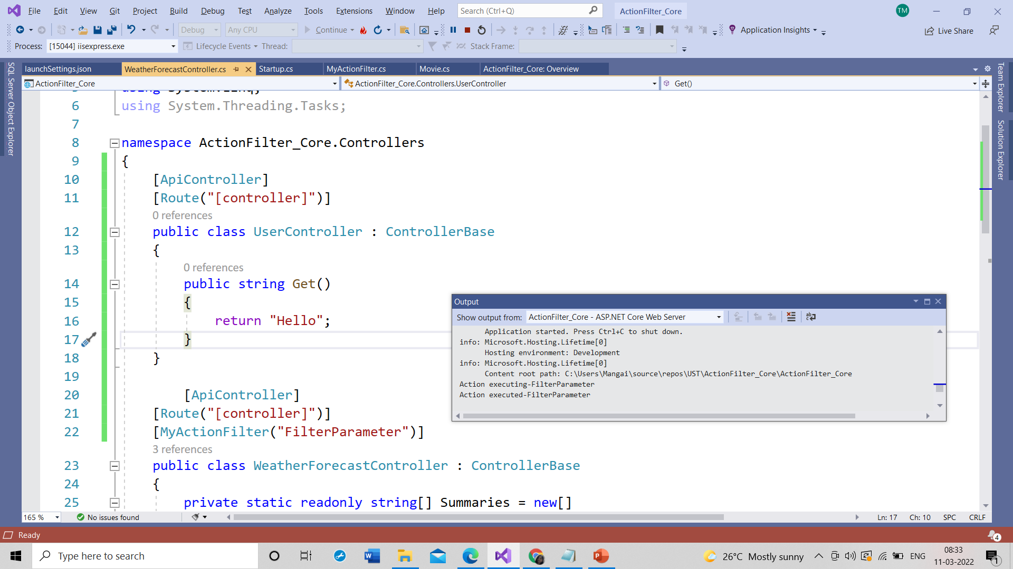

Slide 9
We can even apply it on action method .
[HttpGet]
[MyActionFilter("Action")]
public IEnumerable<WeatherForecast> Get()
{}

Slide 10
Async Filters
Create class
public class MyAsyncFilter :Attribute, IAsyncActionFilter
{
public readonly string _name;
public MyAsyncFilter(string name)
{
_name = name;
}
public async Task OnActionExecutionAsync(ActionExecutingContext context, ActionExecutionDelegate next)
{
Console.WriteLine("Before ASync execution-{_name}");
await next();
Console.WriteLine("Agter ASync execution-{_name}");
}
}
Implement it above action method

Slide 11
Order of Filters
Give filters in action level, controller level and global level and check it s execution(irrespective of sync or async)
Output:
Action executing-Global
Before ASync execution-AsyncController
Before ASync execution-AsyncAction
After ASync execution-AsyncAction
After ASync execution-AsyncController
Action executed-Global

Slide 12
ActionLevel:
[HttpGet]
// [MyActionFilter("Action")]
[MyAsyncFilter("AsyncAction")]
public IEnumerable<WeatherForecast> Get()
{}
ControllerLevel:
[ApiController]
[Route("[controller]")]
//[MyActionFilter("FilterParameter")]
[MyAsyncFilter("AsyncController")]
public class WeatherForecastController : ControllerBase
{}
GlobalLevel:
public void ConfigureServices(IServiceCollection services)
{
services.AddControllers(options=>
{
options.Filters.Add(new MyActionFilter("Global"));
});
}

Slide 13
Now go with IOrdered filter in sync filter class
Add property
Public int Order{get;set;}
In contructor:
Public myactionfilter(string name, int order=0)
{
_name=name;
Order=order;
}
Now add in global filter
options.Filters.Add(new MyActionFilter("Global“, 1));
Then this executes last , if -10 is given it executes first

