Slide 1
Middleware

Slide 2
What are Middleware Components?
The ASP.NET Core Middleware Components are the software components (i.e C# Classes)
They are assembled into the application pipeline to handle the HTTP Requests and Responses.
Examples of using Middleware components :
Middleware component for authenticating the user
To log the request and response
To handle the errors
To handle the static files such as images, Javascript or CSS files, etc.
To Authorize the users while accessing a specific resource
Each part chooses whether to pass the request on to the next part in the pipeline,
and can do certain actions before and after application invokes the next part in the pipeline. Request delegates usage is to build the request pipeline.

Slide 3
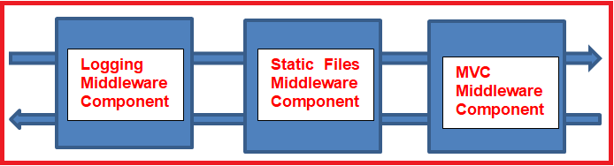
Configure Middleware Components
These are configured within configure() method of startup class by default
These components can
Handle the incoming HTTP request by generating an HTTP response.
Process the incoming HTTP request, modify it, and then pass it to the next middleware component
Process the outgoing HTTP response, modify it, and then pass it on to either the next middleware component or to the ASP.NET Core web server.(see explanation in notes)
Notes:
As shown in the above image, we have a logging middleware component. This component simply logs the request time and then passes the request to the next middleware component i.e. Static Files Middleware component in the request pipeline for further processing.
A middleware component in ASP.NET Core may also handle the HTTP Request by generating an HTTP Response. The ASP.NET Core Middleware component may also decide not to call the next middleware component in the request pipeline. This concept is called short-circuiting the request pipeline.
For example, we have a static file middleware component. And if the incoming HTTP request comes for some static files such as images, CSS files, JavaScript, etc. then this Static Files Middleware component can handle the request and then short-circuit the request pipeline by not calling to the next component in the pipeline i.e. the MVC Middleware component.
As we already discussed the ASP.NET Core middleware components can have access to both the HTTP request and response in the pipeline. So, a middleware component can also process the outgoing response. For example, the logging middleware component in our case may log the time when the response is sent back to the client.

Slide 4
Execution Order of Middleware Components
Middleware components are executed in the same order as they are added to the pipeline(see Notes)
Order is very important
Request Delegate:
In ASP.NET Core, Request delegates are used to build the request pipeline i.e. request delegates are used to handle each incoming HTTP request.
In ASP.NET Core, you can configure the Request delegates using the Run, Map, and Use extension methods.
Notes:
If you are developing a static web application with some static HTML pages and images, then you may require only “StaticFiles” middleware components in the request processing pipeline.
But, if you are developing a secure dynamic data-driven web application then you may require several middleware components such as Logging Middleware, Authentication middleware, Authorization middleware, MVC middleware, etc.

Slide 5
Run() extension method
The following code simply adds a new middleware component to the application’s request pipeline and simply prints a message.
public void Configure(IApplicationBuilder app, IWebHostEnvironment env)
{
app.Run(async (context) =>
{
await context.Response.WriteAsync("Getting Response from First Middleware");
});
}

Slide 6
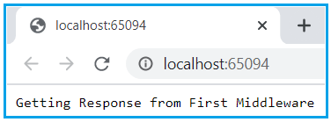

Slide 7
Add one more middleware to the application.
public void Configure(IApplicationBuilder app, IWebHostEnvironment env)
{
app.Run(async (context) =>
{
await context.Response.WriteAsync("Getting Response from First Middleware");
});
app.Run(async (context) =>
{
await context.Response.WriteAsync("Getting Response from Second Middleware- request will never reach here");
});
}
Output:
Getting Response from First Middleware
Notes:
The output is coming from the first middleware component. The reason is, when we registered a middleware component using the Run() extension method then that component becomes a terminal component means it will not call the next middleware component in the request processing pipeline.

Slide 8
Use() Extension Method:
Use
Adds a middleware to the application pipeline and it can either pass the request to next delegate or it can end the request (short-circuit request pipeline). It is the most commonly used method to interact with middleware.
public void Configure(IApplicationBuilder app, IWebHostEnvironment env)
{
app.Use(async delegate(HttpContext context, Func<Task> next)
{
await next.invoke();
});
}

Slide 9
Configuring middleware component using the Use extension method
Then the question that comes to your mind is how to call the next component in the request processing pipeline, the answer is to register your middleware component using the Use extension method as shown below.
public void Configure(IApplicationBuilder app, IWebHostEnvironment env)
{
app.Use(async (context, next) =>
{
await context.Response.WriteAsync("Getting Response from 1st Middleware");
await next();
});
app.Run(async (context) =>
{
await context.Response.WriteAsync("Getting Response from 2nd Middleware");
});
}
Now run the application and you will see the output as expected which is coming from both the middleware components.

Slide 10
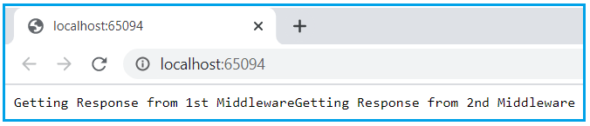

Slide 11
Map
We use Map to connect a request path with another middleware. That middleware can use any of the other mentioned request delegates.
public void Configure(IApplicationBuilder app, IWebHostEnvironment env)
{
app.Map(“/sampleRoute”, HandleSampleRoute);
app.Run(async delegate(HttpContext context)
{
await context.Response.WriteAsync(“Hi");
});
}
Public static void HandleSampleRoute (IApplicationBuilder app)
{
app.Run(async context =>
{
await context.Response.WriteAsync(“Hello from sample Route");
});
}

Slide 12
MapWhen behaves almost the same as Map except that we can specify the detailed condition by using a HttpContext object. We could check for URL, headers, query strings, cookies, etc).
public void Configure(IApplicationBuilder app, IWebHostEnvironment env)
{
app.MapWhen(
delegate(HttpContext context)
{
return Context.Request.Query.ContainsKey(“category”) &&
Context.Request.Query[“category”].ToString().Length>5;
},
HandleMapWhen);
app.Run(async delegate(HttpContext context)
{
await context.Response.WriteAsync(“Hi");
});
}

Slide 13
Public static void HandleMapWhen (IApplicationBuilder app)
{
app.Run(async context =>
{
var category=context.Request.Query[“category”].ToString();
await context.Response.WriteAsync($”Hello from sampleroute -{category}”);
});
}
Output – 1st example & 2ns example given in next page
Notes:
In the example above HandleMapWhen method will execute only when we have query string category and when its value has more than 5 characters. And once HandleMapWhen method executes the app.Run() method inside of Configure will not execute. Since Run delegate ends the request pipeline.

Slide 14

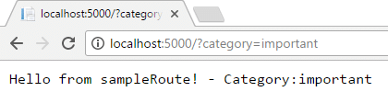

Slide 15
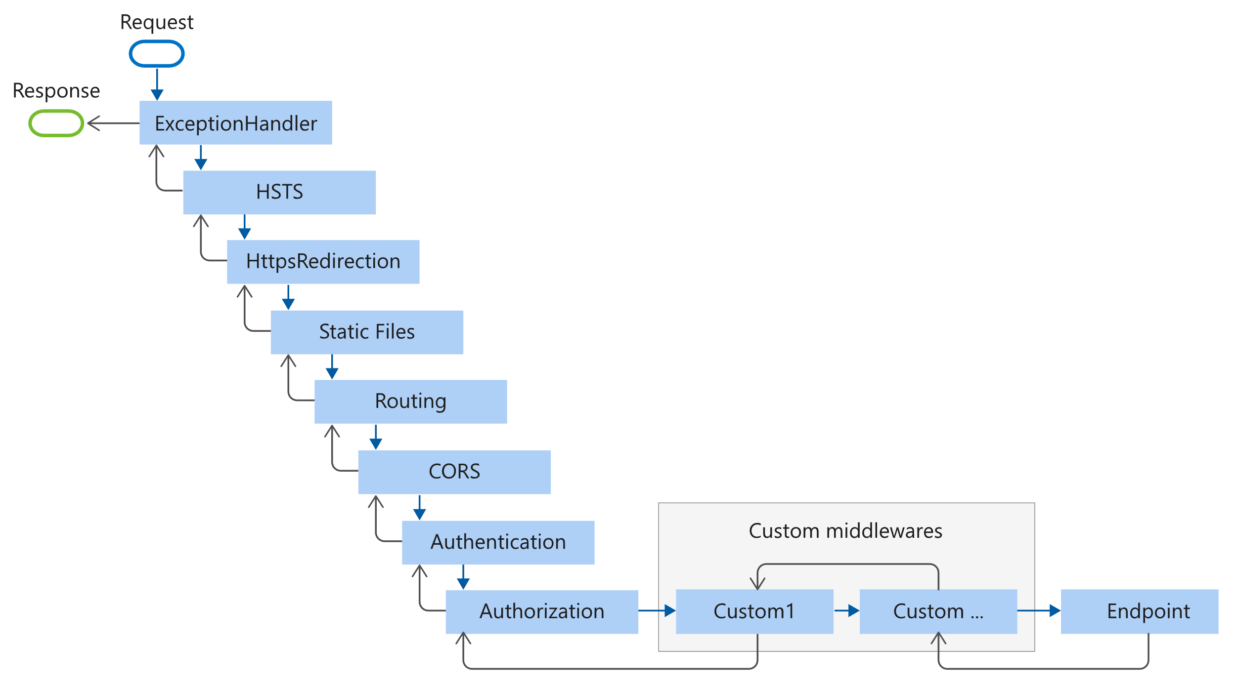
Middleware order
Notes:
HSTS Middleware (UseHsts) to send HTTP Strict Transport Security Protocol (HSTS) headers to clients.
CORS - Cross Origin Resource Sharing

Slide 16
The following Startup.Configure method adds middleware components for common app scenarios:
Exception/error handling
When the app runs in the Development environment:
Developer Exception Page Middleware (UseDeveloperExceptionPage) reports app runtime errors.
Database Error Page Middleware reports database runtime errors.
When the app runs in the Production environment:
Exception Handler Middleware (UseExceptionHandler) catches exceptions thrown in the following middlewares.
HTTP Strict Transport Security Protocol (HSTS) Middleware (UseHsts) adds the Strict-Transport-Security header.
HTTPS Redirection Middleware (UseHttpsRedirection) redirects HTTP requests to HTTPS.
Static File Middleware (UseStaticFiles) returns static files and short-circuits further request processing.
Cookie Policy Middleware (UseCookiePolicy) conforms the app to the General Data Protection Regulation (GDPR) regulations.
Notes:
HSTS - It allows web servers to declare that web browsers (or other complying user agents) should automatically interact with it using only HTTPS connections, which provide Transport Layer Security (TLS/SSL), unlike the insecure HTTP used alone. HSTS is an IETF standards track protocol and is specified in RFC 6797
Trust on first use

Slide 17
Routing Middleware (UseRouting) to route requests.
Authentication Middleware (UseAuthentication) attempts to authenticate the user before they're allowed access to secure resources.
Authorization Middleware (UseAuthorization) authorizes a user to access secure resources.
Session Middleware (UseSession) establishes and maintains session state. If the app uses session state, call Session Middleware after Cookie Policy Middleware and before MVC Middleware.
Endpoint Routing Middleware (UseEndpoints with MapRazorPages) to add Razor Pages endpoints to the request pipeline.

Slide 18
public void Configure(IApplicationBuilder app, IWebHostEnvironment env) {
if (env.IsDevelopment()) {
app.UseDeveloperExceptionPage();
app.UseDatabaseErrorPage(); }
else
{
app.UseExceptionHandler("/Error");
app.UseHsts();
}
app.UseHttpsRedirection();
app.UseStaticFiles();
app.UseCookiePolicy();
app.UseRouting();
app.UseAuthentication();
app.UseAuthorization();
app.UseSession();
app.UseEndpoints(endpoints => { endpoints.MapRazorPages();
}); }

Slide 19
https://dotnettutorials.net/lesson/asp-net-core-middleware-components/
https://codingblast.com/asp-net-core-middleware/ - this site is good

