Slide 1
ASP.NET Core
wwwroot

Slide 2
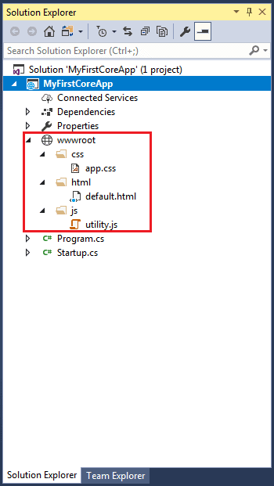
ASP.NET Core - wwwroot Folder
wwwroot folder is the web root folder
Static files can be stored here
only files that in wwwroot folder can be served over an http request.
Separate folders for the different types of static files
such as JavaScript, CSS, Images, library scripts etc. are in the
wwwroot folder
Access it using http://localhost:<port>/css/app.css
Note: Remember, you need to include a middleware for serving static files
in the Configure method of Startup.cs

Slide 3
Rename wwwroot Folder
Rename wwwroot folder to Content folder.
Now, call UseWebRoot() method to configure Content folder as a web root folder in the Main() method of Program class
public class Program
{
public static void Main(string[] args)
{
var host = new WebHostBuilder() .UseKestrel() .UseContentRoot(Directory.GetCurrentDirectory())
.UseWebRoot("Content")
.UseIISIntegration()
.UseStartup<MyStartup>() .Build();
host.Run();
}
}

Slide 4
ASP.NET Core - Program.cs
ASP.NET Core web application is actually a console project
It starts executing from the entry point
public static void Main()
in Program class where we can create a host for the web application.

Slide 5
Setup Host in ASP.NET Core 2.x
Main() method calls method expression BuildWebHost() to build web host with pre-configured defaults.
BuildWebHost expression can also be written as a method that returns IWebHost
public static void Main(string[] args)
{
BuildWebHost(args).Run();
}
public static IWebHost BuildWebHost(string[] args)
{
return WebHost.CreateDefaultBuilder(args)
.UseStartup<Startup>()
.Build();
}

Slide 6
Hosting steps:
WebHost is a static class - used for creating an instance of IWebHost and IWebHostBuilder with pre-configured defaults
CreateDefaultBuilder() method - configures Kestrel, IISIntegration and other configurations.
public static IWebHostBuilder CreateDefaultBuilder(string[] args) {
var builder = new WebHostBuilder()
.UseKestrel()
.UseContentRoot(Directory.GetCurrentDirectory()) .ConfigureAppConfiguration((hostingContext, config) => {……

Slide 7
Kestrel is an open-source, cross-platform web server. It is designed to be used behind proxy because it has not yet matured to be exposed as a full-fledge web server.
It also calls ConfigureAppConfiguration() to load configurations from appsettings.json files, environment variables and user secrets. The ConfigureLogging() method setup logging to console and debug window.

Slide 8
Startup.cs
It is like Global.asax file
At the time of configuring the host in the Main() method
the startup class can be configured using UseStartup<T>() method
We can give any name to the Startup class
For example, to name the Startup class as MyStartup, specify it as .UseStartup<MyStartup>().

Slide 9
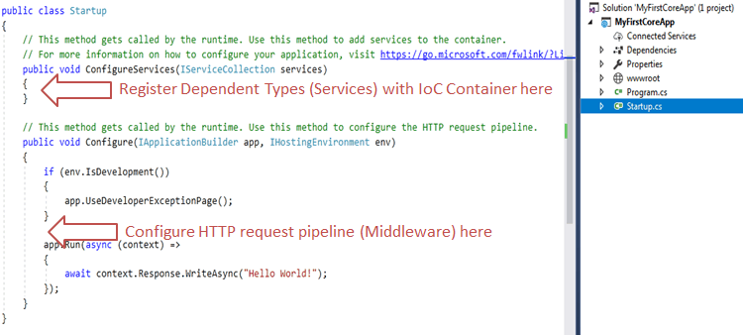
Startup.cs class

Slide 10
Startup class includes two public methods: ConfigureServices and Configure.
The Startup class must include a Configure method and can optionally include ConfigureService method

Slide 11
ConfigureServices()
The ConfigureServices method - to register your dependent classes(called as service)
It can be used anywhere in the application - included as parameter of the constructor of a class.
The IoC container will inject it automatically.
Service is going to be used in some other class.
ConfigureServices method includes IServiceCollection parameter to register services to the IoC container
Note: The Dependency Injection pattern is used heavely in ASP.NET Core architecture. It includes built-in IoC container to provide dependent objects using constructors.

Slide 12
Configure()
using IApplicationBuilder instance - the Configure method configures application request pipeline
ASP.NET Core introduced the middleware components to define a request pipeline, which will be executed on every request.
You include only those middleware components which are required by your application and thus increase the performance of your application.
public void Configure(IApplicationBuilder app, IHostingEnvironment env) {
if (env.IsDevelopment()) {
app.UseDeveloperExceptionPage();
}
app.Run(async (context) => {
await context.Response.WriteAsync("Hello World!"); }); }

Slide 13
At run time, the ConfigureServices method is called before the Configure method.
This is so that you can register your custom service with the IoC container which you may use in the Configure method.subex,bansali,trigen

