Slide 1


Slide 2
Introduction to Time Series Forecasting
A time series is a sequence of data points that occur in successive order over some period of time.
A time series can be yearly (for example, an annual budget), quarterly (for example, expenses), monthly (for example, air traffic), weekly (for example, sales quantity), daily (for example, weather), hourly (for example, stock prices), minutes (for example, inbound calls in a call center), or even seconds in length, depending on the frequency (ex: web traffic).
Forecasting is the next step in the process, and it involves predicting the series' future values. When you generate scientific forecasts based on historical time-stamped data, you're doing time series forecasting. It entails developing models based on previous data and applying them to make observations and guide future strategic decisions. A key distinction in forecasting is that the future outcome is completely unknown at the time of the work and can only be anticipated by meticulous analysis and evidence-based priors.
Now forecasting a time series can be broadly divided into two types.
Univariate Time Series Forecasting is when you utilize only the prior values of a time series to predict its future values.
For example, Here we have to forecast close prices, so we are taking only past close prices to forecast prices in upcoming days
Sales
67.405298
68.459983
69.785998
70.225955
65.345345
68.353453
69.345347

Slide 3
Multi-Variate Time Series Forecasting is when you employ predictors other than the series (also known as exogenous variables) to forecast.
For example, Here close price value is dependent on open, high, and low price values so we can use all these as features to fit our multivariate model and forecast close price value.
Sales | Profit | Quantity
67.405998 | 4.123879 | 2
68.673246 | 3.237498 | 4
69.378432 | 2.892348 | 3
70.482379 | 1.782687 | 1
65.238973 | 4.928749 | 8
68.289349 | 5.389724 | 6
69.732878 | 8.287389 | 8

Slide 4
Introduction to ARIMA Models
ARIMA models are a type of statistical model that can be used to analyze and forecast time series data. It gives a simple yet powerful way to create time series forecasts by explicitly catering to a set of common structures in time series data.
ARIMA is an acronym for AutoRegressive Integrated Moving Average. It's a more complex version of the AutoRegressive Moving Average, with the addition of integration.
An ARIMA model is characterized by 3 terms: p, d, and q where
p is the order of the AR term. The number of lag observations included in the model is also called the lag order.
q is the size of the moving average window, also called the order of moving average.
d is the number of differencing required to make the time series stationary.
What does ARIMA(p, d, q) mean?
For example :
ARIMA(1, 0, 3) signifies that you're combining a 1st order Auto-Regressive model and a 3rd order Moving Average model to describe some response variable (Y) in your model. It's a good idea to think about it this way: (AR, I, MA). In simple words, this gives your model the following appearance:
Y = (Auto-Regressive Parameters) + (Moving Average Parameters)
The 0 between the 1 and the 3 represents the 'I' part of the model (the Integrative component), which denotes a model that takes the difference between response variable data - this can be done with non-stationary data, but you don't appear to be dealing with that, so ignore it.
ARIMA(2, 1, 2) signifies that you're combining a 2nd order AR model and also a 2nd order MA model to describe Y. d = 1st denotes that the model used 1 order differencing to make the data stationary.
Just like these examples, we have to find the perfect order of p, d, and q to fit the best model.

Slide 5
There are a number of ways to find values of p, q, and d:
look at an autocorrelation graph of the data (will help if the Moving Average (MA) model is appropriate)
look at a partial autocorrelation graph of the data (will help if the AutoRegressive (AR) model is appropriate)
look at the extended autocorrelation chart of the data (will help if a combination of AR and MA is needed)
try Akaike's Information Criterion (AIC) on a set of models and investigate the models with the lowest AIC values
try the Schwartz Bayesian Information Criterion (BIC) and investigate the models with the lowest BIC values
Before working with non-stationary data, the Autoregressive Integrated Moving Average (ARIMA) Model converts it to stationary data. One of the most widely used models for predicting linear time series data is this one.
The ARIMA model has been widely utilized in banking and economics since it is recognized to be reliable, efficient, and capable of predicting short-term share market movements.
Problem Statement: In this notebook, we are going to use the ARIMA model to forecast the Sales of Cryogenic Storage Tank sales

Slide 6
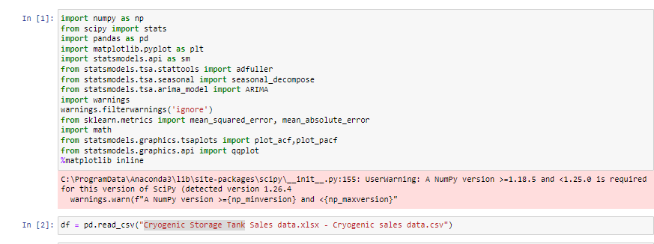
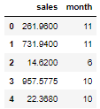
Importing important libraries and reading data
As we are performing Univariate Time Series Forecasting we will consider only sales.

Slide 7
A time series is also thought to include three systematic components: level, trend, and seasonality, as well as one non-systematic component termed noise.
The components' definitions are as follows:
The level is the sum of all the values in a series.
The trend is the upward or downward movement of the series' value.
The series' short-term cycle is known as seasonality.
Noise is the term for the random variation in the series.
Check for stationarity
Time series analysis only works with stationary data, so we must first determine whether a series is stationary. A stationary time series is when the mean and variance are constant over time. It is easier to predict when the series is stationary.
What does it mean for data to be stationary?
The mean of the series should not be a function of time. Because the mean increases over time, the red graph below is not stationary.

Slide 8
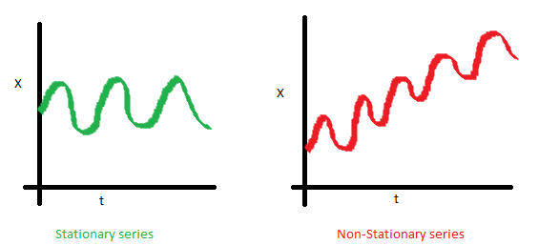
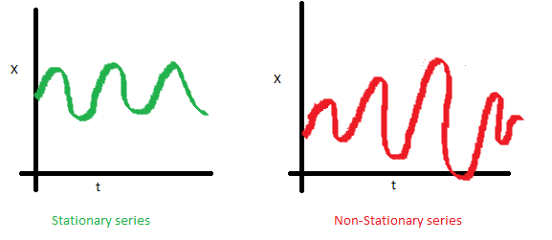
The variance of the series should not be a function of time. Homoscedasticity is the term for this characteristic. The varying spread of data over time can be seen in the red graph.

Slide 9
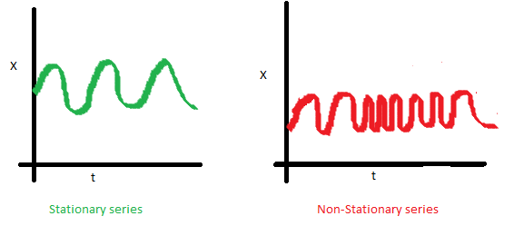
Finally, neither the I th term nor the (I + m) th term's covariance should be a function of time. As you can see in the graph below, the spread gets less as time goes on. As a result, the red series' covariance does not remain constant throughout time.

Slide 10
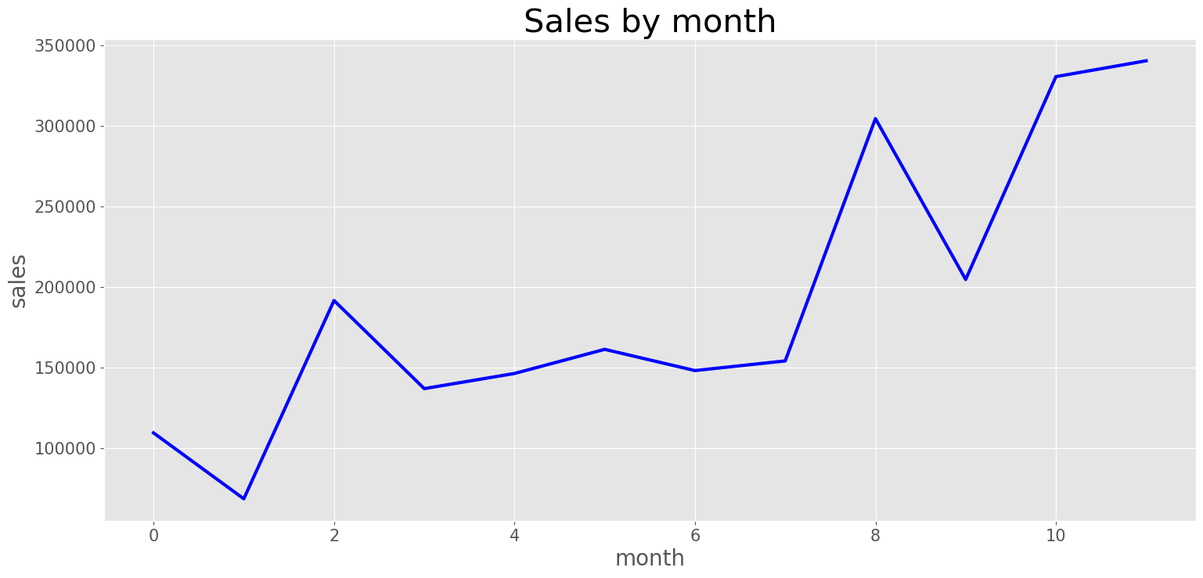
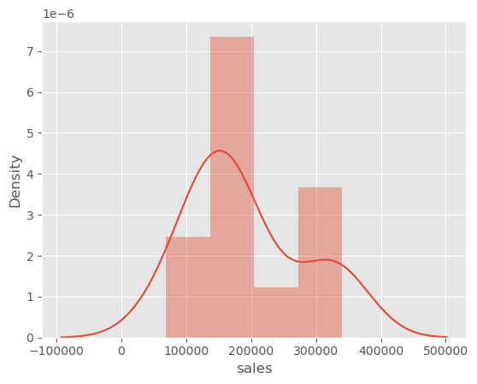
By Looking at our data we can say it is Non-stationary and Up Trend
Checking the Distribution of the data

Slide 11
ADF (Augmented Dickey-Fuller) Test
The Dickey-Fuller test is one of the most extensively used statistical tests. It can be used to establish whether a series has a unit root and, as a result, whether the series is stationary. The null and alternate hypotheses for this test are: Distinguish between point-to-point links and multi-point links Null Hypothesis: The series has a unit root (a =1).
Alternative Hypothesis: There is no unit root in the series.
The series is considered to be non-stationary if the null hypothesis is not rejected. As a result, the series can be linear or difference stationary. If both the mean and standard deviation are flat lines, the series becomes stationary (constant mean and constant variance).

Slide 12
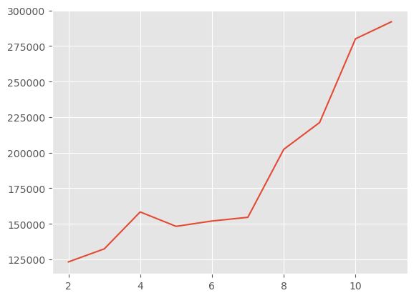
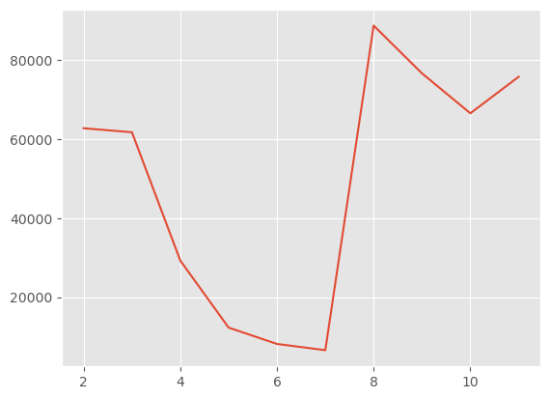
Checking Running Mean of Sales Data
Checking Running STD of Sales Data

Slide 13
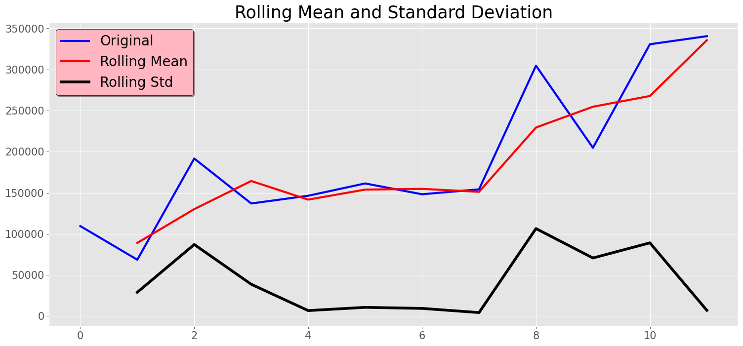
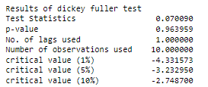
We can't reject the Null hypothesis because the p-value is bigger than 0.05. Furthermore, the test statistics exceed the critical values. As a result, the data is not stationary. Differencing is a method of transforming a non-stationary time series into a stationary one. This is an important step in preparing data to be used in an ARIMA model. So, to make the data stationary, we need to take the first-order difference of the data.

Slide 14
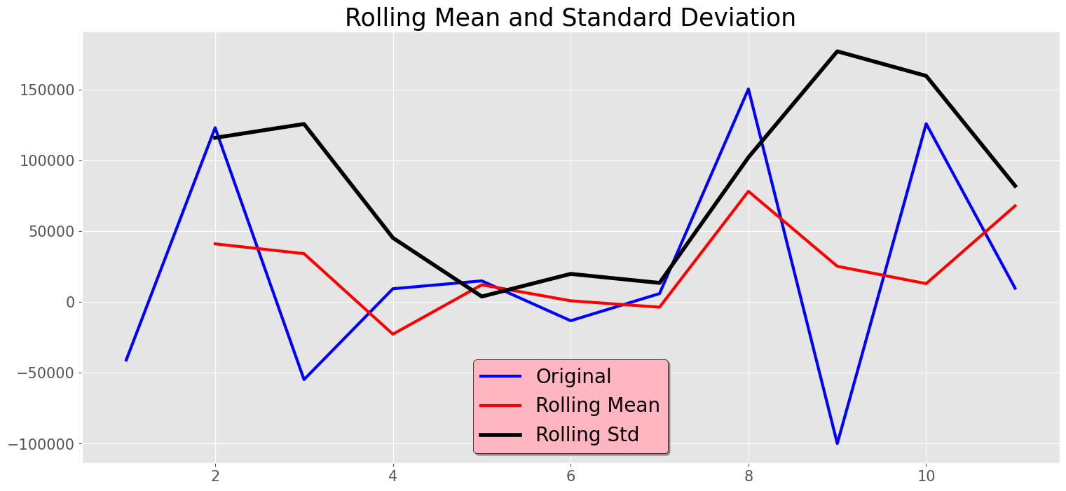
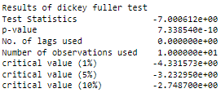
Differencing
The p-value is obtained is less than the significance level of 0.05 and the ADF statistic is lower than any of the critical values.
We can reject the null hypothesis. So, the time series is stationary.

Slide 15
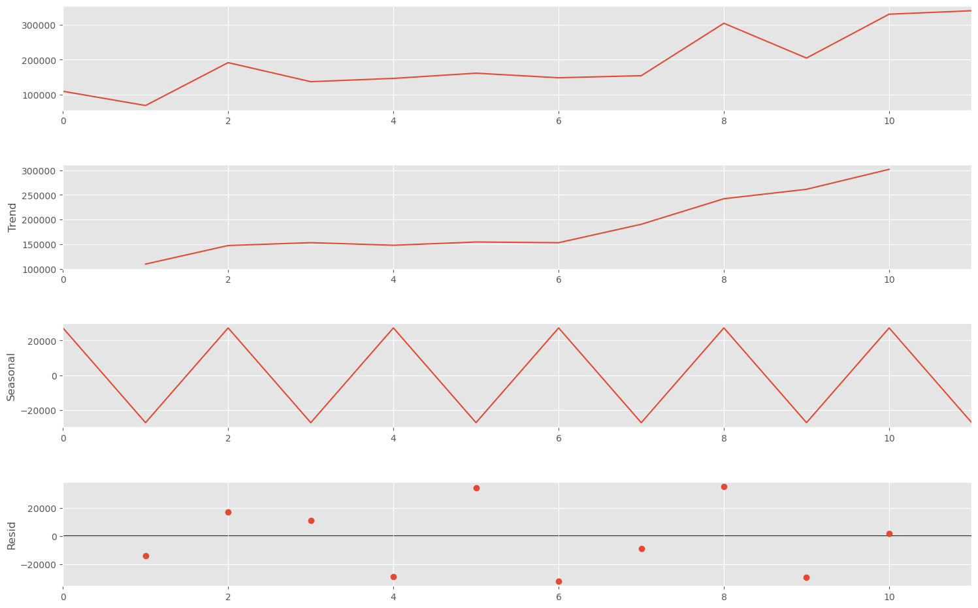
Decompose the time series: To start with, we want to decompose the data to separate the seasonality, trend, and residual. Let's use the function seasonal_decompose in stats models to help us find it.

Slide 16
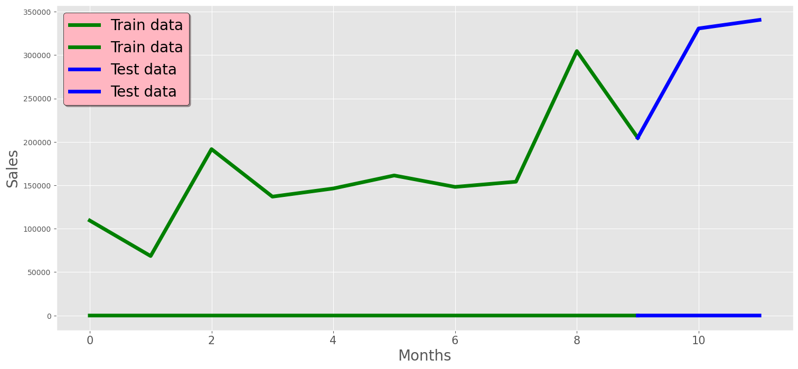
Let’s split out data into Train and Test

Slide 17
Auto-correlations
After a time series has been stationarized by differencing, the next step in fitting an ARIMA model is to determine whether AR or MA terms are needed to correct any autocorrelation that remains in the differenced series.
By looking at the autocorrelation function (ACF) and partial autocorrelation (PACF) plots of the differenced series, you can tentatively identify the numbers of AR and/or MA terms that are needed.
Autocorrelation function plot (ACF): Autocorrelation refers to how correlated a time series is with its past values whereas the ACF is the plot used to see the correlation between the points, up to and including the lag unit. In ACF, the correlation coefficient is in the x-axis whereas the number of lags is shown in the y-axis.
Normally, we employ either the AR term or the MA term in an ARIMA model. Both of these phrases are rarely used on rare occasions. The ACF plot is used to determine which of these terms we should utilize for our time series
.
If the autocorrelation at lag 1 is positive, we utilize the AR model.
If the autocorrelation at lag 1 is negative, we employ the MA model.
We move on to Partial Autocorrelation function plots (PACF) after plotting the ACF plot.

Slide 18
Partial Autocorrelation function plots (PACF) A partial autocorrelation is a summary of the relationship between an observation in a time series with observations at prior time steps with the relationships of intervening observations removed. The partial autocorrelation at lag k is the correlation that results after removing the effect of any correlations due to the terms at shorter lags.
If the PACF plot drops off at lag n, then use an AR(n) model and if the drop in PACF is more gradual then we use the MA term.
Use AR terms in the model when the
ACF plots show autocorrelation decaying toward zero
PACF plot cuts off quickly towards zero
ACF of a stationary series shows positive at lag-1
Use MA terms in the model when the model is
Negatively Auto-correlated at Lag — 1
ACF drops sharply after a few lags
PACF decreases more gradually

Slide 19
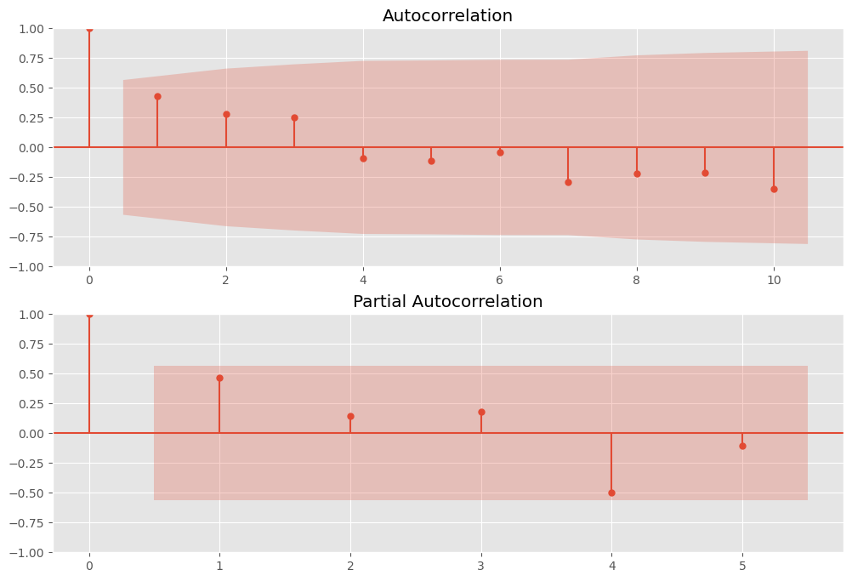

Slide 20
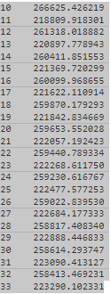
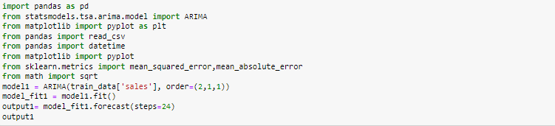
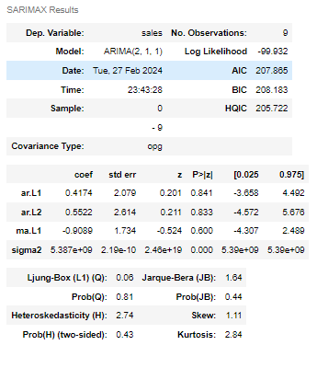

Importing the Arima Model and checking our Prediction

Slide 21
Thank You

