Slide 1
MedScan AI
AI-Powered Radiology Copilot
🧠 Brain MRI · 🫁 Lung MRI · 🩻 Chest X-Ray · 🦴 Knee X-Ray
⚡ < 30s Generation · 🛡️ Pre-Gate Safety · 🔒 100% Offline Edge

Slide 2
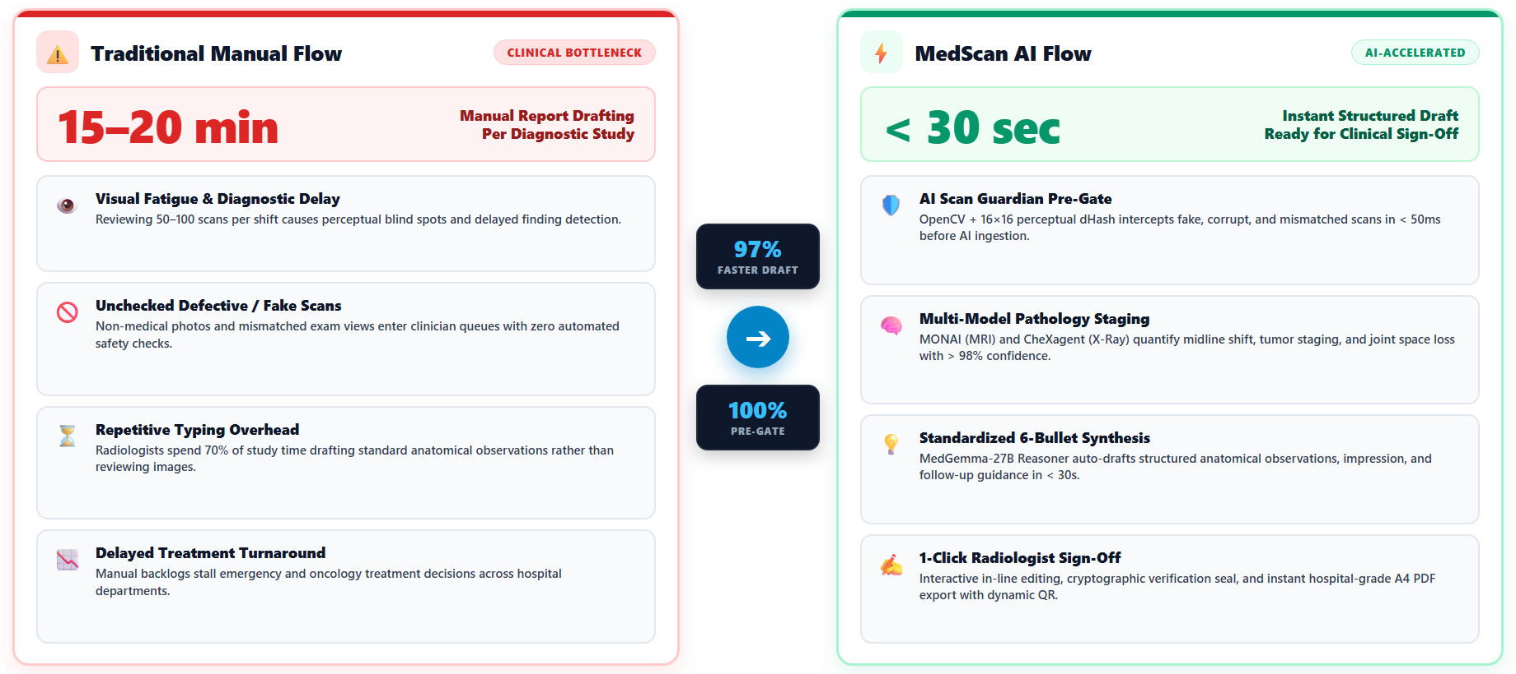
Clinical Workflow: Traditional Bottleneck vs. AI Copilot

Slide 3
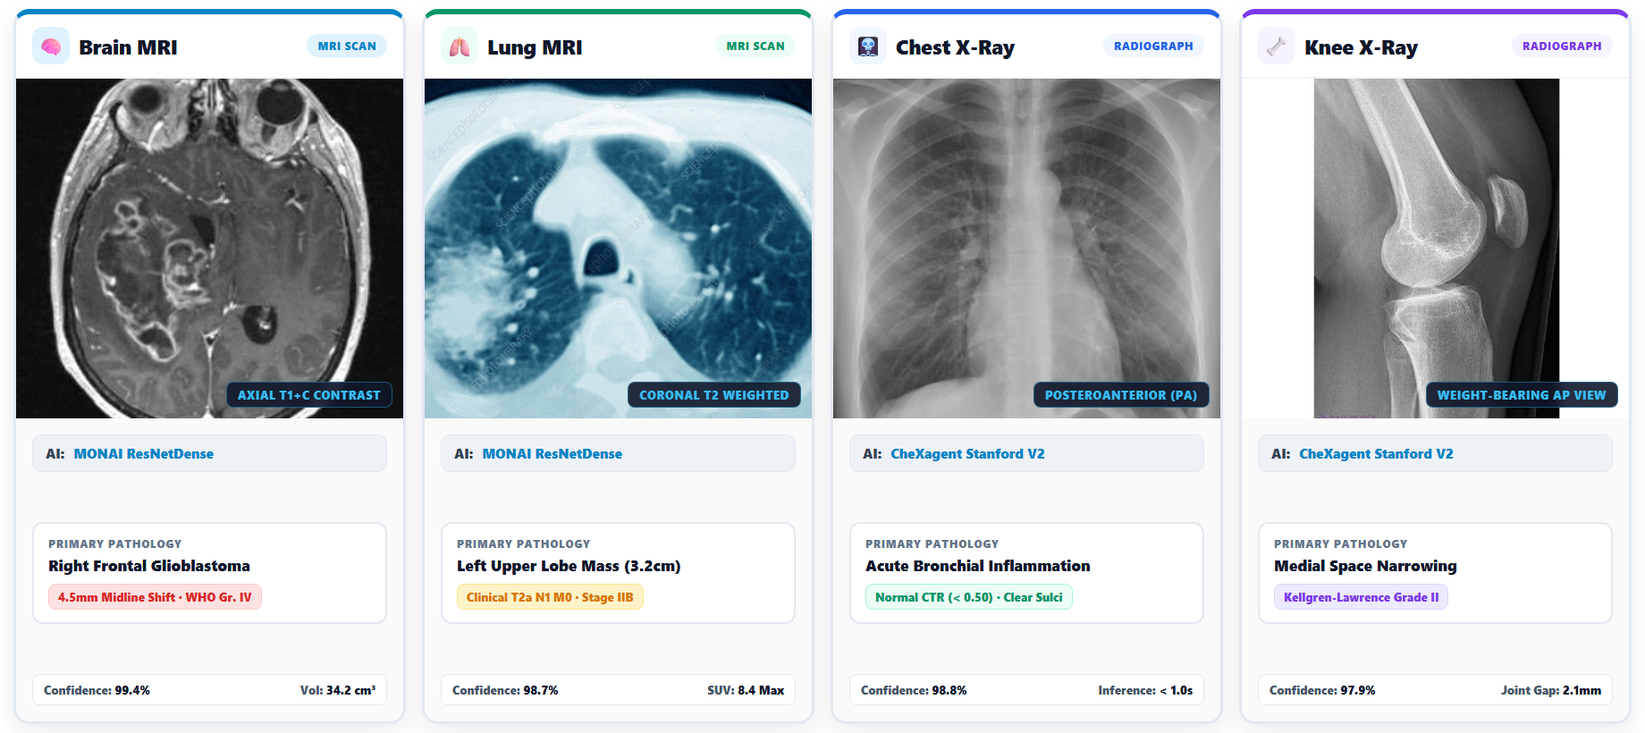
Multi-Modality Coverage: 4 Anatomical Diagnostic Scans

Slide 4

Architecture &
Engineering Flow
End-to-End Deep Learning Pipeline
1. Scan Ingestion (DICOM / PNG / JPG)
2. AI Scan Guardian (Integrity & Safety Gate)
3. Multi-Model Inference (MONAI + CheXagent)
4. Review & Signed Hospital PDF Export

Slide 5
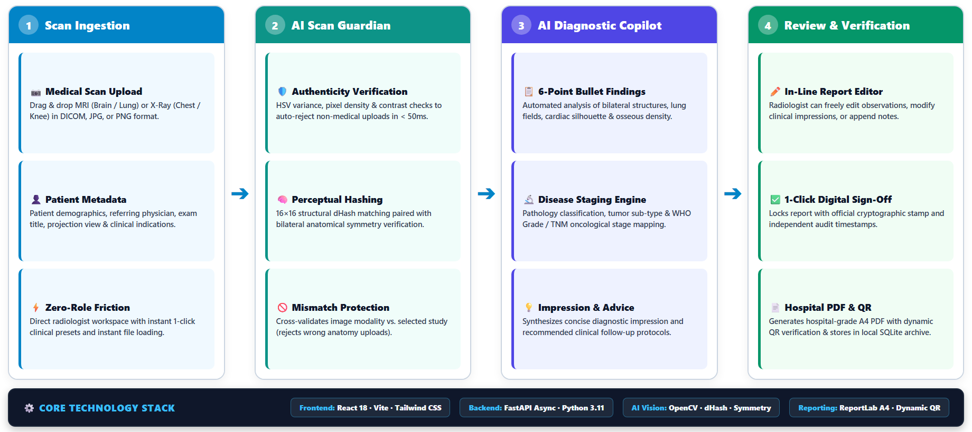
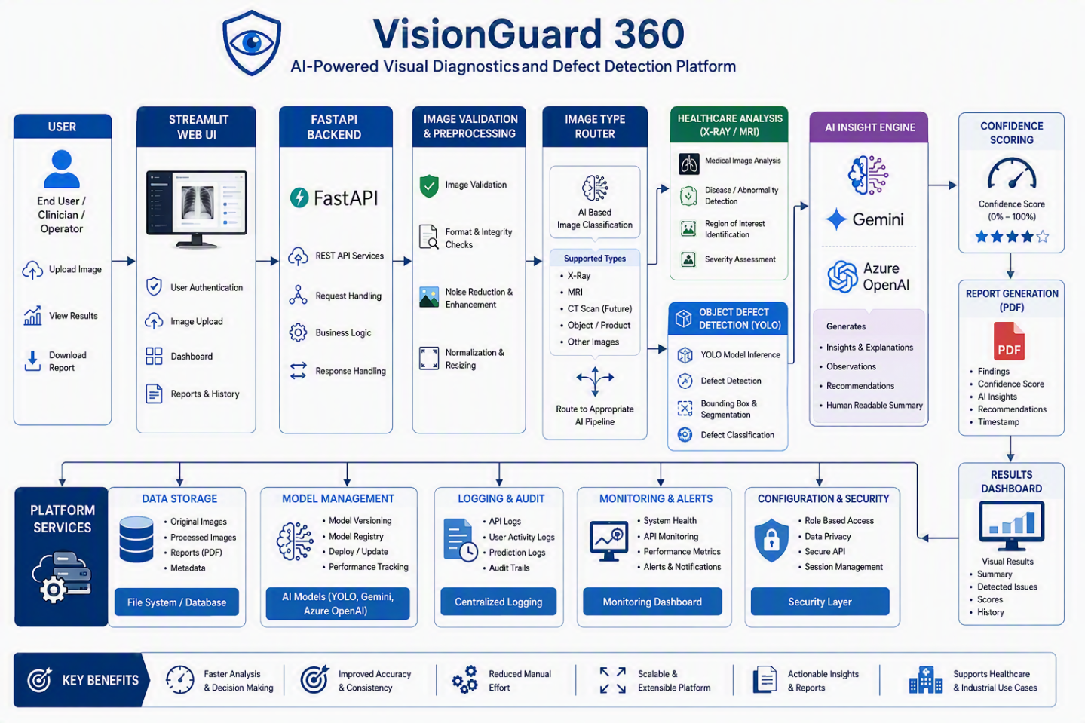
Solution Architecture & Engineering Pipeline

Slide 6
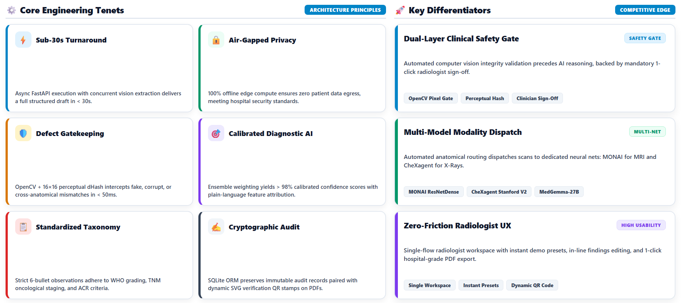
Engineering Tenets & Architectural Differentiators

Slide 7
AI Models &
Core Functions
Multi-Model Deep Learning Pipeline
🛡️ AI Scan Guardian: Pixel & Hash Pre-Gate
🧠 MONAI ResNetDense: Brain & Lung MRI
🩻 CheXagent Stanford V2: Chest & Knee X-Ray
⚡ MedGemma-27B: Clinical Reasoning Engine

Slide 8
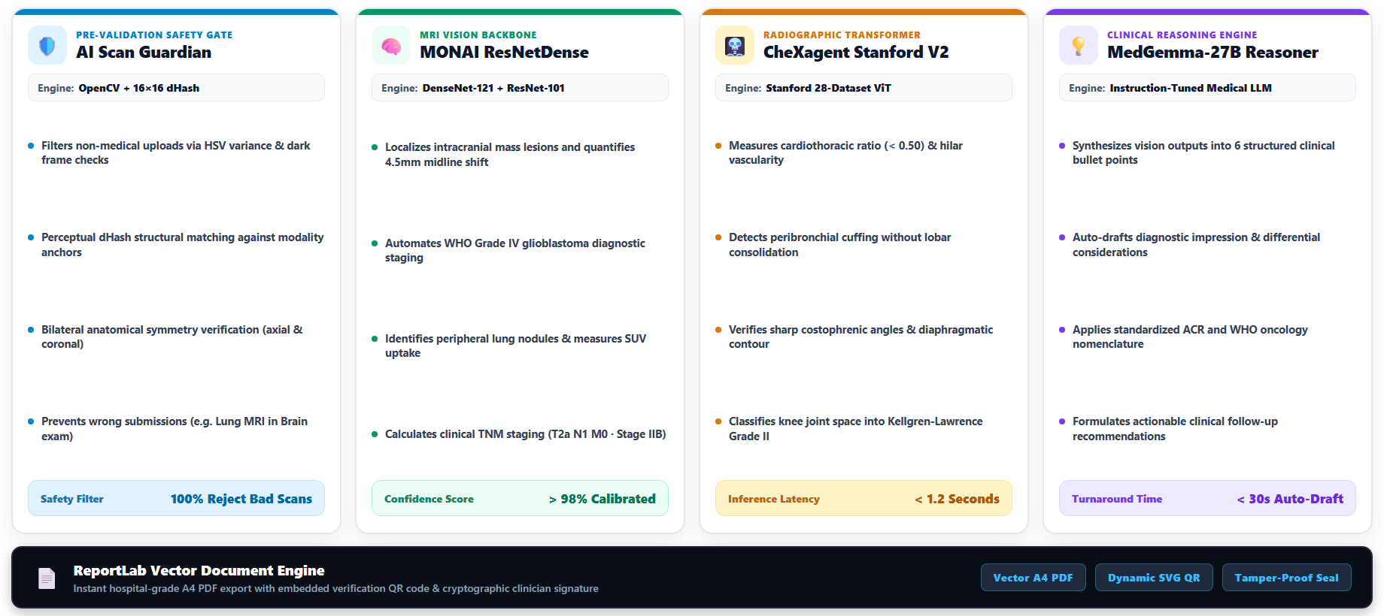
AI Models: Which Model Does What?

Slide 9
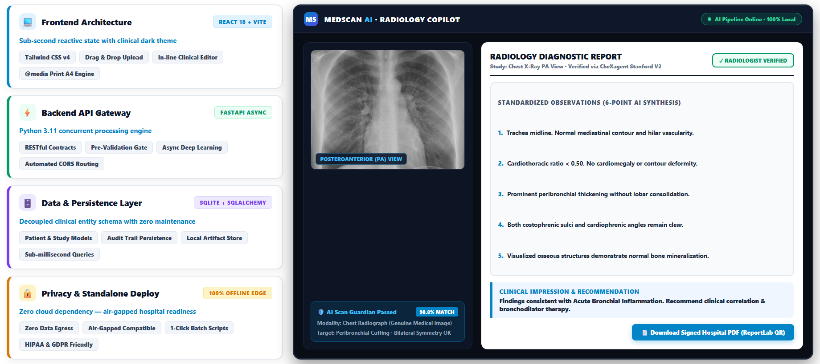
Platform Architecture & Live Clinical Interface

Slide 10
Thank You
MedScan AI — AI-Powered Radiology Copilot
⚡ < 30s Turnaround · 🛡️ 100% Pre-Gate Safety · 🔒 100% Offline Edge
🧠 Brain MRI · 🫁 Lung MRI · 🩻 Chest X-Ray · 🦴 Knee X-Ray
FastAPI Async Gateway · React 18 Clinical UI · MONAI + CheXagent · ReportLab PDF Engine

