Slide 1
VisionGuard 360
AI-Powered Visual Inspection & Diagnostics Platform
Healthcare Imaging | Object Defect Detection | Automated Reporting
Engineering Excellence Expo 2026
Humana Inc | LSHCERU | IS-LSHC-Healthcare 2.3

Slide 2
The Problem & Opportunity
Current Challenges
The AI Opportunity
▸ Manual image analysis is time-consuming & resource-intensive
▸ Human error in radiology review leads to missed abnormalities
▸ 15-20 minutes per image for manual healthcare inspection
▸ Inconsistent quality across different inspectors
▸ No unified platform for healthcare + industrial inspection
▸ Scaling manual review to meet demand is cost-prohibitive
▸ AI-driven analysis reduces review time by 10x
▸ Computer Vision + GenAI enables explainable diagnostics
▸ Single platform for healthcare imaging & object inspection
▸ Automated PDF reports for audit trails & compliance
▸ Confidence scoring improves decision-making quality
▸ Extensible architecture for future enterprise use cases
TCS Confidential

Slide 3
Solution Overview
VisionGuard 360 combines YOLO, Gemini, and Azure OpenAI into a unified platform for healthcare image analysis, object defect detection, and automated intelligent reporting.
Healthcare
Imaging
Object Defect
Detection
Intelligent
Reporting
▸ X-ray disease detection
▸ MRI abnormality analysis
▸ AI-generated clinical observations
▸ Severity assessment summaries
▸ Product quality inspection
▸ Surface defect identification
▸ YOLO-powered object detection
▸ Multi-class defect classification
▸ Confidence score generation
▸ Explainable AI insights
▸ Automated PDF report builder
▸ Downloadable analysis packages
TCS Confidential

Slide 4

Architecture & Technology Stack

Slide 5
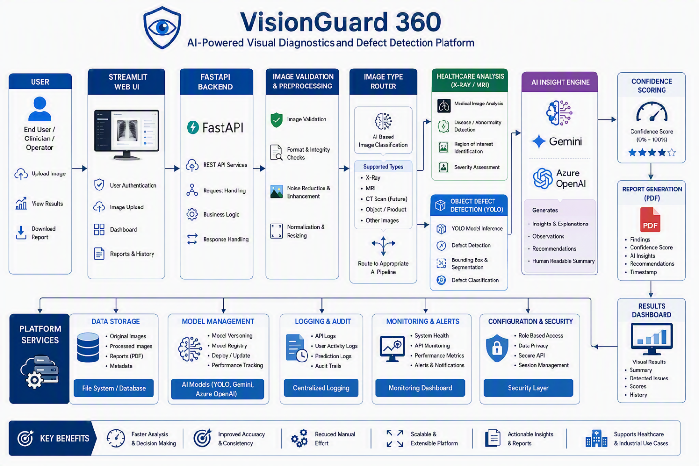
Solution Architecture
TCS Confidential

Slide 6
Engineering Tenets & Differentiators
Engineering Tenets
Key Differentiators
Modular
Architecture
Scalability
Performance
Optimization
Unified Platform
Single platform for healthcare imaging & object defect detection in one solution.
Reusability
Automation
Security-Conscious
Design
Explainable AI
Reliability
Extensibility
Maintainability
Generates understandable explanations of findings — not just detection, but insight.
AI-Assisted Decision Support
Multi-Model Intelligence
Combines YOLO + Gemini + Azure OpenAI for comprehensive, high-quality results.
Future-Ready Design
Extensible to additional imaging types, manufacturing QC, and asset monitoring.
TCS Confidential

Slide 7
Measurable Impact & Results

Slide 8
Measurable Impact & Results
< 2 min
~65%
35%
30-40%
Per-Image
Analysis Time
Reduction in
Manual Effort
Consistency
Improvement
Operational
Cost Savings
Was: 15-20 min
vs. Manual Review
vs. Human Inspection
Estimated ROI
Impact Summary
▸ Business Value: Transformed manual image review into automated AI-assisted analysis
▸ Productivity: ~65% reduction in manual inspection effort across workflows
▸ Cycle Time: Image analysis reduced from 15-20 min to under 2 min per image
▸ Quality: Estimated 35% improvement in detection consistency over human-only inspection
▸ Scalability: From single-user manual review to multi-user concurrent AI processing
TCS Confidential

Slide 9
Quality Engineering & Delivery
Agile Delivery Methodology
Shift-Left Quality Strategy
▸ Weekly sprint planning & retrospectives
▸ Incremental feature releases every sprint
▸ Continuous testing integrated in pipeline
▸ User feedback after each demo cycle
▸ Engineering reviews for code quality
▸ Demo-based progress tracking
▸ Unit Testing – Component-level validation
▸ Integration Testing – End-to-end API flows
▸ API Validation – Request/response contracts
▸ Image Processing Validation – Pipeline accuracy
▸ AI Response Validation – Model output quality
▸ Model Accuracy Monitoring – Drift detection
Team (3 Members)
Operational Readiness
▸ Mangesh Gupta – AI Expert & Technical Lead
▸ Manoj – AI Engineer & Developer
▸ Mangesh Awasekar – PM & Stakeholder Coord.
▸ Application logging & error recovery
▸ Health monitoring dashboards
▸ Model performance monitoring
▸ Rollback-ready deployment strategy
▸ Knowledge docs & user operation guides
Aug 2026 — Jan 2027 | 5 Months | PoC Delivered
TCS Confidential

Slide 10
Thank You
VisionGuard 360 — AI-Powered Visual Inspection & Diagnostics
Nominated By: Mangesh Awasekar | Humana Pune Delivery Owner
SPOC: Mangesh Gupta | gupta.mangesh@tcs.com | +91 7030376124
Humana Inc | LSHCERU | IS-LSHC-Healthcare 2.3
Engineering Excellence Expo 2026
TCS Confidential

