Slide 1
University Parking System

Slide 2
Presentation Outline
Introduction
Project Objectives
Project Scope in Modern Time
Problem Statement
Proposed Solution
Functional Requirements
Non Functional Requirements
Use Case Diagram
Class Diagram
Frontend Screenshot
References

Slide 3
1: My project titled, as University parking system basically a web-based project. 2: The main function of the University parking system is to provide security for students and faculty. 3: This project will help everyone to park their vehicle safely and no one can take another person’s vehicle. 4: This project will help to ensure that parking is only for University faculty and students so that no outsider can enter into University parking.
Introduction

Slide 4
University Parking System helps in: 1: View Parking Details 2: Show Vehicle Enter Time 3: Show Vehicle Exit Time 4: Save Vehicle Record For Future Use 5: Helps in Secure Parking

Slide 5
1: The objective of University parking system is to provide the security for faculty and students for their vehicles. 2: To make the entrance authenticated without wasting their precious time. 3: System is be able to scan QR Codes from their cards for authentication.
Project Objectives

Slide 6
Project Scope in Modern Time
1: This project has great future scope because it save time of people.
2: Nowadays parking is very important and hence it is necessary for every person to park their vehicle safely.
3: The only authorized person has access to the software.
4: It also provide security with the use of authentication so unauthorized person cannot park their vehicle.

Slide 7
Problem Statement
1: Current University Parking is not secure.
2: Do not record of which vehicle come in or out.
3: Do not record of which person can take vehicle in side or out side.

Slide 8
Proposed Solution
1: There will be web based University Parking System that secure current parking situation.
2: Have Record of which vehicle come in or out.
3: Have Record of which person can take vehicle in side or out side.

Slide 9
1 : User login 2: Registered persons 3 : Scan QR Codes 4 : Manage person details 5 : View parking details
Functional Requirements

Slide 10
1: Efficiency Requirement 2 : Reliability Requirement 3 : Usability Requirement 4 : Implementation Requirement 5 : Delivery Requirement
Non Functional Requirement

Slide 11
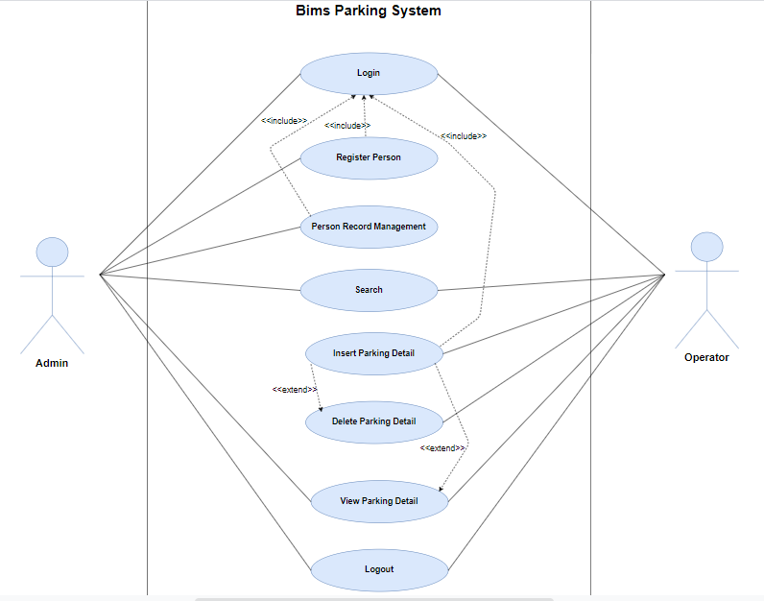
Use Case Diagram

Slide 12
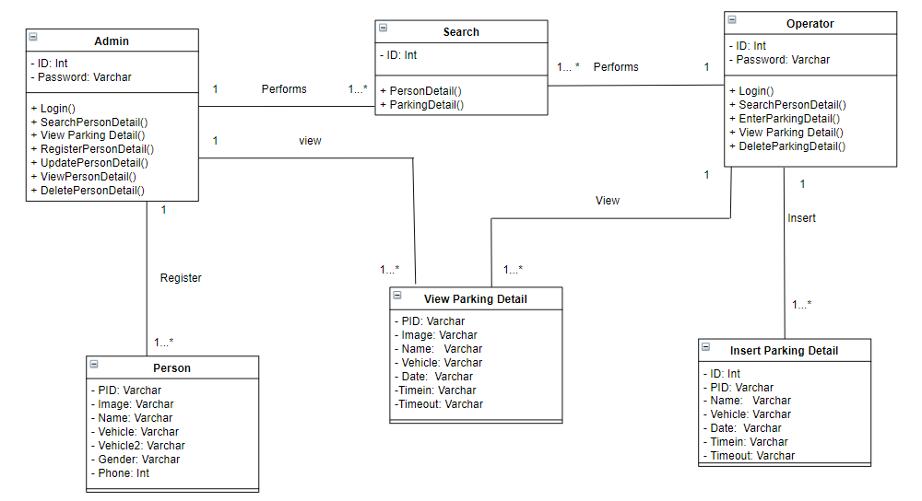
Class Diagram

