Slide 1
Feature selection
Usman Roshan
Machine Learning

Slide 2
What is feature selection?
Consider our training data as a matrix where each row is a vector and each column is a dimension.
For example consider the matrix for the data x₁=(1, 10, 2), x₂=(2, 8, 0), and x₃=(1, 9, 1)
We call each dimension a feature or a column in our matrix.

Slide 3
Feature selection
Useful for high dimensional data such as genomic DNA and text documents.
Methods
  Univariate (looks at each feature independently of others)
    Pearson correlation coefficient
    F-score
    Chi-square
    Signal to noise ratio
    And more such as mutual information, relief
  Multivariate (considers all features simultaneously)
    Dimensionality reduction algorithms
    Linear classifiers such as support vector machine
    Recursive feature elimination

Slide 4
Feature selection
Methods are used to rank features by importance
Ranking cut-off is determined by user
Univariate methods measure some type of correlation between two random variables. We apply them to machine learning by setting one variable to be the label (y_{i}) and the other to be a fixed feature (x_{ij} for fixed j)

Slide 5

Pearson correlation coefficient
Measures the correlation between two variables
Formulas:
  Covariance(X,Y) = E((X-μ_{X})(Y-μ_{Y}))
  Correlation(X,Y)= Covariance(X,Y)/σ_{X}σ_{Y}
  Pearson correlation =
The correlation r is between -1 and 1. A value of 1 means perfect positive correlation and -1 in the other direction

Slide 6
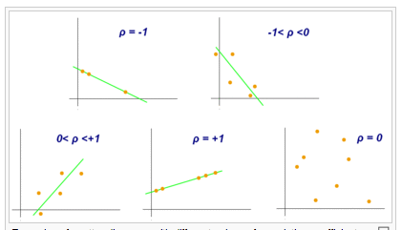
Pearson correlation coefficient
From Wikipedia

Slide 7
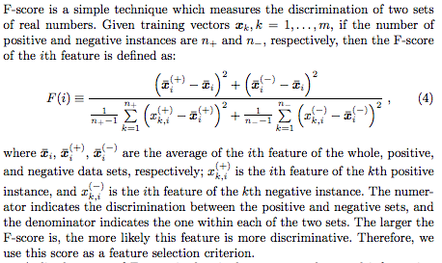
F-score
From Lin and Chen, Feature extraction, 2006

Slide 8
Chi-square test
Contingency table
We have two random variables:
  Label (L): 0 or 1
  Feature (F): Categorical
Null hypothesis: the two variables are independent of each other (unrelated)
Under independence
  P(L,F)= P(D)P(G)
  P(L=0) = (c1+c2)/n
  P(F=A) = (c1+c3)/n
Expected values
  E(X1) = P(L=0)P(F=A)n
We can calculate the chi-square statistic for a given feature and the probability that it is independent of the label (using the p-value).
Features with very small probabilities deviate significantly from the independence assumption and therefore considered important.
Feature=A
Feature=B
Label=0
Observed=c1
Expected=X1
Observed=c2
Expected=X2
Label=1
Observed=c3
Expected=X3
Observed=c4
Expected=X4

Slide 9
Signal to noise ratio
Difference in means divided by difference in standard deviation between the two classes
S2N(X,Y) = (μ_{X} - μ_{Y})/(σ_{X} – σ_{Y})
Large values indicate a strong correlation

Slide 10
Multivariate feature selection
Consider the vector w for any linear classifier.
Classification of a point x is given by wTx+w0.
Small entries of w will have little effect on the dot product and therefore those features are less relevant.
For example if w = (10, .01, -9) then features 0 and 2 are contributing more to the dot product than feature 1. A ranking of features given by this w is 0, 2, 1.

Slide 11
Multivariate feature selection
The w can be obtained by any of linear classifiers we have see in class so far
A variant of this approach is called recursive feature elimination:
  Compute w on all features
  Remove feature with smallest w_{i}
  Recompute w on reduced data
  If stopping criterion not met then go to step 2

Slide 12
Feature selection in practice
NIPS 2003 feature selection contest
  Contest results
  Reproduced results with feature selection plus SVM
Effect of feature selection on SVM
Comprehensive gene selection study comparing feature selection methods
Ranking genomic causal variants with SVM and chi-square

Slide 13
Limitations
Unclear how to tell in advance if feature selection will work
  Only known way is to check but for very high dimensional data (at least half a million features) it helps most of the time
How many features to select?
  Perform cross-validation

